Slide 1
Statistics Project
Presented by
Pratik Satpati & Biplab Kar
PGPDS Fall 2023 Batch
Praxis Tech School

Slide 2
Contents
Objective of the project
3
Data Source & Methodology
4
Analysis & Results
5
8
Interpretation
Conclusion
9

Slide 3
Objective of The Project
3
To comprehensively analyze the educational landscape in India, with a primary focus on the student population, gender distribution, dropout rates, and their relationship with poverty levels across states. This project aims to provide valuable insights into the challenges and opportunities in India's education system, facilitating data-driven decisions for policymakers, educators, and stakeholders.

Slide 4
Data Source and Methodology
https://data.gov.in/resource/enrolment-age-and-class-udise-plus-during-2018-19
Tools Used
Excel for Data Preprocessing
2. Python for Data Cleaning,Data Modelling & Regression Analysis
3. Power BI for Exploratory Data Analysis

Slide 5
Analysis & Results
Student percentage of Total Population among States

Slide 6
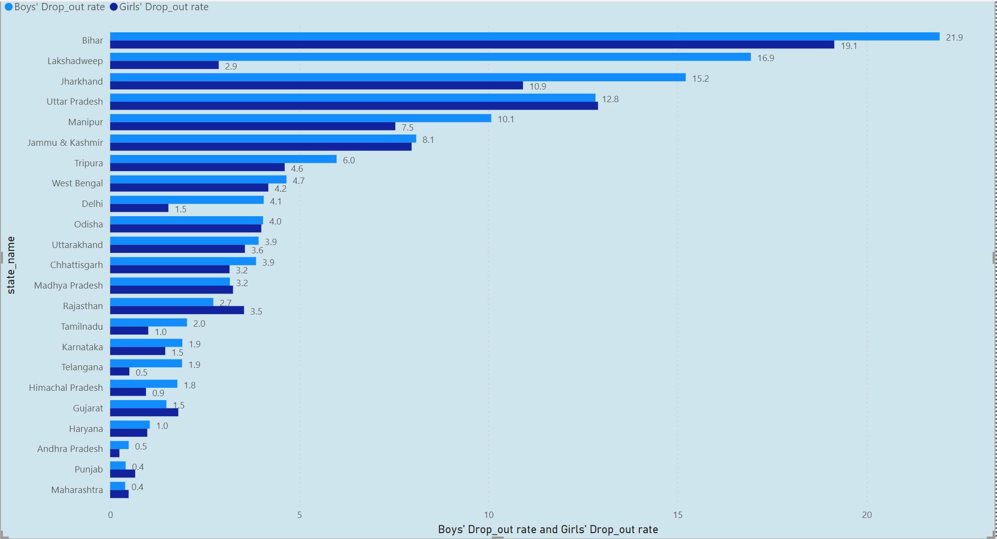
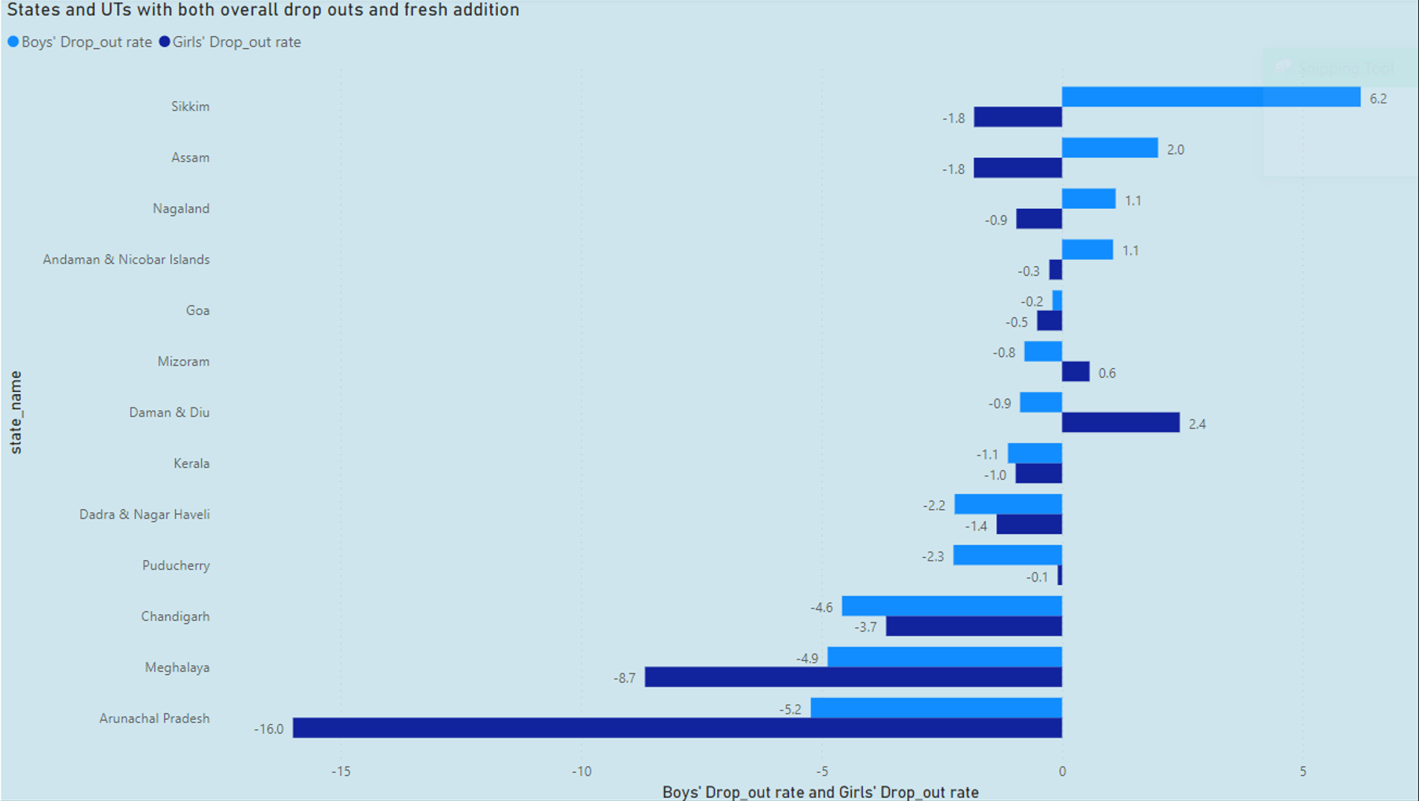
Boys vs Girls Drop in Drop Out Rate Statewise

Slide 7
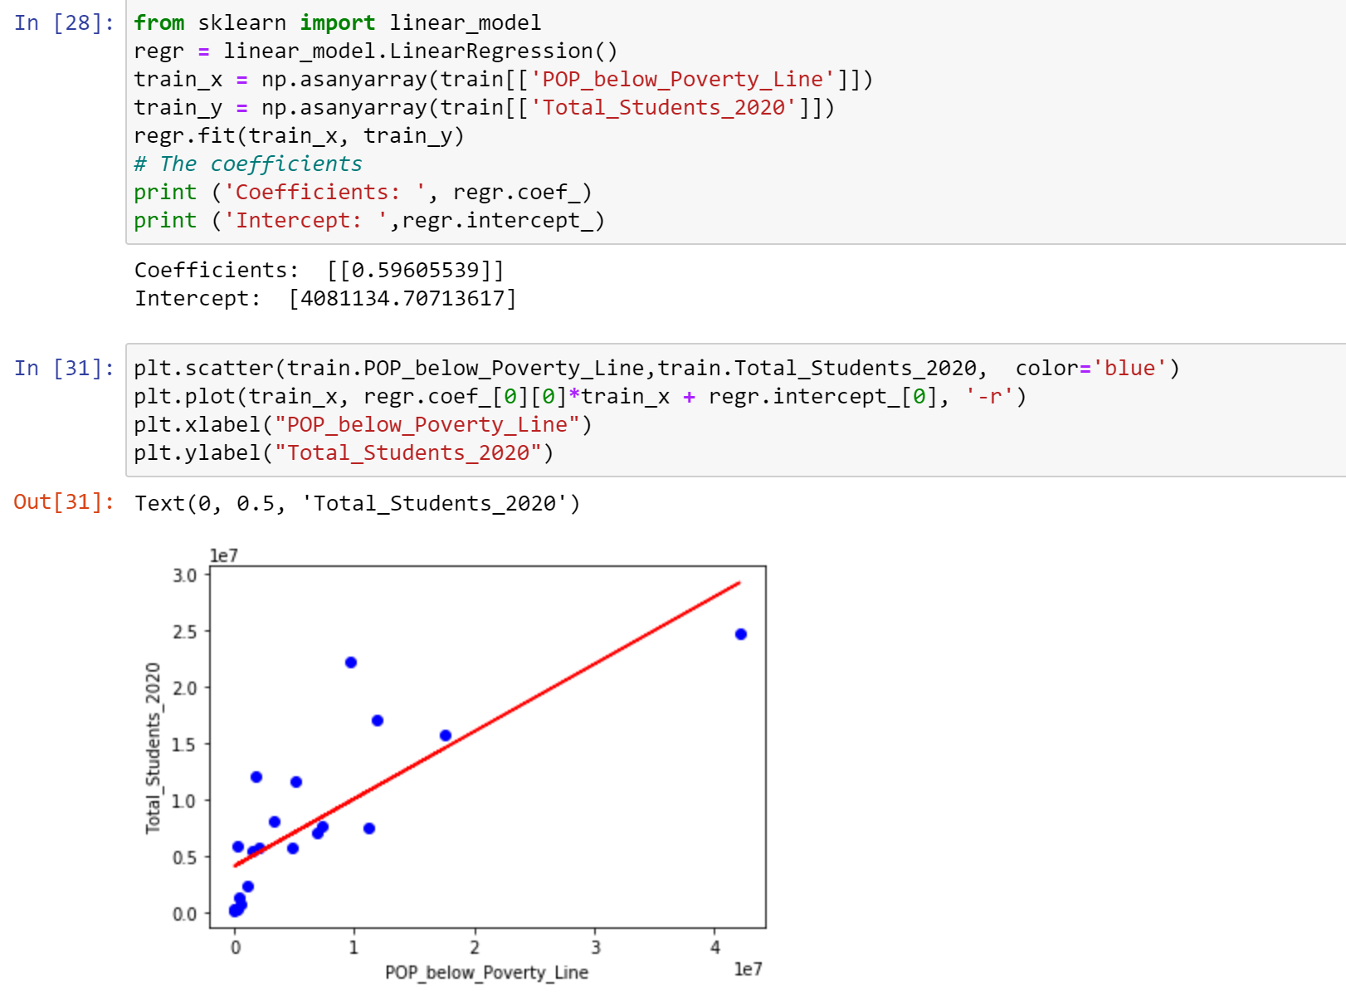
Regression of Proverty level and Students Statewise
From the R2 score of 0.9, we can say that it is a good fit of the model to the data.
R2 measures the proportion of the total variance in the dependent variable, Total Students (Y) that is explained by the independent variable, Poverty level (X) in our linear regression model.

Slide 8
Interpreation
From the % of student chart among population we can see that Meghalaya has approx. 32 student among every 100 people i.e highest in India where as Andaman & Nicobar Island has approx. 18 students every among 100 people i.e. lowest in India.
From the drop out and drop in chart we can say that Bihar has 22% Boys drop out rate & 19% girls drop out rate which is highest in India where as Maharashtra has less than 1% drop out rate of boys and girls which is also lowest India.
From the fresh addition chart we can say that Sikkim has highest boys drop out & girls addition rate whereas Arunachal Pradesh has the highest boys and girls fresh addition rate.
From the Regression analysis we can say that as our R squared score is 0.90 so it is a good fit for the model.It measures the proportion of the total variance in the dependent variable, Total Students (Y) that is explained by the independent variable, Poverty level (X) in our linear regression model.

Slide 9
Conclusion
Our statistics project has provided valuable insights into the relationships between student enrolment, gender ratios and poverty levels. These findings can inform evidence-based policy decisions aimed at improving education access, quality, and inclusivity in different states.
Gender Ratio in Schools: We found variations in the gender ratio in schools across different states. Some states showed a nearly equal distribution of girls and boys in schools, while others exhibited significant disparities. Understanding these variations is crucial for policymakers to address gender-related issues in education.
Student Enrolment: By examining student enrolment statewide, we identified trends in education participation. Some states had higher student enrolment numbers, which could indicate a robust education system, while others lagged behind. These findings can inform efforts to improve access to education.
Poverty and Students: Our regression analysis revealed a complex relationship between poverty levels and no of students. While some states with high poverty rates had lower student enrolment, others had higher enrolment, possibly indicating successful efforts to mitigate the impact of poverty on education.

Slide 10
Thank you

