Slide 1

Customer Behavioural Analytics in the Retail Sector

Slide 2

Research Questions
Are customers willing to travel long distances to purchase products in spite of the high average product price in a shop?
What are the factors that contribute towards the long distance travel of the customer to purchase products in spite of the high average product price in a shop?
What is the maximum likelihood of a customer to select a particular shop?
What are the different customer segments based on their purchase behaviour?
Which are the Top 100 customers that are most profitable in terms of revenue generation?

Slide 3
Ready to travel long distances

Slide 4
Factors for the long distance travel

Slide 5
Customer shop selection

Slide 6
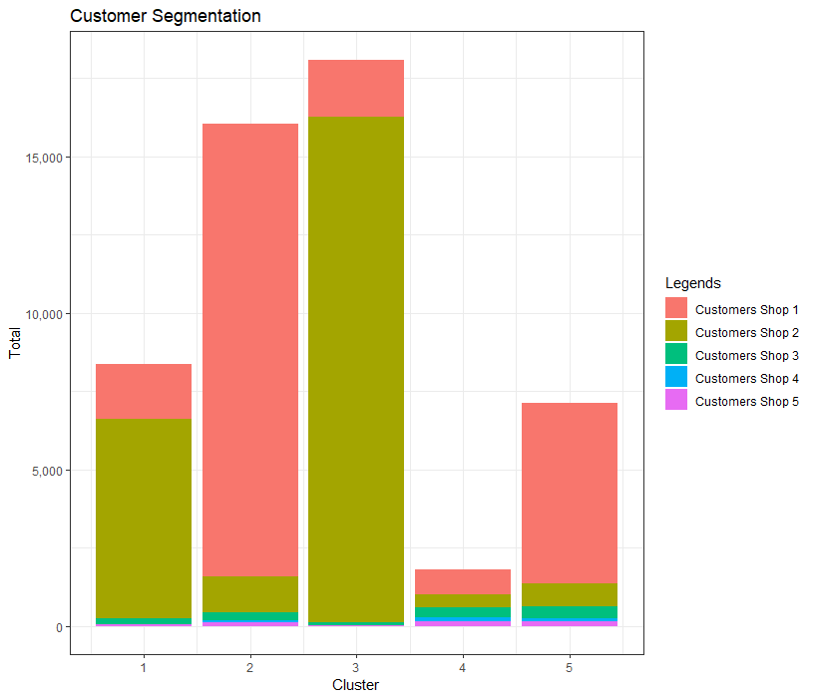
Customer Segmentation

Slide 7
Top 100 profitable customers

Slide 8

Thank you

