Slide 1

Customer Behavioural Analytics in the Retail Sector

Slide 2

Research Questions
Are customers willing to travel long distances to purchase products?
What are the factors that contribute towards the long distance travel of the customer to purchase products?
What is the maximum likelihood of a customer to select a particular shop?
What are the different customer segments based on their purchase behaviour?
Which are the Top 100 customers that are most profitable in terms of revenue generation?

Slide 3
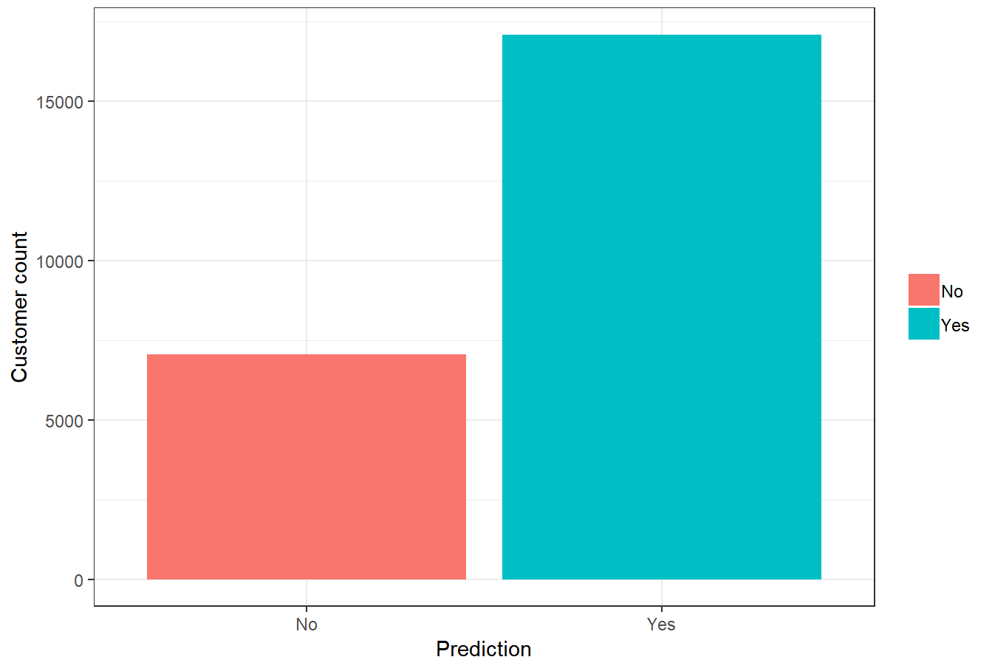
Ready to travel long distances

Slide 4
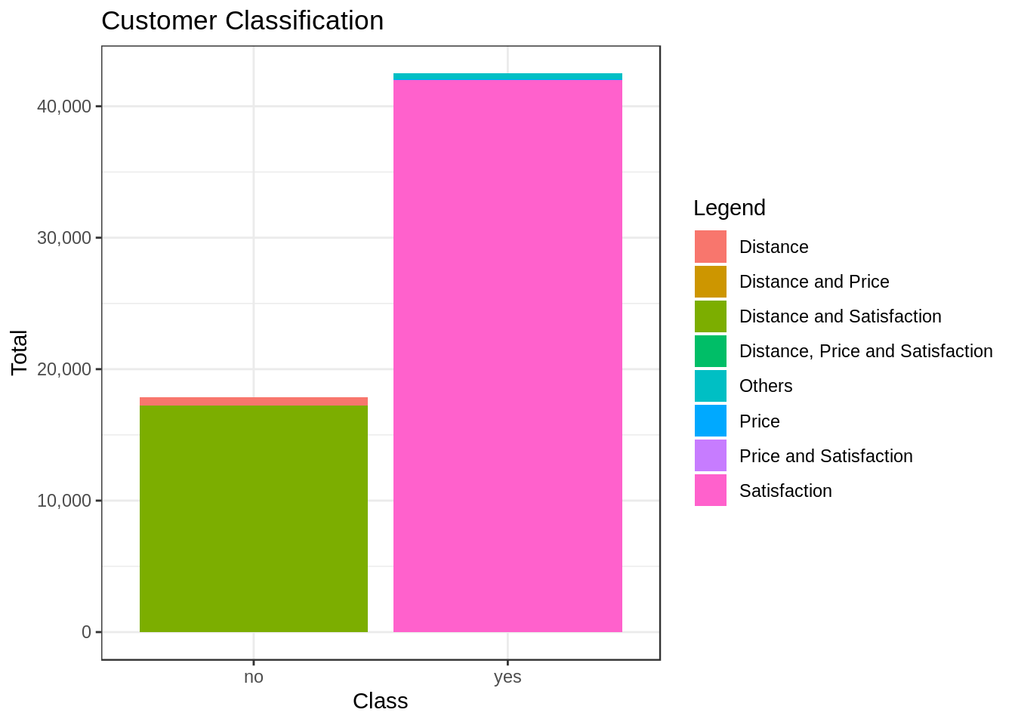
Factors affecting customer's decision while choosing most preferred shop

Slide 5
Customer shop selection

Slide 6
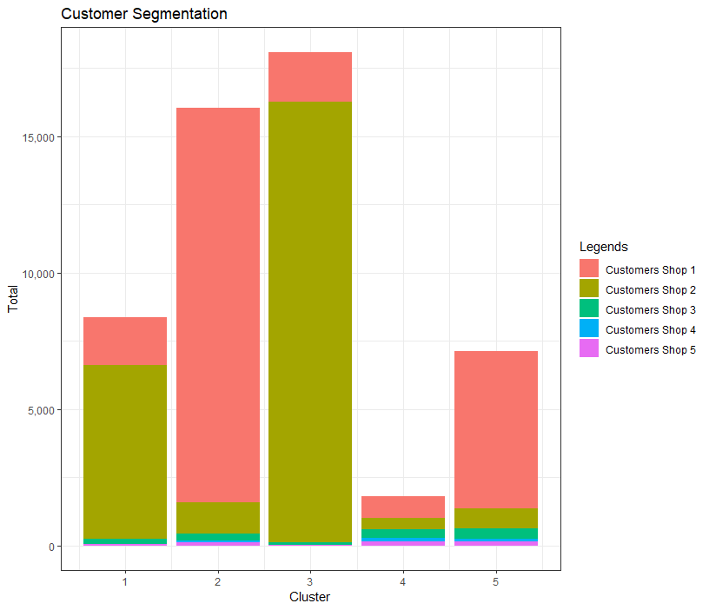
Customer Segmentation

Slide 7
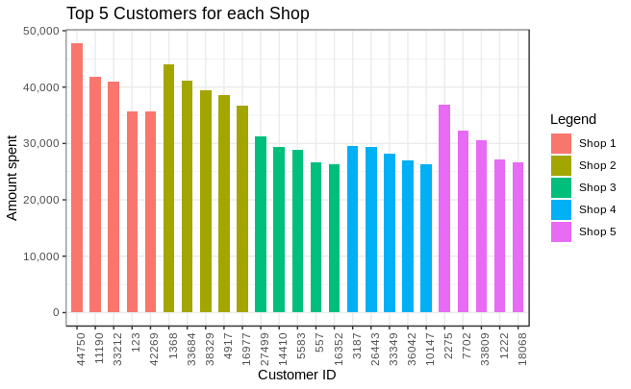
Top 5 customers based on revenue generation

Slide 8

Thank you

