Slide 1
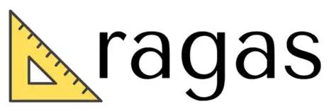
Understanding RAGAS
Evaluate Your LLM response

Slide 2
What is RAGAS?
RAGAS = Retrieval-Augmented Generation Assessment Scores
Open-source framework to evaluate RAG systems
Ragas is a library that provides tools to supercharge the evaluation of Large Language Model (LLM) applications. It is designed to help you evaluate your LLM applications with ease and confidence.

Slide 3
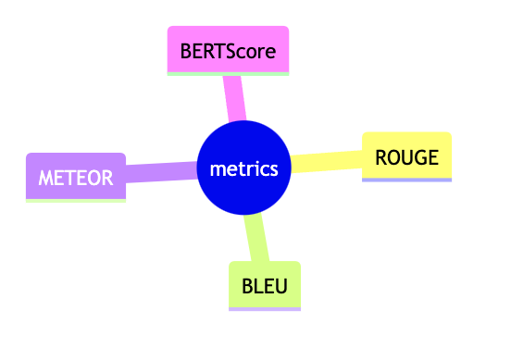
Why Do We Need RAGAS?
Metric | Focus Area | Limitations for RAG | RAGAS Advantage
BLEU | N-gram precision | Surface-level similarity, ignores context and factual accuracy | Evaluates factual grounding and context usage
ROUGE | N-gram recall | Recall-focused, doesn't assess relevance or evidence support | Measures both precision and recall of retrieved context
METEOR | Synonym matching, stemming | Better than BLEU/ROUGE in semantics, but still lacks context-awareness | Tailored for RAG’s need for evidence-based responses
BERTScore | Semantic similarity using embeddings | Captures meaning better, but doesn’t verify factual correctness or source grounding | Checks if response is faithful to retrieved documents
RAGAS | Faithfulness, relevance, context usage | Designed specifically for RAG; holistic and evidence-aware | Comprehensive evaluation of RAG model performance
Reference

Slide 4
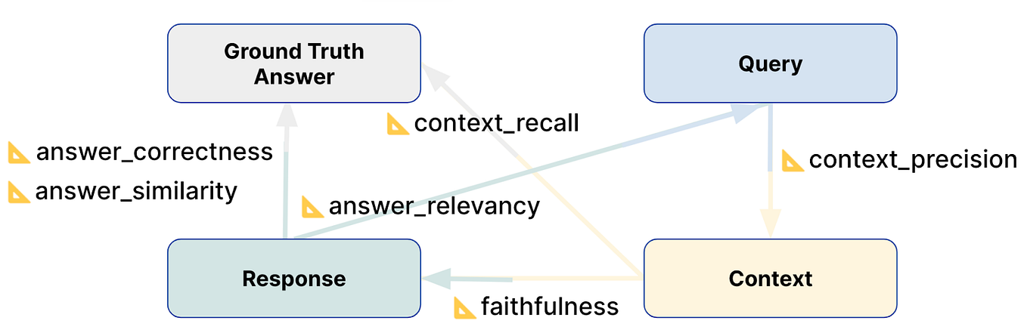
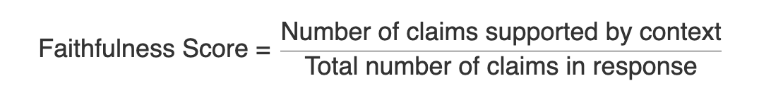
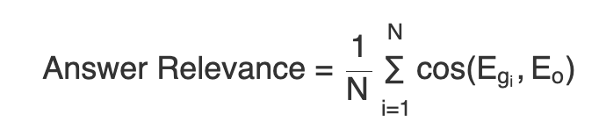
📐 Core RAGAS Metrics
Faithfulness (Factual Consistency, Truthfulness)
Definition: Measures whether the generated answer is factually supported by
the retrieved context.:
Query: "What is the capital of Germany?"
Generated Answer: "Paris is the capital of Germany."
Retrieved Context: "Berlin is the capital of Germany."
2. Answer Relevancy (Response Relevancy, Semantic Match)
Definition: Assesses how relevant the generated answer is to the original query.:
Query: "What is the capital of France?"
Generated Answer: "France is a country in Europe."
Result: The answer is less relevant than "Paris is the capital of France."
Reference

Slide 5
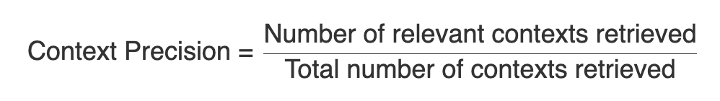
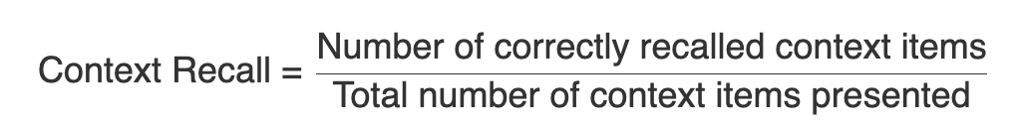
📐 Core RAGAS Metrics
3. Context Precision (Retrieval Precision, Top-K Precision)
Definition: Measures how much of the retrieved context is actually useful for answering the query. Example:
Query: "Who founded Microsoft?"
Retrieved Documents: 5 documents, only 1 mentions "Bill Gates and Paul Allen."
Result: Low precision due to irrelevant context.
4. Context Recall (Retrieval Recall, Evidence Coverage)
Definition: Evaluates whether all necessary information from the corpus was retrieved. Example:
Query: "Who discovered gravity?"
Retrieved Context: Does not include "Isaac Newton."
Result: Low recall, as key information was missed.
Reference

Slide 6
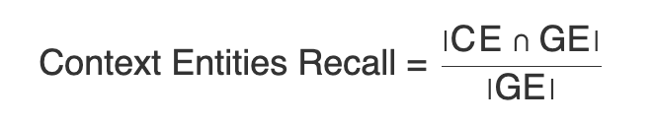
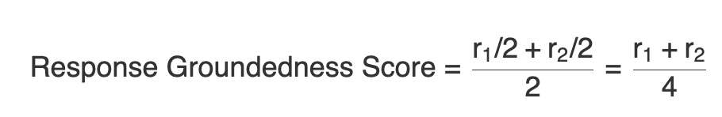
📐 Core RAGAS Metrics
5. Context Entities Recall (Entity Coverage, Entity Recall)
Definition: Checks if key entities from the query are present in the retrieved context.:
Query: "Who founded Microsoft?"
Retrieved Context: Mentions "Microsoft" but not "Bill Gates" or "Paul Allen."
Result: Low entity recall.
6. Response Groundedness (Evidence Grounding, Source Attribution)
Definition: Determines if the response is grounded in the retrieved documents.:
Query: "What is the tallest mountain in the world?"
Generated Answer: "Mount Kilimanjaro."
Retrieved Context: Mentions "Mount Everest."
Result: The response is not grounded in the evidence.
Reference

Slide 7
Result
Original file
RAGAS result

