Slide 1
13F GNN
SAGE vs GAT vs LightGCN V4 — five-slide summary
Daniel · 2026

Slide 2
01
The three models
WeightedSAGE
WeightedGAT
LightGCN V4
Mean of neighbour features.
Attention-weighted neighbour messages.
Embedding-only collaborative filtering.
h_v ← W · MEAN(h_v, h_u for u ∈ N(v))
α_uv = softmax(LeakyReLU(a · [Wh_u||Wh_v]))
e_u^(k+1) = Σ_v (1/√(|N_u||N_v|)) e_v^(k)
3-way tertile classification · 2 layers · h=64 · 150 epochs
Same task as SAGE · 4 heads · dropout 0.5
BPR ranking · embeds=128 · 3 layers

Slide 3
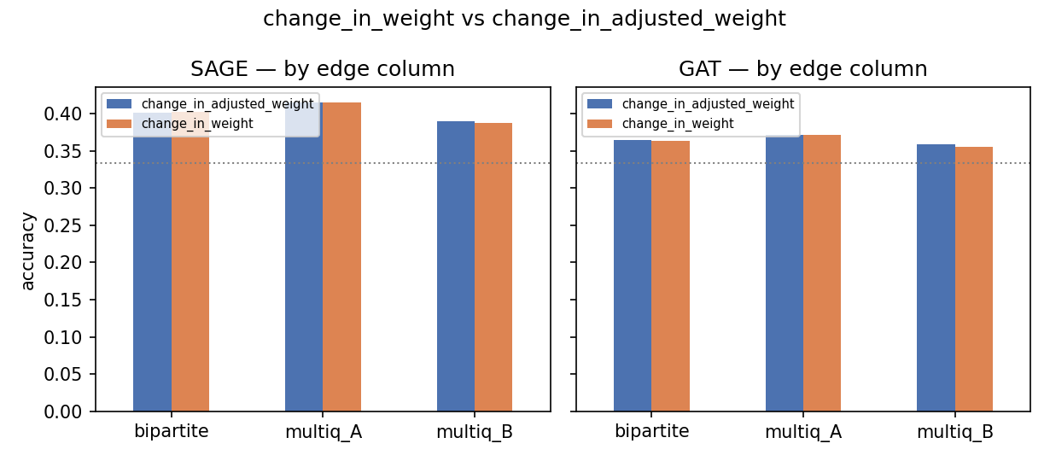
02
Edges vs weighted edges
• Edges = fund → stock (CIK → CUSIP) from 13F.
• change_in_weight: raw Δ in portfolio weight quarter-over-quarter.
• change_in_adjusted_weight: Δ normalised for AUM movement.
• Empirical: ≤ 0.003 difference across all 6 corners.
• v1 models do not consume the weight value (architecture choice).

Slide 4
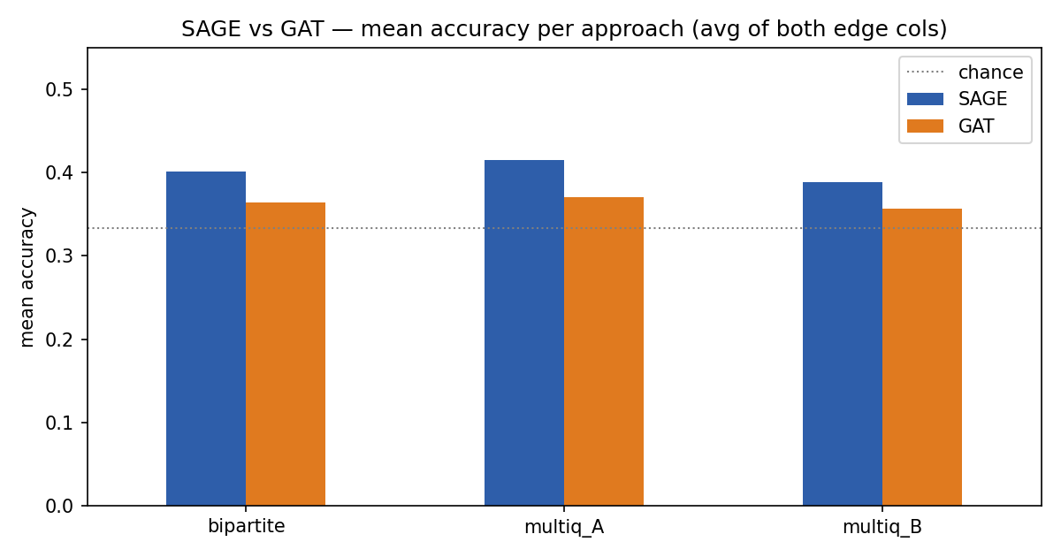
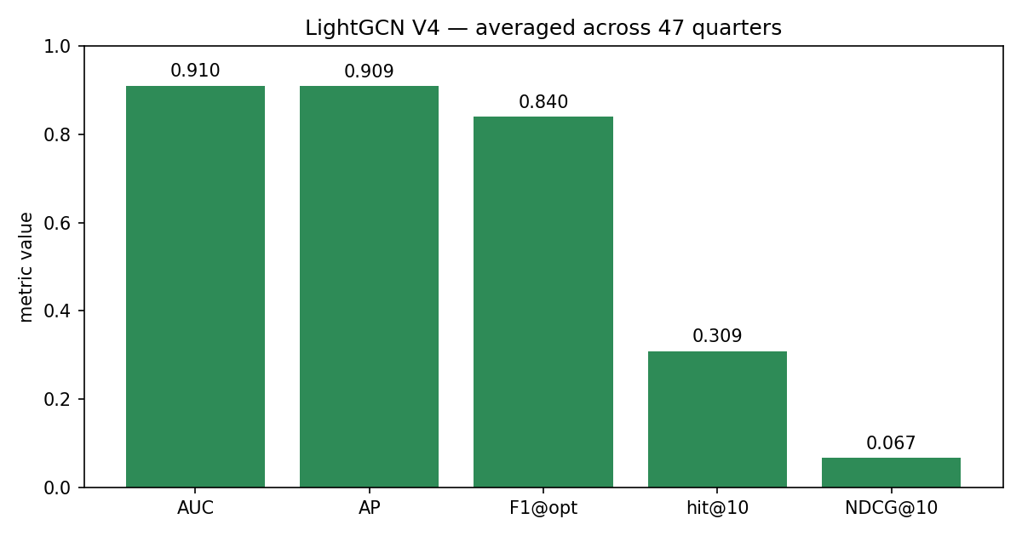
03
Results in short
• SAGE > GAT in every (approach, edge col) — Δ ≈ −0.03 to −0.04.
• Best classifier: multiq_A · SAGE · 0.415 acc.
• All corners beat chance (0.333).
• LightGCN V4: AUC 0.910 · F1@opt 0.840.
• V4 metrics ≠ SAGE/GAT accuracy (different task, different scale).
• GAT missing 3 quarters per multiq corner (24 GB OOM, see KNOWN_ISSUES).

Slide 5
04
Further work
Align hyperparameters
Match hidden dim, layer count, and epoch count across SAGE / GAT / LightGCN so the accuracy gap reflects the architecture, not the recipe.
Filter big funds
Drop the largest funds (BlackRock, Vanguard) — they appear in almost every stock's neighbourhood and overwhelm aggregation.
Filter big stocks
Drop highest-AUM mega-caps that every fund holds — they dominate the edge set and crowd out signal.
Retry missing GAT quarters
Re-submit runandcompare_{A,B}.sbatch on RTX 5090 (32 GB) to fill 2024Q2-Q4 GAT rows; smart resume picks them up automatically.
Compare v1 vs v2 weighted models
Re-introduce the v2 sweep with edge_weight in the message function, and check whether the empty edge-column effect we see in v1 changes.

