Slide 1
13F GNN
SAGE · GAT · LightGCN-V4 — technical summary
v1 unweighted GNN classification ⊕ V4 recommendation · 11-year quarterly sweep
Daniel · 2026 · 7 slides

Slide 2
§1
Models — what each one actually does
MODEL
PROPAGATION
TRAINING / SHAPE
WeightedSAGE
h_v ← σ(W · MEAN(h_v ∪ {h_u : u ∈ N(v)}))
2 layers · hidden 64 · dropout 0.5
Cross-entropy on tertile labels · Adam(lr=8e-4, wd=5e-4) · 150 ep
WeightedGAT
α_uv = softmax_u(LeakyReLU(a · [Wh_v ∥ Wh_u])); h_v ← ∥_k σ(Σ α^k Wh_u)
2 layers · hidden 64 · 4 heads · dropout 0.5
Same loss & optimiser as SAGE
LightGCN-V4
e_u^(k+1) = Σ_{v∈N(u)} (1/√|N_u||N_v|) · e_v^(k); e_u = Σ_k β_k e_u^(k)
embed_dim 128 · 3 layers · no MLP, no nonlinearity
BPR ranking on (fund, +stock, −stock) triples · ≈90 epochs
Note — v1 SAGE / GAT do NOT use edge_weight
The class names ("WeightedSAGE", "WeightedGAT") are historical. Their forward methods call conv(x, edge_index) — edge_weight is in the signature but never passed to SAGEConv/GATConv. _common.py hardcodes weighted=False. Edge weights only act as a NaN-filter on which edges exist.

Slide 3
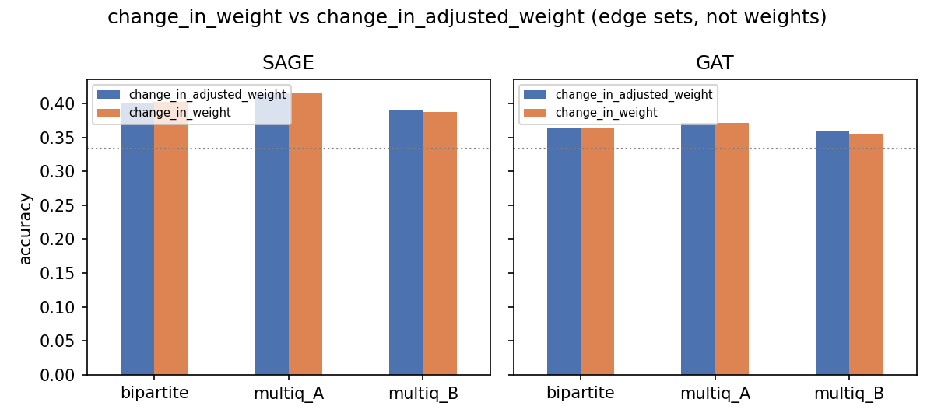
§2
Edge columns — change_in_weight vs change_in_adjusted_weight
• Edges built from 13F filings: u (CIK / fund) → v (CUSIP / stock).
• change_in_weight = w_t(u,v) − w_{t−1}(u,v); raw quarter-over-quarter Δ.
• change_in_adjusted_weight = same Δ but normalised by fund AUM movement, removing pure-rescaling effects when a fund's value swings.
• BOTH columns are used as a NaN-filter — rows with NaN Δ (new / sold holdings) are dropped, producing slightly different edge sets per quarter.
• v1 model classes IGNORE the weight value — only edge existence matters during message passing.
• So the per-corner gap (≤ 0.003 acc) reflects edge-set differences, not weight differences. A real weighted v2 sweep is on slide 7's further-work list.

Slide 4
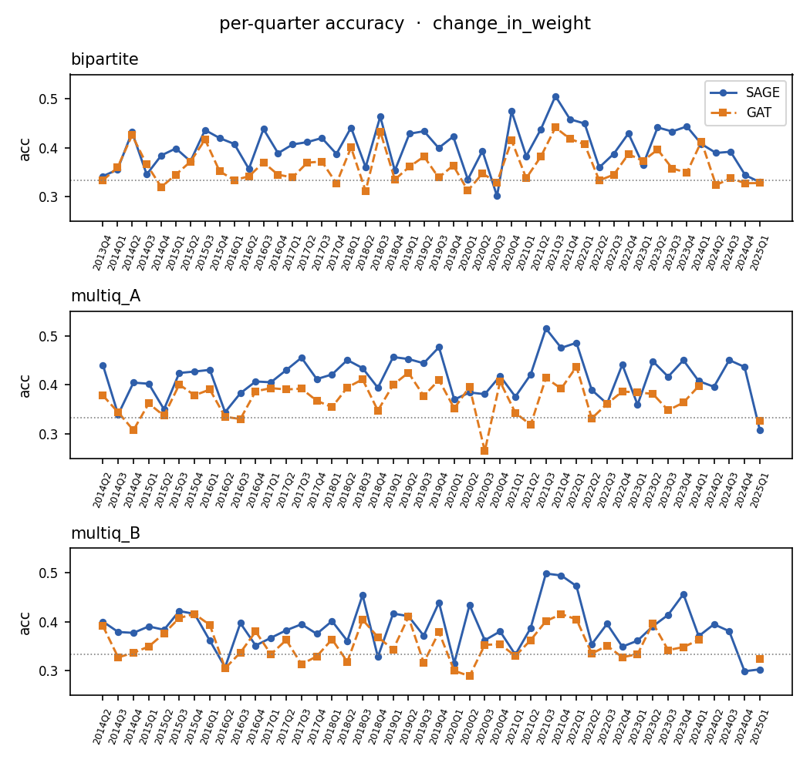
§3
Results — change_in_weight
SAGE / GAT · change_in_weight · 3 approaches × 2 models (chance = 0.333)
corner | acc | F1 | stk_acc | inv_acc | train_s
bipartite · SAGE | 0.402 | 0.385 | 0.372 | 0.425 | 1.0
bipartite · GAT | 0.363 | 0.313 | 0.343 | 0.376 | 7.5
multiq_A · SAGE | 0.415 | 0.401 | 0.382 | 0.438 | 141.0
multiq_A · GAT | 0.371 | 0.334 | 0.345 | 0.388 | 80.0
multiq_B · SAGE | 0.387 | 0.374 | 0.357 | 0.409 | 69.1
multiq_B · GAT | 0.356 | 0.310 | 0.338 | 0.367 | 79.1
• Best SAGE corner here: multiq_A → acc 0.415 (0.401 F1).
• Mean GAT − SAGE accuracy gap on this edge col: -0.038.
• Training time spans 1s to 141s per quarter (multi-quarter graphs are heaviest).
• v1 models do NOT consume edge weights — see slide 2 note.

Slide 5
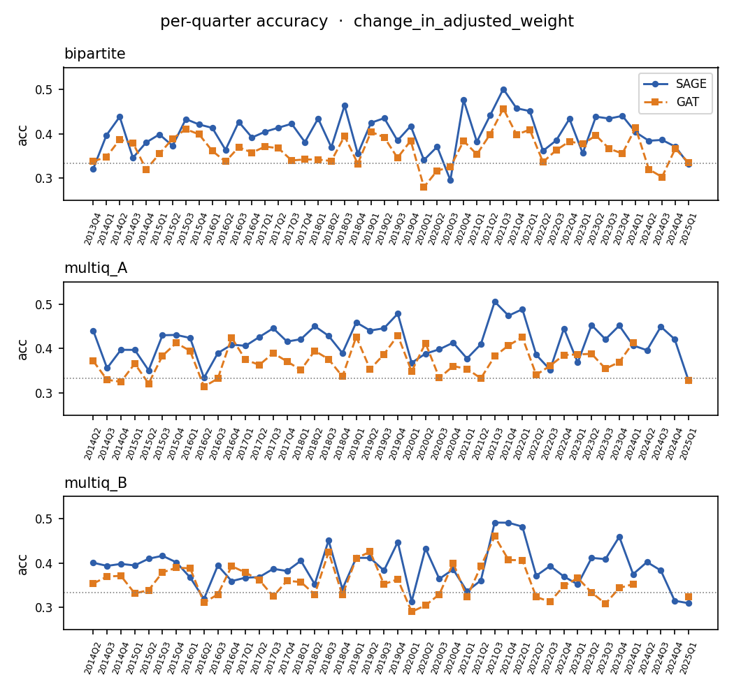
§4
Results — change_in_adjusted_weight
SAGE / GAT · change_in_adjusted_weight · 3 approaches × 2 models (chance = 0.333)
corner | acc | F1 | stk_acc | inv_acc | train_s
bipartite · SAGE | 0.402 | 0.386 | 0.372 | 0.425 | 1.0
bipartite · GAT | 0.364 | 0.319 | 0.343 | 0.379 | 7.5
multiq_A · SAGE | 0.415 | 0.400 | 0.384 | 0.436 | 141.6
multiq_A · GAT | 0.371 | 0.335 | 0.345 | 0.386 | 80.6
multiq_B · SAGE | 0.390 | 0.377 | 0.365 | 0.411 | 68.4
multiq_B · GAT | 0.358 | 0.315 | 0.337 | 0.373 | 78.9
• Best SAGE corner here: multiq_A → acc 0.415 (0.400 F1).
• Mean GAT − SAGE accuracy gap on this edge col: -0.038.
• Training time spans 1s to 142s per quarter (multi-quarter graphs are heaviest).
• v1 models do NOT consume edge weights — see slide 2 note.

Slide 6
§5
LightGCN V4 (separate task) and top stable CUSIPs
LightGCN V4 · 47 quarters (recommendation, not classification)
Top-5 most stably-ranked CUSIPs · bipartite × change_in_weight
AUC
0.910
SAGE
Avg precision
0.909
cusip | n_q | mean_rank | best | top25%
65542W107 | 23 | 1016 | 2 | 13.0%
28414H103 | 26 | 1027 | 152 | 0.0%
53071M104 | 33 | 1044 | 8 | 6.1%
81362J100 | 24 | 1075 | 11 | 4.2%
42225K106 | 26 | 1090 | 82 | 0.0%
F1 @ opt thr
0.840
hit@10
0.309
NDCG@10
0.067
rank↔return ρ
0.024
GAT
V4 is a recommender (binary BPR ranking on fund-stock edges), so its AUC ≈ 0.91 isn't directly comparable to the 3-way tertile accuracy of SAGE / GAT. It runs only with change_in_weight.
cusip | n_q | mean_rank | best | top25%
594918104 | 46 | 993 | 6 | 4.3%
023135106 | 46 | 995 | 7 | 4.3%
037833100 | 46 | 998 | 5 | 6.5%
060505104 | 46 | 1005 | 28 | 0.0%
30303M102 | 46 | 1006 | 11 | 4.3%
GAT's top-5 = mega-caps (MSFT, AMZN, AAPL, BAC, META) appearing in every quarter — motivates the 'filter big stocks' work item on slide 7.

Slide 7
§6
Further work
• Add a TRUE v2 weighted SAGE / GAT — pass edge_weight into the message function (current v1 ignores it; class names are misleading). Then compare to this v1 unweighted baseline.
• Align hyperparameters across models — matched hidden dim, layer count, epoch budget. Right now SAGE/GAT have hidden 64, V4 has embed_dim 128, so accuracy gaps are entangled with capacity gaps.
• Filter big funds: top-decile-AUM funds dominate the bipartite edge set, producing a 'connect-everyone' star pattern that washes out smaller specialised investors' signal.
• Filter big stocks: mega-caps (AAPL, MSFT, AMZN, etc.) appear in essentially every fund's portfolio — confirmed by the GAT top-stable CUSIPs on slide 6 — and act as a constant background.
• Re-run the missing 2024 GAT quarters (multiq_A, multiq_B × both edge cols) once a 32 GB GPU is available — the smart-resume in _common.py picks them up automatically; see KNOWN_ISSUES.md.
• Add a non-13F return baseline (linear / random forest on stock fundamentals) so we can attribute the lift to graph structure vs features.

