Slide 1
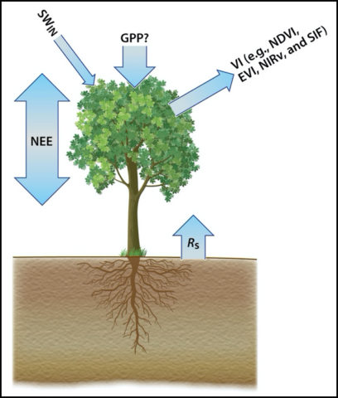
Photosynthesis
CO₂ Uptake
Sunlight
Plant
Respiration
CO₂ Emission
Net emission
(+ positive)
Net
CO₂ Flux
Net uptake
(- negative)
Soil
Respiration
CO₂ Emission

