Slide 1
What Works for Whom: Assessing Heterogeneous Treatment Effects
Carly L. Brantner
Data Science for Health Equity (DSxHE) x Cancer Research UK
September 10th, 2026

Slide 2
Beyond Averages…
Averages can be misleading
A study can have an overall average treatment effect of 0, when if we looked at subgroups:
Group A: 40% risk increase
Group B: No effect
Group C: 40% risk reduction
Notes:
If the treatment worked the same for everyone (no heterogeneity), it wouldn’t matter (statistically) who is in our sample
But we think it typically does and we need to have diverse samples to be able to see if it does

Slide 3
Beyond Averages…
Averages can be misleading
A study can have an overall average treatment effect of 0, when if we looked at subgroups:
Group A: 40% risk increase
Group B: No effect
Group C: 40% risk reduction
Heterogeneous treatment effects ~ data diversity
Data diversity
Increased trust and study participation
Better understanding of treatment effect heterogeneity
Individualized resource allocation & improved outcomes
Notes:
If the treatment worked the same for everyone (no heterogeneity), it wouldn’t matter (statistically) who is in our sample
But we think it typically does and we need to have diverse samples to be able to see if it does

Slide 4




Treatment Allocation
 | Should elite female soccer players receive an agility training or stretching protocol to prevent ACL tear?
Goal: Guide treatment decision-making by estimating heterogeneous treatment effects

Slide 5
Treatment Allocation
 | Average-based decision
 | Agility training
 | Agility training
 | Agility training
 | Agility training
Goal: Guide treatment decision-making by estimating heterogeneous treatment effects

Slide 6
Treatment Allocation
 | Average-based decision | Individualized decision
 | Agility training | Agility training
 | Agility training | Agility training
 | Agility training | Stretching protocol
 | Agility training | Agility training
Goal: Guide treatment decision-making by estimating heterogeneous treatment effects

Slide 7
Outline for Today
Framing: Why HTE?
Core Concepts: ATE, CATE, assumptions, methods
Data setup and descriptives (Coding)
Traditional approaches for HTE (Coding)
Causal forest for HTE (Coding)
Signposting & Wrap-Up
Q&A / Discussion
Notes:
Have people install R packages in the google collab

Slide 8

About Me
Assistant Professor of Biostatistics, Duke University & Duke Clinical Research Institute
PhD: Biostatistics, Johns Hopkins Bloomberg School of Public Health
Consultant: Data Science, Kang Women’s Institute @ US Soccer Federation
Research: Real-World Data & Precision Causal Inference
Clinical Focus: Women’s Health & Chronic Disease (Rheumatology, Gastroenterology)
https://www.carlybrantner.com/

Slide 9
1. Framing

Slide 10
Overview of Heterogeneous Treatment Effects
Heterogeneous Treatment Effects (HTE): Variation in the effect of a treatment across individuals or subgroups; beyond an overall average effect
Analogous Concepts: Subgroup analysis, effect moderation, personalized medicine

Slide 11
Overview of Heterogeneous Treatment Effects
Heterogeneous Treatment Effects (HTE): Variation in the effect of a treatment across individuals or subgroups; beyond an overall average effect
Analogous Concepts: Subgroup analysis, effect moderation, personalized medicine
Rationale: Hypothesize that the effect of treatment is not consistent across all individuals/units (not “one size fits all”)
The right treatment, for the right individual, at the right time

Slide 12
Overview of Heterogeneous Treatment Effects
Heterogeneous Treatment Effects (HTE): Variation in the effect of a treatment across individuals or subgroups; beyond an overall average effect
Analogous Concepts: Subgroup analysis, effect moderation, personalized medicine
Rationale: Hypothesize that the effect of treatment is not consistent across all individuals/units (not “one size fits all”)
The right treatment, for the right individual, at the right time
How can we optimize resource allocation and efficiency?

Slide 13
2. Core Concepts

Slide 14
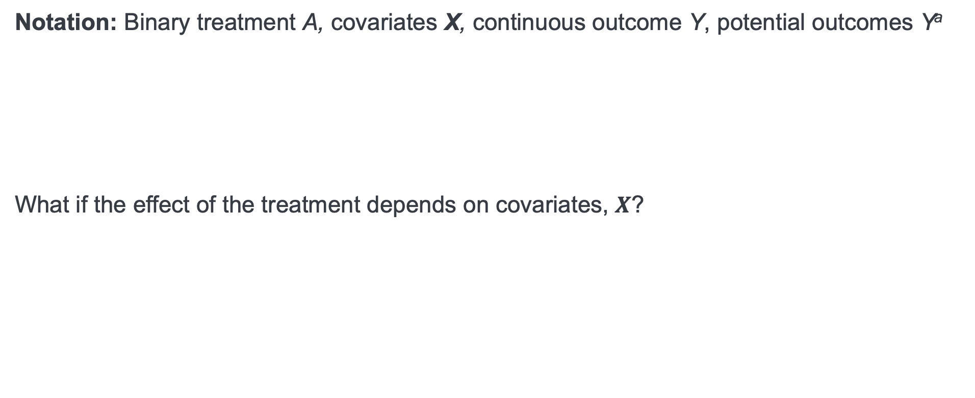
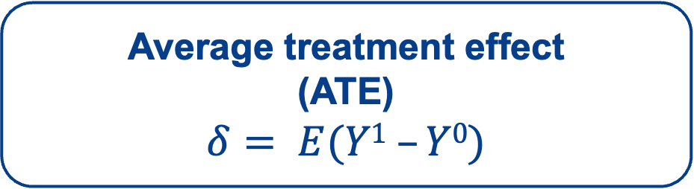
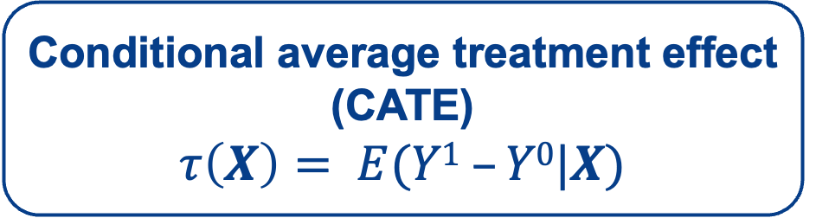
Notation and Estimands
Notation: Binary treatment A, covariates X, continuous outcome Y, potential outcomes Yª
What if the effect of the treatment depends on covariates, $X$?
Average treatment effect
(ATE)
$$δ= E(Y1 –Y0)$$
Conditional average treatment effect
(CATE)
$$τ\left(X\right)= E(Y1 –Y0|X)$$

Slide 15
Notation and Estimands
Average treatment effect
(ATE)
$$δ= E(Y1 –Y0)$$
What is the average difference in the outcomes if we were to give everyone the treatment vs. everyone the control?
Conditional average treatment effect
(CATE)
$$τ\left(X\right)= E(Y1 –Y0|X)$$
What is the average difference in the outcomes if we were to give a subgroup the treatment vs. the subgroup the control?
Notes:
ATE: Does this treatment help on average?
CATE: Does this treatment help for patients with characteristics X?

Slide 16
Assumptions
Consistency: the outcome we actually observe for someone who got the treatment is the same as their potential outcome under treatment
SUTVA: one person’s outcome isn’t affected by another’s treatment assignment
Unconfoundedness: after accounting for measured patient characteristics, treatment assignment is essentially as good as random
Positivity: every patient has a non-zero chance of ending up in either treatment group

Slide 17
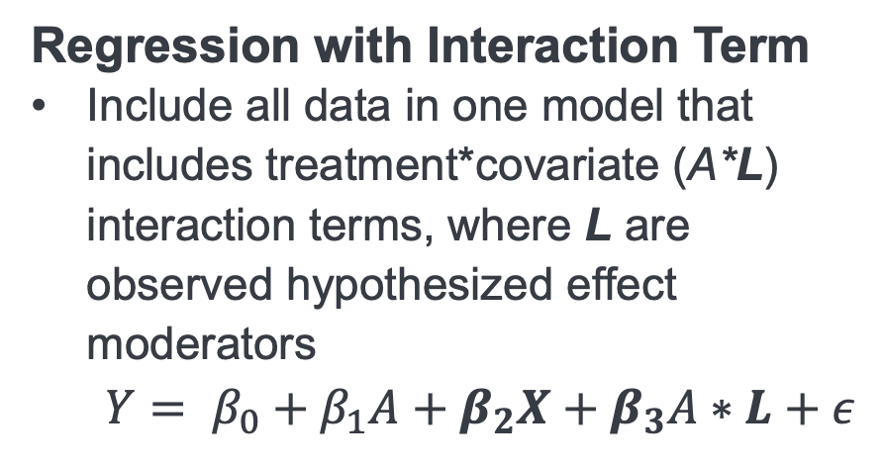
Approaches to Estimate HTE: Traditional
Traditional Parametric Models
Stratified Analysis
Divide data into subgroups with hypothesized treatment effect heterogeneity
Estimate treatment effects per subgroup
Regression with Interaction Term
Include all data in one model that includes treatment*covariate (A*L) interaction terms, where L are observed hypothesized effect moderators
  $$Y= β_{0}+β_{1}A+β_{2}X+β_{3}A∗L+ε$$

Slide 18
Approaches to Estimate HTE: Modern
Non-Parametric, Machine Learning CATE Estimators
Causal Forest
  Extension of random forests to estimate heterogeneous treatment effects
  Causal tree: Splits data to maximize differences in treatment effects across subgroups
  Causal forest: Aggregation of causal trees
  (Athey et al., 2019)
R package: grf
Other machine learning estimators: X-learner, Bayesian additive regression trees (BART), etc.

Slide 19
Approaches to Estimate HTE
Traditional
Modern
Interpretable
Moderation is testable under statistical properties
Typically focuses in on one effect moderation relationship at a time
Flexible
Does not require a priori pre-specification of moderators
Allows for non-linearities and interactions

Slide 20
Challenges With HTE Estimation
Most studies are underpowered for CATE estimation
CATE may involve interactions & non-linearities
Multiple testing; risk of overfitting to noise
Tradeoff between interpretability and flexibility

Slide 21
Application: Comparative Effectiveness in Major Depression
Hypothetical randomized controlled trial
Question: Who should take Duloxetine (Cymbalta), and who should take Vortioxetine (Trintellix)?
Exposures: Vortioxetine (treatment) and Duloxetine (control)
Outcome: MADRS score (Montgomery-Asberg Depression Rating Scale) at 8 weeks follow-up
10-item clinician-rated scale, ranging from 0-60 (higher # = worse symptoms)
Normal = 0-6; Mild = 7-19; Moderate = 20-34; Severe = 35-60

Slide 22
3-5. Coding!

Slide 23
6. Signposting & Wrap-Up

Slide 24
Other HTE Methods
BART (Bayesian Causal Forests): tree-ensemble method that also gives uncertainty estimates on each CATE
Meta-learners (S-, T-, X-learner): general framework for turning any prediction model (e.g., boosting, neural nets) into a CATE estimator
R-learner: uses a "double robust" trick to isolate the treatment effect from other predictors of the outcome, reducing bias from model misspecification
Deep learning approaches (e.g., TARNet, Dragonnet): neural network architectures designed specifically for estimating individualized treatment effects

Slide 25
Notes on Observational Studies
HTE methods can be applied to observational data too (if core causal assumptions hold)
Key adjustment: incorporate the propensity score (each patient's estimated probability of receiving treatment, given their characteristics) into the model, so it can account for the fact that treatment wasn't randomly assigned
  Most methods account for this implicitly (e.g., causal forest) by estimating and adjusting for the propensity score internally as part of fitting
Same tools and interpretation but stronger assumption to defend and an extra propensity-score component in the model

Slide 26
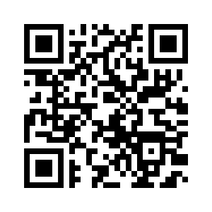
Implementation
Helpful packages / resources
grf
dbarts
causalToolbox
XBCF
bcf
multicate

Slide 27
Key References
Other ML HTE Methods
Multi-Study Applications
Interpretation / Visualization
Athey, Tibshirani & Wager (2019): Generalized Random Forests (causal forest foundation)
Hill (2011): Bayesian Additive Regression Trees for causal inference
Künzel et al. (2019): meta-learners (S-, T-, X-learner)
Riley et al. (2021): The Two-stage Approach to IPD Meta-Analysis.
Brantner et al. (2024): Comparison of methods that combine multiple randomized trials to estimate heterogeneous treatment effects.
Brantner et al. (2023): Methods for integrating trials and non-experimental data to examine treatment effect heterogeneity.
Liz Stuart website: https://www.elizabethstuart.org/hte/
Athey & Wager (2019): Estimating Treatment Effects with Causal Forests: An Application
https://grf-labs.github.io/grf/ diagnostic tools and code

Slide 28
Acknowledgements
Collaborators
Elizabeth Stuart
Trang Nguyen
Hwanhee Hong
Laine Thomas
Daniel Obeng
Congwen Zhao
Elena Badillo Goicoechea
Funding
PCORI Award ME-2020C3-21145 (PI: Stuart)
NIMH R01MH126856 (PI: Stuart)
Contact Information
carly.brantner@duke.edu
www.carlybrantner.com
www.github.com/carlyls

Slide 29
7. Q&A / Discussion

