Slide 1
Gendered Interaction Online
By Katie Thomas

Slide 2
Motivation
Sociolinguistics
Women, Men, and Language, by Jennifer Coates
Women use minimal responses and back channels more
Only really applies in speech, not online interaction
Women use more hedges
Expressing uncertainty
Socialized to believe asserting themselves isn’t ladylike
Women give and receive more compliments than men
Women prefer collaborative speech style; men prefer competitive speech style
Women use questions to avoid the role of expert
Ex) right? Isn’t it? Don’t you? Etc.
Men avoid self-disclosure and talk about more impersonal topics

Slide 3
Plan for analysis
Questions:
How do women and men present themselves differently online?
Do people respond differently to male vs. female posters?
Do male responders respond differently to male vs. female posters? Do female responders respond differently to male vs. female posters?
Hypothesis:
Female responders “favor” female posters, male responders “favor” male posters
Unsure of specifics, but thought there would be a difference
Women use more hedges than men
Women use more questions that “avoid the role of expert” than men
What did I look at?
Post length, response length, average sentence length, Google k-band
Never found anything significant with Google k-band
Hedges and questions (maybe compliments?)
t-tests to determine significance by gender

Slide 4
Original data
Original data from a study at Stanford University called RtGender (https://nlp.stanford.edu/robvoigt/rtgender/)
Format:
Facebook Congress: know gender of poster
Facebook Wiki: know gender of poster
Fitocracy: know gender of poster and responder
Reddit: know gender of poster and responder
TED: know gender of “poster” (speaker)
Notes:
Facebook files: multiple comments per post
Wiki: searched Wikipedia category pages like ”television actress”, “male tennis players”, etc. and searched for their verified Facebook pages
Fitocracy and Reddit: only one comment per post
TED: multiple responses per speaker

Slide 5
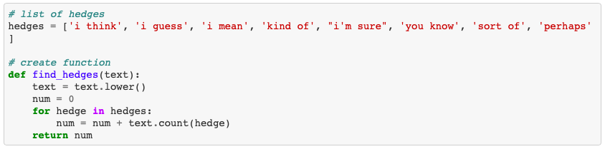
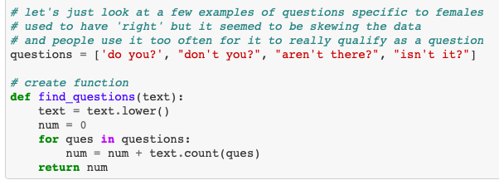
Modifying data
Merged posts and responses into a single data frame for each source
Tokenized and found post/response length, post/response sentence length, and average Google k-band
Hedges and questions:
Split into smaller samples for analysis and machine learning
Notes:
Need to add more questions – as we’ll see later, they’re barely used and data isn’t really meaningful
Unsure how to search for compliments

Slide 6
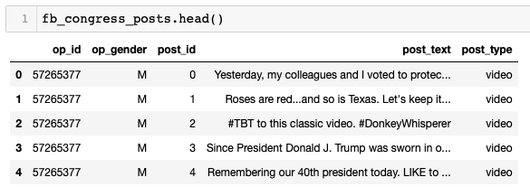
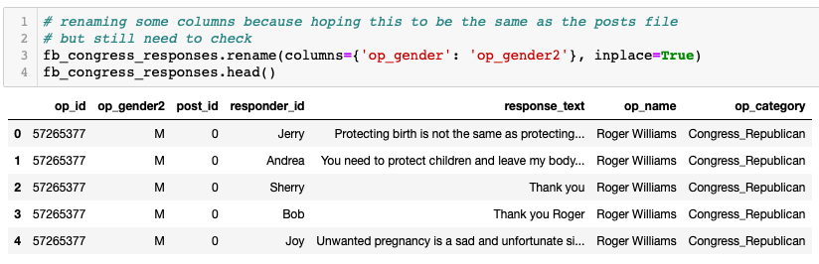
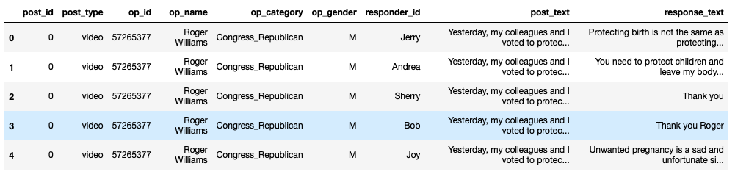
Example: Facebook Congress
Merged on post ID
Notes:
Response text contains some info about the poster that wasn’t listed in the posts file, thought that was weird

Slide 7
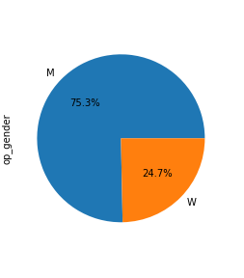
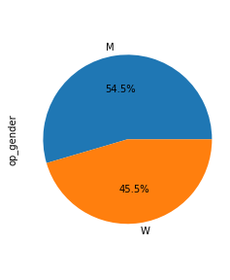
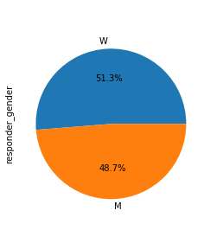
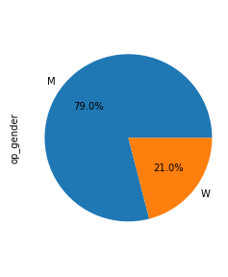
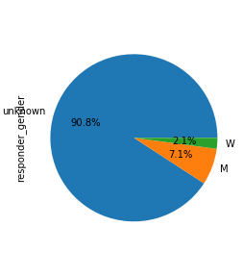

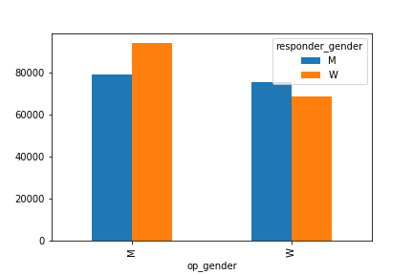
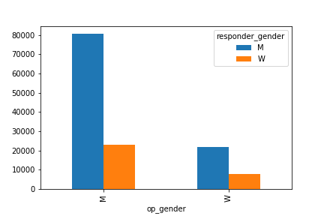
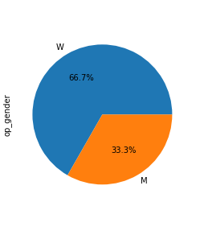
Gender distributions
Facebook Congress
Fitocracy
Reddit
TED
Facebook Wiki

Slide 8
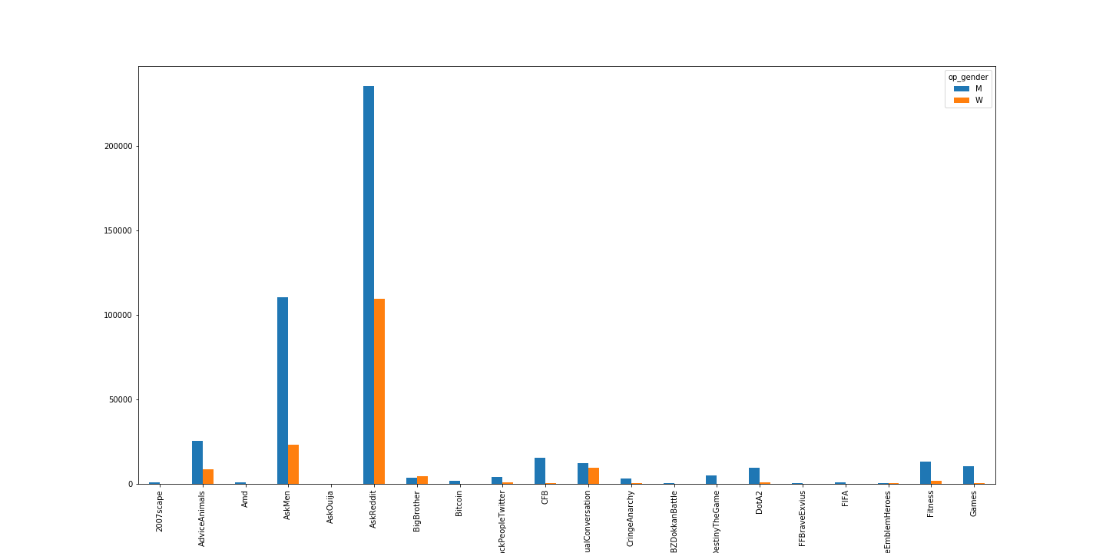
Reddit: more in depth
75.8% male: very male dominated
Is this because of the specific subreddits?
Out of 98 subreddits, only 5 have more female posters than male posters
BigBrother, awww, counting, relationships, and rupaulsdragrace

Slide 9
Findings: Gender
Post/response length seems to be correlated with sentence length
 | Facebook Congress | Facebook Wiki | Fitocracy | Reddit
Post length | Female posters have longer posts | Male posters have longer posts | Female posters have longer posts | Female posters have longer posts
Sentence length | Female posters use longer sentences | Male posters use longer sentences | Responses to female posters use longer sentences Female responders use longer sentences | No significance
Response length | No info about responder gender | No info about responder gender | Responses to female posters are longer Female responders have longer responses | Responses to female posters are longer Female responders have longer responses
Hedges | Female posters use more hedges | Male posters use more hedges | No significance | Female posters use more hedges Female responders use more hedges
Questions | No significance | No significance | No significance | No significance
Notes:
SUMMARY:
Female posters have longer posts for ¾ (congress, fitocracy, and reddit), female responders have longer responses (when info available)
Sentence length correlated with post length – when females have longer posts, they also have longer sentences. When males have longer posts, they also have longer sentences
Responses to female posters longer
Females use hedges more often than males (except in wiki)
QUESTIONS: none of this went how I planned
Don’t think I have enough, there’s only like .2% of posts that use questions
Note: haven’t looked at compliments and don’t know if I will. May need annotation

Slide 10
Findings: Gender x Gender
 | Male responder | Female responder
Male poster | Fitocracy Longer responses Longer sentences in response Reddit Shorter responses | Fitocracy Shorter responses Shorter sentences in response
Female poster | Fitocracy Shorter responses Shorter sentences in response Reddit Longer responses | Fitocracy Longer responses Longer sentences in response
Note:
when saying “longer”, “shorter” - this refers to the difference between the rows in the specific responder column
Reddit is opposite of Fitocracy
Could this be because female posters are so much more rare?

Slide 11
Machine Learning
Goals:
1. Identify gender by looking at text, regardless of if poster or responder
Merged all sample files of posters (always know gender) and some responders (sometimes know gender)
2. Identify gender of poster and responder by looking at response text
Merged Fitocracy and Reddit files when gender of both poster and responder was known and visible
Notes:
Goal 1:
Facebook files posts, Fitocracy posts and responses, Reddit posts, and some Reddit responses

Slide 12
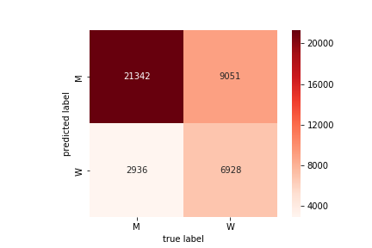
Goal 1: Simply identify gender
Baseline: 60% male
Used train test split, TfidfVectorizer, and MultinomialNB
Using nltk’s tokenizer improved accuracy
Punctuation is important?
Accuracy score: 70.2%

Slide 13

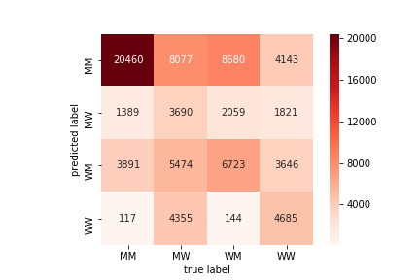
Goal 2: Identify both genders
Created new column
First letter: gender of poster
Second letter: gender of response
Baseline: 32.6% male poster/male responder
Used train test split, TfidfVectorizer, and MultinomialNB
Accuracy score: 44.8%
Confusion:
When true label is WM (female poster, male responder):
Predicted as both MM and WM
When true label is WW (female poster, female responder):
Predicted as both MM and WW
Least accurate is MW

Slide 14
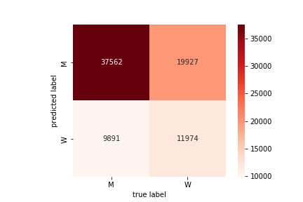
Goal 2.5: identify gender of poster given response
Attempting to simplify the last task
Baseline: 59.8% male
Used train test split, TfidfVectorizer, and MultinomialNB
Accuracy score: 62.4%

Slide 15
Improvements for the future
Go deeper into hedge/compliment/question analysis
Look at most informative features – why are things being classified the way that they are?
FeatureUnion????
Annotation for compliments and questions

Slide 16
Thank you!

