Slide 1
Spell Checker
Ting-Wei Shen
Data Science for Linguistics
April 11, 2019

Slide 2
Outline
Spell checker foundation
the basic four elements
Data processing
ELI dataset – raw data without precleaning
the fair use of data
Linguistic analysis
writing quality assessment
check out spell checker on our dataset
Notes:
Actually, I will go through the analysis of ELI dataset. Then employ the spell checker on my data. So, it may be more proper to name my project as Utilizing spell checker on ELI dataset.

Slide 3
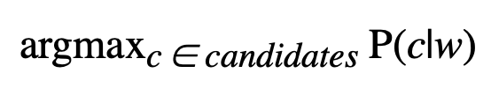
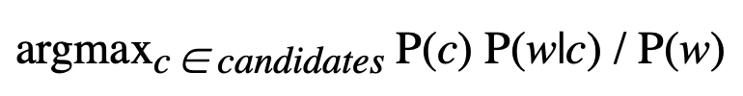
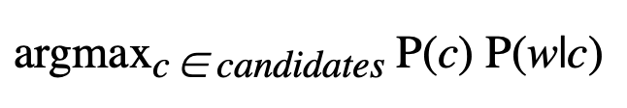
The main idea- Some Probability Theory
Most likely spelling correction c for w
By Bayes' Theorem, this is equivalent to:
Since P(w) is the same for every possible candidate c, we can factor it out, giving:

Slide 4
Divided into four main parts
Selection Mechanism: argmax
Choose the candidate with the highest combined probability.
Candidate Model: c ∈ candidates
This tells us which candidate corrections, c, to consider.
Language Model: P(c)
The probability that c appears as a word of English text.
For example, occurrences of "the" make up about 7% of English text, so we should have P(the) = 0.07.
Error Model: P(w|c)
The probability that w would be typed in a text when the author meant c.
For example, P(teh|the) is relatively high, but P(theeexyz|the) would be very low.
Notes:
P(A): the probability of A occurring
P(A|B): Conditional probability
the probability of A occurring, given that B has occurred
P(A, B): Joint probability
the probability of A occurring and B occurring
Same as P(B, A).
If A and B are independent events, same as P(A)*P(B).
If not, same as P(A|B)*P(B) and also P(B|A)*P(A).

Slide 5
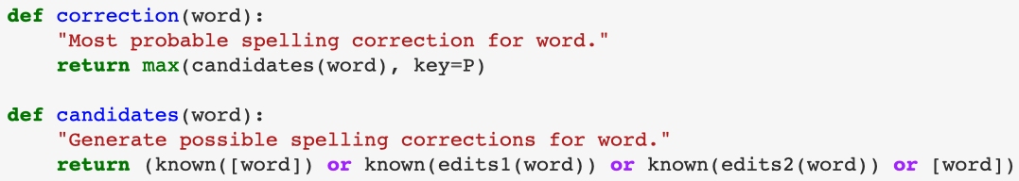
Some assumptions on Error Model - candidates(word)
The original word, if it is known; otherwise
The list of known words at edit distance one away, if there are any; otherwise
The list of known words at edit distance two away, if there are any; otherwise
The original word, even though it is not known.

Slide 6
How does ELI data look like?
Original: 46239 files
student_id, question_id, text, gender, native_language, question
After data processing: 492 files
student_id, question_id, text, gender, native_language, question, tokens, token_count, types, type_count, TTR
Notes:
屬性 Attributes

Slide 7
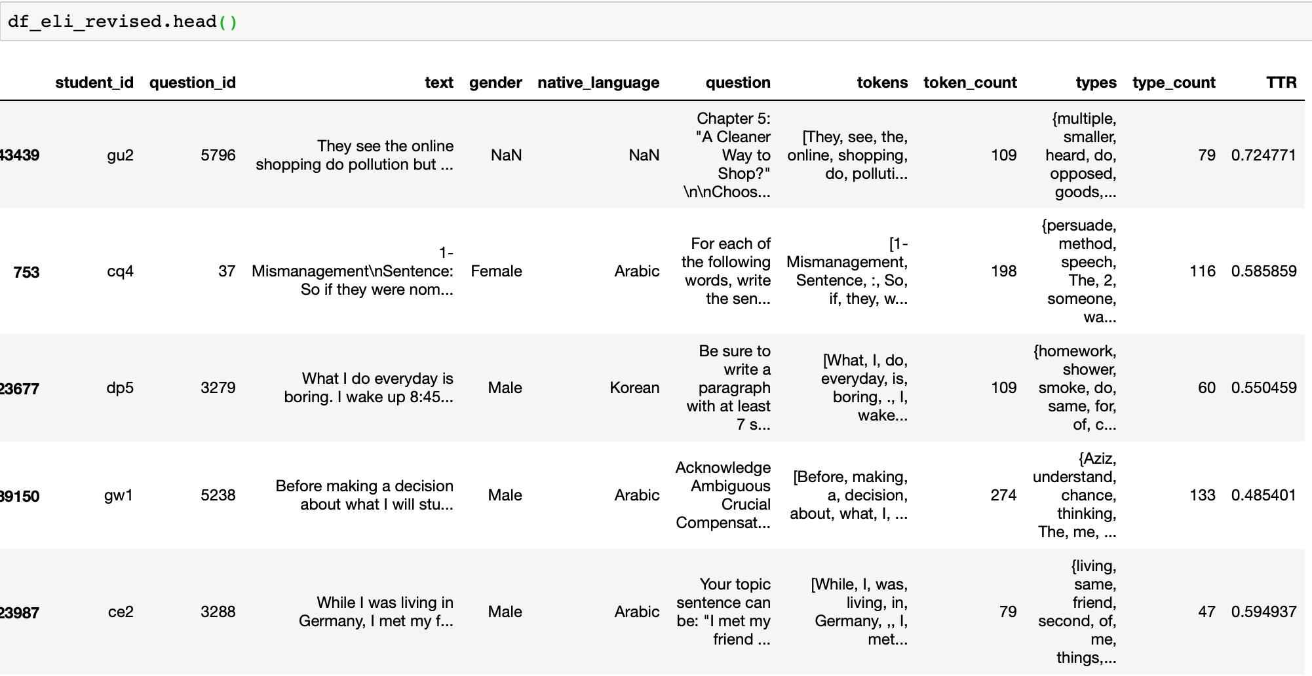

Slide 8
Loading chosen data
answer.csv
student_id, question_id, text
student_information.csv
student_id, gender, native_language
question.csv
question_id, question

Slide 9
Sample data
Consider the fair use – 500 texts to represent
Sample data to avoid data bias
random_state = 1 to fix the data
Eliminate personal information
Output as a new csv file – 492 texts left
Notes:
1/10 for fair use

Slide 10
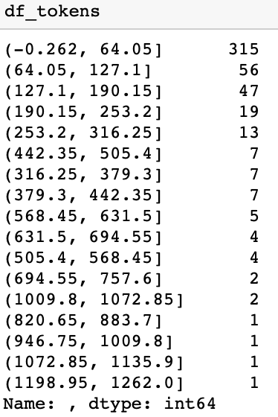
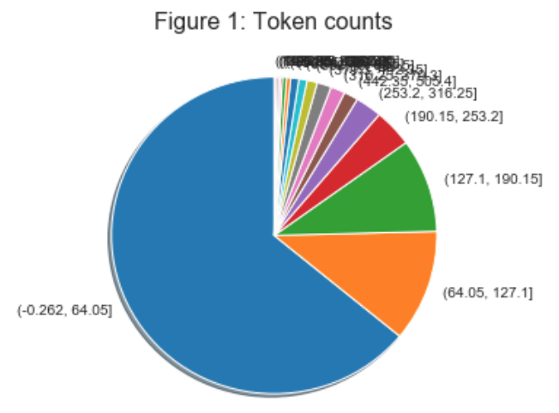
Challenge I met - Text length as token count

Slide 11
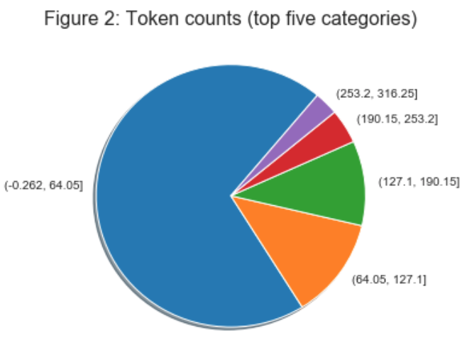
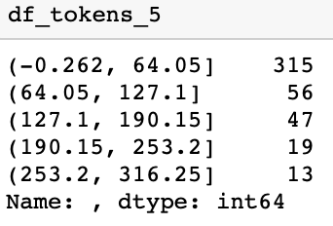
Token counts (top five categories)

Slide 12
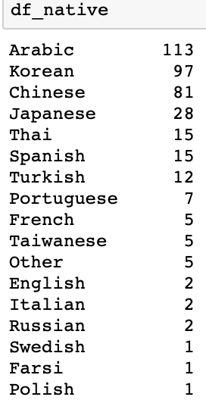
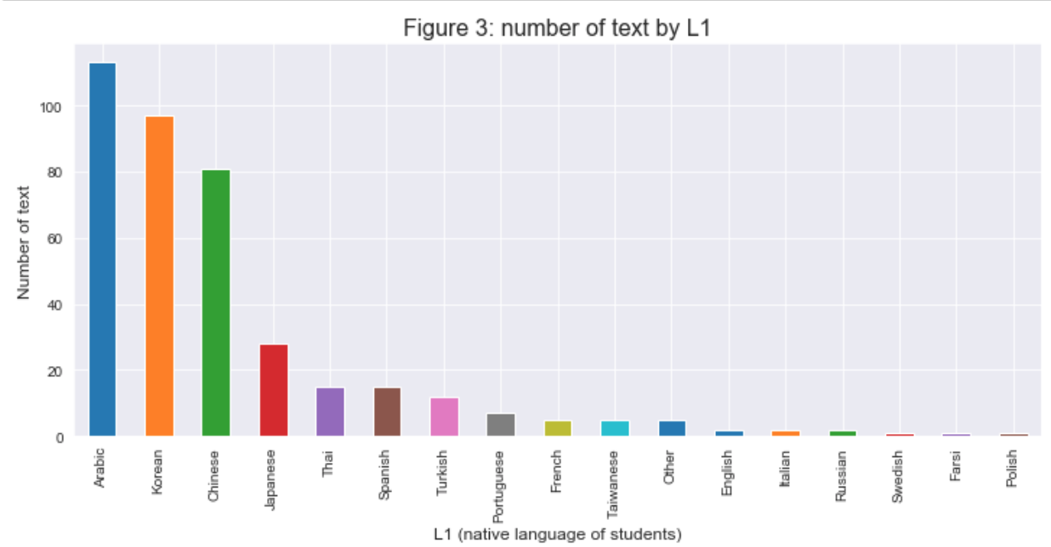
Number of text by native languages

Slide 13
Challenge from data part
There are 49 text files that only contains one word. These are true/false, fill in the blank and multiple choice questions.
315/492 = 64% of total files are under 64.05 tokens.
Arabic, Korean and Chinese are the three main categories of native languages.

Slide 14
Linguistic analysis
By selecting essays between 50 to 600 tokens, there are 172 essays left.
On the other hand, there are many NaN existed in the data. So the number of total available files is 132.

Slide 15
Linguistic analysis - Assessing writing quality
Lexical diversity
Type-token ratio (TTR)
Syntactic complexity
Average sentence length
Vocabulary level
Average word length, % of word tokens in top 1K, 2K, 3K most common English words
Notes:
Without tokens count, because my data is not made up with all essays.
proportion (%) of word tokens

Slide 16
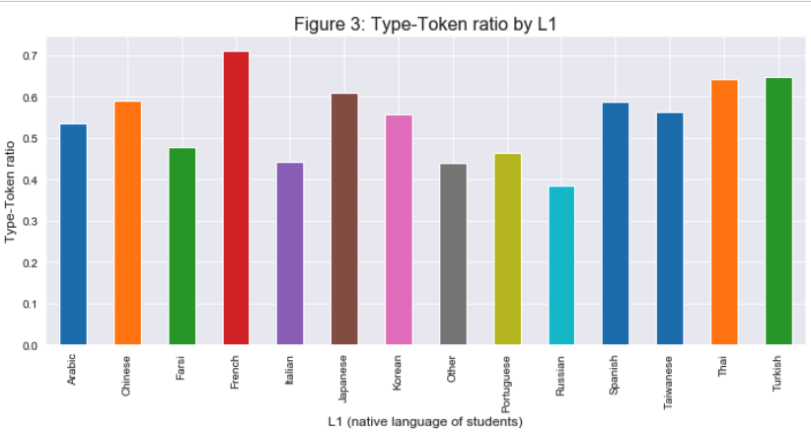
1. Lexical diversity

Slide 17
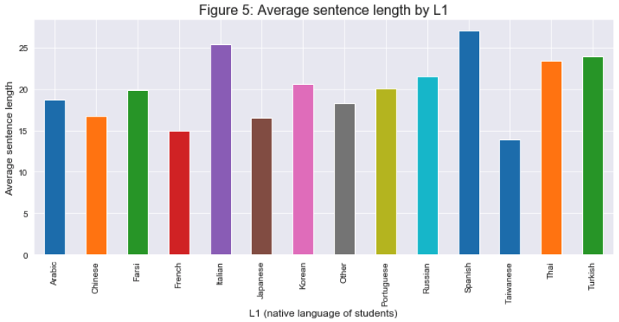
2. Syntactic complexity

Slide 18
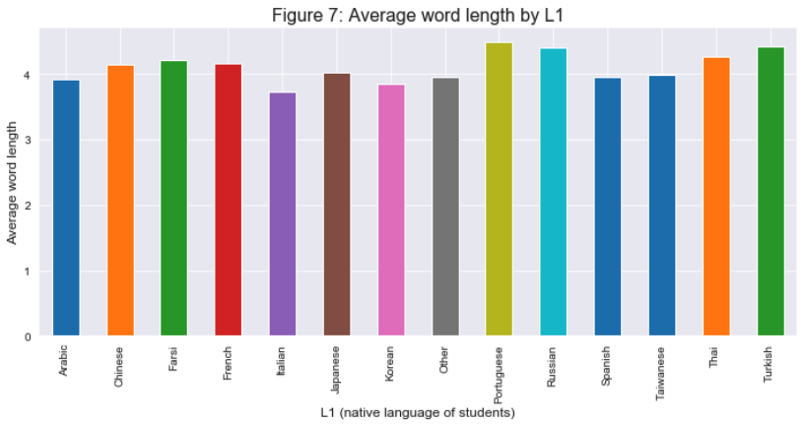
3a. Vocabulary level - Average word length

Slide 19
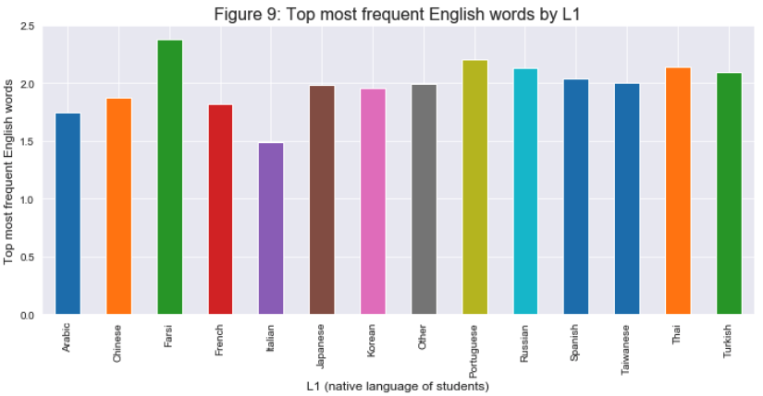
3b. Top most frequent English words

Slide 20
Check out the results on our dataset
Narrow down the scope of the text to essays only.
Select essays between 250 to 400 tokens. There are 22 essays left.

Slide 21
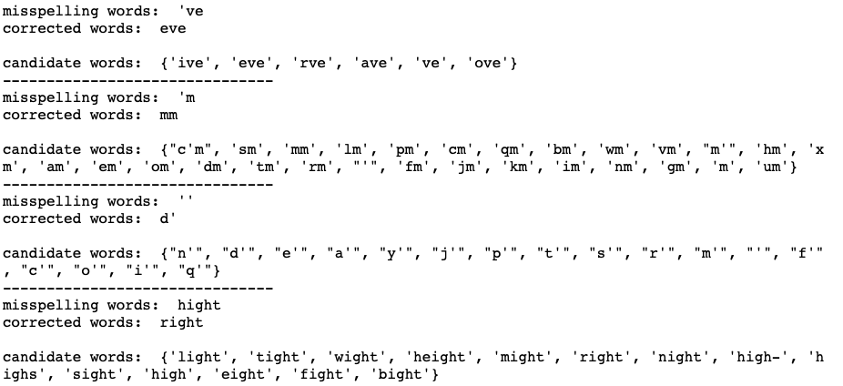

Slide 22
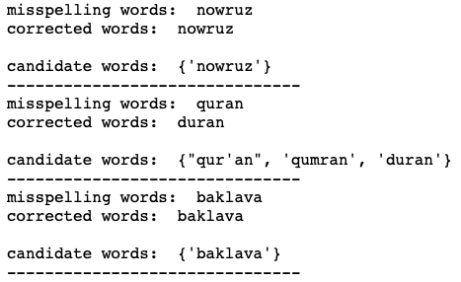

Slide 23
Conclusion
Students may have less error in writing material.
The spell checker performance will be influenced by the dictionary and tokenized words.
This model may be more suitable to the speaking data which are written as the texts.
It may not be proper to replace the data we have now with the words that this spell checker model recommend.
Notes:
1. In general, there are not many misspellings in the data. That may be caused by students have less error in the writing material.
2. The spell checker (by Peter Norvig) still has many restriction on data. The performance will be influenced by the dictionary and tokenized words. We need to choose the proper dictionary corresponding to our data.
3. This model may be more suitable to the speaking data which are written as the texts. The data may contains more spelling error than writing materials.
4. It may not be proper to replace the data we have now with the words that this spell checker model recommend.

Slide 24
Thank you!
Reference:
How to Write a Spelling Corrector (Peter Norvig)
http://norvig.com/spell-correct.html
Bayes' Theorem (Na-Rae Han slides)
http://www.pitt.edu/~naraehan/ling1330/Lecture11.pdf

Slide 25
Q&A

Slide 26
Bayes' Theorem
P(A): the probability of A occurring
P(A|B): Conditional probability
the probability of A occurring, given that B has occurred
P(A, B): Joint probability
the probability of A occurring and B occurring
Same as P(B, A).
If A and B are independent events, same as P(A)*P(B).
If not, same as P(A|B)*P(B) and also P(B|A)*P(A).

Slide 27
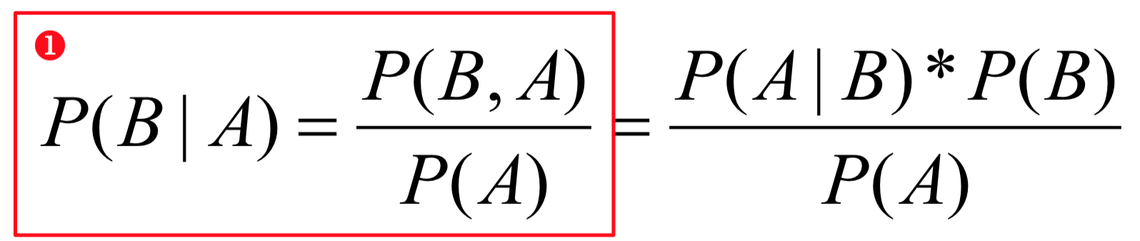
Bayes' Theorem
B: Pitt closing, A: snowing
P(B|A): probability of Pitt closing, given snowy weather
P(B, A): probability of Pitt closing and snowing
1 : the probability of Pitt closing given it's snowing is equal to the probability of Pitt closing and snowing, divided by the probability of snowing.

