Slide 1

Identifying Russian rhyme
David J. Birnbaum
djbpitt@gmail.com
http://www.obdurodon.org
2019-04-11

Slide 2
Outline
About rhyme
Rhyme in verse
Perfect and inexact rhyme
The historiography of the study of Russian rhyme
Research questions
About Russian poetry data
Corpora
Data and findings
Method
Visualization
Analysis

Slide 3
Rhyme helps organize poetry
End rhyme makes lineation and line grouping accessible
Rhyme scheme makes the structure of the poem accessible
Rhyming words contribute to meaning by forming a non-linear ngram
Once upon a midnight dreary, while I pondered, weak and weary, Over many a quaint and curious volume of forgotten lore— While I nodded, nearly napping, suddenly there came a tapping, As of some one gently rapping, rapping at my chamber door. “’Tis some visitor,” I muttered, “tapping at my chamber door— Only this and nothing more.”
Ah, distinctly I remember it was in the bleak December; And each separate dying ember wrought its ghost upon the floor. Eagerly I wished the morrow;—vainly I had sought to borrow From my books surcease of sorrow—sorrow for the lost Lenore— For the rare and radiant maiden whom the angels name Lenore— Nameless here for evermore.

Slide 4
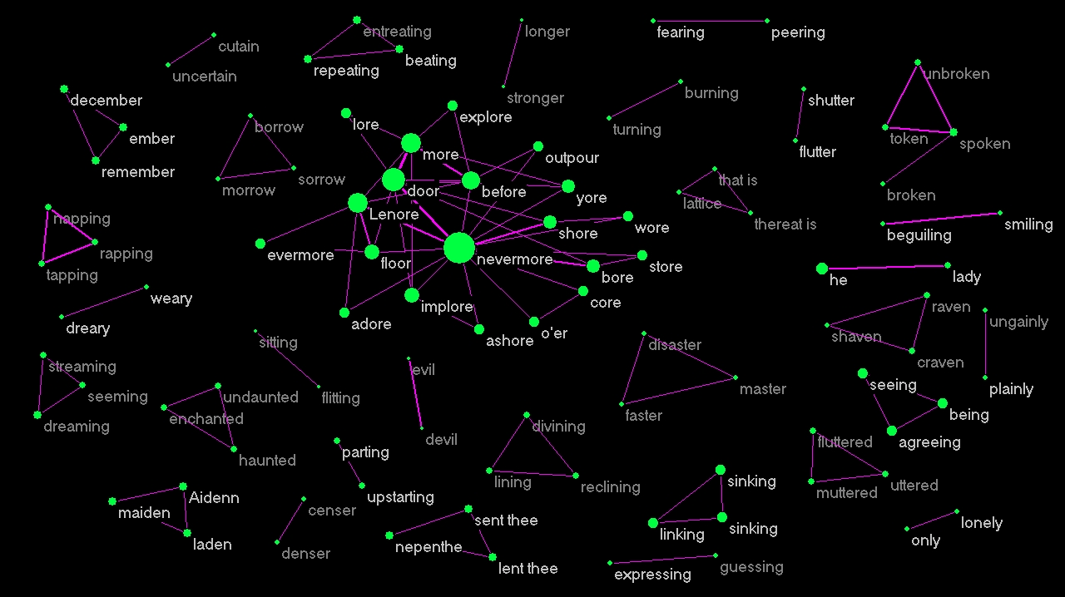
The raven
Notes:
Network graph byTom Lombardi, https://telombardi.wordpress.com/

Slide 5
Perfect and imperfect rhyme
Perfect rhyme: last stressed vowel of the line and all following sounds
Imperfect, approximate, near, slant
Shakespearean sonnet: ABAB CDCD EFEF GG
Shall I compare thee to a summer’s day? Thou art more lovely and more temperate. Rough winds do shake the darling buds of May, And summer’s lease hath all too short a date.
Notes:
Shakespeare, Sonnet #18

Slide 6
What makes a rhyme?
Phonetic similarity
Proximity
Expectation (rhyme scheme)

Slide 7
Russian rhyme historiography
Viktor Žirmunskij (1923): standard for rhyme becomes progressively freer
Valerij Brjusov (1924): the domain of rhyme shifts, and is no longer located entirely in the ending
Mixail Gasparov (1984): taxonomy of rhyme types, e.g., “near vowels (pena-seno, pene-seni), jotation (teni-genij, pene-genij), inexact completion (teni-smenit), inexact substitution (teni, temi)”

Slide 8
Characterizing rhyme
Line (rhyme scheme)
Word (semantic associations)
Segment
Phonetic distinctive features

Slide 9
Topic: research questions (general)
Observation: Certain types of inexact rhyme have been permitted since the early nineteenth century, while others haven’t
Does decomposition below the level of the segment help us distinguish inexact rhyme from non-rhyme?
Can we extend the historiographic chain?
Progressive relaxation of strictures (Žirmunskij)
Extension of domain (Brjusov; segment as environment)
Taxonomy of inexactness (Gasparov; segment as unit of differentiation)
Are there patterns in inexactness at the level of distinctive features?

Slide 10
Research questions: specific
In the early Stalin (interwar) period, provincial poets published newspaper verse in celebration of socialism
Meanwhile, in Moscow the preeminent formal innovator in terms of rhyme and meter was Vladimir Majakovskij (1893–1930)
When provincial poets thought they were writing like Majakovskij, can we formalize what that meant in terms of meter, rhythm, rhyme, and other poetic devices and features?

Slide 11
Russian verse corpora
The J. Thomas Shaw corpus of Golden Age verse (Puškin, Baratynskij, Batjuškov)
The Russian National Corpus (RNC)
Can be queried through a web interface
Raw corpus files can be licensed for research purposes
Markup of data and metadata is inconsistent or incomplete in places
No annotated corpus of non-canonic poetry

Slide 12
From orthography to phonetic features
Identify stress locations
Convert from orthography to broad phonetic representation algorithmically (fifteen-step pipeline)
Identify rhyme zone (clausula)
Hierarachical decomposition
String
Syllables
Onset, nucleus, coda
Segments
Distinctive features

Slide 13
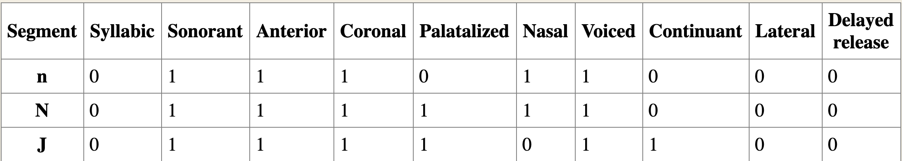
Feature matrix (excerpt)

Slide 14
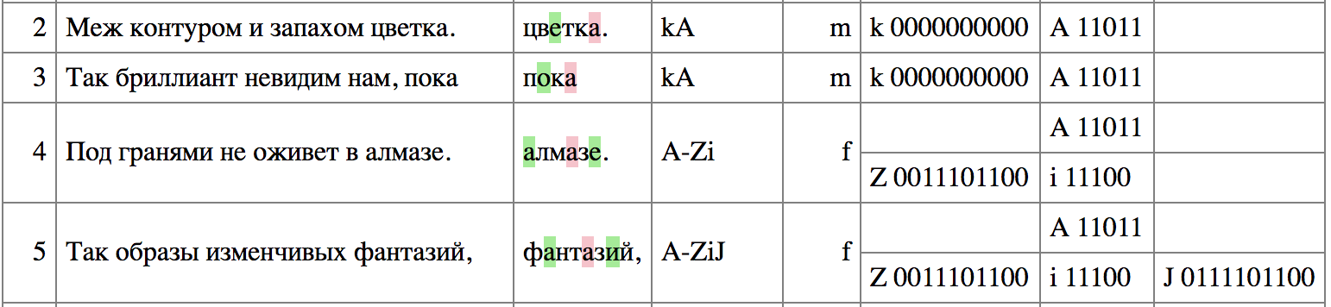
Perfect and imperfect rhyme
Valerij Brjusov, “Sonnet to form” (1913)

Slide 15
Data: visualization

Slide 16
Dat: analysis

Slide 17
Thank you!
Co-investigator: Elise Thorsen
Assisted by: Sam Depretis, Richie Fulop, Erin Harrigan, Kayleen Pickering
Thanks to students and instructors in Ling 1340 for comments and suggestions
http://poetry.obdurodon.org
https://github.com/Data-Science-for-Linguists-2019/russian_rhyme

