Slide 1
FlüchtlingsKrise Sentiment Analysis
Emily Martin
Notes:
Welcome!

Slide 2
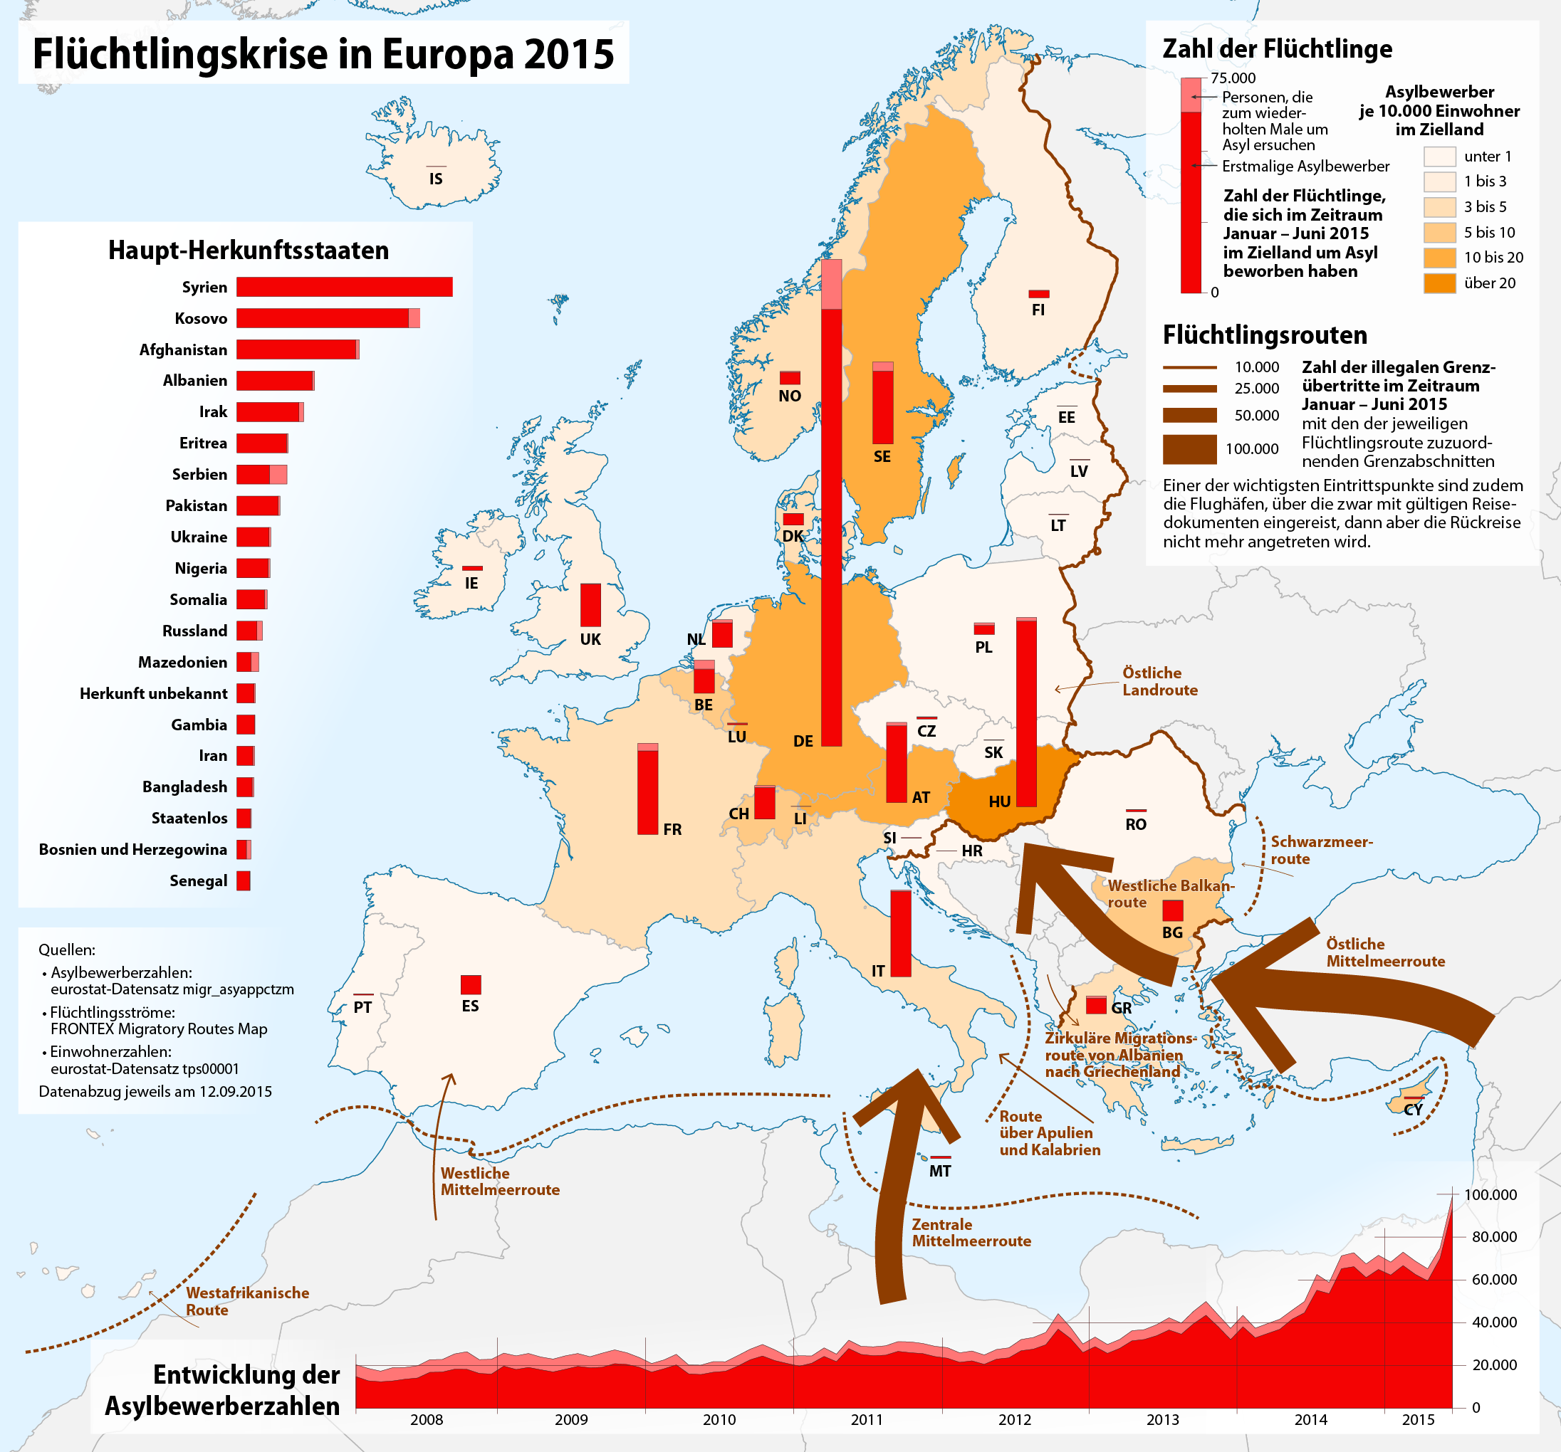




Why this project?

Slide 3
What was my goal?
Scrape newspapers across the political spectrum and do sentiments analysis to see if they differ in sentiments towards refugees.
Possibilities beyond sentiment analysis:
Do different words for “refugee” carry different weights?
Does tense play any role?
German has so many “fun” tenses…
My Hypothesis
More left leaning newspapers will report more positively about refugees than more right leaning newspapers.
Notes:
Subjunctive 2! Indirect speech

Slide 4
My sources:
Die TAZ (Die Tageszeitung): left-wing/green; daily German newspaper with a modest circulation.
Der Süddeustche Zeitung: left-liberal, daily newspaper with a very wide circulation.
Der Zeit: centrist/liberal; one of the largest weekly newspapers in Germany
Junge Freiheit: strong right-wing leanings, small weekly newspaper.
Notes:
Wanted to use FAZ, which is moderately conservative but they said NOOOO

Slide 5


Data Acquisition….
This won’t take
long at all!
What are Na-Rae and Joey so worried about anyway?
Web scraping is
easy!!

Slide 6


Turns out it is not so easy…
COPYRIGHT
Every website is different!
So so different…
“An API? Why have that?”
Many different tools
How much data do you want?
How messy can it be?

Slide 7


The solution!
Der Zeit: Has an API! I collected links and dates, etc, through that, then used Urllib and Beautiful Soup to get the actual article text.
Die TAZ: Pitt has access to their archive (can’t scrape that), so I manually collected 100 links and then used Urllib and Beautiful Soup.
Der SZ: I created 20 URLs of search result pages, then found each relevant link on the page and opened and scraped each one for date and text.
Junge Freiheit: I opened every results page for the search term and filtered by date before collecting URLs to open and scrape.
Notes:
SZ – nice enough to put who search term + date range in url
JF - not as nice

Slide 8
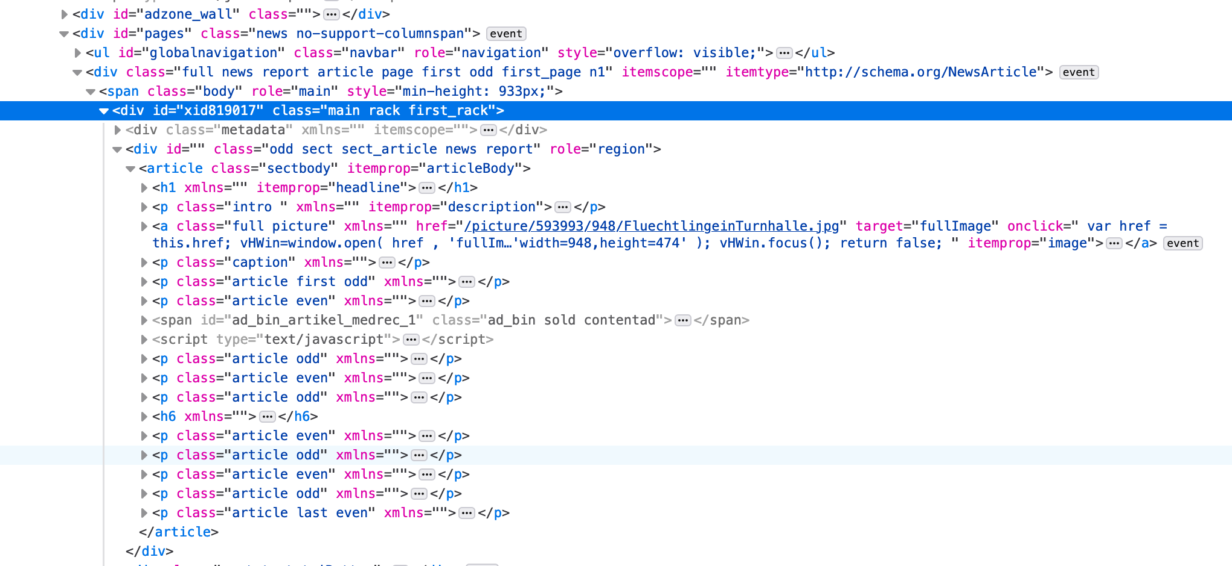
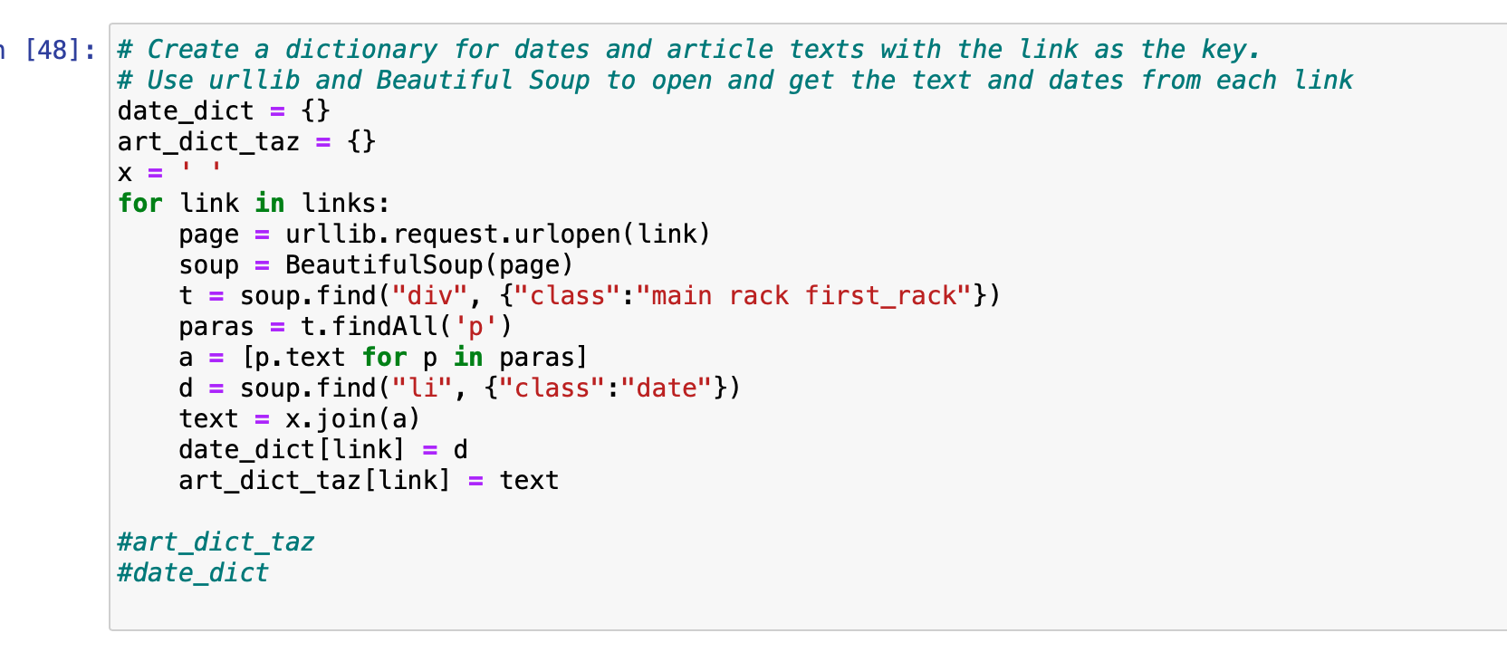

Slide 9
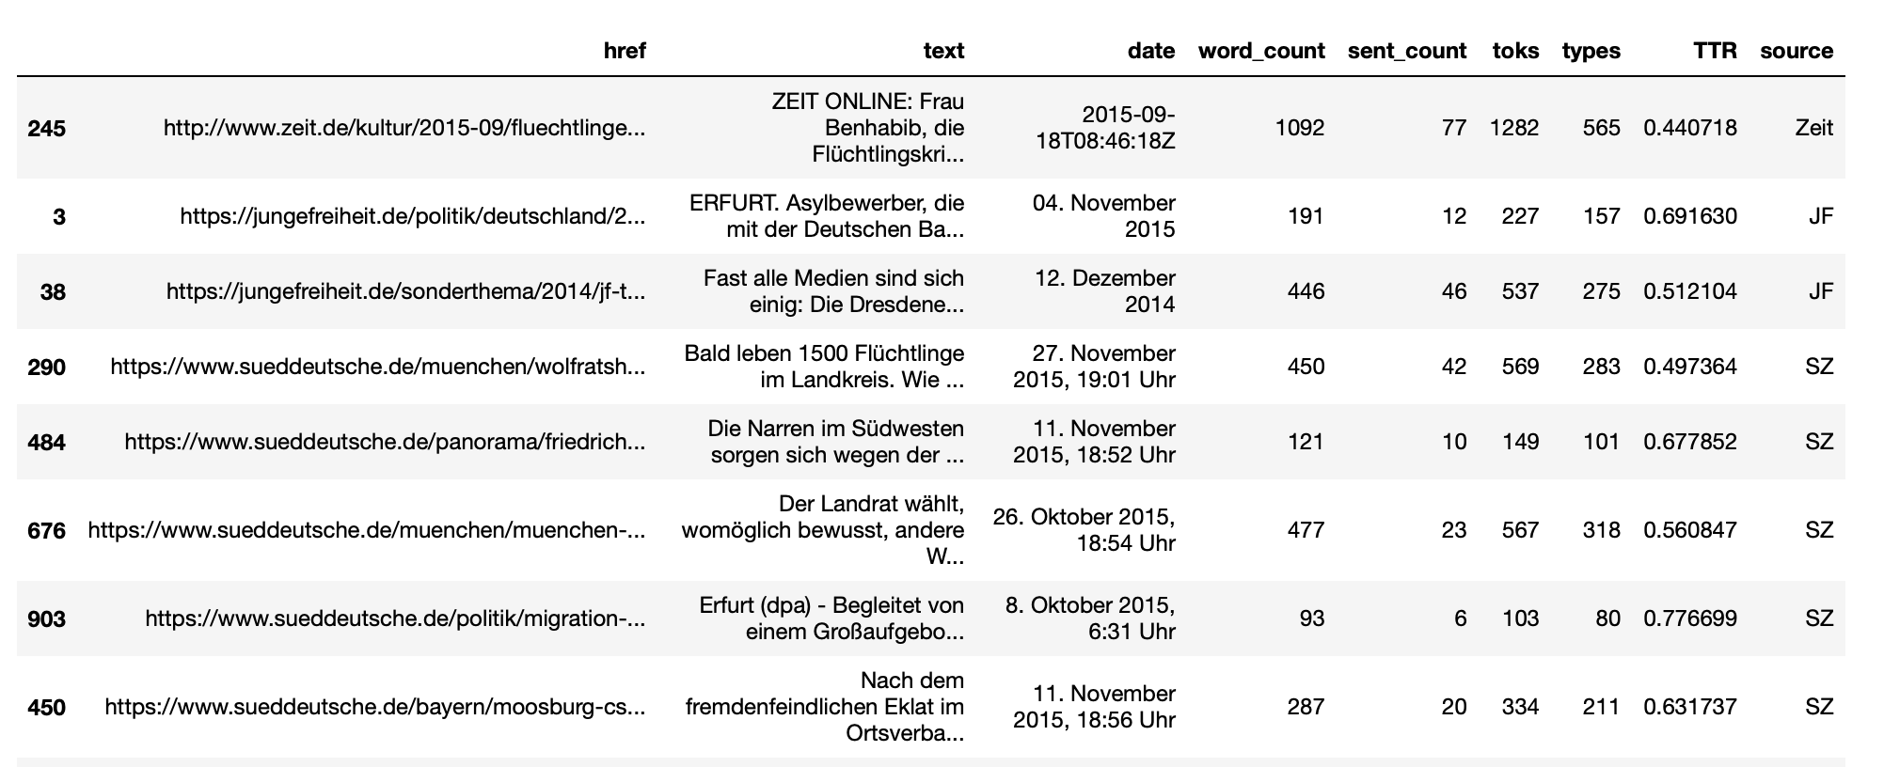
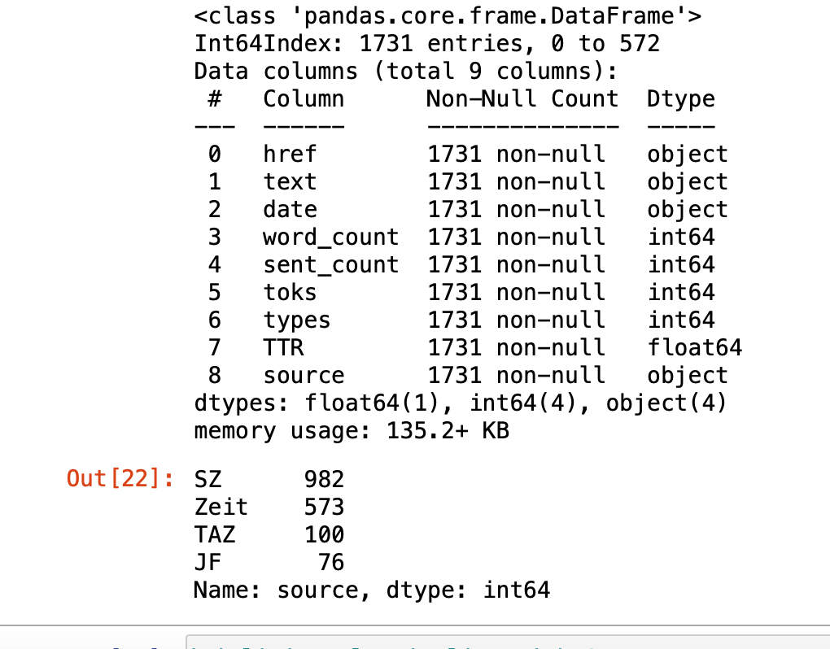
A quick look at the data

Slide 10
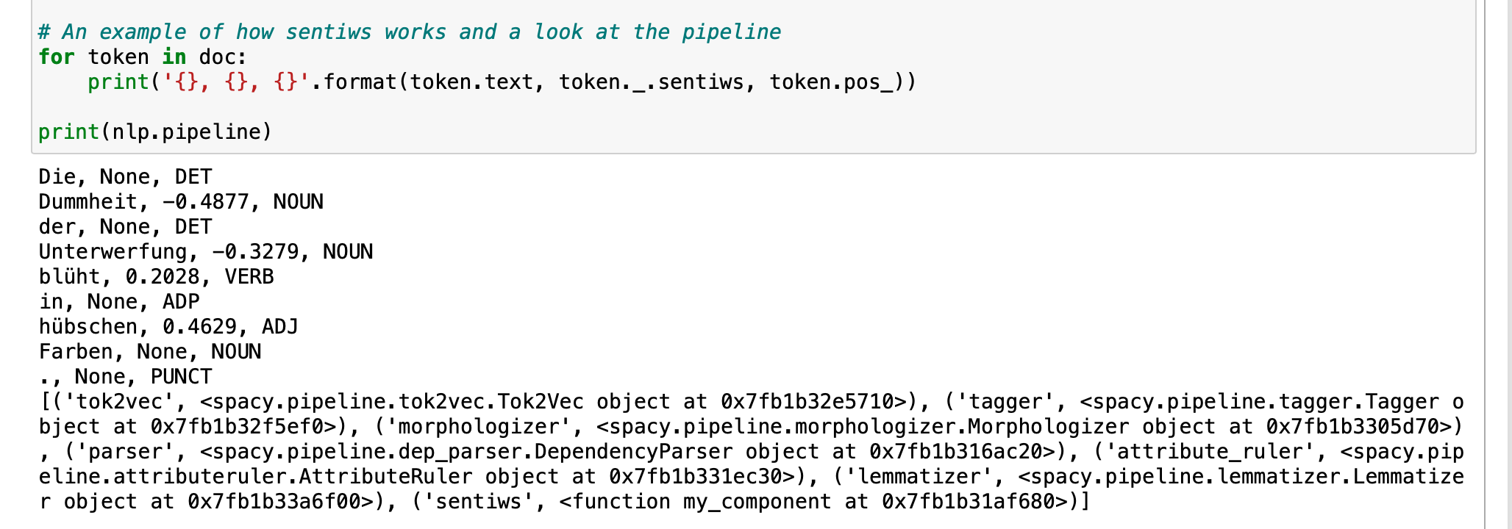
At last... Analysis!
Why SpaCy?
Language processing pipelines, easy to build and customize.
SpaCy speaks German!
Someone built a package for sentiment analysis on German
Sentiws (https://spacy.io/universe/project/spacy-sentiws)
Notes:
Really fast and good for processing batches of texts.

Slide 11
Getting the Sentiment scores
The process:
Passed each text through the pipeline
Removed stop words
If the word had a sentiws sentiment score I collected it
Took the mean of the scores for each article (why not the median?)
If it was <0 -> ‘neg’, if it was >0 -> ‘pos’
Some very important notes:
Flüchtling (refugee) has a negative weight (-0.0048) and it is in all my articles
Interesting in its own right
Most words have a score of ‘None’
‘Migrant’ (migrant/another term often used) does not have a weight from sentiws
Notes:
Flüchtling = one who flees
I would not call it innately negative myself, not used derogatorily (I was the “Flüchtlingslehrerin”)

Slide 12
But What did I find?? Yeah, Get to some plots already…

Slide 13

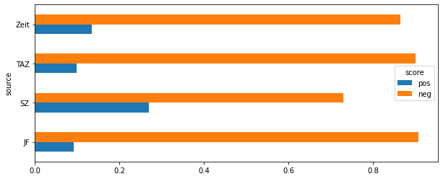
Sentiment by Source

Slide 14
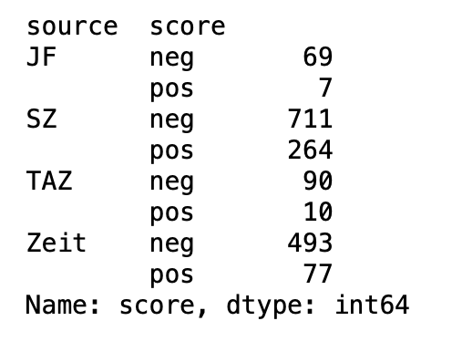
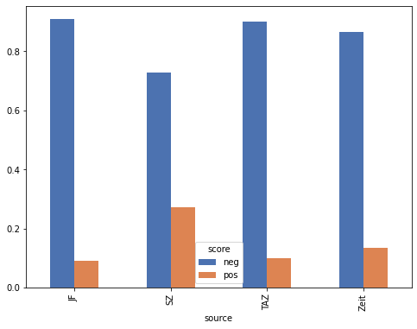
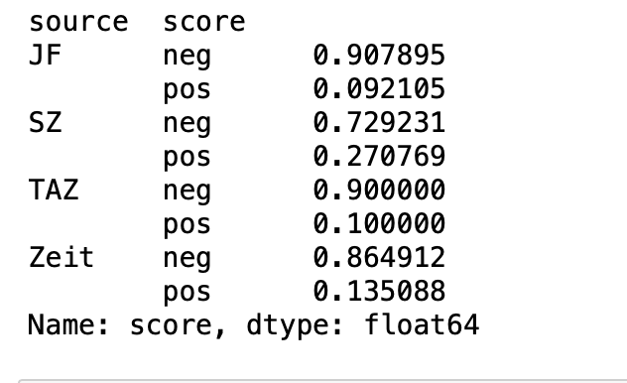

Slide 15
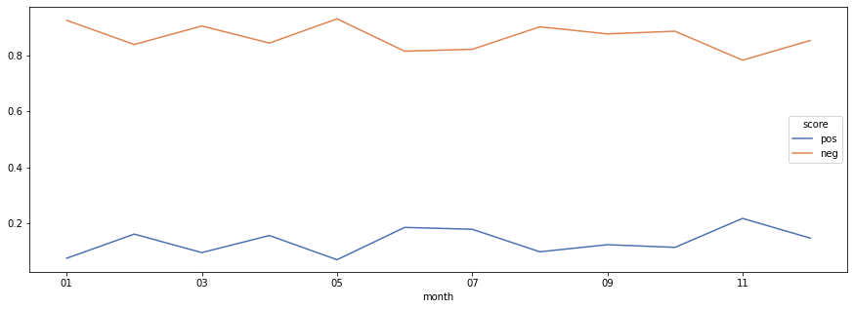
Change in sentiment by month for der Zeit

Slide 16
Notes/further goals
I willingly acknowledge there are flaws and room for improvement in this project
Sentiws may not have been the best tool
The scraping scripts are temperamental
Uneven distribution of data and dates of publication
Data cleaning…
Future goals/possibilities
Sentence based analysis
Tenses?
Over-time analysis for more sources
Try another sentiment analysis tool?

Slide 17

Any questions?
Thank you all ☺
A BIG thank you to everyone who helped me: @Ruth Martin, @Na-Rae, @Joey

