Slide 1
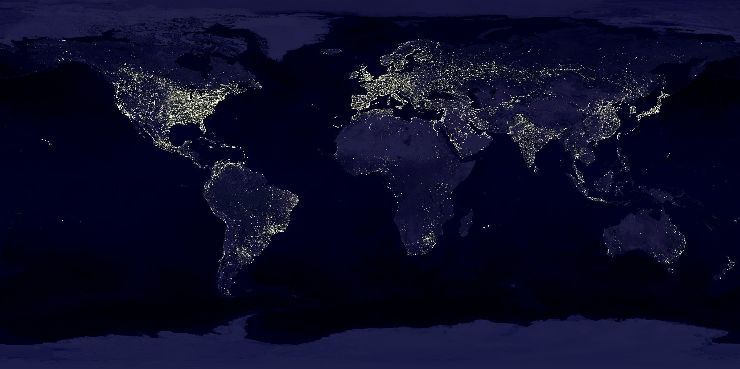
Automatic Language Identification and Relatedness Mapping
Sonia Cromp
Notes:
Pixabay, CC0
https://www.pexels.com/photo/black-textile-41949/

Slide 2
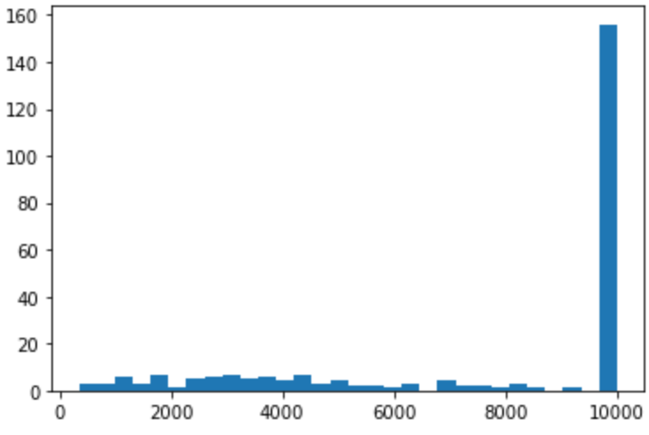
Dataset
248 languages’ Wikipedia article texts
Cleaning: Remove punctuation, non-text characters
Result: Random 500-character “chunks”
Acknowledgement: Compute resources from University of Pittsburgh
Center for Research Computing (CRC) offered through LING 1340 coursework
Chunks per Language

Slide 3
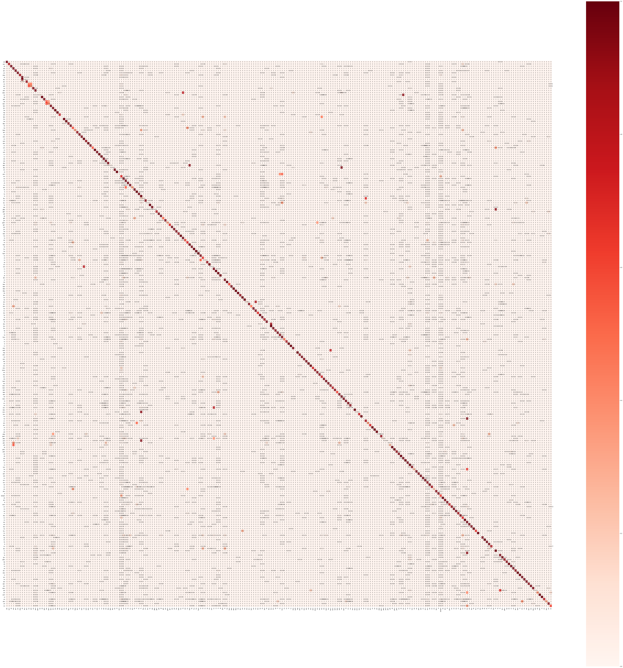
Classification, Clustering
Language Identification
Naïve Bayes on character bigrams
90.6% accuracy
Mapping Relatedness
k-means clustering, k=150
Future Work
Anonymize writing systems
Fine-tune Naïve Bayes, implement Convolutional Neural Net
True Language
Predicted Language

Slide 4
Clusters
Swahili, Tsonga, Xhosa, Chewa, Kinyarwanda (Bantu)
French, Norman, Picard (Oïl)
Persian, Gilaki, Mazanderani (Western Iranian)
Central Bikol, Cebuano, Javanese, Pangasinan, Tagalog (Malayo-Polynesian),
Tok Pisin (English creole)
Alemannic, Ripuarian, Pennsylvania German, Palatine German (High German)
Romanian (Balkan Romance), Silesian (West Slavic), Kotava, Lojban (constructed)

