Slide 1

United Nations Six Way Parallel Corpora Analysis

Slide 2

Hello!
I am Kinan Al-Mouk
This project counts as my submission for my term project in Na-Rae Han’s 2022 Data Science for Linguists course at the University of Pittsburgh.

Slide 3
U.N. Parallel Corpus
https://conferences.unite.un.org/uncorpus
Notes:
The corpus I am working with can be found at this link, it was a whole mess.

Slide 4
Background Info
Why did I choose to study the UN’s Corpus?

Slide 5
The United Nations wants to make technology, software, and intellectual property available to everyone. Open source and free software are great tools to empower people and global collaboration.
Notes:
Although I ultimately want to work in big tech, at Microsoft, Amazon, I do not agree with their morals or their goals. I think corporations will be our demise. The UN gives me some sliver of hope and I would like to continue working with open source data that is accessible for all people for all fields of study. Data is wealth/power.

Slide 6
Parallel Corpus Details
composed of official records and other parliamentary documents of the United Nations
produced and manually translated between 1990 and 2014
purpose of the corpus is to allow access to multilingual language resources and facilitate research and progress in various natural language processing tasks
Notes:
So essentially there is a huge amount of text, language data to work with

Slide 7
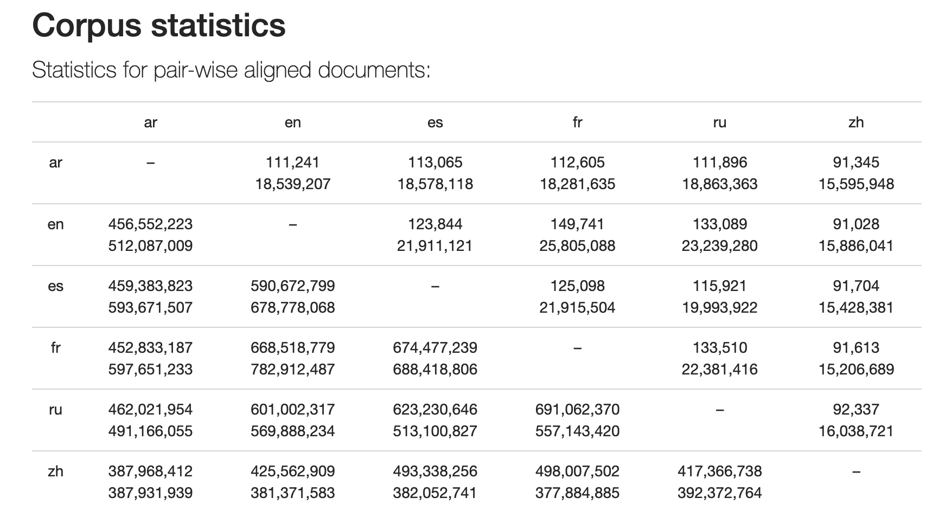
Notes:
This is basically how the data is organized for the pair-wise aligned documents with the UN Parllel Corpus/

Slide 8
Research Questions
How can I use UN data to analyze linguistic features of standardized UN official languages.
How can I measure the way that standard multi language has changed in 25 years.

Slide 9
Data Processing
1
Pandas, NLTK, SpaCy, Juypter Notebook

Slide 10
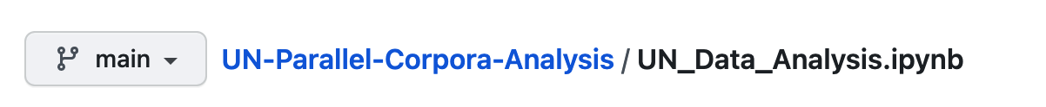
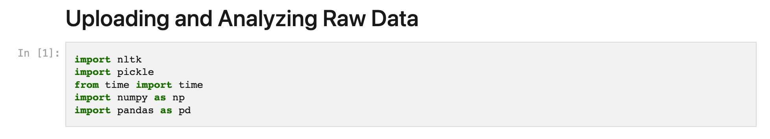
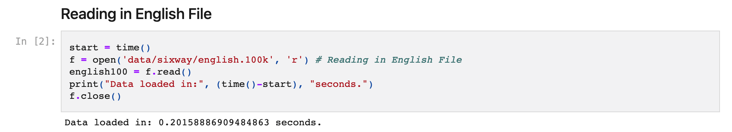
Notes:
So originally I started with this file which can be found in my repo. I started by importing the following and then reading in the files.

Slide 11
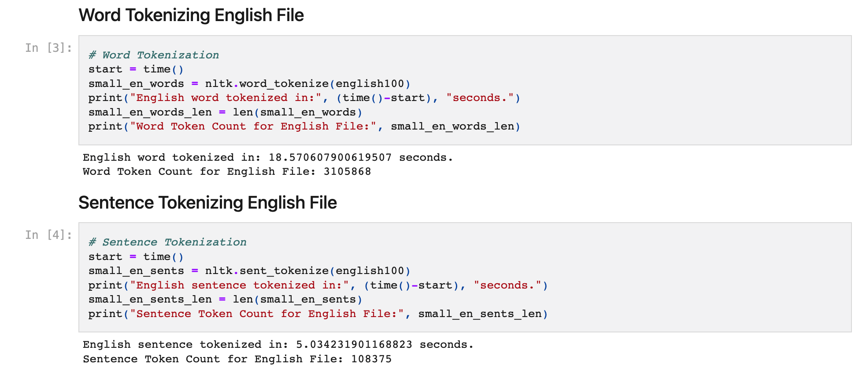
Notes:
I then used nltk to tokenize.

Slide 12
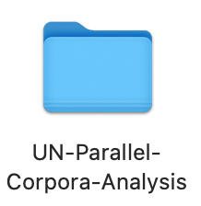

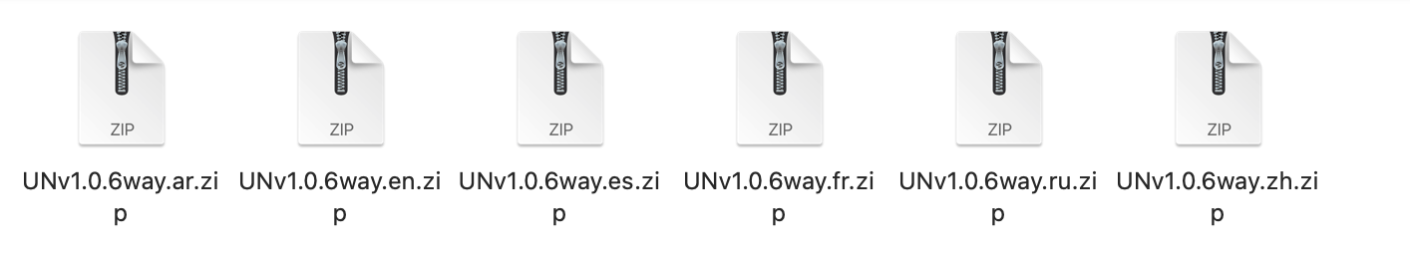
Initial Problems in Processing
File Size
Notes:
However I ran into problems in the beginning. The first being File Size.

Slide 13
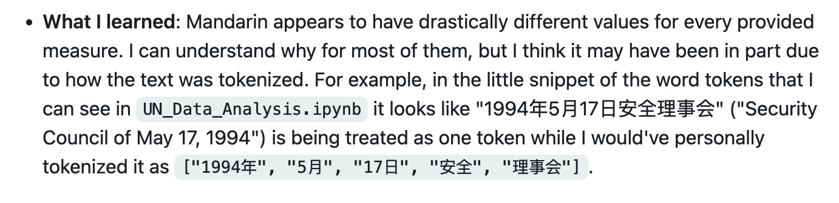
Initial Problems in Processing
NLTK
Notes:
The second being NLTK. Thank you ManHo and Tianyi <33 xoxo.

Slide 14
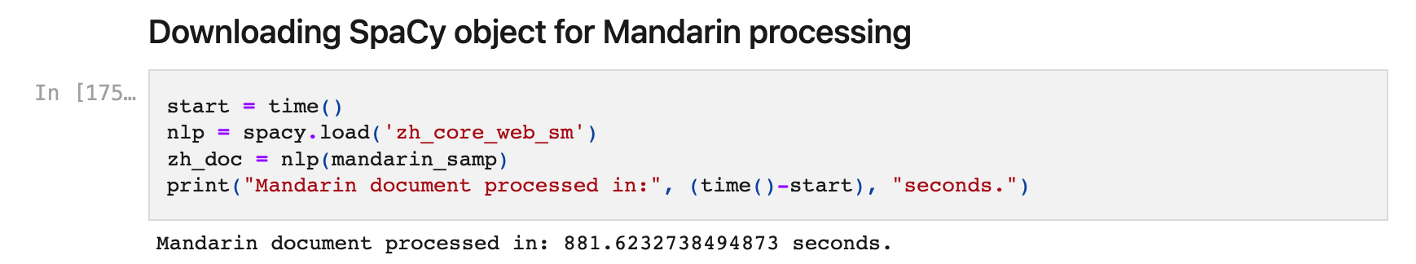
Initial Problems in Processing
Time
Notes:
The third being time. So much time, it was awful. Its so awful.

Slide 15
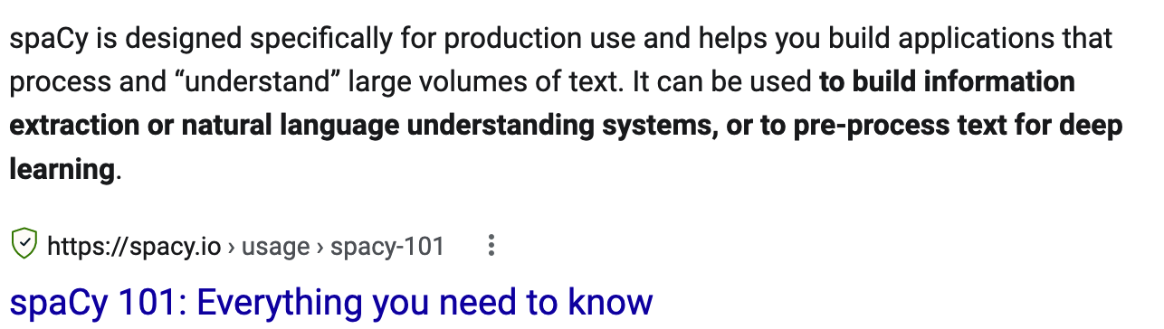
Notes:
I solved this by making a new document. Which can also be found in my repo. I’ll access it shortly to show you guys some things with that file specifically. Instead of using NLTK, I went with SpaCy. Which also raised its own problems. Like text processing, and also there is no way to process Arabic with this file.

Slide 16
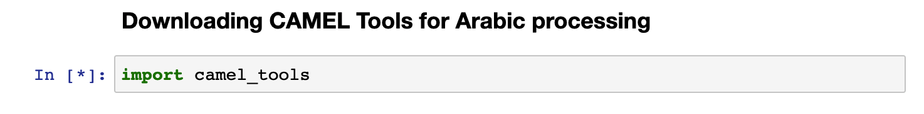
Notes:
No Arabic, so I am using camel tools. Which is designed for Arabic processing. Idk why they named it camel but anyways it also brought up a lot of issues. A lot. So many. Data science is so fun .

Slide 17
UN Data Analysis
2
Linguistics!

Slide 18
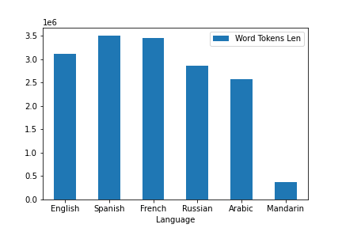
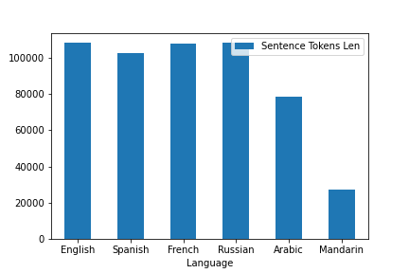
NLTK Data Analysis
Notes:
This is the NLTK, as we can clearly see the mandarin is not being processed correctly it seems.

Slide 19
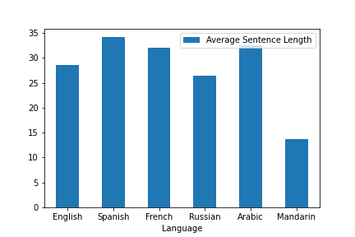
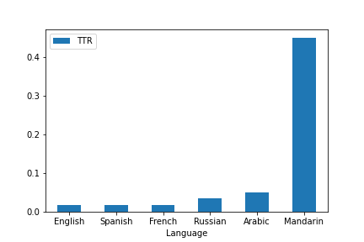
NLTK Data Analysis

Slide 20
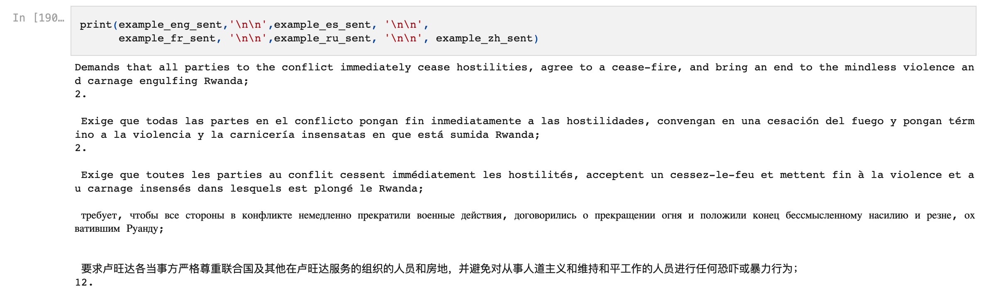
SpaCy Data Analysis

Slide 21
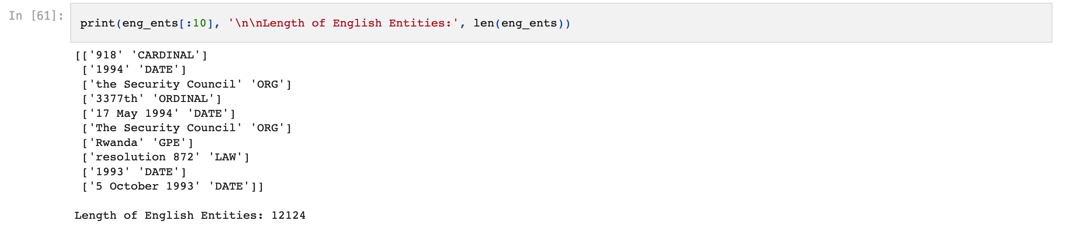
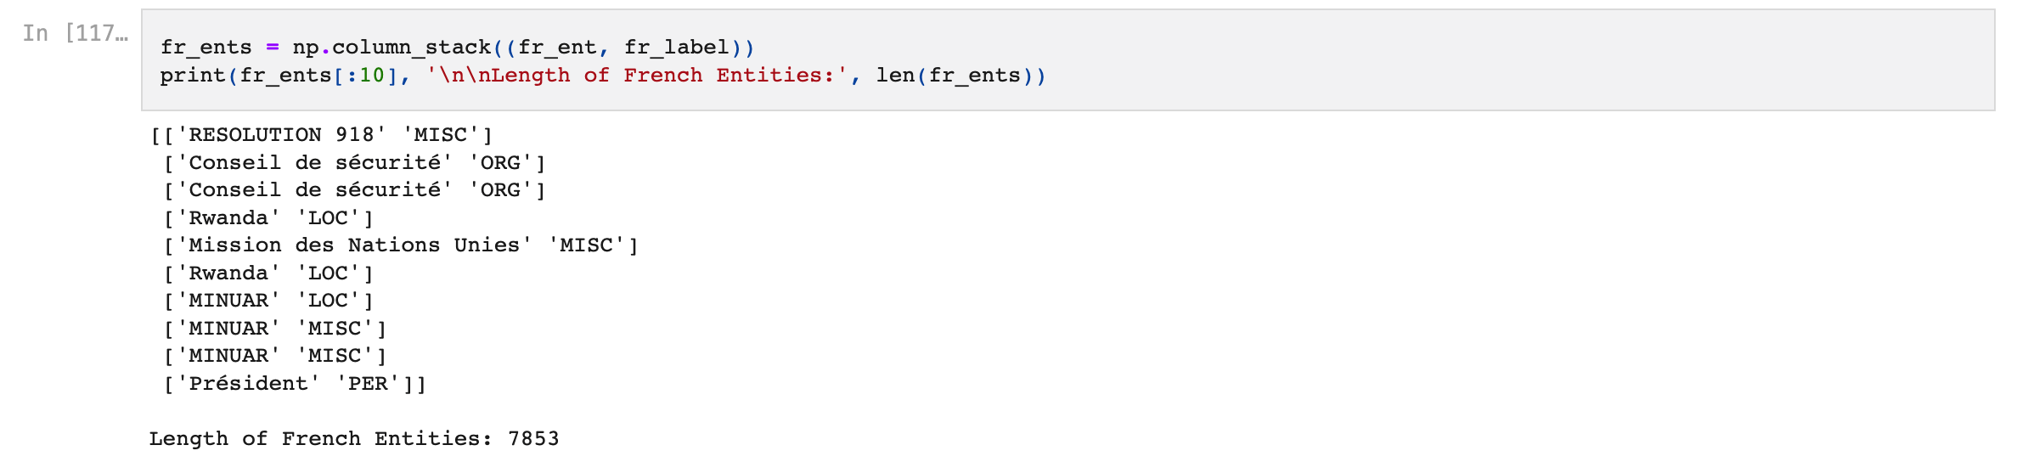
SpaCy Data Analysis
Notes:
Another cool thing is entity labeling! However it varies for language..

Slide 22
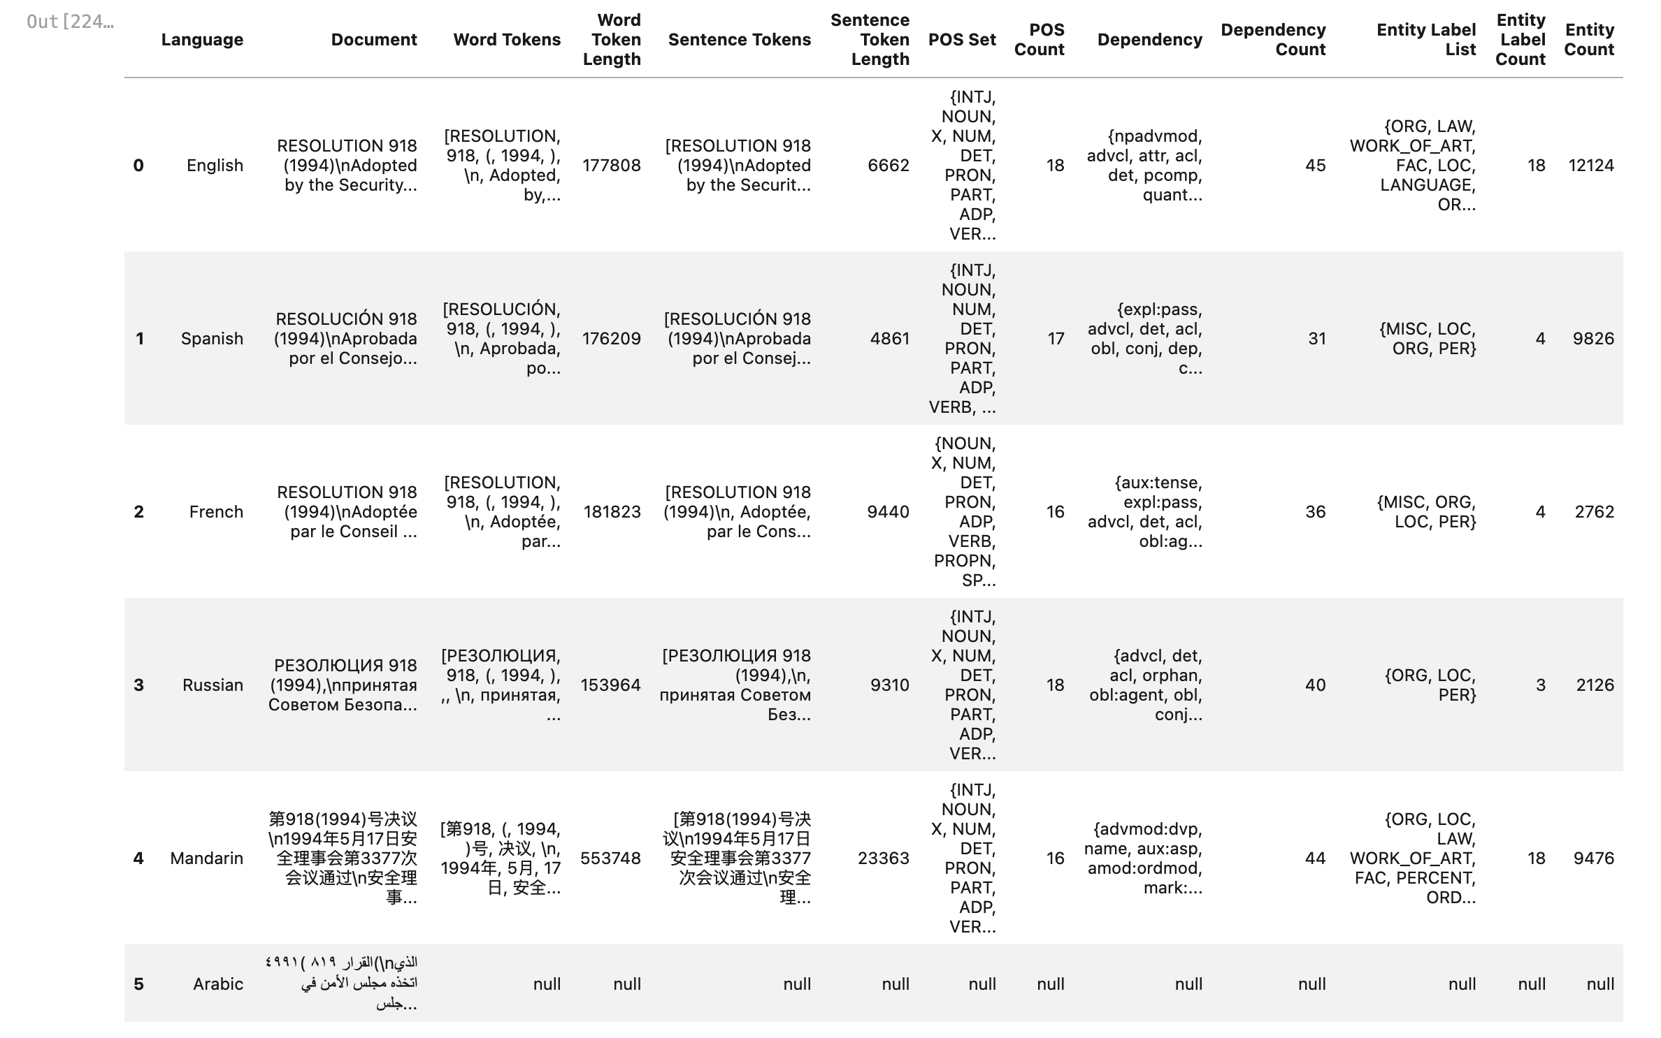
Notes:
Here is where I am at with the data at the moment.

Slide 23
Data is worth a thousand words
If I was able to process this Data file by file, we could make very interesting observations of political events, terminology, and linguistic features for each UN Language since 1990.
I plan to complete this with a better computer soon.

Slide 24
Credits
Special thanks to all the people who helped me learn the skills I needed to accomplish this
Professor Na-Rae Han at the University of Pittsburgh
TA’s Lindsey Rojitas and Sean Steile

Slide 25
Thank You!
Any questions ?
You can find me at
kim47@pitt.edu
LinkedI

Slide 26
SlidesCarnival icons are editable shapes.
This means that you can:
Resize them without losing quality.
Change line color, width and style.
Isn’t that nice? :)
Examples:

