Slide 1
A Linguistic Look Inside Outsider Music
Emma McKibbin

Slide 2
What is Outsider Music?
Notes:
Why outsider music?
I decided to study outsider music because it’s an interest. I had heard about Alexus Brown’s analysis of rap lyrics last year while she was working on it and was very intrigued!
https://github.com/Data-Science-for-Linguists-2021/Rapper_Topic_Modeling
I had tried to pick genres that were closer to my personal music taste (that way I’d have some emotional stake in the project and would want to work on it more often that not), but often, certain bands wouldn’t fit perfectly into a genre together, or the genres were extremely broad and included artists that I was a bit averse to.
I took a step back and went with something that I know a little bit less about, that way any negative emotions couldn’t influence my thoughts about the project! Outsider music was well documented on Wikipedia, and I had seen a video essay about Outsider Music and the exploitation of vulnerable amateur artists on YouTube about a year ago. There are so many facets to this genre, both musical and social. It’s strange that, though the music spans many subgenres, the genre of outsider music does sound cohesive, perhaps because it’s frequently lo-fi and off-key.

Slide 3

Outsider Art
Encyclopedia Britannica describes it as:
“any work of art produced by an untrained idiosyncratic artist who is typically unconnected to the conventional art world—not by choice but by circumstance.”
© ADAGP, Paris and DACS, London. Photo credit: Collection Foundation Dubuffet, Paris
Source Link

Slide 4
Expanded to Music
Outsiders often suffer from mental illnesses
Works characterized as “childlike,” “primitive”
“Not by choice but by circumstance”
Self-taught, self-recorded, and self-produced
Notes:
Musically, shares traits with lo-fi genre
Not intentionally “outsider music”
Willis – Schizophrenia
Johnston - Bipolar
Wild Man Fischer – paranoid schizophrenia and bipolar

Slide 5
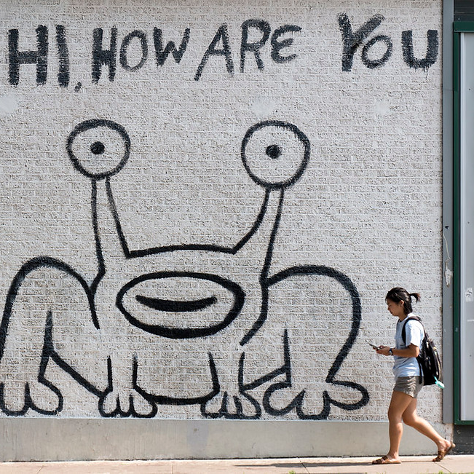
But it’s hard to define…
Photo Source Link
Do these characteristics apply across the whole genre?
And can we determine that computationally?

Slide 6
Initial Research Questions
Looking within Outsider Music:
What linguistic trends exist within the genre?
For example: repetition, nonsense lyrics, word and text length, etc.
Comparing Outsider and “Insider” Music:
What characteristics distinguish outsider music from popular music?
Binary classifier – not included here

Slide 7
The Data

Slide 8
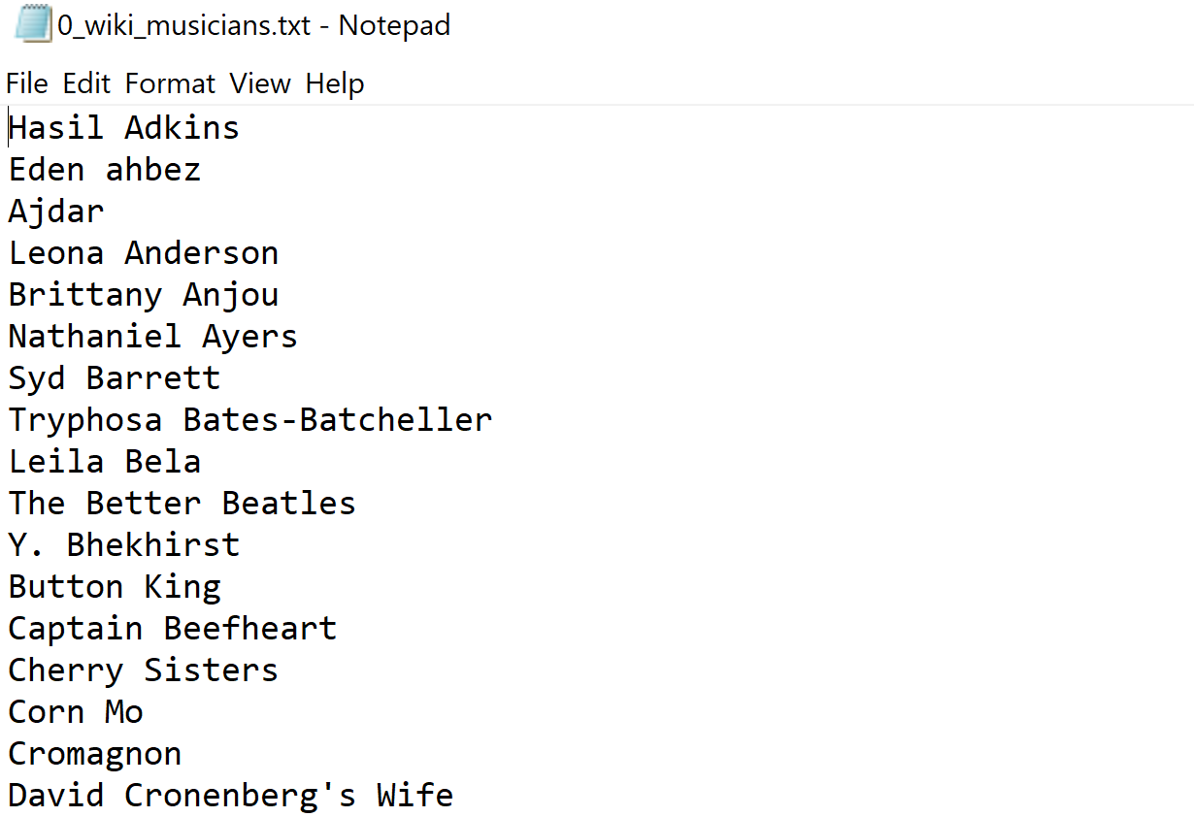
Data Collection Musician List
beautifulsoup4 and requests packages
Retrieved from Wikipedia
111 artists
Manually edited quotation marks and parentheticals
Notes:
Parentheticals were Wikipedia-specific, like (artist), (musician), (rapper)
Some names have quotation marks in them, like “Weird Paul” Petroskey

Slide 9
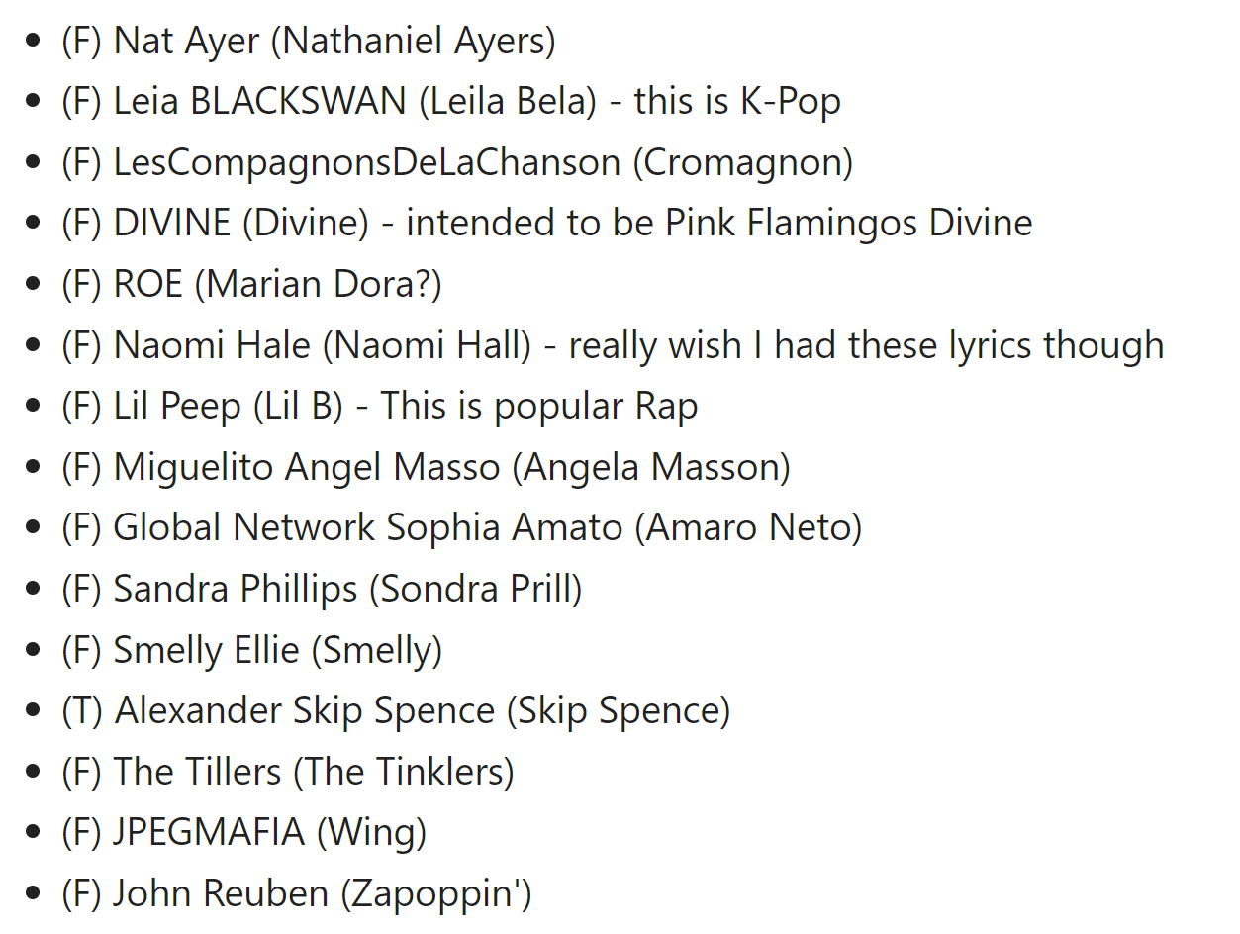
Data Collection Genius Lyrics
John W. Miller’s lyricsgenius package and Genius API
Looped through musician list
Saved as JSON
40 artists were not found
26 not found on Genius
14 misidentified on Genius
In the end, only 63 artists
Notes:
71 artists left after pulling lyrics, but some JSONs were just backgrounds of the artists with no lyrics (i.e., no data).
This leaves us with 63 artists total, which will later be reduced to 62 after some cleaning (one artists was identified as
entirely non-English).

Slide 10
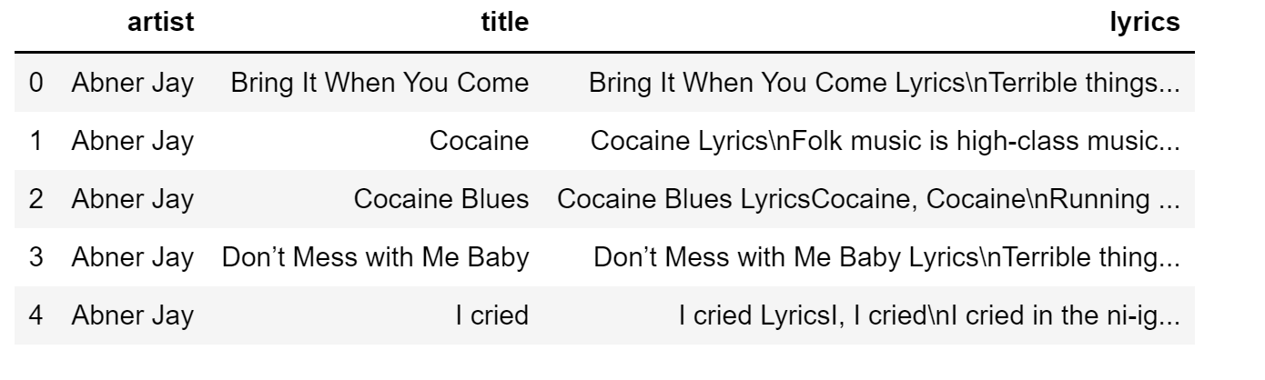
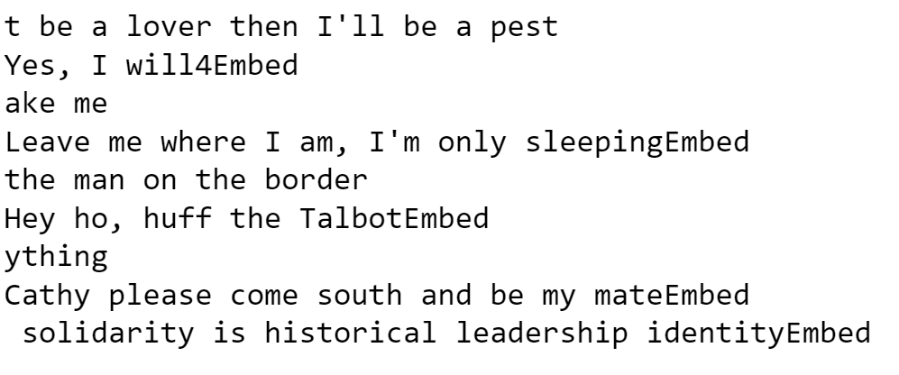
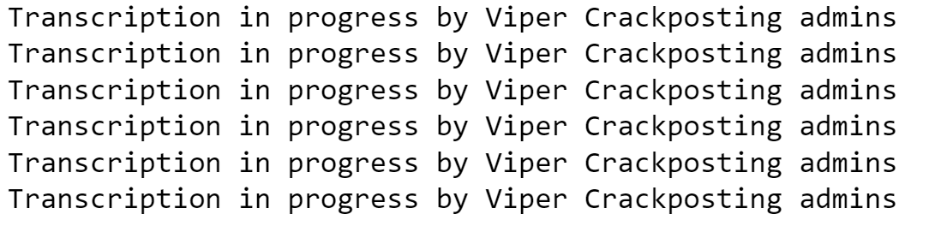
Data Cleaning
Load JSONs to data frame
What needed cleaning?
“Song Title Lyrics”
“\dEmbed”
“Transcription in progress…”
Stripping whitespace
Replace “\n” and other formatting characters
Remove empty strings or “instrumental”
Notes:
Used python functions like “strip” and “replace,” as well as regex
Song Title Lyrics:
Loops through dataframe
Retrieves title string
Concatenates “ Lyrics”
Replace this string with the empty string
Stripping whitespace afterward was meant to adapt to multiple newlines after this “Lyrics” line
1Embed:
Regex to represent any number of digits before “Embed”
Transcription in progress:
Searched for this and found 6 identical lyrics
Just replaced these whole texts with “”
Later found out that similar lyrics are still in the data

Slide 11
What did NOT need cleaning?
Foreign language data.
Notes:
But I realized that this wouldn’t actually be helpful a bit too late, so I do talk a significant amount about language detection/identification in my analysis notebook.

Slide 12
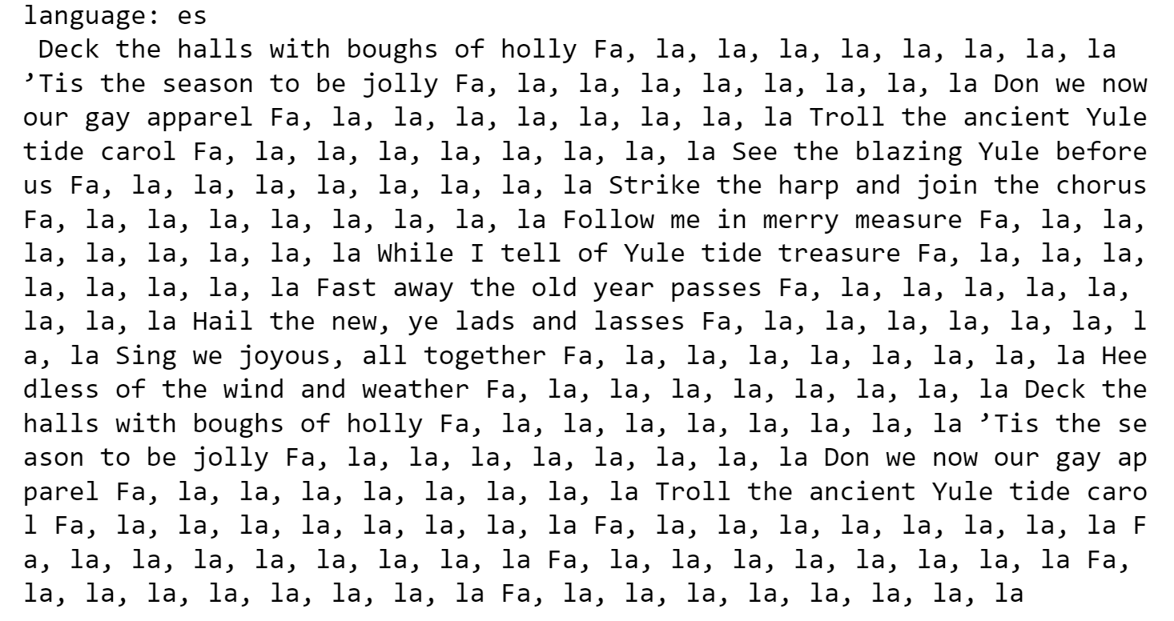
Language Detection!
Rudimentary Version:
Detecting characters that can’t be encoded in ASCII
Bad precision and recall
Found formatting errors
spaCy Language Detector:
Better at guaranteeing a fully English dataset
However, many false positives →
Removed Swedish and Japanese
Notes:
In the end, I didn’t really use the language detection that I had spent so much time on. I was able to definitively remove anything that spaCy determined what Swedish or Japanese by visually scanning the data for those 2 languages.
Otherwise, because of the number of “nonsense” words in these lyrics, it’s difficult to filter out the non-English (but still a real language) lyrics without manually checking them all.

Slide 13
Analysis

Slide 14
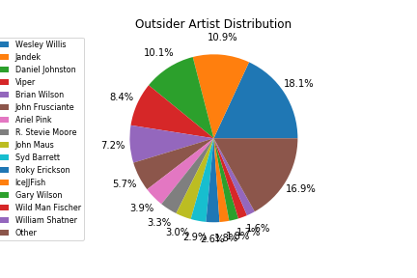
Beginning Analysis
3,102 lyric entries
62 unique artists
561 songs by Wesley Willis (18.1%)
Notes:
Please ignore the percent formatting. I’m having trouble understanding Matplotlib.
Note the major skew toward 4-5 artists!

Slide 15
Popular Music
Using Kaylin Pavlik’s “50 Years of Pop Music”
Billboard Hot 100 Dataset
Caveats:
Only the most popular music from many subgenres
Different cleaning schema
Apostrophes and newlines

Slide 16
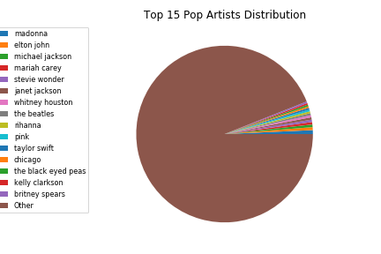
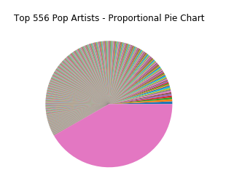
Beginning Analysis Popular Music
15 artists represent 6% of the data
4,627 lyric entries
2,335 unique artists
33 songs by Madonna (<1%)
No one artist dominates this data.
Top 24% of artists represent 58.3% of the data
Notes:
These graphs are intentionally horrid (or we’ll go with that, at least). They are intended to illustrate just how massive this dataset is.
Ideally, my own dataset would match this distribution and cleaning style, but given the time and resources I have, comparing these sets as-is is my best option.

Slide 17
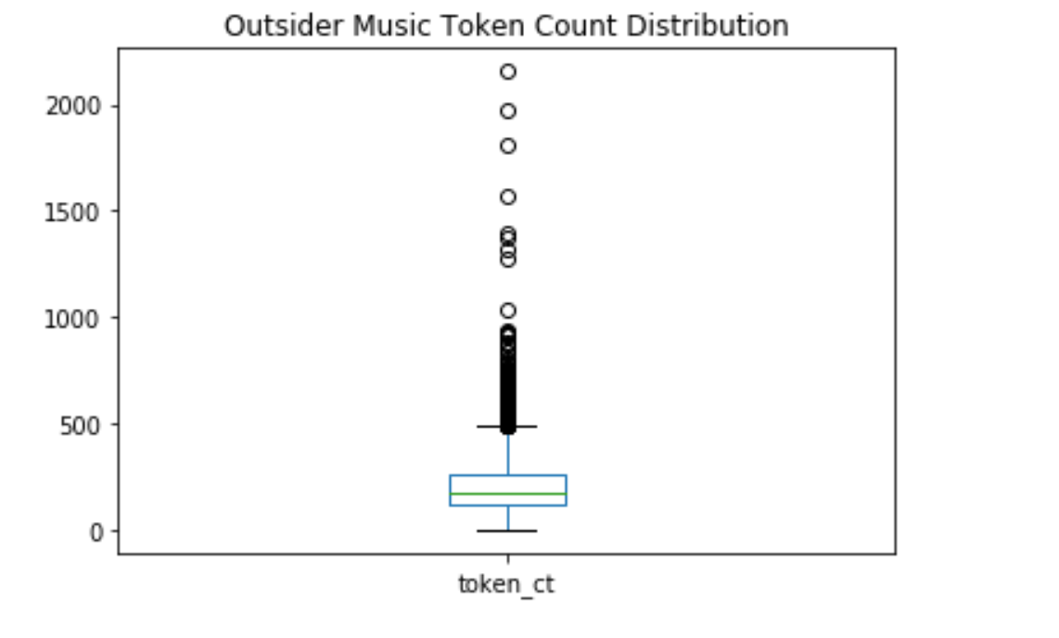
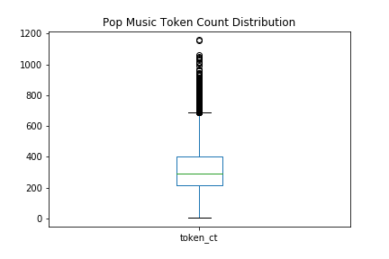
Token Count Distribution
Note scale differences*
OUTSIDER MUSIC
POPULAR MUSIC
Mean = 215
Min = 1
Max = 2155 (30 minutes long)
50% of data within 119-267 tokens
Mean = 330
Min = 5
Max = 1158
50% of data within 214-403 tokens long

Slide 18
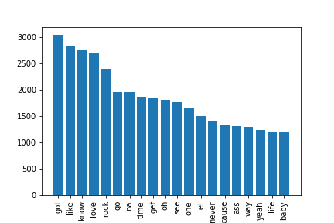
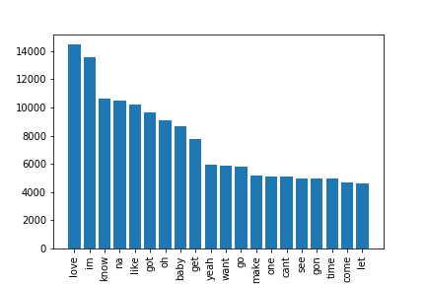
Most Common Words without stopwords
OUTSIDER MUSIC
POPULAR MUSIC
Notes:
A lot of similar most common words, just in different orders.
Purple arrows: “love,” distributed very differently
In pop, love is the #1 most common non-stopword
In outsider music, it’s #4, with #1 being “got” (potentially a missed auxiliary verb)
Orange arrows: #5 “rock” and #16 “ass” demonstrate skew in outsider data
Green arrows: “im” and “cant”
Pop data is cleaned differently – no apostrophes
Even after editing the stop words, I didn’t conclusively remove all stopwords from the most common words list

Slide 19
So far… OUTSIDER vs. POP
There is some disparity in average text length
Notable difference in most common words, BUT:
The artist distribution is very different for the two datasets
Pop is more representative
Outsider is more idiosyncratic and skewed

Slide 20
The Faces of Outsider Music

Slide 21
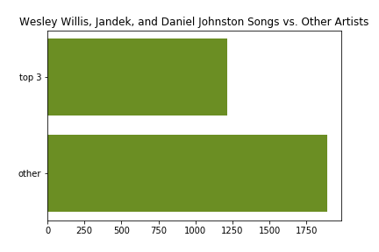
The Top 3 Artists
Three very well-known artists in the genre with idiosyncratic styles:
Wesley Willis
Jandek
Daniel Johnston
In the cleaned dataset, these 3 artists make up nearly 40% of the data.
Notes:
Wesley Willis is sort of absurdist, very repetitive
Jandek’s songs are occasionally instrumental, but more blues/folk-based. Written almost like poetry. Some are incredibly long pieces.
Daniel Johnston’s music is very simple. He conveys feelings very bluntly.

Slide 22
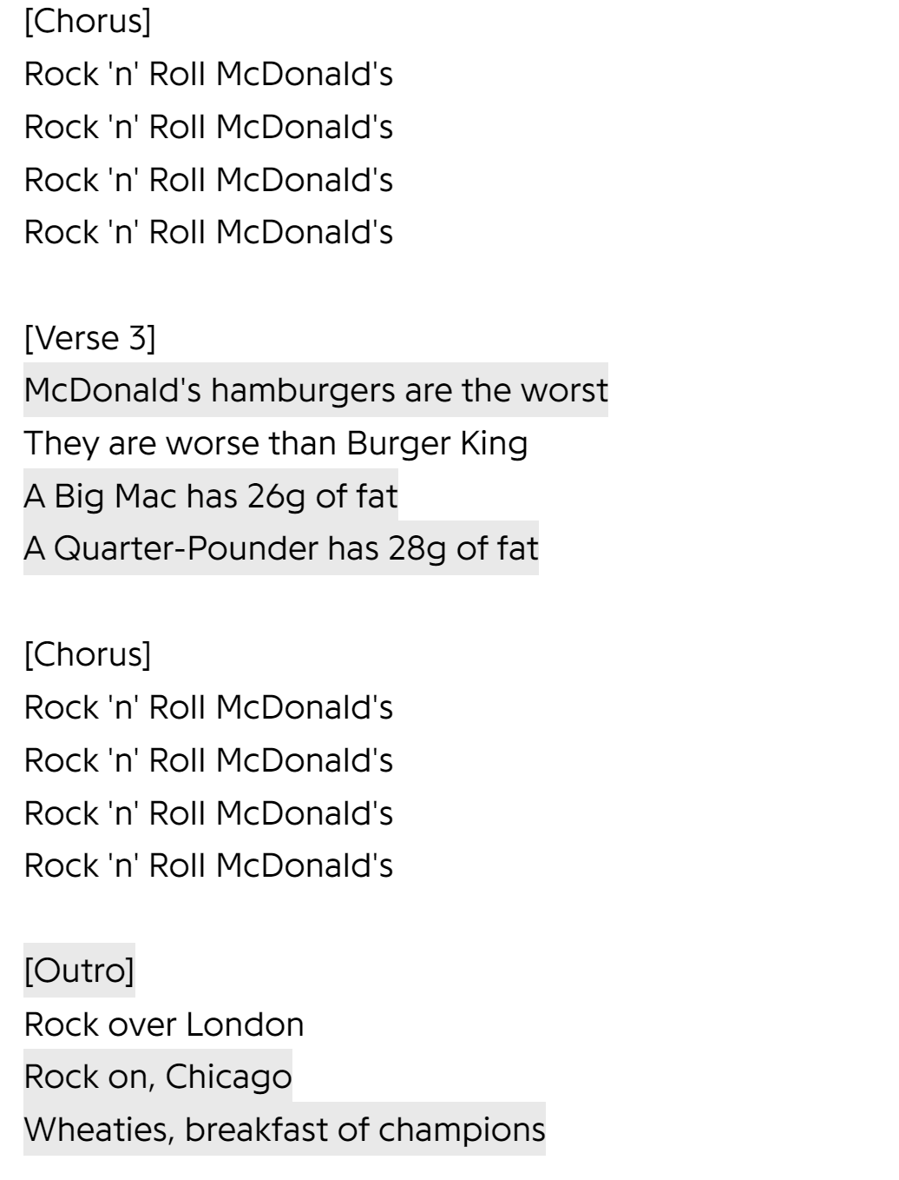
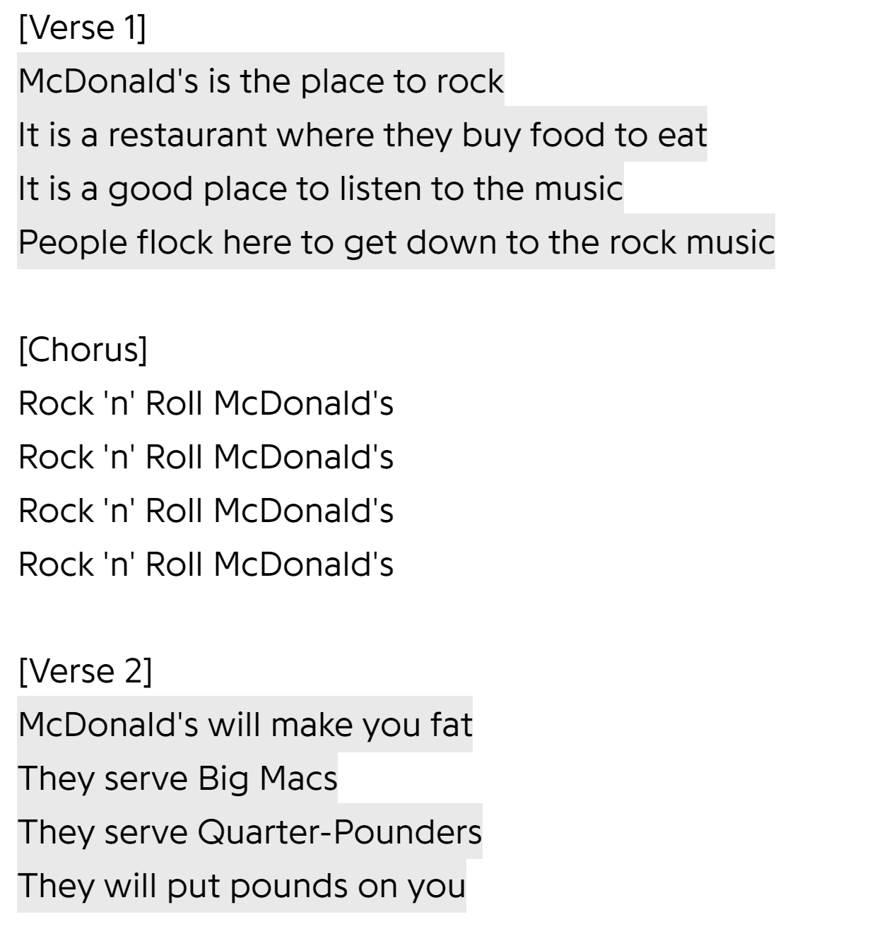
Rock N Roll McDonalds Wesley Willis
Lyrics screenshotted from Genius.com
Notes:
That’s 16 “rocks” in one song, and this is on an album with “rock” in the title.

Slide 23
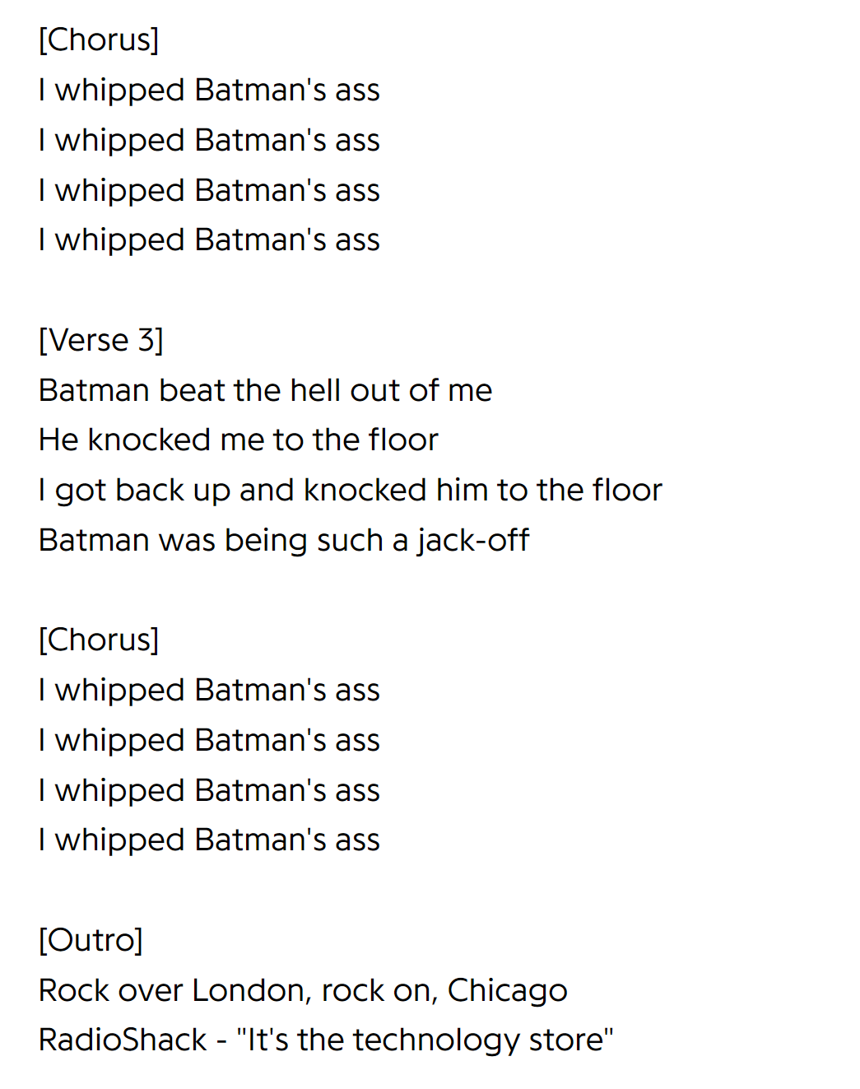
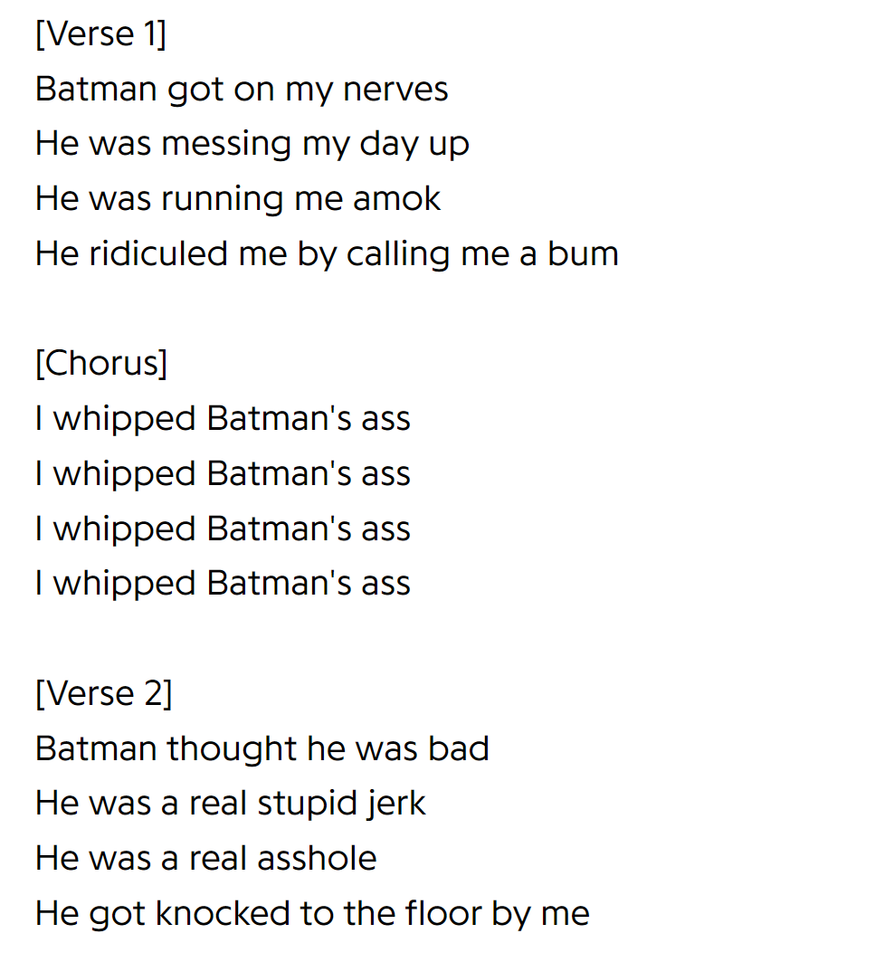
I Whipped Batman’s Ass Wesley Willis
Lyrics screenshotted from Genius.com
Does this look familiar?
Notes:
Wesley Willis’s lyrics are extremely repetitive, and though he has a large body of music, it all follows a fairly similar pattern.
Note the verse, chorus, verse, chorus pattern, where every chorus is the same line repeated 4 times.
Even though this song isn’t “rock and roll” related, it still ends with a “rock” line, then an advertisement tagline

Slide 24
What’s the Problem?
Perhaps if we were to only look at the top artists, existing generalizations would apply.
But what about IceJJFish?

Slide 25
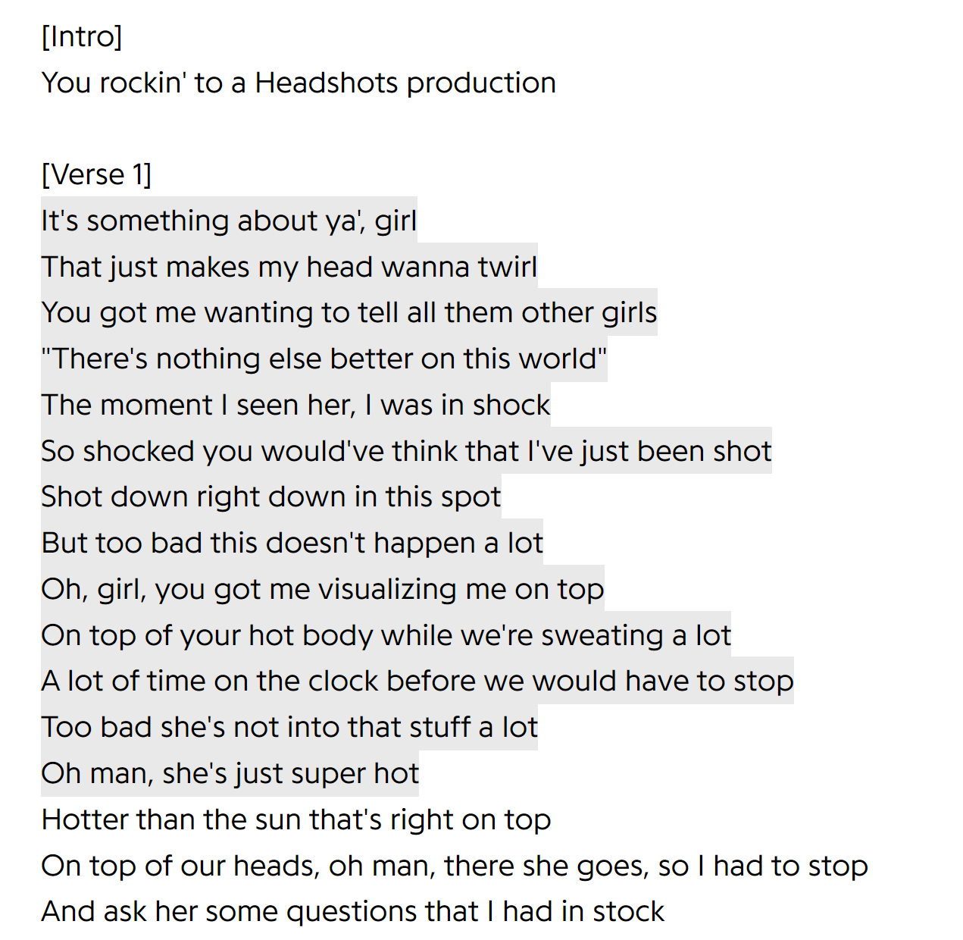
On the Floor IceJJFish
Lyrics screenshotted from Genius.com
Represents only 1.8% of the data
Many other artists with low representation
Totally different subgenre
Notes:
Only an excerpt of the lyrics

Slide 26

In the Future…
Photo Source Link
Excerpt at least the Wesley Willis data
Analyze the possible effects of skew in the full dataset
Re-analyze the dataset with new distribution
How much do the trends change with less of a skew toward Willis’s music?

Slide 27



Thank you!
Feel free to ask any questions

