Slide 1
ESL Syntactic Analysis
Tianyi Zheng

Slide 2
Background
ESL, PELIC, and Project Goals

Slide 3
What is ESL?
English as a Second Language (ESL) is the instruction of English to native speakers of other languages
Classes may be comprised of speakers from a variety of native languages (L1s) and proficiency levels
There is a lot of research delving into second language acquisition, and more specifically ESL

Slide 4

What is PELIC?
PELIC is a corpus of writing and speech samples from students at Pitt’s English Language Institute
Managed by Drs. Alan Juffs, Na-Rae Han, and Ben Naismith
Consists of 7 years’ worth of data, specifically data from students over time (longitudinal data)

Slide 5
Project Goals
My goal for this project was to analyze variations in syntactic complexity in PELIC
How does the students’ syntax vary between proficiency levels?
Are there significant differences in syntactic complexity between students with different L1s?
I tried to investigate these questions by performing statistical analyses on the PELIC written data

Slide 6
Measures of Syntax
I decided to investigate 7 6 syntactic measures:
Number of T-units per sentence
Mean length of T-units
Number of clauses per T-unit
Mean length of clauses
Number of prepositions per clause
Number of subordinating conjunctions per clause
Number of discourse markers per clause

Slide 7
What is a T-Unit?
A T-unit is defined to be an independent clause and all of its associated dependent clauses
Examples:
Because this sentence has one independent clause, it has 1 T-unit
This is a compound sentence with 2 independent clauses, so it has 2 T-units

Slide 8
The Data
Exploration and Visualization

Slide 9
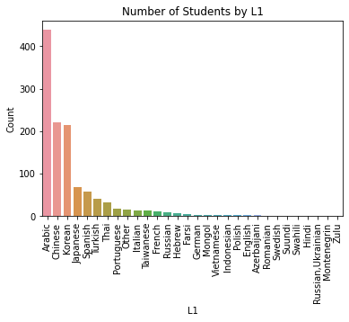
Overview of PELIC Data
The written corpus consists of 46,204 student essays
Over 30 L1s represented
L1 counts vary drastically
Arabic and CJK students dominate the dataset

Slide 10
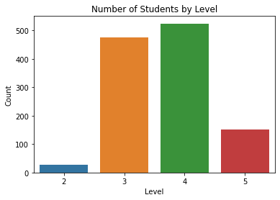
Overview of PELIC Data
The students’ proficiency levels ranged from low-intermediate to advanced
Proficiency levels:
2: CEFR A2 – B1
3: CEFR B1
4: CEFR B1 – B2
5: CEFR B2 – C1
Most students were at a mid-to-high-intermediate level

Slide 11
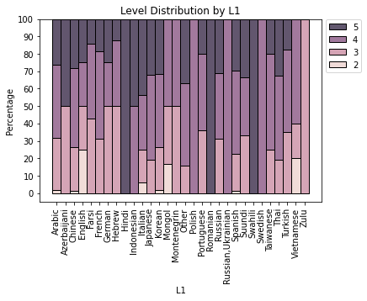
Overview of PELIC Data
When broken down by L1, the distribution of proficiency levels vary drastically

Slide 12
Generating the Measures
Where the pain really begins

Slide 13

What is TAASSC?
The Tool for the Automatic Analysis of Syntactic Sophistication and Complexity (TAASSC) is a program that can calculate many numerical measures of syntactic complexity for writing samples
It takes in individual text files and outputs their measures in a CSV file

Slide 14
The Bottleneck
I wrote every essay to a separate text file and ran TAASSC on those text files (or at least I tried)
It turned out that TAASSC is ludicrously inefficient
When I had tried to process the essays for my 2nd progress report, TAASSC took two days to get through about half to two-thirds of the essays
It also stored temporary files for every essay that it doesn’t delete until it’s completely done running, which bloated the size of the program over time

Slide 15
The Pain
While working on my 2nd progress report, I discovered that none of the essays had any discourse markers
Did TAASSC only count certain kinds of markers? I’m not sure and I couldn’t find any info about it
I ended up dropping discourse markers from my list of syntactic measures (hence why it was crossed out earlier)

Slide 16
The Pain 2: Electric Boogaloo
TAASSC was also incredibly sensitive to imperfect writing
Things like non-standard grammar, punctuation, and whitespace could easily trip it up
As a result, the generated syntactic data contained a lot of (incorrect) outliers
This was obviously a massive problem since I’m working with ESL writing in particular

Slide 17
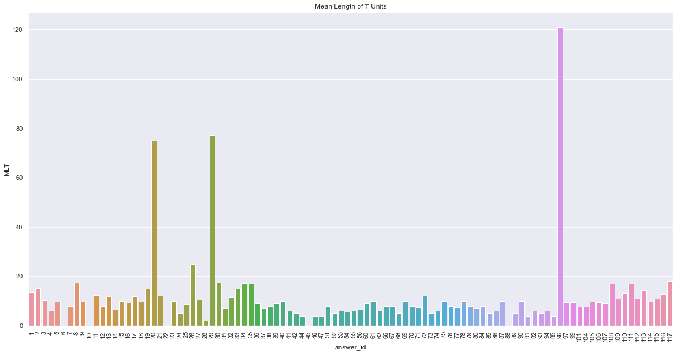
Essay 96:
Failing a test is not easy successful ,but if you want to do this,there are many method can reach this goal.For example,sometimes i always forget what the teacher say in the class,and i never write down any important thing in my notebook.So i never get a high score in my test.Then, you needn't to do your homework and don't go to class on time.When you have a test,don't write anything on your test paper if you know the answer.On the other hand,you needn't to review your classes everyday and don't highlight any important vocabulary or senternces on your book.Finally,if your follow tese steps, you'll esay to fail a test.

Slide 18
The Compromise
I decided to massively scale down my sample size
I stuck to only L1s with more than 30 students
Arabic, Chinese, Korean, Japanese, Spanish, Turkish, and Thai
At least I got good variation in language families
For each L1, I randomly sampled 10 students each for proficiency levels 3, 4, and 5
This cut down my dataset to only 4,341 essays (but it still took TAASSC hours to run)

Slide 19
Final Data Analysis
(Or Lack Thereof)

Slide 20
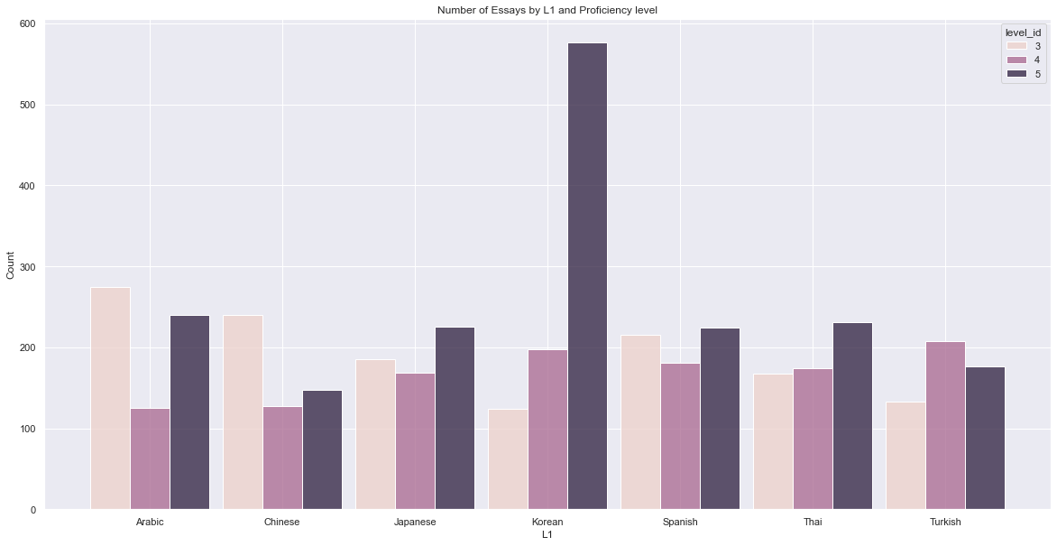
The Final Dataset

Slide 21
Okay Something Went Horribly Wrong
There were way more essays by advanced Korean students than any other group in my sample
It turned out that advanced Korean speakers had more essays on average than most groups in the dataset, but it wasn’t nearly as extreme
I decided to investigate the Korean students specifically

Slide 22
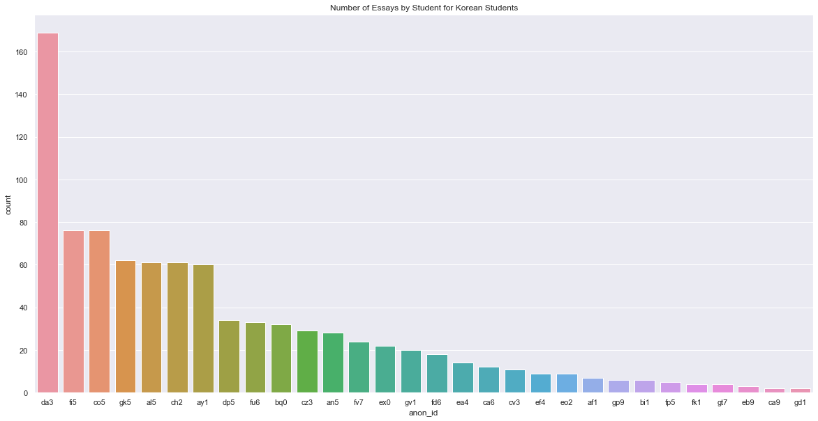
For some reason this one student had over twice as many essays as everyone else…

Slide 23
Bad Luck
Apparently, I just had really bad luck and ended up selecting that one Korean student, which skewed my distribution
Since there was no way that I’d have enough time to try to fix this (using the whole dataset, sampling multiple times, etc.), I had to just stick with it and hope for the best

Slide 24
Hitting a Wall
Remember how I said that TAASSC was really sensitive to non-standard writing? Yeah, about that…
Those incorrect calculations/outliers ended up being a serious problem

Slide 25
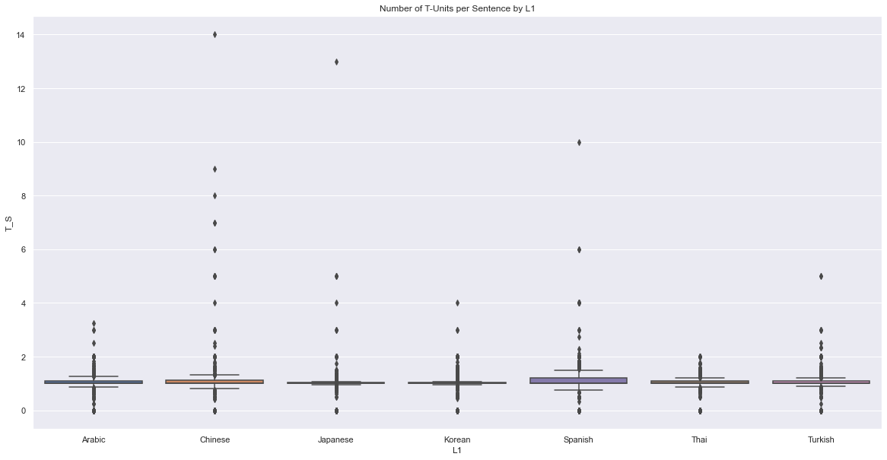
The most extreme “outlier”:
Pon-ANON_NAME_0 is an island near Taiwan,I went there with my classmates.That was my graduation travel.According to my experience,I think it was the best place to go on a vacation.First of all,we can do many water activiies there,like snorkling and taking a boat,they are very exciting.Second,we can try some dishes which are their traditional foods,the foods were made by local.Third,there are also many good places in Pon-ANON_NAME_0,we can see nature and strange stones,if we go there,we can feel relaxing.The most importantly,there are firework fastival in summer vacation,if we go there on July,we can see fireworks there,they are very wonderful because many pictures like animal and colors in the sky.According to these things,I think the best vacation place is Pon-ANON_NAME_0.

Slide 26
Unreliable Data
“Outliers” like this were scattered throughout my dataset
Although I could only examine the most extreme outliers, it’s likely that the measures for the other essays, both non-outliers and less extreme outliers, were still miscalculated to some degree
It’s likely that these inaccurate calculations are seriously skewing the distributions of the syntactic measures

Slide 27
Conclusion
It’s Almost Finally Over

Slide 28
What Now?
I’m torn about how I should proceed from here, if at all
I don’t think I can in good conscience perform statistic analyses on this data and draw conclusions when I know that the data is this inaccurate

Slide 29
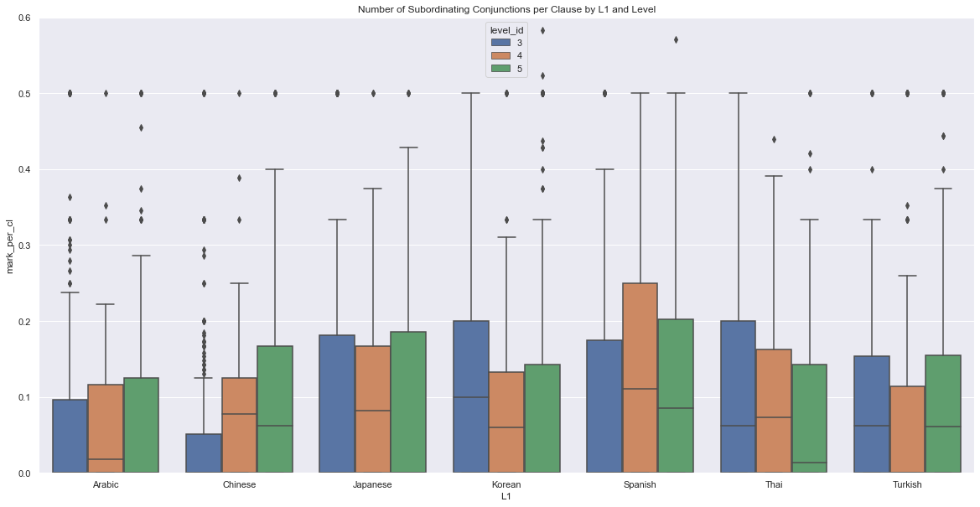
Glimmers of Hope
Exploratory data analysis revealed that there may still be trends worth exploring (ignoring the outliers)
Could be tested with t-tests or ANOVA tests
Likely not reliable until better methods are found

Slide 30
Some Ideas
Find a substitute for TAASSC?
Manual tagging and parsing?
Other ideas that I haven’t thought of?
Open to suggestions

Slide 31
Questions? Ideas?
TAASSC has brought me immense pain and suffering

