Slide 1
Analyzing Blame Shifting on AITA
Alex Ocampo

Slide 2
r/AmITheAsshole
Most viewed community on Reddit (2022 Reddit Recap)
"a place to finally find out if you were wrong in an argument that's been bothering you"
Users submit posts explaining some conflict in their life and commenters vote on whether the user was justified in their behavior
Rigid posting guidelines on both form and content
3000 characters max, no violence, no medical conflicts, no cheating/divorcing/etc.
Strictly interpersonal drama

Slide 3
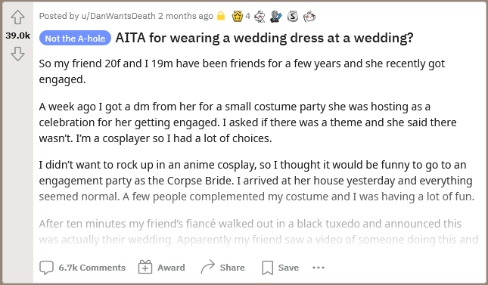

Slide 4
Rulings
You're the Asshole (YTA), "Asshole"
Not the Asshole (NTA), "Not the A-hole"
Everyone Sucks Here (ESH), "Everyone Sucks"
No Assholes Here (NAH), "No A-holes here"
Not Enough Information
Left out of analysis
Question: How does language vary between rulings? How do posters frame their narratives, and what does that make us think about their role in the conflict?

Slide 5
Data Collection: Problems
Reddit API does not allow you to scrape more than 1000 posts from a single subreddit and this project revolves around one subreddit
Pushshift API – Third party database of Reddit posts
PMAW – Python wrapper
Currently undergoing migration, no data available from before November 2022
PMAW bugged so that any attempt to scrape over 1000 posts will scrape all posts available
Cannot filter search to only contain posts with link flairs

Slide 6
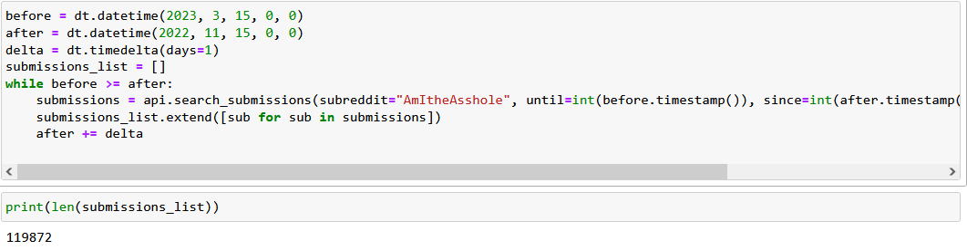
Data Collection
Solution: Scrape 1000 posts per day in a large range and then pare down the data set to only applicable posts

Slide 7
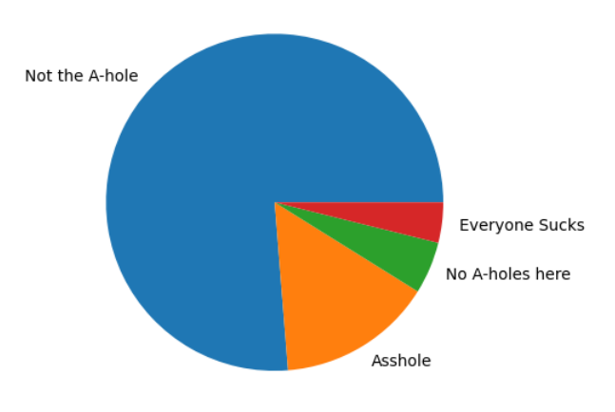
Data Collection
9414 Posts
Not the A-hole: 7180
Asshole: 1399
No A-holes here: 471
Everyone Sucks: 364

Slide 8
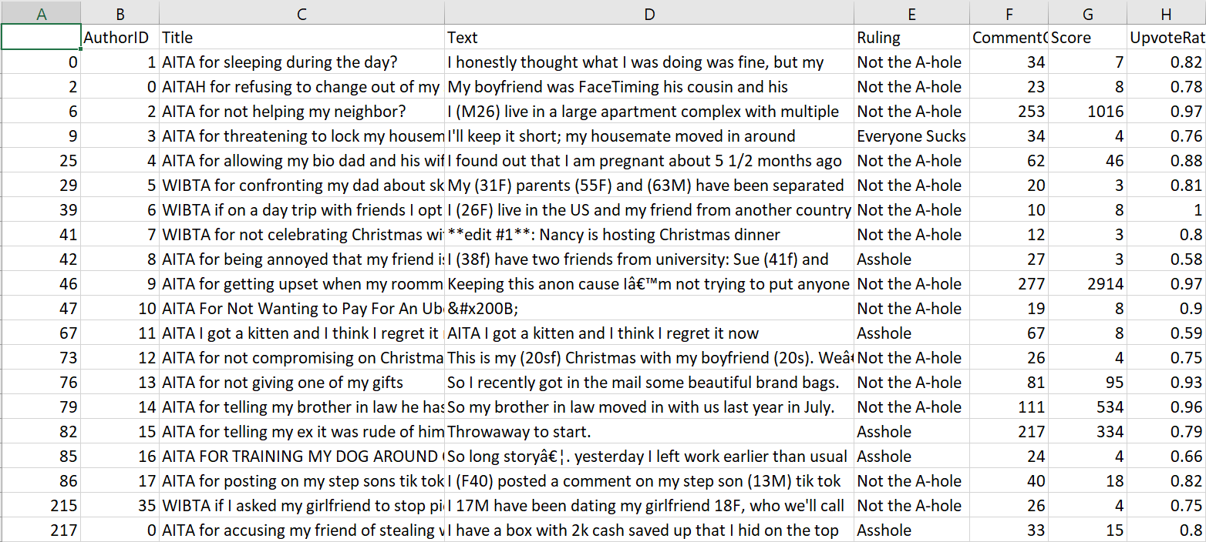

Slide 9
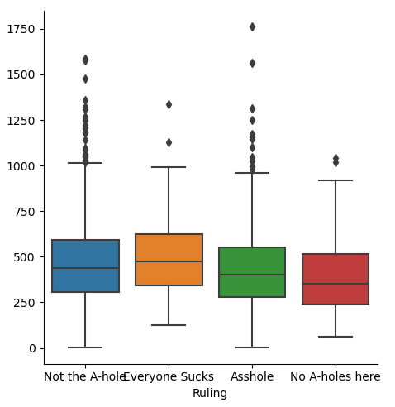
Question: How much context and justification do the posters give?
NTA write the most on average
NAH have shortest stories
YTA widest variance

Slide 10
Question: Who do their stories focalize?
Practically: Do the most common subjects of sentences vary between rulings?
Use spaCy to extract dependencies within sentences
Select all nominal subjects
Compare top 30 subjects per ruling

Slide 11
Subjects by Ruling
Not the A-hole: I, she, he, it, we, they, that, you, me, this, who, mom, which, her, dad, sister, parents, him, one, husband, friend, brother, what, mother, family, people, everyone, wife, things
Asshole: I, she, he, it, we, they, that, this, you, me, who, her, mom, which, parents, wife, him, friend, one, sister, dad, what, husband, people, brother, everyone, son, daughter, family, them
No A-holes here: I, she, he, we, it, they, that, this, me, you, who, which, her, mom, him, friend, dad, one, parents, husband, wife, sister, family, brother, people, what, them, everyone, mother, boyfriend
Everyone Sucks: I, she, he, we, it, they, you, that, me, this, who, which, her, mom, sister, husband, him, friend, what, one, parents, dad, people, everyone, family, brother, mother, friends, them, all

Slide 12
Subjects by Ruling
Not the A-hole: I, she, he, it, we, they, that, you, me, this, who, mom, which, her, dad, sister, parents, him, one, husband, friend, brother, what, mother, family, people, everyone, wife, things
Asshole: I, she, he, it, we, they, that, this, you, me, who, her, mom, which, parents, wife, him, friend, one, sister, dad, what, husband, people, brother, everyone, son, daughter, family, them
No A-holes here: I, she, he, we, it, they, that, this, me, you, who, which, her, mom, him, friend, dad, one, parents, husband, wife, sister, family, brother, people, what, them, everyone, mother, boyfriend
Everyone Sucks: I, she, he, we, it, they, you, that, me, this, who, which, her, mom, sister, husband, him, friend, what, one, parents, dad, people, everyone, family, brother, mother, friends, them, all

Slide 13
Question: How much agency does the writer express?
Practically: What proportion of sentences is written in passive voice? And, who are the subjects of active versus passive sentences?
Use the ratio of passive versus active subjects to determine how much passive or active voice a given post uses
SpaCy: "nsubj" vs. "nsubjpass"
Compare a ruling's passive versus active subjects

Slide 14
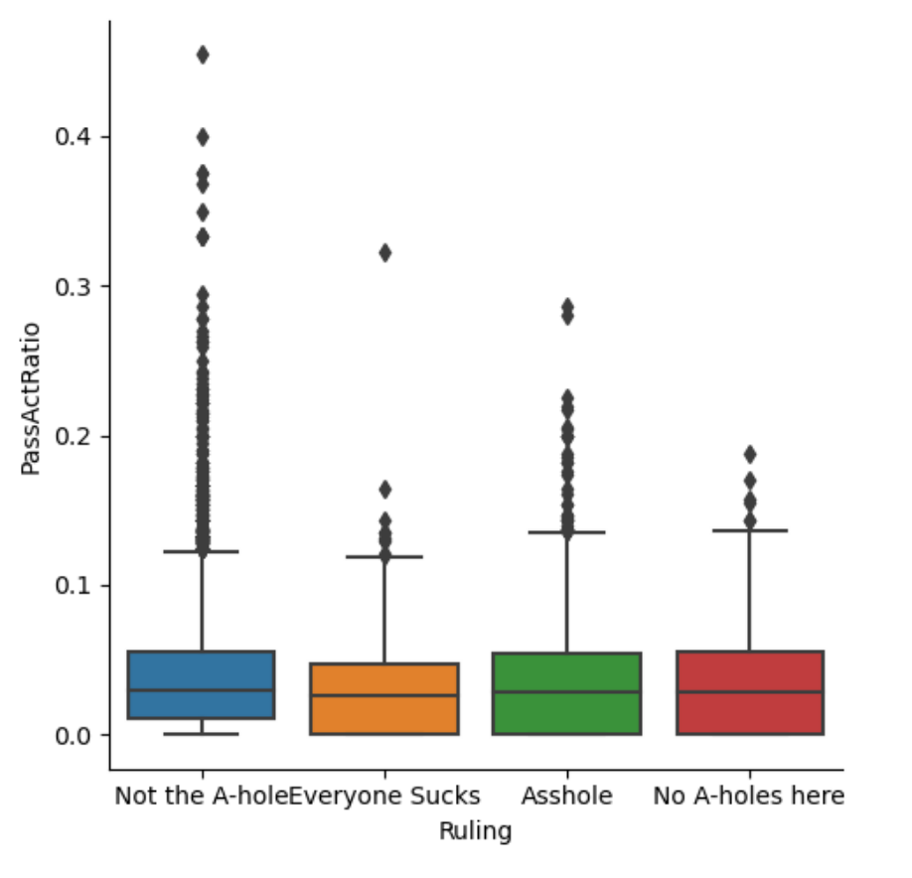
Passive/Active Ratio
Practically: How does post length vary between rulings?
NTA use most passive voice on average, followed by YTA
Might be a coincidence but the ratio of passive versus active voice is in the same order as total number of posts in the data set (NTA, YTA, NAH, ESH)

Slide 15
AITA for telling my mom I don’t care about my little brothers
(...) I don’t hate them nor resent them I just don’t care for them, I’m 16 and I have a ton of things I’d rather be doing and hanging out with babies that I have no care for is not one of them. What’s worse is how much my mother demands that I watch them and take care of their needs, these are not my kids and not my responsibility however I am constantly yelled at by her, my step father, and my biological father that I need to take care of them. Today was the final straw, I was just relaxing when they barged in,I told the, to get out but was met by a rotten scowl from my mother and she yelled at me to keep them in, immediately my switch was thrown of the floor, my desk was completely trashed, and my phone was being yanked out of my hands by my toddler brother, I was fed up and yelled at my mom to just leave because I don’t have any desire to spend time with them and to stop forcing me to love them. She gave me another scowl and told me that I no longer get my allowance or my console because I’m being cruel and heartless. So tell me, Am I the Asshole?

Slide 16
AITA for telling my mom I don’t care about my little brothers
(...) I don’t hate them nor resent them I just don’t care for them, I’m 16 and I have a ton of things I’d rather be doing and hanging out with babies that I have no care for is not one of them. What’s worse is how much my mother demands that I watch them and take care of their needs, these are not my kids and not my responsibility however I am constantly yelled at by her, my step father, and my biological father that I need to take care of them. Today was the final straw, I was just relaxing when they barged in,I told the, to get out but was met by a rotten scowl from my mother and she yelled at me to keep them in, immediately my switch was thrown of the floor, my desk was completely trashed, and my phone was being yanked out of my hands by my toddler brother, I was fed up and yelled at my mom to just leave because I don’t have any desire to spend time with them and to stop forcing me to love them. She gave me another scowl and told me that I no longer get my allowance or my console because I’m being cruel and heartless. So tell me, Am I the Asshole?
NOT THE ASSHOLE

Slide 17
Passive/Active Subjects by Ruling: NTA
Not the A-hole Passive: I, she, he, it, we, they, that, who, which, this, you, what, sister, me, mom, everything, parents, brother, all, dad, husband, car, things, one, mother, son, friend, baby, wife, her
Not the A-hole Active: I, she, he, it, we, they, that, you, me, this, who, mom, which, her, dad, sister, parents, him, one, husband, friend, brother, what, mother, family, people, everyone, them, wife, things

Slide 18
Passive/Active Subjects by Ruling: YTA
Asshole Passive: I, she, he, it, we, they, that, this, who, wife, brother, which, you, what, one, husband, son, nothing, people, me, mom, family, sister, daughter, kids, money, parents, dad, car, her
Asshole Active: I, she, he, it, we, they, that, this, you, me, who, her, mom, which, him, parents, friend, wife, sister, dad, one, what, husband, people, brother, everyone, son, daughter, family, them

Slide 19
Gendering of Passive/Active Subjects
Not the A-hole Passive: she, he, sister, mom, brother, dad, husband, mother, son, wife, her
Not the A-hole Active: she, he, mom, her, dad, sister, him, husband, brother, mother, wife
Asshole Passive: she, he, wife, brother, husband, son, mom, sister, daughter, dad, her
Asshole Active: she, he, her, mom, him, wife, sister, dad, husband, brother, son, daughter

Slide 20
Coming Up
Using machine learning to try and predict the verdict on these posts
Use the information built up my the ML model to find any further patterns in writing style across the rulings and consider why those patterns might be present

Slide 21
Thank you!
Questions?

