Slide 1
Ted talk Analysis - Focusing on Transcript and popularity
Soobin Choi
LING 2234
Dr. Narae Han

Slide 2

1. Motivation / Research Question
TED Talk Analysis – focusing on transcript and popularity
What make a Popular Ted Talk?
Two biggest part of the talks: verbal aspect / nonverbal aspect
RQ: Can the popularity of a talk be predicted solely based off of the content of it?
Popularity here: each talk’s share of positive / negative review in rating column
Notes:
I do not have a strong linguistic background here; I was browsing Kaggle, looking for a dataset to use for the final project; cause I was not into scraping the data,
Then I saw this project titled: what makes a popular ted talk? And I got curious, what would be the major factor when people give ratings to the talks.
the video contents like Ted talks can be divided into two parts: verbal aspect, which is the content of it, and nonverbal aspect such as speaker’s tone, body language, specific choice of word, and so on. I, as an L2 speaker of English, become curious about which part weighs more when rating the talks; whether the content of the talk is what matters the most, or it is the delivery strategy that attracts viewers.
So My research question is, ~~~ (RQ 읽기)

Slide 3
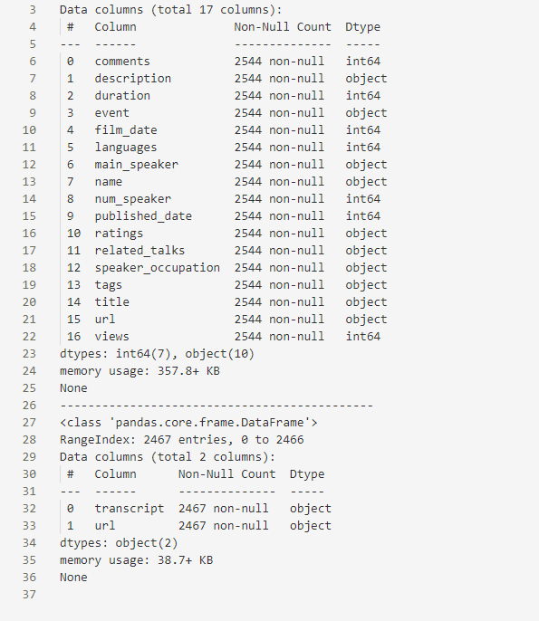
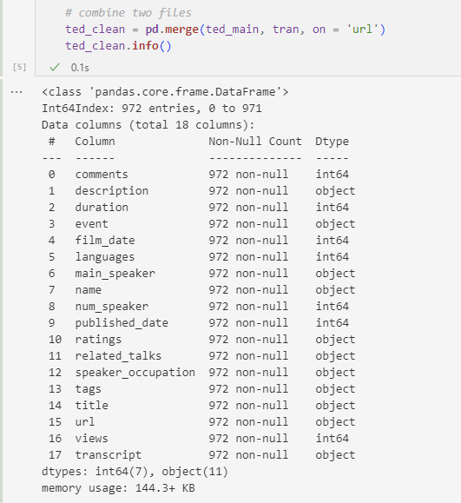
2. Data Processing
TED Talk Analysis – focusing on transcript and popularity
Before Merging/sorting:
After Merging (and a bit of sorting):
Notes:
There are two data sets I used: one is regarding the talks’ information such as comments, language used in it, title, etc., and another one only contains the url of the talks and their transcript.
As you can see here, there are 25 hundred something values in each data set before merging and sorting.
But after sorting we are now with 972 values in the data set.
This huge decrease in the number of value is mainly from the sorting; not merging. When I merged them, I only lost 5-6 rows because there were missing url values in the main ted data set.
This huge decrease in number is because I filtered them with the type // program of the ted talk. I am only using ted original talks in this project.

Slide 4
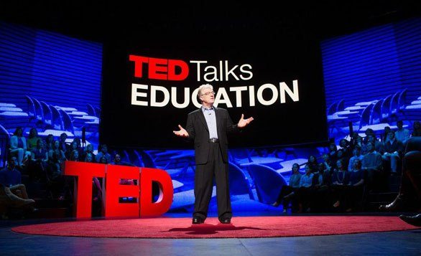
2. Data Processing
TED Talk Analysis – focusing on transcript and popularity
Why only TED original?
TEDx, TEDMED, TED India, ... : programs supported by TED organization when a specific group wants to hold conferences similar to TED talk.
Topics depend on the nature of the group.
Image from: http://www.findaspark.co.uk/resource/schools-kill-creativity/
Notes:
왜 ted original만 filter 했는지.
TEDx, TEDMED, .. But these are not held by TED organization; the organization gives the license to a specific country or community to host conferences similar to TED. And the topics that these sub-ted talks handle are a little bit restricted compared to the original TED talk.
So I decided to use the original Ted talk for my final project.
Popularity에서 왜 comments랑 view는 고려하지 않았는지?
Do Schools Kill Creativity Ken Robinson

Slide 5
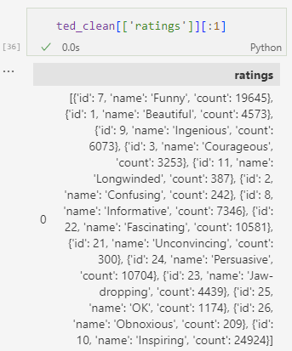
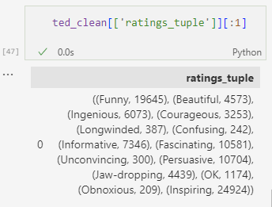
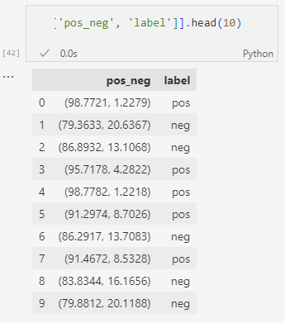
2. Data Cleaning
TED Talk Analysis – focusing on transcript and popularity
‘ratings’ column
Notes:
There are 14 categories of rating, which are funny, beautiful, confusing, etc., and 10 of them is positive and 4 of them is negative.
this column represent the total sum of each ratings here; 19645 people checked Funny, 4500 checked Beautiful, etc. etc.
So, in order to label the talk, the percentage of each option has to be calculated.
And then, I categorized them based on the percentage positive and negative
There is ‘OK’ ; since it’s more or less neutral, I did not take this into consideration when calculating percentages of each rating.
As we can see here, the majority of the talks have higher `positive` percentage than `negative` percentage, so I calculated the mean of negative percentage, and if a talk has higher negative percentage than the mean, I labelled it as negative

Slide 6
3. Analysis
TED Talk Analysis – focusing on transcript and popularity
Features I am using: Tf-idf (unigram, bigrams, trigrams), Mean K-band, Mean Sentence Length
Models I am using: Multinomial NB, SVM
• Hypothesis testing here:
It is possible to predict the popularity of talks based on their transcript
There is a positive correlation between the rating obnoxious and mean k-band
There is a positive correlation between the rating longwinded and mean sentence length
Notes:
H2, H3 설명. 증명하다 demonstrate / testify
Higher mean k-band can be an indicator of more sophisticated, technical words and if the talk has a lot of this jargon-like words, I supposed, viewers might think that it is obnoxious.
If the sentences are generally not short nor concise, the viewers might think it is longwinded.
Base rate here is 67%

Slide 7
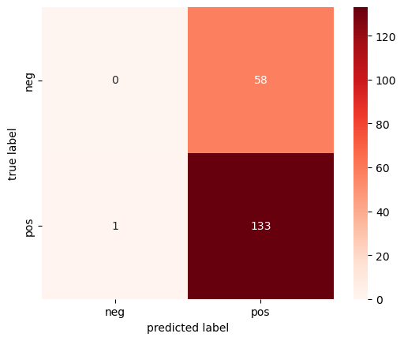

3. Analysis 1 – Multinomial NB (unigram)
TED Talk Analysis – focusing on transcript and popularity
1. Max Feature = 1500, Accuracy Score = 69%
2. Max Feature = 3000, Accuracy Score = 70%
Notes:
When I increased the max feature to 5000, it started to overfit – basically the model predicted that all of them are positively rated.

Slide 8

3. Analysis 1 – Multinomial NB (bigrams)
TED Talk Analysis – focusing on transcript and popularity
Max feature = 20000, Accuracy Score = 66%
The model classified all of the transcripts as positive.
This indicates that there is no difference between the talks with more positive rating and those with less positive rating when it comes to tf-idf feature.
Notes:
Unigram // bigram feature 둘 다 사용함.

Slide 9
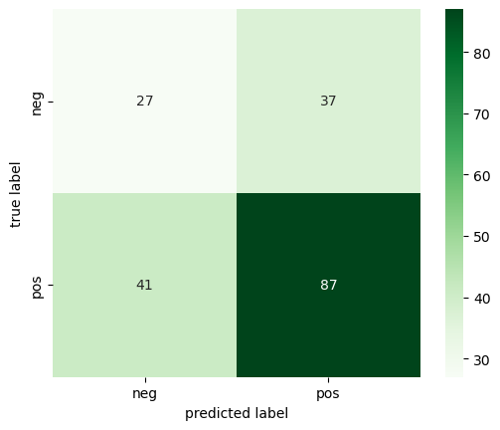
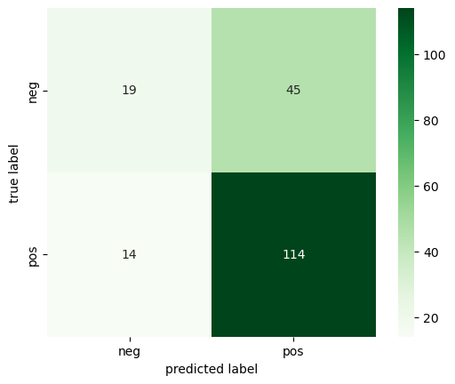
3. Analysis 1 – SVM (unigram)
TED Talk Analysis – focusing on transcript and popularity
Max Feature = 15000, Accuracy Score = 59%, C = 1E5
Max Feature = 15000, Accuracy Score = 65%, C = 1
Notes:
C parameter
왜 이런 일이 일어났을까?

Slide 10
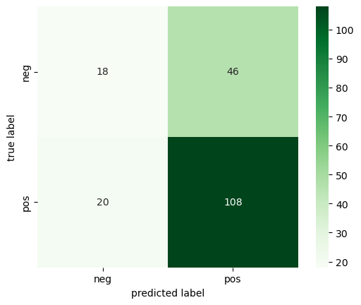
3. Analysis 1 – SVM (ngrams)
TED Talk Analysis – focusing on transcript and popularity
Max Feature = 15000, Accuracy Score = 65%, C = 1E5
Overall, the accuracy was lower than that of NB model
However, SVM models were more successful in classifying true negatives. – SVM more sophisticated than NB
Hypothesis – rejected.

Slide 11
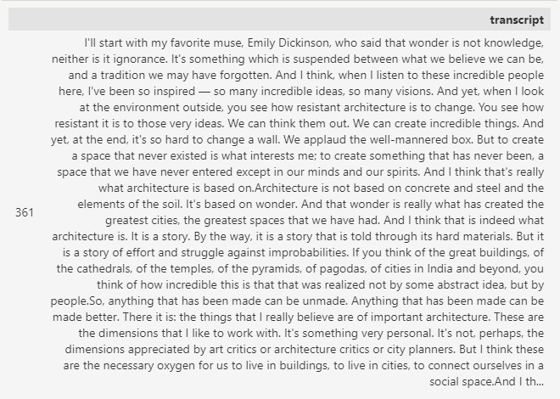
3. Analysis 2 – K-band & obnoxious
TED Talk Analysis – focusing on transcript and popularity

Slide 12
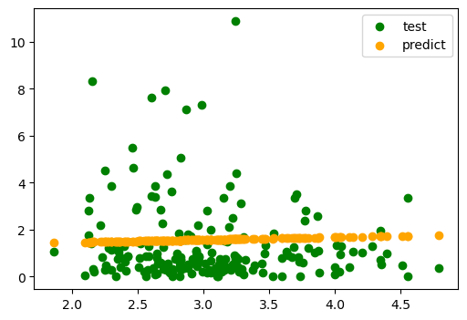
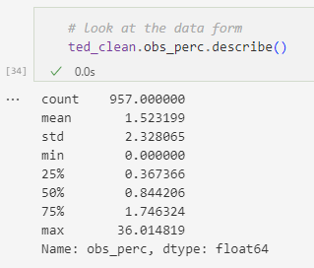
3. Analysis 2 – K-band & obnoxious
TED Talk Analysis – focusing on transcript and popularity
Model: Regression
Result: very low correlation
Coef: 0.11
Mean Absolute Error: 1.24
Conclusion: there are other elements that induce ‘obnoxious’ rating more than the level of the words in the transcript.
Notes:
I used regression model because both dependent and independent variable are continuous variables.

Slide 13
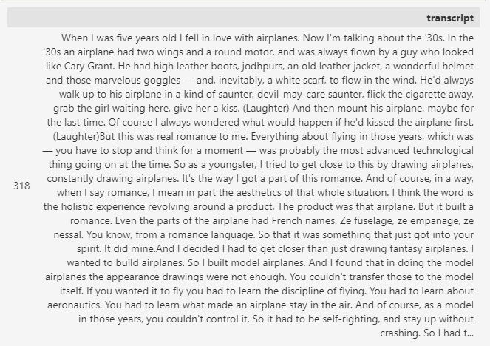
3. Analysis 3 – Sentence Length & longwinded
TED Talk Analysis – focusing on transcript and popularity

Slide 14
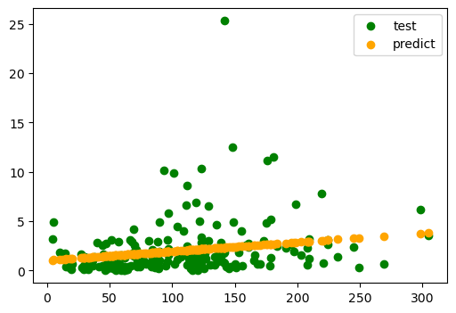
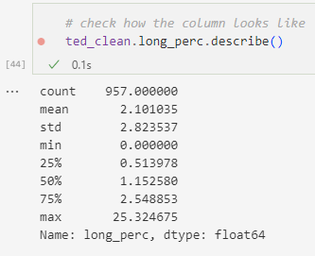
3. Analysis 3 – Sentence Length & longwinded
TED Talk Analysis – focusing on transcript and popularity
Model: Regression
Result: No correlation.
Coef: 0.009
Mean Absolute Error: 1.59
Conclusion: The length of the sentence has no significant effect on being rated as longwinded.
Notes:
In summary, after

Slide 15
4. Summary
TED Talk Analysis – focusing on transcript and popularity
The textual features of transcript (Tf-idf (ngrams), K-band, sentence length) does not affect the talk’s rating / popularity in a meaningful way.
My best guess: nonverbal aspects of the talk (tone, speed rate, body language, …) matters more.

Slide 16
Thank you ☺
Any Questions?

