Slide 1
Text-Based Age Classification
Varun Venkatesh

Slide 2
Introduction
Goal
Find linguistic markers of age
Roadmap
Introduction
Data
Analysis
Findings?
Further work

Slide 3
Questions?
Notes:
<and feel free to stop me at any point if you have questions>
<so let’s get into the data>

Slide 4
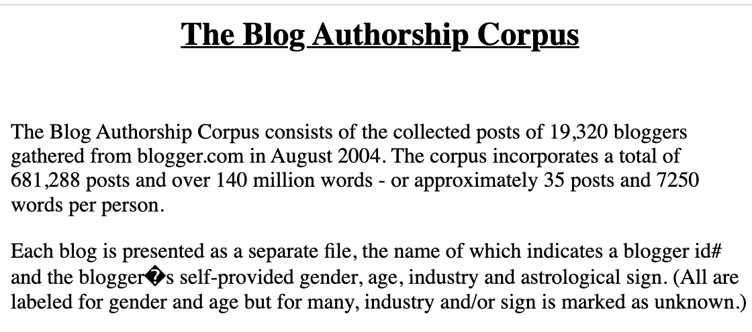
Data
😍
Notes:
So, how did this project idea start?
<found blog authorship corpus online on a list of datasets>
<impressed>
<practical use case> -> <age classification>
Since most of the bloggers are their teenage years, their twenties, or their thirties,
These became my target domain, or labels

Slide 5
But…
Notes:
BUT there was an issue -
Data already found, no added data work except preprocessing
SO, i looked for a way to form new data
Not only would this add value to the data aspect of the project, it would be helpful to see if my findings were dataset-specific or if they hold true across a different context,
WHICH is

Slide 6

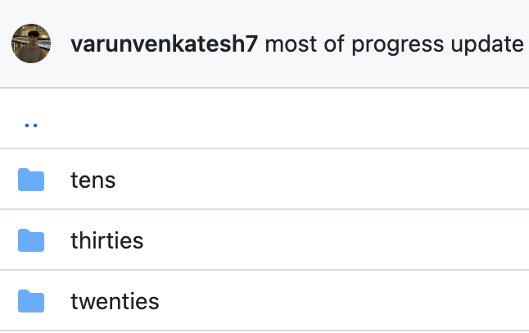
Data, Pt. 2
Notes:
Reddit.
So, I had to find a way to use reddit
And somehow get primarily age locked data to the domain that I was looking for, which is
Teens, twenties, and thirties.
Now, how would i do that?

Slide 7
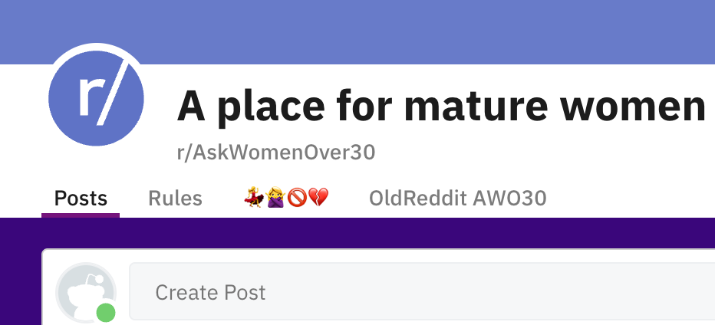




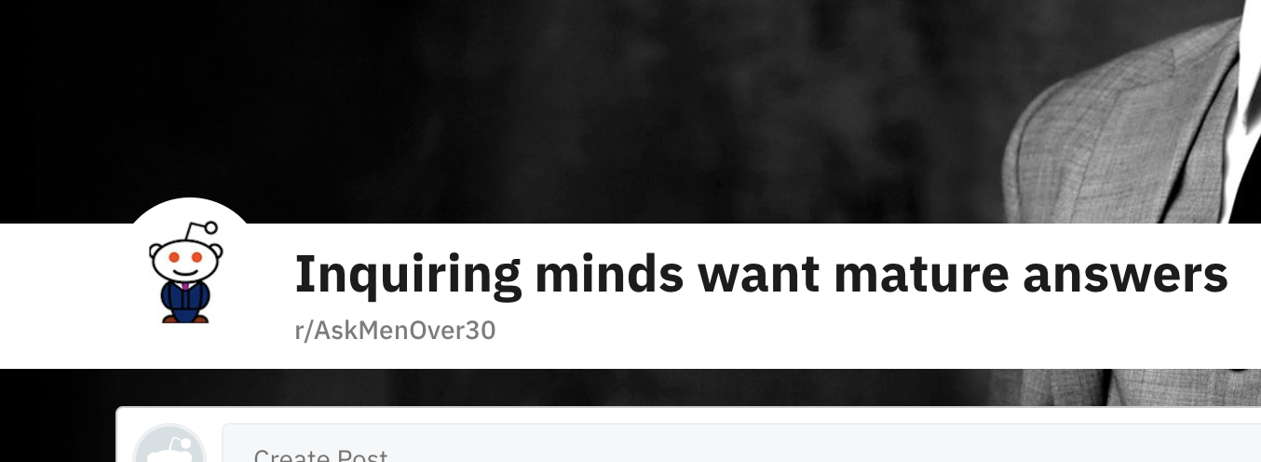
Data, Pt. 2
Notes:
Uh … yeah

Slide 8
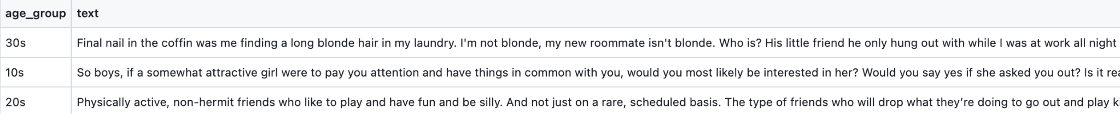
Data, Pt 2
Notes:
So, anyway, I ran my data pipeline on those subreddits
and made sure to scrape the comments
(since the poster doesn’t necessarily belong to that age group)
And eventually
I did obtain a blog-authorship-corpus like dataset that I am able to use
So, now that we’ve got our data sorted out, let’s move onto analysis

Slide 9
Analysis
Hypotheses
Punctuation matters, and it helps classification
Feature engineering doesn’t help
N-grams > Bag-of-Words

Slide 10
Analysis
Questions
Preprocessing → does it matter?
Capitalizations
Punctuation
Spacing (whitespace)
Feature Engineering → does it matter?
Syntactic features?
Lexical features?
N-grams or Bag-of-Words?

Slide 11
Analysis
Test a variable = keep everything else constant
Notes:
Going with a good old multinomial naive bayes classifier for these experiments.
why?

Slide 12
Analysis - No Preprocessing vs Preprocessing (BoW)
Blog data:
Accuracy
0.635
Some of the most significant features
'concommitent', 'Porthcawl', 'Mazaa', 'Republispeak', 'غیرت', 'alcanza', 'tabindex', 'compañia', 'wangouette'
Reddit data
Accuracy
0.700
Some significant features
'workup', 'tradesman', 'flintstone', 'pessimisticpotatoe', 'REQUIS', 'zelda', 'futuristic'
Reddit data:
Accuracy
0.638
Some of the most significant features
'waorcaaknvidutazhimtwy', 'pinangatawanan', 'responsiblity', 'squashesmelonszucchiniscucumbers', 'dotnessyness', 'wigglemunch'
Reddit data
Accuracy
0.698
Some significant features
'bridle', 'bruised', 'two', 'glovers', 'greyhound', 'sende', 'celtics'

Slide 13
Analysis - No Preprocessing vs Preprocessing (bigram)
Blog data:
Accuracy
0.469
Some significant features
' 嘻', 'ce', '仲想', '同聲', ' g', '聲話', '但偏', '是向', '^6', "n'", ' 嘻'
Reddit data
Accuracy
0.608
Some significant features
'̱̬', 'ut', 'g(', 'ca', 'MJ', 'bp', '><', '̦͇', 't7', 'ho', '̱̬', 'ut', 'g('
Blog data:
Accuracy
0.467
Some significant features
'pu', 'of', 'vu', 'he', 'zr', 'vd', 'ai', 'oc', 'nn', 'eo', 'pu', 'of', 'vu',
Reddit data:
Accuracy
0.570
Some significant features
' l', 'yh', ' h', 'm ', 'xx', 'wu', 'r ', 'ry', 'kl', 'zg'

Slide 14
So,
Partial preprocessing?

Slide 15
Analysis - Feature Engineering
Tried looking at features that might be relevant
"punct_count"
"punct_density"
"exclamation_ratio"
"question_ratio"
"Double_spaces"
They didn’t really help, for both blog and reddit data (low accuracy)
Tried ensemble and SelectKBest
Models do worse than just BoW or N-grams

Slide 16
So,
That doesn’t work

Slide 17
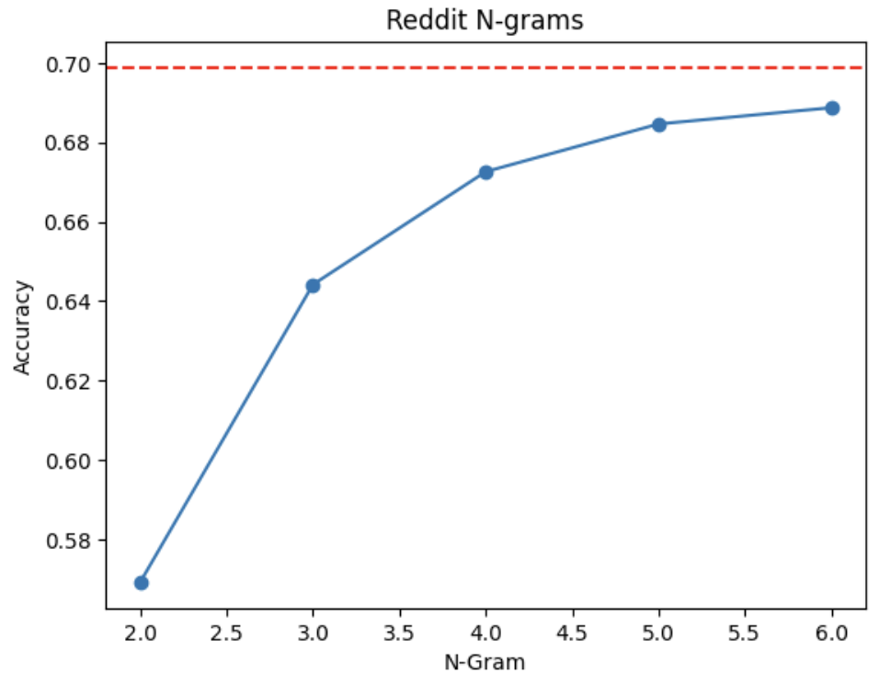
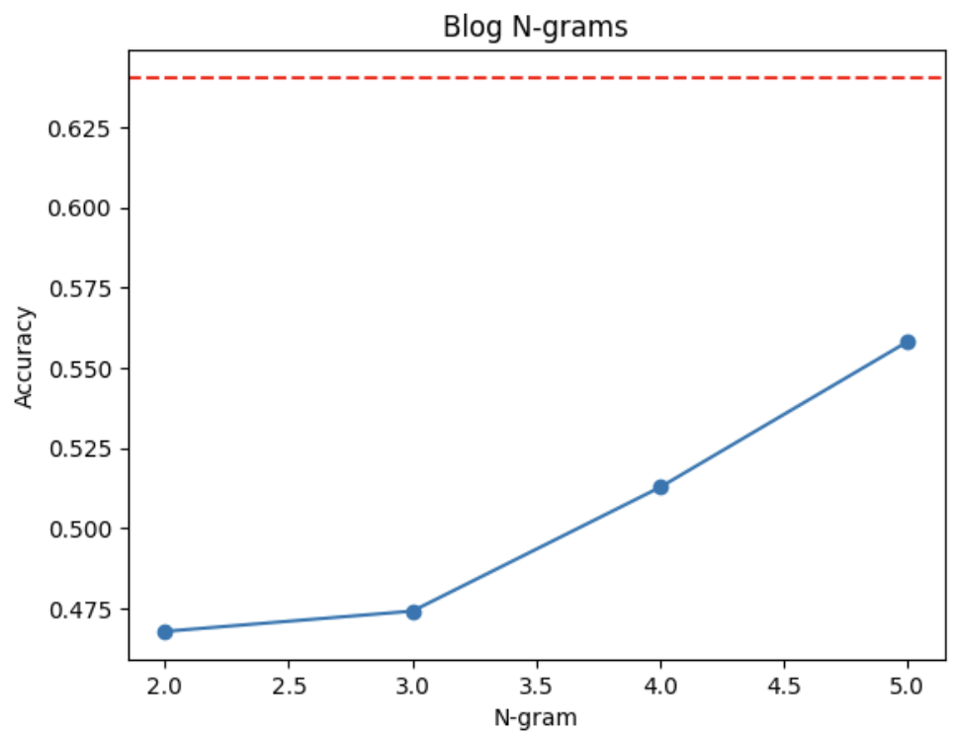
Analysis - N-grams vs Bag-of-Words

Slide 18
Moving forward
Use what I learned from testing my hypotheses, ie.
Partial preprocessing
No Engineered Features
Count Vectorizer using
High N-gram (~5)
BoW
To Benchmark accuracy / try it on a couple of models and compile results

Slide 19
Q & A

