Slide 1

Native Language Prediction Through Fanfiction
Jenna Higgins

Slide 2
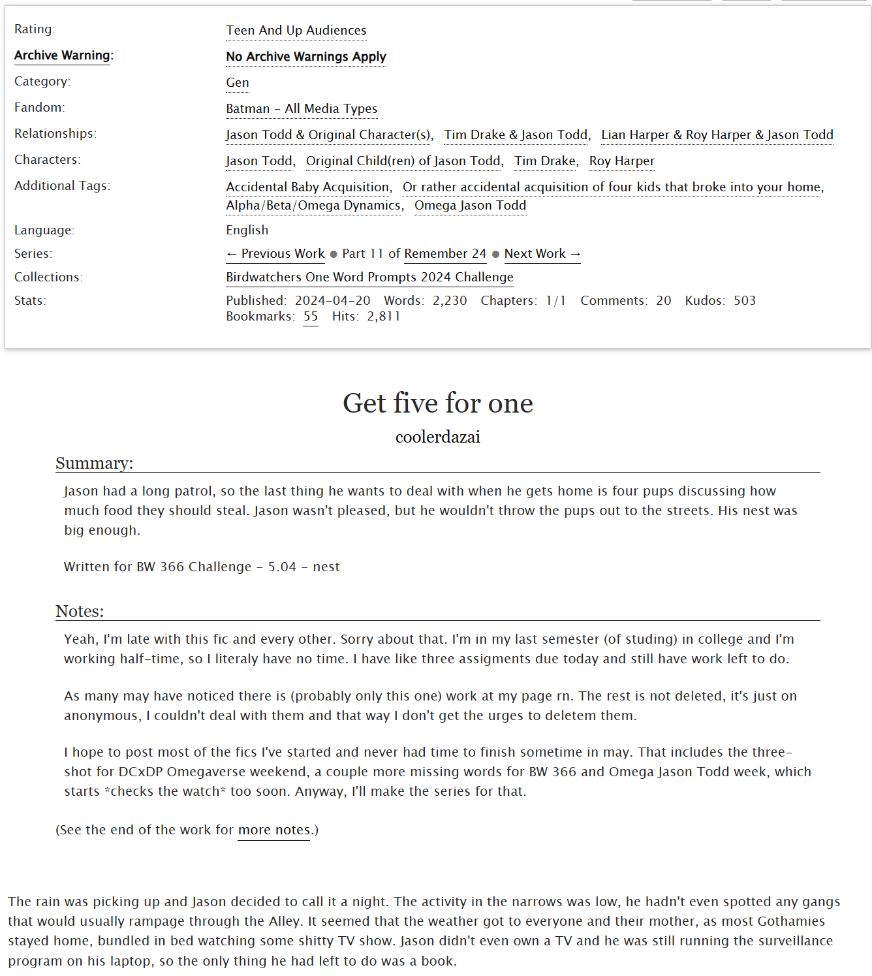
Archive of Our Own
website that hosts fanfiction and other fanworks (ie; podfics, fanart)
fic
beta
kudos
hits
tags
bookmarks
comments
example fic – written by Polish L1

Slide 3
The issue with webscraping...
Most people who write fanfiction either a) don’t mention whether they are writing in their native language or not or b) don’t specify what their native language is
It’s hard to find out their native language without hunting down all of their social media
This isn’t usually difficult (see next slide), but webscraping adds a whole other layer of complexity

Slide 4
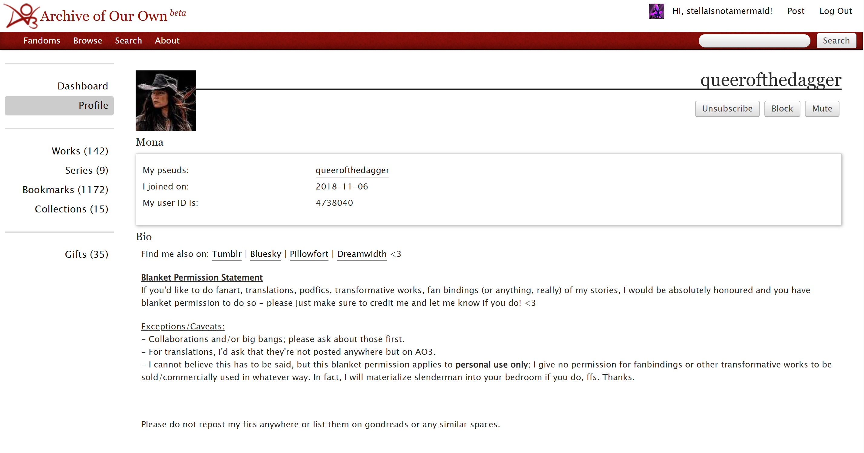

Slide 5
The issue with webscraping...
Most people who write fanfiction either a) don’t mention whether they are writing in their native language or not or b) don’t specify what their native language is
It’s hard to find out their native language without hunting down all of their social media
Archive of Our Own has profiles/bios available, but...

Slide 6
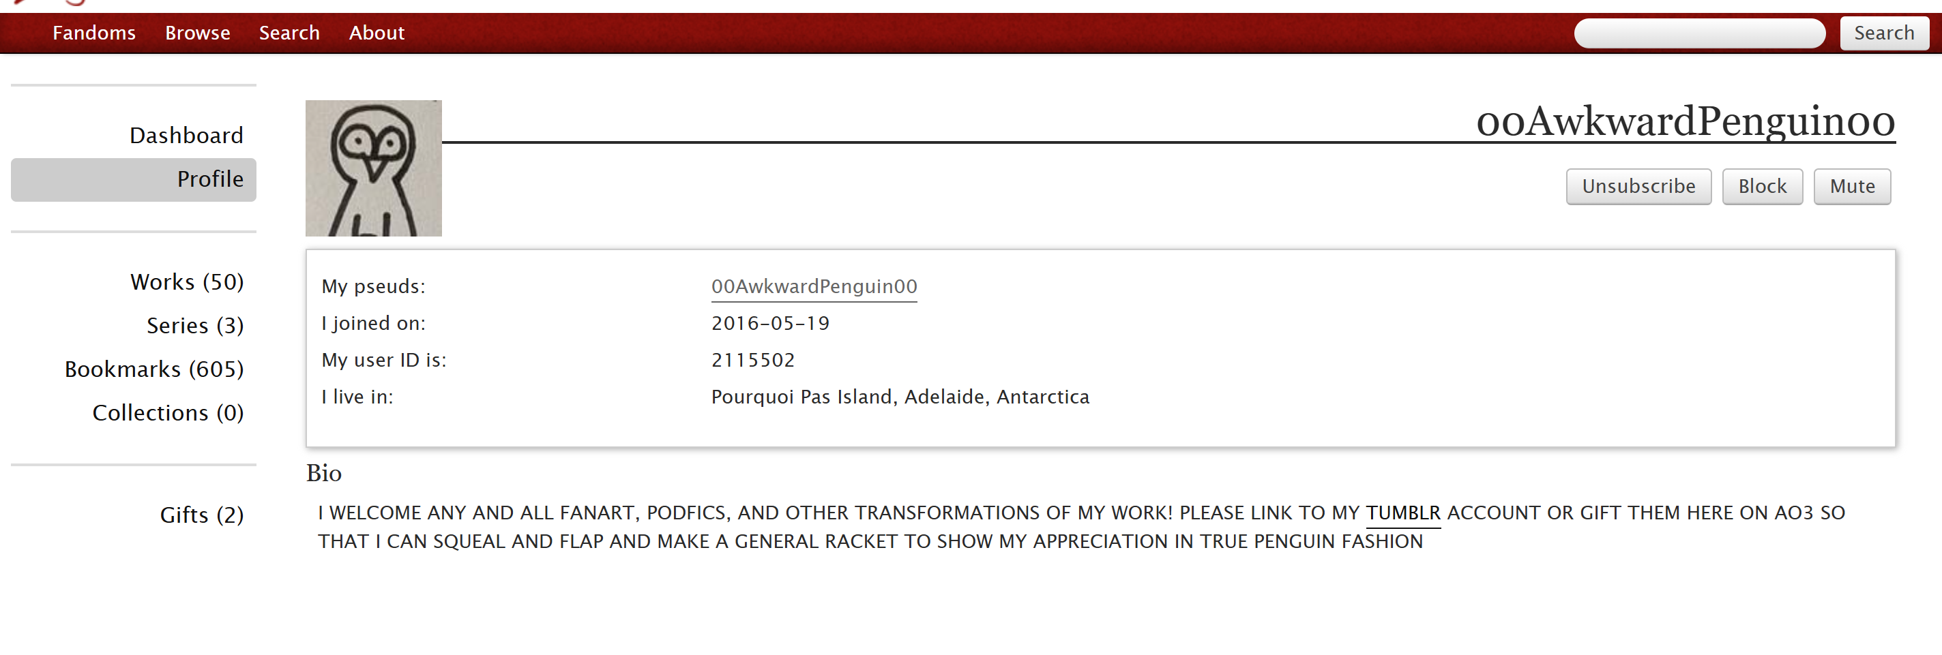

Slide 7
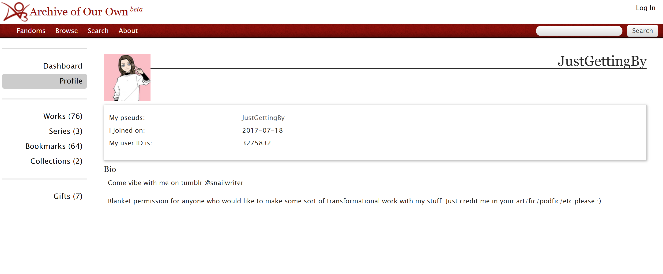
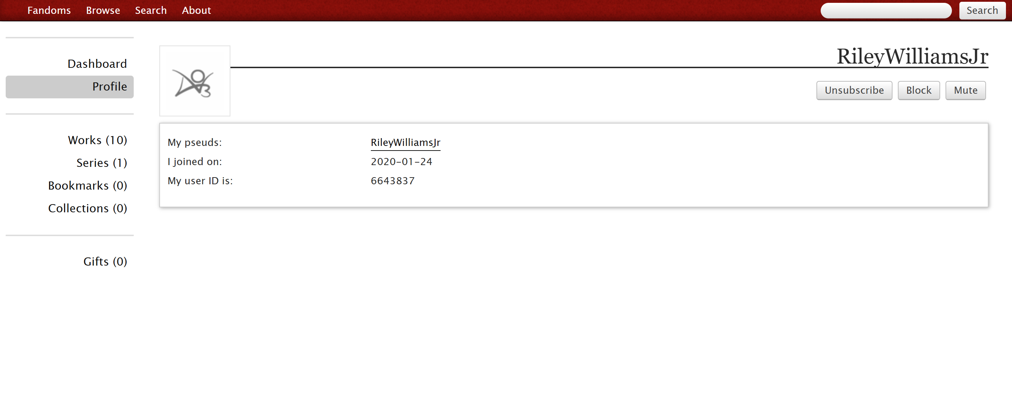

Slide 8
The issue with webscraping...
Most people who write fanfiction either a) don’t mention whether they are writing in their native language or not or b) don’t specify what their native language is
It’s hard to find out their native language without hunting down all of their social media
Archive of Our Own has profiles/bios available, but they aren’t always filled with useful information
People may end up discussing the native language of a CHARACTER and explaining their thought process while writing... usually, this brings me great joy, but I found myself rather irritated when trying to gather data

Slide 9
Favorite Comments
“I’m French and so, so sorry if there is any mistake.”
“Still French! Still no Beta! I’m sorry about the mistakes T_T
“FoUr FiCs chillin in a hot tub F0Ur YeArS aPart cause I’m not okay”
“Hey, I’m German, please don’t judgeEnjoy, you little gay, depressed bitch”
“I refuse to sexualize saunas and I have a right to exoticize my own people.”
“I know, it’s a fucking trash. And I have mistakes in this shit. I’m Russian and I do this with a translator.”
“I’m German so no good accent for Soap, sorry.”
“Also why is coconutty not a word?”
“I’m Czech, I know what happens after all this.”
“(This means Topher is speaking Italian because forcing people to Google translate in a context where it’s funnier that they know exactly what he’s saying without looking it up is for squares)”
“Not joking, I’ve moved high-school just to avoid another Arabic mandatory Class.”
“Please excuse me for mistakes, I’m german and my autocorrekter wants to change the english words into german words. Anyways, have fun.”
“What the fuck am i doing awake it’s 3:30 holy shit goodnight guys”
“just a warning that a. I’m polish so my English is a no no b. I can’t write fanfics, I just need to fulfill my dreams”
“Yes I’m Turkish yes I write about Turkish people in English. We exist.”
“Here I am once again! English is still not my native language and I continue to be dyslexic lol.”
“Btw, English may sometimes not be Englishing cuz homie I’m Polish, so sorry for that in advancexoxo”

Slide 10
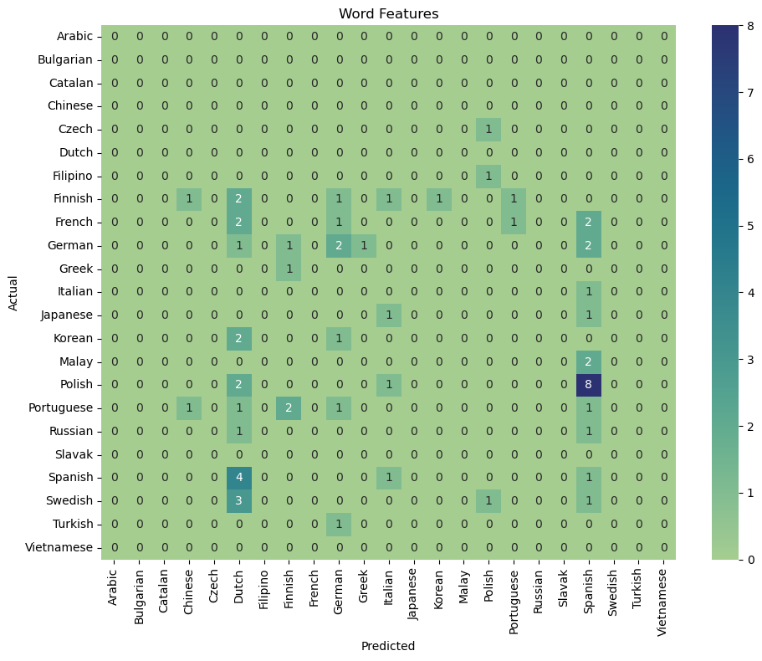
0.046875

Slide 11
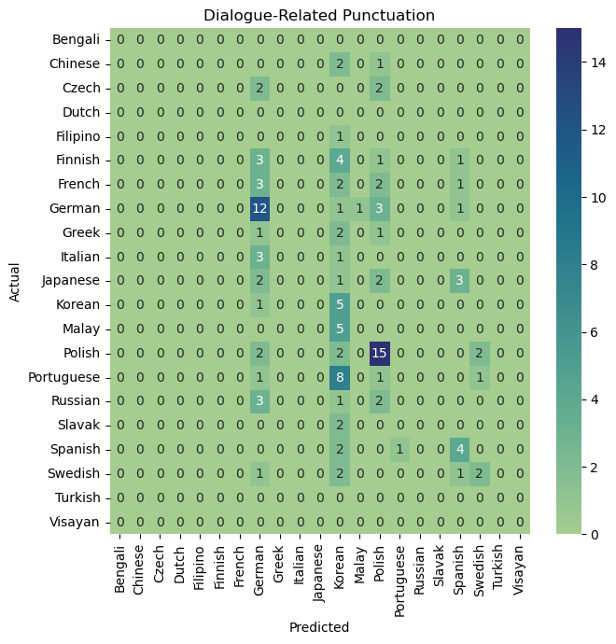
" | '
“ | ”
‘ | ’
« | »
„ | ‚
: | …
¡ | ¿
0.2992125984251969

Slide 12
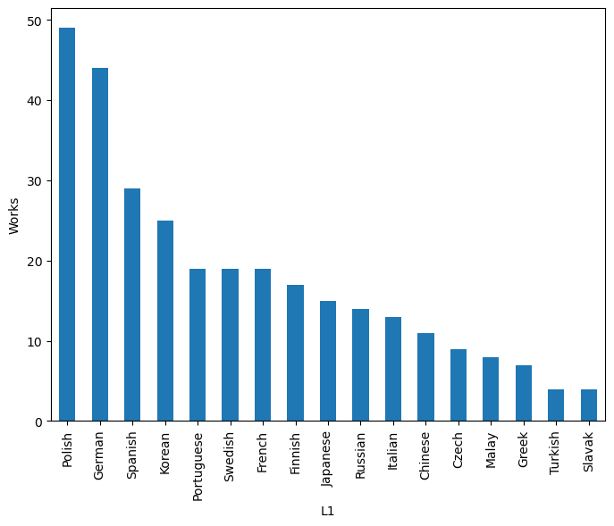
L1 Distributions (post-drop)
As you can see, very unbalanced...
... and mostly Indo-European
(The drop removed languages that I had fewer than 4 works for)

Slide 13
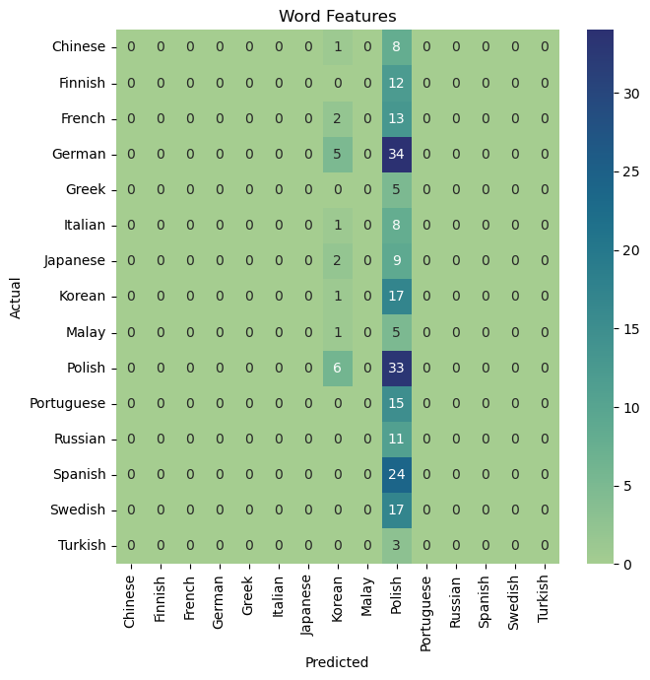
{'verbform:part', 'prontype:ind', 'gender:fem', 'polarity:neg', 'mood:ind', 'degree:cmp', 'prontype:art', 'degree:pos', 'typo:yes', 'gender:neut', 'number:sing', 'case:acc', 'number:plur', 'prontype:int', 'polarity:pos', 'prontype:dem', 'extpos:adv', 'extpos:sconj', 'extpos:cconj', 'gender:masc', 'person:3', 'numtype:frac', 'numform:word', 'extpos:adp', 'style:vrnc', 'voice:pass', 'definite:ind', 'case:nom', 'style:coll', 'prontype:prs', 'mood:imp', 'numtype:mult', 'abbr:yes', 'numtype:card', 'definite:def', 'verbform:ger', 'prontype:neg', 'numtype:ord', 'case:gen', 'foreign:yes', 'person:1', 'verbform:inf', 'poss:yes', 'numform:digit', 'tense:pres', 'reflex:yes', 'extpos:pron', 'degree:sup', 'prontype:tot', 'person:2', 'verbform:fin', 'tense:past'}
0.13821138211382114

Slide 14
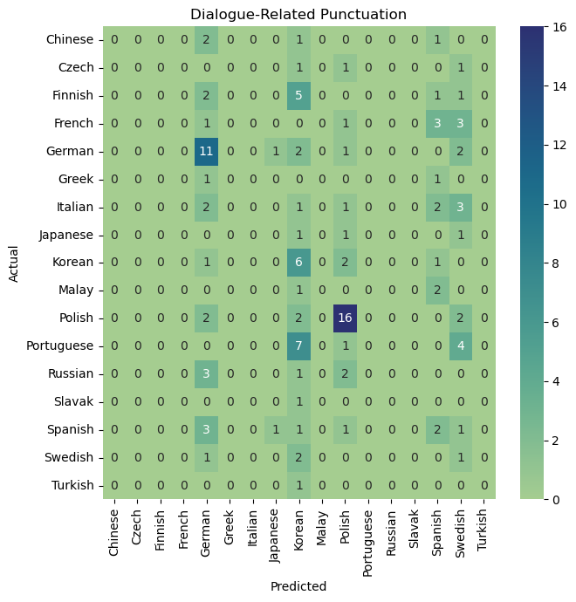
0.2926829268292683

Slide 15
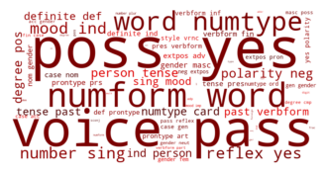
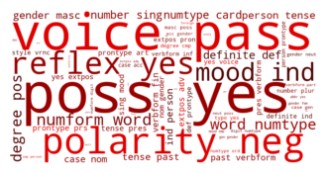
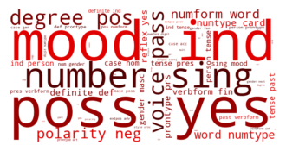
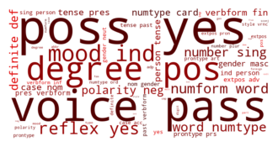
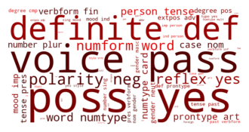
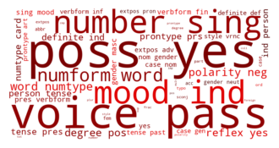
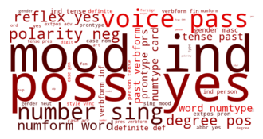
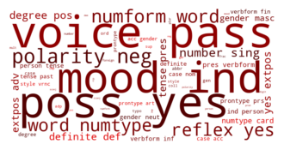
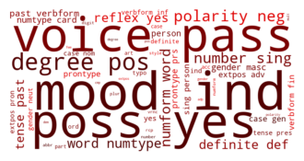
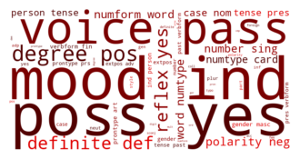
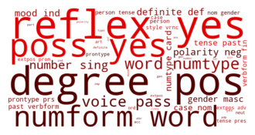
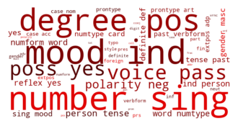
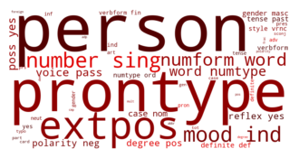
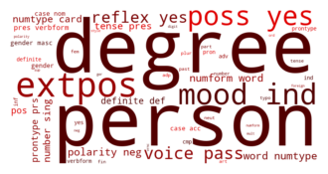
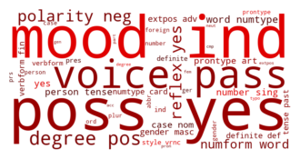
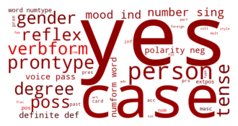
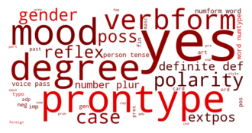
WordClouds of word features per lang!
Notes:
Polish, German, Spanish, Korean, Portuguese, Swedish, French, Finnish, Japanese, Russian, Italian, Chinese, Czech, Malay, Greek, Turkish, Slavak

Slide 16
WordClouds of word features per lang!
Notes:
Polish, German, Spanish, Korean, Portuguese, Swedish, French, Finnish, Japanese, Russian, Italian, Chinese, Czech, Malay, Greek, Turkish, Slavak

Slide 17
Future Explorations
Trying to find more data; I was not logged into AO3 to scrape the pages, and many works are hidden from non-users...
Sorting languages by language family
Studying the use of hyphens & dashes (though, to be fair, I see most people who natively speak English use different dashes to represent an em-dash, and almost everyone uses a hyphen instead of an en-dash)
Noting the use of sentence fragments versus proper sentences
Once I get more experience webscraping, I could potentially search through their social media bios, which are much more likely to state which languages a person speaks
See if there are apparent differences in translations versus originally-written-in-English works

