Slide 1
DATA STRUCTURES
& ALGORITHMS
END-SEM-PROJECT
19AIE111

Slide 2
TABLE OF CONTENTS
01
02
03
PROBLEM
OUR PROCESS
RESULT AND INNOVATION
To Compress a given text file.
Encoding and Decoding using Huffman algorithm
Decrease in file size and modification of the code to crypto- compressed images.

Slide 3
OUR TEAM
Aaditya Jain(CB.EN.U4AIE19001)
Anirudh Bhaskar(CB.EN.U4AIE19007)
C S Ayush Kumar(CB.EN.U4AIE19017)
Rohith Ramakrishnan(CB.EN.U4AIE19052)
Srinath Murali(CB.EN.U4AIE19063)
To finish this project, we had collaborated on Github using a repository and by creating a to-do list and uploading our specific task(part of code) assigned to each of us.

Slide 4
UNDERSTANDING THE PROBLEM
ENCODING
DECODING
READ A TEXT FILE
RUN IT OVER THE HUFFMAN ALGORITHM
OBTAIN THE ENCODED FILE
READ THE ENCODED TEXT FILE
USE THE ENCODED STRING TO TRAVERSE THE HUFFMAN TREE
OBTAIN THE DECODED FILE WITHOUT LOSS OF DATA VIA TRAVERSAL

Slide 5
HUFFMAN
Encoding & Decoding
01
A quick overview of the algorithm

Slide 6
The Need for Compression
Any text file when saved will be converted to corresponding ASCII values typically 8-bit long to be saved in the memory.
Each of the characters will occupy 1 byte in the memory since each of them are usually 8 bit long (1 byte = 8 bit)
Now by applying Huffman Algorithm on a text file, each characters will be assigned by a different binary values depending upon its frequency in the text file.
The most frequent character will be assigned smaller binary values and the least occurring character will be assigned a relatively longer value.

Slide 7
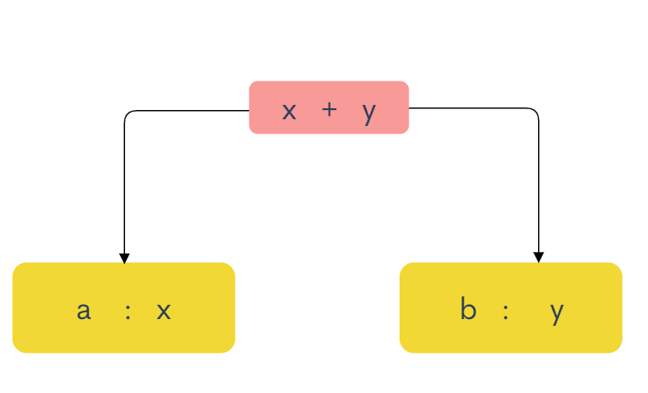
HUFFMAN ENCODING
The given string is converted to a BST whose nodes contain the character and their respective frequency.BST is converted to a heap
2 nodes of min frequency are retrieved from the heap.
New internal node is created with frequency as the sum of retrieved nodes.
This process continues until the heap is left with just a single node
Traverse the tree starting from the root. While moving to the left child, write 0 to the array and 1 while moving to the right

Slide 8
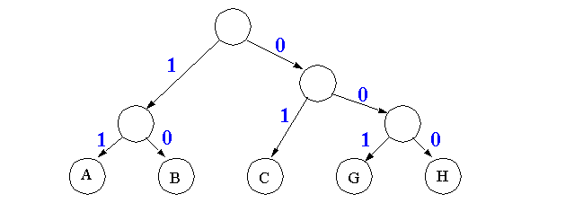
HUFFMAN DECODING
To decode the encoded data we require the Huffman tree. We iterate through the binary encoded data. To find character corresponding to current bits, we use following steps:
We start from root and do following until a leaf is found.
If current bit is 0, we move to left node of the tree and if the bit is 1, we move to right node of the tree.
During traversal, if we encounter a leaf node, we obtain the character of that particular leaf node and then again continue the iteration of the encoded data starting from root.

Slide 9
Our Process
02
A quick overview of our implementation

Slide 10
OUR PROCESS - Encoding :
READ
MaxHeap
Step 02
Step 04
Step 01
Step 03
Binary Search Tree
Huffman Tree Generation
We first read the given text file and convert it to a character array
The BST is broken down to a Node array which in turn is converted to a MaxHeap
After creating a char array, we load all the char in a BST with nodes consisting of char and frequency
Using the MaxHeap Node array , we implement the Huffman Algorithm and Form the Tree

Slide 11
OUR PROCESS - Decoding :
READ
Decoding
Step 02
Step 04
Step 01
Step 03
Huffman Tree
OutPut
We first read the given text file and store in a String variable
While traversing , we convert the Huffman Code to corresponding characters
We iterate through the String consisting of 0s and 1s and traverse the tree accordingly
The decoded String will be exported as a Text File

Slide 12
Result :
Consider a word : MalayalaM
M : 01001101
a : 01100001
l : 01101100
y : 01111001
Frequencies : M-2 , a-4 , l-2 , y-1
ASCII Notation :
Huffman Code :
M:111
a:0
l:10
Y:110

Slide 13

Compression Values :
Original Text File
Encoded/Compressed Huffman Text
DeCoded Huffman Text
We loaded a huge article from Wikipedia and stored it in a text file.

Slide 14
Result & Innovation
03
The Result of our implementation and further implementation

Slide 15
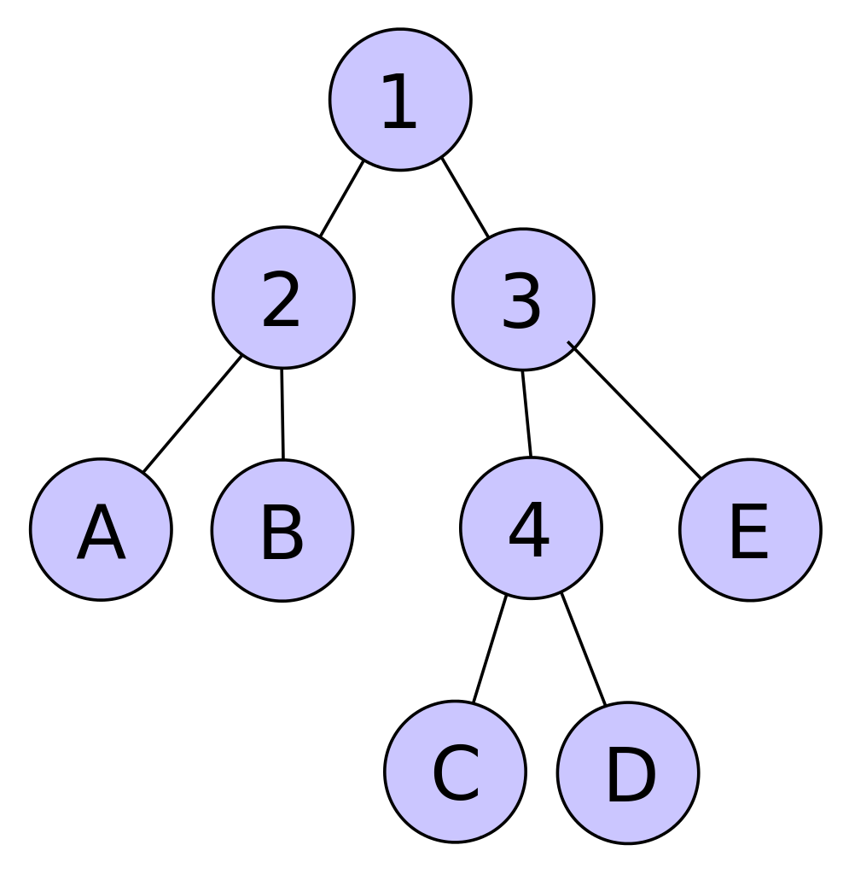

Our Innovation :
Huffman Compression:
Base64 :
/9j/4AAQSkZJRgABAQEASABIAAD/4gxYSUNDX1BST0ZJTEUAAQEAAAxITGlubwIQAABtbnRyUkdCIFhZ
Base64 :
/9j/4AAQSkZJRgABAQEASABIAAD/4gxYSUNDX1BST0ZJTEUAAQEAAAxITGlubwIQAABtbnRyUkdCIFhZ
Image :
Image :

Slide 16
WHY COMPRESS BASE64 ENCRYPTED TEXT AGAIN ?
The size of the base64 encrypted text file of the image is quite larger than the image itself.
Huffman Compression of this text file brings it back to the original file size with a double encryption, having a crypto-compression effect.
This not only helps us in compression but adds two layers of security and eases the file transfer of large files.

Slide 17
1,213,160 bytes
1.1 mB
SIZE OF BASE64 ENCRYPTED IMAGE
For an Image of size : 909 kB

Slide 18

Image Encryption
IMAGE SIZE
BASE64
HUFFMAN ENCODED BASE64
Size representation in Kb

Slide 19
THANK YOU
GitHub repository :
https://github.com/Data-Struct-Proj/proj-files/tree/master/src/proj/Final
Notes:
Rohith : 10,13,14,15
AADITYA :1,6,7,8,9
AYUSH : 5,16,17,18
Anirudh 11,12
Srinath : 2,3,4

