Slide 1





Bringing visibility to food security data results: harvests of PRAGMA and RDA AIST-IU-IRRI
Quan (Gabriel) Zhou, Venice Juanillas
Ramil Mauleon, Jason Haga, Inna Kouper, Beth Plale

Slide 2

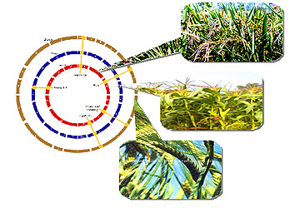





Bringing visibility to food security data results: harvests of PRAGMA and RDA Co-PIs: Beth Plale, Indiana University, USA; Jason Haga, AIST, Japan
Rice genome variant discovery
PRAGMA/Rocks compute VMs
Persistent ID Types (PIT)
Data Type Registry (DTR)
PRAGMA Data Service
Launch the use of two RDA products in Asia by utilizing the PRAGMA community and tools to work with a new rice genome group in the Philippines and implement software services at AIST (Japan) using the outputs of the PID Information Types and Data Type Registries Working Groups.
Goals:
Seek an agreeable PID attribute type profile to harvest data objects from varied scientific domains for wider adoption;
Implement RDA PIT and DTR recommendations to support data citation of rice genomes data objects;
Developed Software will be installed additionally at the National Data Service to stimulate adoption in the US.

Slide 3
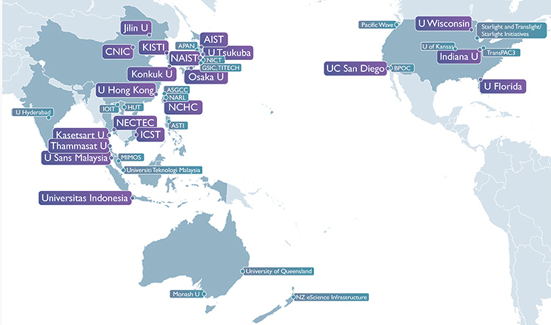
PRAGMA: A Community of Practice Enabling the Long Tail of Team Science
Founded in 2002, NSF funded
Framework for collaboration – people drive activities
Market place of ideas – trusted environment to share
Nurturing environment – support students and participants to learn and share resources
PRAGMA Members and Affiliates
http://www.pragma-grid.net/

Slide 4
Our Motivation
Use RDA PIT/DTR model to improve citation and sharing of scientific data objects by embedding minimum metadata in persistent data identifier
Provide a framework with both repository and PID service to provide long-term access and findability to heterogeneous data objects across scientific boundaries
Propose a methodology to automatically harvest data objects from scientific workflows and improve reproducibility of workflow execution
Page 3

Slide 5
Motivation for International Rice Research Institute (IRRI)
Enable collaborators to do genome wide association studies (GWAS) of their own phenotyping data for 3000 Rice Genomes using common analysis framework
Run the workflow selected, version the analysis done to support rice genomic workflow reproducibility for researchers
Provide means to share and cite GWAS analysis results back to IRRI
Page 4

Slide 6


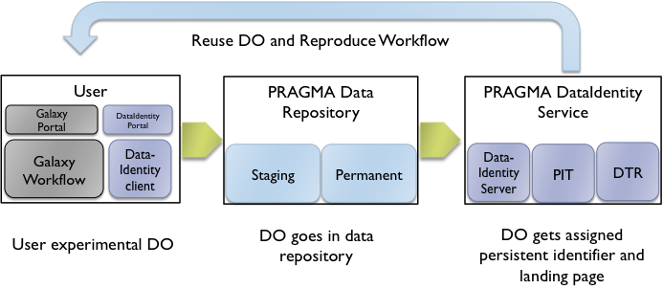
Data Object (DO) Lifecycle
1. End-user
2. Repository Service
3. PID Service
Reuse DO and Reproduce Workflow
User
PRAGMA Data
Repository
PRAGMA Data Service
Galaxy
Portal
Data Identity
Portal
MongoDB
Galaxy Workflow
Data Identity
client
Data-Identity
Server
PIT
DTR
User experimental DO
DO goes in
repository database
DO gets assigned persistent identifier and landing page
Page 5

Slide 7

Demo – Reproducing Rice Genomics Workflow
Page 6

Slide 8

Success to Date
The PRAGMA Data Services is a user transparent means of harvesting DOs from applications and assignment of PIDs to scientific outcomes
Modular architecture, informed by core members of the rice genomics team
Software is stable.
Built with default PID information types and metadata (RDA inside!)
High-impact, multi-disciplinary effort in the Pacific Rim
Cross WG interactions in RDA (Rice Data Interoperability)
Page 7

Slide 9
Future Work
Exploring the use of PRAGMA data services and repository in other domain applications running on and off the PRAGMA Cloud testbed
User interface and hardening over Fall 2016; Release early 2017
Refine metadata types based on user group study feedback
Extend data server (mongoDB) with basic preservation capabilities
Demonstrate the service on National Data Service (NDS)
Using experience to inform PID minimum metadata effort in Data Fabric IG
Page 8

Slide 10
QUESTIONS?
Come find us!
Jason Haga
Beth Plale
Ramil Mauleon
Gabriel Zhou
Poster #6
Funded in part by:
RDA US - MacArthur Foundation
PRAGMA NSF OCI-1234983
AIST ICT International Team
Special thanks to CNRI for hosting handle V8 server
Page 9

