Slide 1


PRAGMA-IRRI User Feedback IRRI-AIST-D2I
Presenter: Quan (Gabriel) Zhou
Venice Juanillas

Slide 2
Review: Purpose of TASSEL in Galaxy
3K RG project distributes seeds of the 3K RG panel for phenotyping of collaborating institutes/groups
Genotyping (SNP) dataset is already pre-defined by 3KRG publication
Enable collaborators to do their own GWAS analysis of their own phenotyping data for 3KRG using common analysis framework
Enable IRRI to collect phenotyping data and results of analysis of 3KRG from the collaborators
Page 1

Slide 3
Review: Typical use cases
Inside Galaxy
Input dataset (phenotype)
Built-in genotype dataset (3K RG core SNPs)
Upload phenotype data
Select phenotype data to merge;
Merge phenotype to genotype data
Pre-computed kinship matrix
GWAS MLM (parameters specified)
GWAS GLM (parameters specified)
GWAS GLM Results
GWAS MLM Results
Page 2

Slide 4
Review: Need to do in Galaxy
Install TASSEL data handling and compute steps (blue boxes) as Galaxy Tools
Define Galaxy workflows to execute each use case
Enable input of user-adjustable parameters of analysis
Run the workflow selected, version the analysis done
Workflow id
Input file used
Parameters supplied to tool in each step
Output file
Page 3

Slide 5
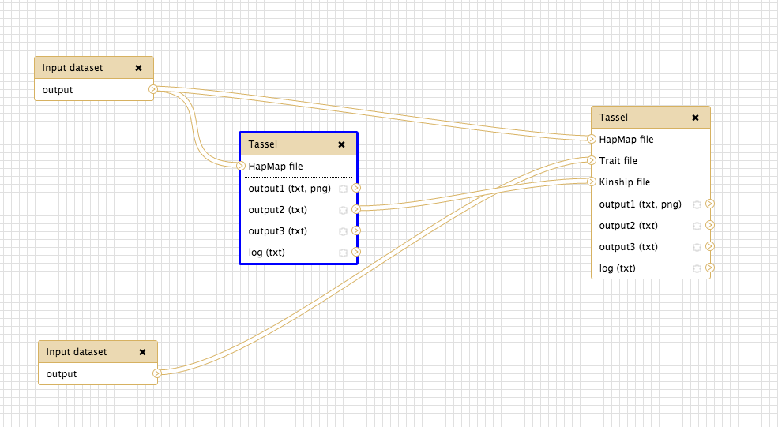
Galaxy Tassel Workflow (MLM Instance)
Page 4

Slide 6
Galaxy Resources we can harvest
Workflow History
Published history includes input, intermediate output and output data objects with minimum metadata
Published history includes log files containing runtime information (e.g., INFO level, ERROR level)
Can be retrieved with Galaxy API as tabular data
Workflow exported as .ga file (JSON format)
General information of workflow
Info about each computational steps (tools) including input, input connections, output, tool metadata and tool state (parameters)
Page 5

Slide 7
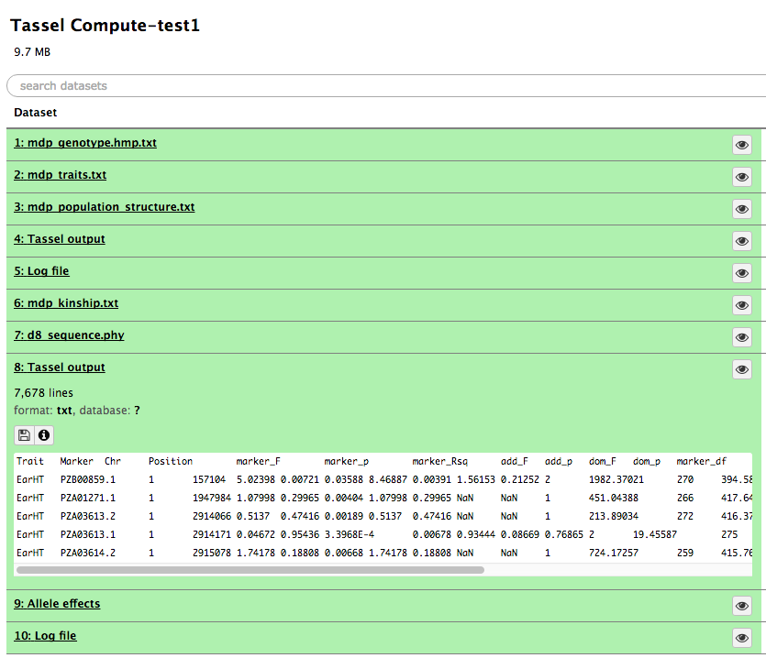
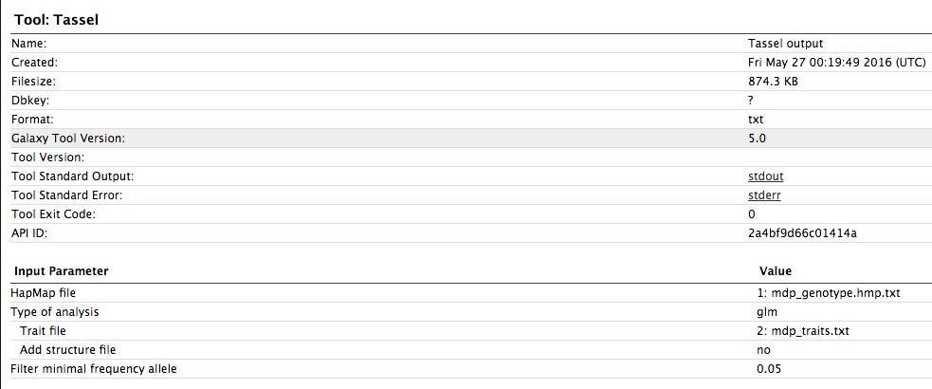
Galaxy Workflow History – Data
Page 6

Slide 8
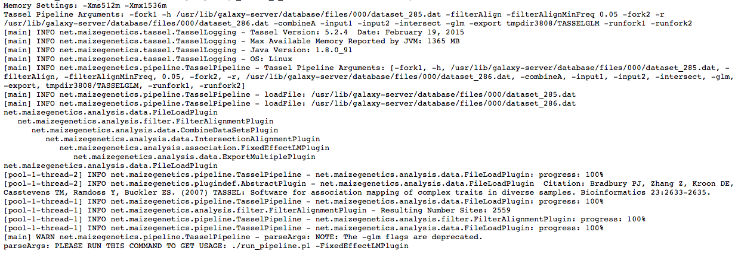
Galaxy Workflow History - Logging
Page 7

Slide 9
Workflow exported as JSON file
General Workflow information
Version
Name
Annotation
Computational Step information
Input connections (from which step’s output or initial input)
Inputs data
Output
Tool state (parameters, e.g., filterAlignMinFreq:0.05)
Tool version
Page 8

Slide 10
Proposed Design – DOs Harvest
ALT 1: Develop data identity service client as a galaxy tool to harvest input/intermediate/output DOs generated inside tassel workflow
User-friendly GUI support; Can be published as a Galaxy tool
Unable to harvest workflow information
ALT 2: Galaxy workflow can be triggered using run_pipeline script; DOs can be harvest through an instrumentation to the pipeline script.
After workflow is executed, the instrumentation block will harvest DOs (workflow, computational steps, data) from workflow JSON file, workflow history and workflow runtime logs
Page 9

Slide 11
Proposed Design – DOs Provenance
Layer-view of DOs provenance tracing
Baseline Provenance (Simple Derivative View)
Store as linkage between DO’s PIDs to provide core information of DOs derivations as simple DAG graph
Context Provenance (Contextual View)
High level provenance may contain contextual information such as processing log files or additional annotations
High level provenance can be built upon simple DAG provided by PID linkages and attached contextual information from external provenance system (e.g., Komadu)
T. Weigel, M. Lautenschlager, F. Toussaint, and S. Kindermann, “A Framework for Extended Persistent Identification of Scientific Assets”, Data Sci. J., vol. 12, 2013, pp. 10–22.
Page 10

Slide 12
Proposal Design Graph
Workflow
.ga file
Workflow
History
Step 1
Step 2
Step 3
……
Step N-1
Step N
Prospective Provenance
Retrospective Provenance
Workflow
DOs
Input/output
DOs
Data Identity Client
Komadu Provenance
Adaptor
Context
Provenance
Data Identity Server
Komadu Provenance
Storage
Page 11

Slide 13
Design Questions
To register PID for workflow, should we register 1 PID for the whole workflow or separately for each workflow computational steps? If separately, how could we present the linkage between workflow and its related steps?
For phenotypes or genotypes data, there are cases that one data object is merged by two data objects. Only predecessor and successor linkage in PID metadata profile is not quite sufficient to express the relations between DOs. Is it necessary to put more information (parent object PID, child object PID, etc.) into PID metadata profile to enrich the expression of relations between DOs?
Page 11

Slide 14
The End
Thanks!

