Slide 1
GlobalMart Supply Chain Analytics
Executive Capstone Project
Prepared by: Owolabi Kaothar Pelumi

Slide 2
Business Problem Overview
• Increasing delivery delays
• Inventory imbalance
• Flat profit margins despite revenue growth
• Limited visibility for decision making

Slide 3
Methodology
Raw Data → Power Query Cleaning → DAX KPIs → Interactive Dashboards → Business Insights

Slide 4
Data Overview & Structure
Rows: 1,784
Columns: 24
Date Range: 2023–2024
Suppliers: 13
Product Categories: 10
Regions: 5
Cleaning Performed:
• Removed duplicates
• Fixed date formats
• Corrected decimal inconsistencies
• Handled nulls
• Corrected invalid shipping records
• Fixed unit price/cost errors

Slide 5
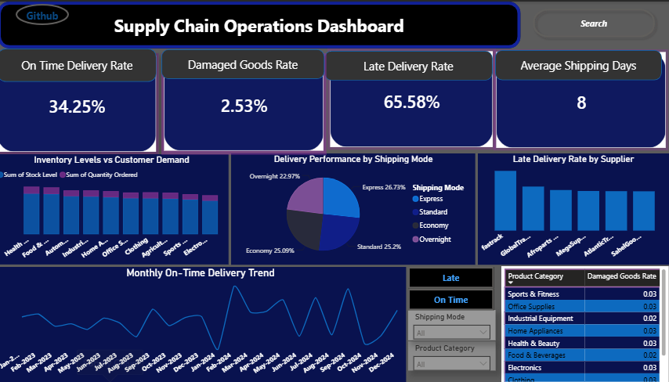
Delivery Performance Insights
• FastTrack had highest late deliveries
• Express most reliable
• Avg shipping: 8 days
• Health & Beauty highest damage
• March 2024 strongest on-time trend

Slide 6
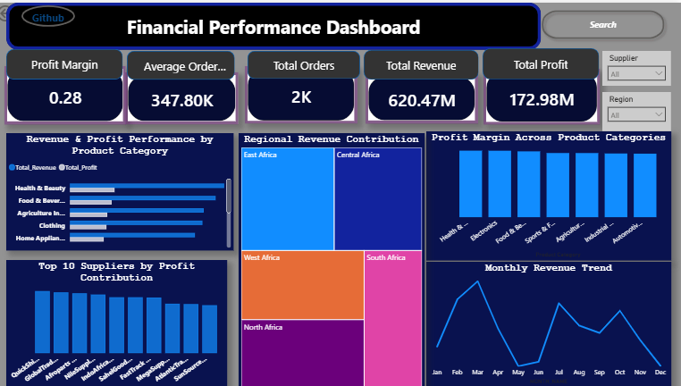
Profitability Analysis Insights
• Revenue: 620.47M
• Profit: 172.98M
• East Africa highest revenue
• Health & Beauty most profitable
• QuickShip Co top supplier

Slide 7
Inventory Optimization Insights
• Inventory generally aligned with demand
• Health & Beauty showed strongest demand
• Monitor categories with widening stock-demand gaps
• Improve replenishment planning

Slide 8
Business Trends & Patterns
• Revenue peaked in February, July and October
• Lowest revenue observed in seven months
• East Africa led regional performance
• Delivery performance varied by shipping mode

Slide 9
Strategic Recommendations
• Prioritize FastTrack supplier improvement
• Increase Express shipping for urgent orders
• Strengthen packaging for Health & Beauty
• Monitor revenue trends monthly
• Use dashboards for continuous KPI tracking

Slide 10
Conclusion & Next Steps
The dashboards provide actionable insights into supply chain efficiency and business profitability.
Continuous monitoring of delivery, inventory and financial KPIs will support faster and better strategic decisions.

