Slide 1
Location for NYC’s First Coffee Outlet in Toronto
Project Presentation
XYZ Consultancy Company

Slide 2
Introduction
Nanyang Coffee Company (NYC) is a major supplier of the processed coffee beans used in the Nanyang style of coffee popularly drank by the people of Southeast Asia.
NYC is keen to expand to North America
Identified Canada as a promising country for its maiden entry into the North American market
NYC plan to set up specialty coffee retail outlet offering a range of roasted coffee products and take-away drinks.
Earmarked the city of Toronto as its first city in Canada to expand
Toronto largest Southeast Asian population in Canada

Slide 3
Goal and Objective
Goal is to maximize the awareness and penetration of the Nanyang coffee among the coffee drinking consumers, measures in terms of sales of this first outlet.
Objective of the study is to identify the neighborhood in Toronto to locate this first NYC outlet
Outlet should best maximize the awareness and sales of the Nanyang coffee among the targeted customer
Key assumptions
Identify neighborhood based on relatively high concentration of coffee shops and cafes, and (2) ethnic Southeast Asian restaurants
indicative of a population of ethnic Southeast Asian customers who drinks coffee.
Based on NYC’s understanding of customers in home region i.e. Southeast Asians often patronize coffee outlets to drink coffee and socialized as a post dinner activity

Slide 4
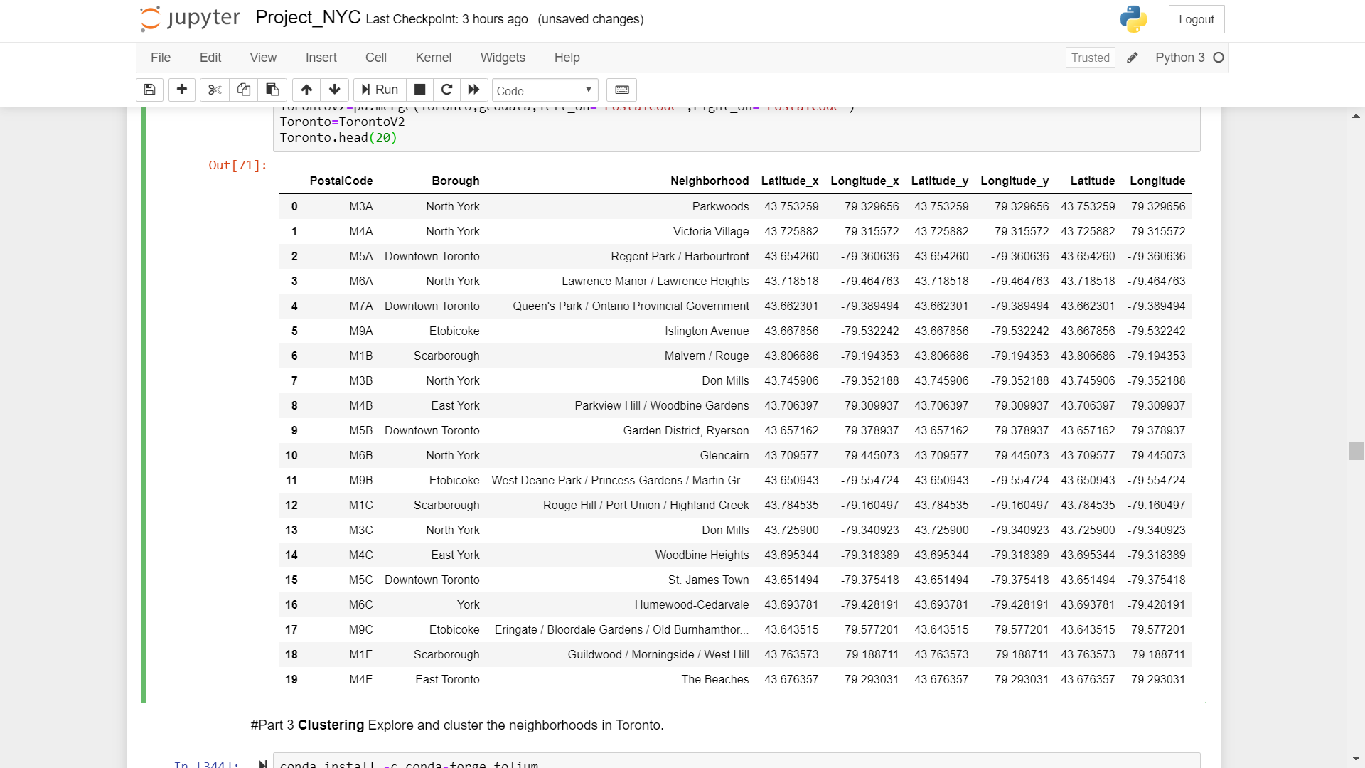
Data (1/2)
Geographical Data: Comprises (1) postal codes of boroughs in Toronto, (2) boroughs and associated neighborhoods in Toronto and (3) latitudes and longitudes of the neighborhood
https://en.wikipedia.org/wiki/List_of_postal_codes_of_Canada:_M.
http://cocl.us/Geospatial_data
Geographical Data Sample

Slide 5
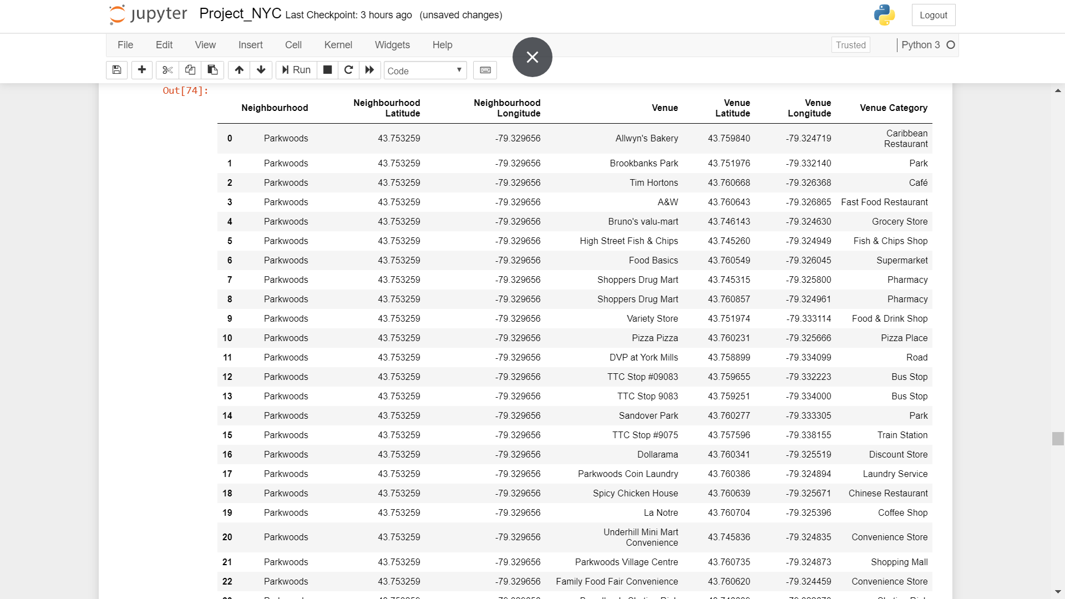
Data (2/2)
Venue Data: Data on restaurants, ethnic Southeast Asian (SEA) restaurants and coffee outlet in each neighbourhood obtained from Foursquare.
Venue data integrated with geographical data as master data for subsequent analysis
Geographical Data Sample

Slide 6
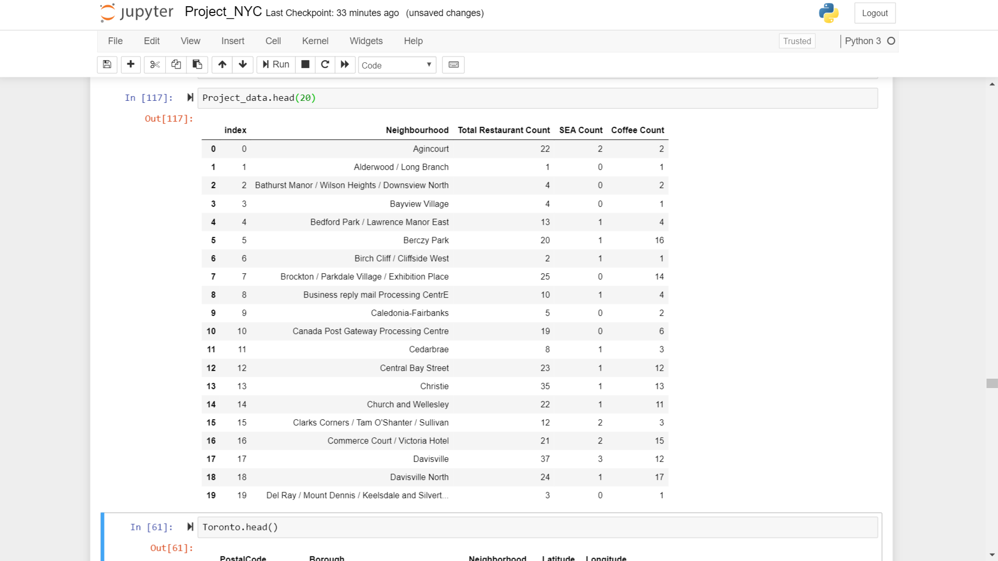
Methodology (1/2)
Wrangling
Extract the different type of restaurants i.e. 62 different types
Extract the different type of SEA restaurants i.e. (1) Thai, (2) Vietnamese, (3) Indonesian, (4) Malay and (5) Filipino
Extract the coffee outlets
Sum the above for each neighborhood
Clean and combine into data frame
Dataframe Sample

Slide 7
Methodology (1/2)
Analysis
Basic statistics using the ‘describe’ method in panda
Identify the neighbourhoods with highest number of SEA restaurants and coffee outlets
Understand correlation between number of restaurants, number of SEA restaurants and number of coffee outlets in each neighbourhood
K-Means Cluster the neighbourhoods based on number of restaurants, number of SEA restaurants and number of coffee outlets in each neighbourhood to identify patterns
Visualisation
Visualise location of selected neighbourhoods to refine location
Visualise distributions of clusters of neighbourhoods to identify patterns and enhance location of NYC outlet

Slide 8
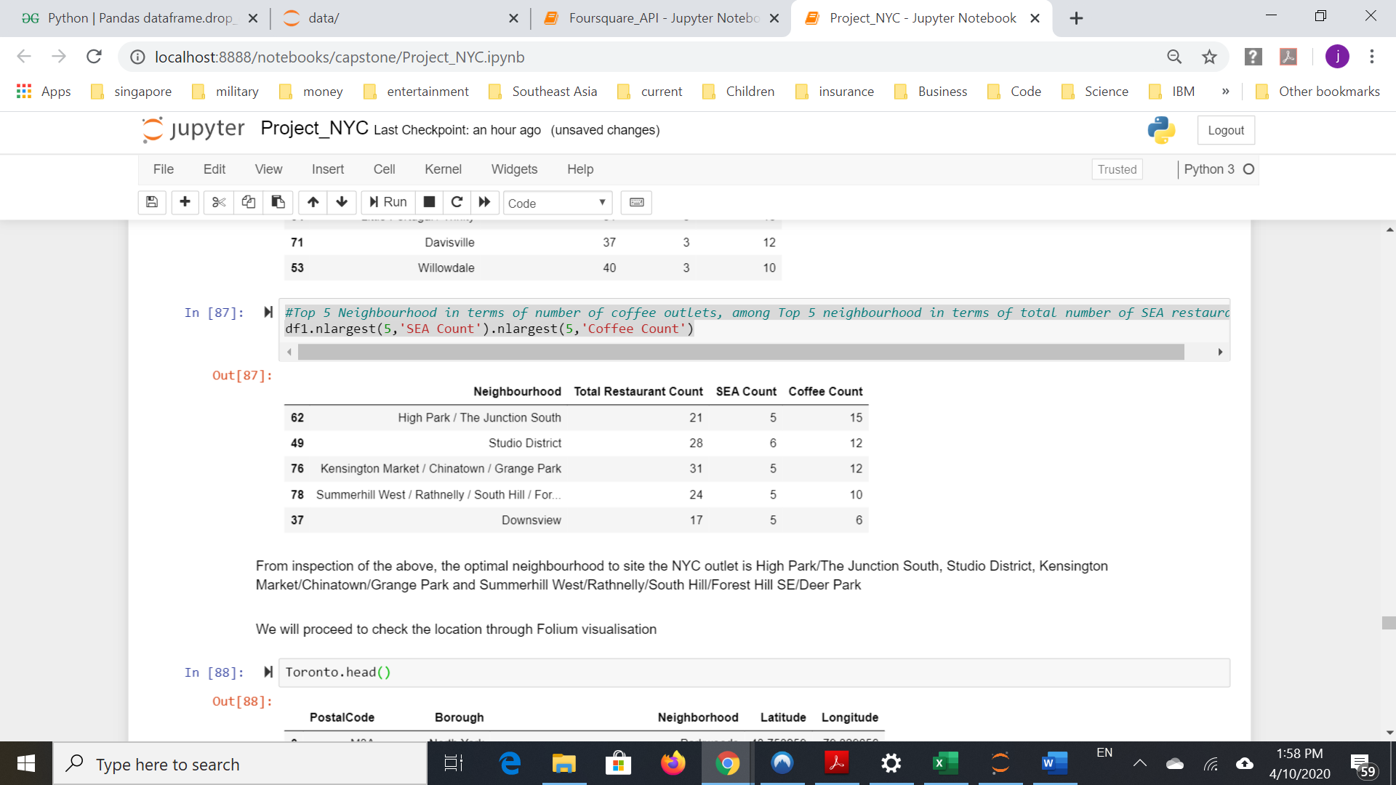
Results (1/4)
‘nlargest’ method indicate the optimal neighbourhoods to site the NYC outlet could be
High Park/The Junction South
Studio District
Kensington Market/Chinatown/Grange Park
Summerhill West/Rathnelly/South Hill/Forest Hill SE/Deer Park.
nlargest result

Slide 9
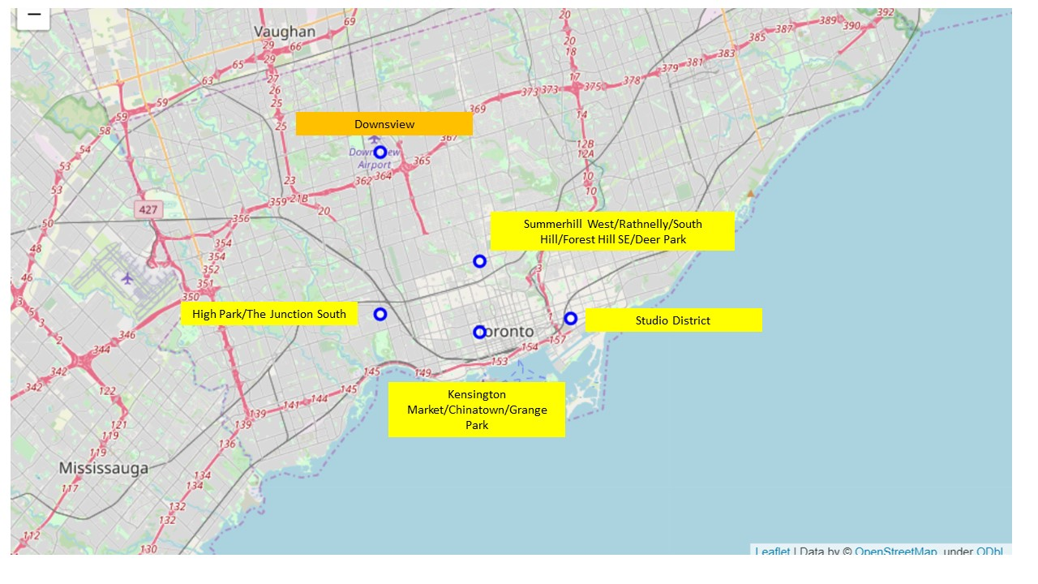
Results (2/4)
Visualisation via Folium indicate the optimal neighbourhoods to site the NYC outlet could be Kensington Market/Chinatown/Grange Park
All (less Downsview) forms a cluster in downtown Toronto
Closest distance to the other neighbourhood in the cluster
Most meet the criteria in hypothesis

Slide 10
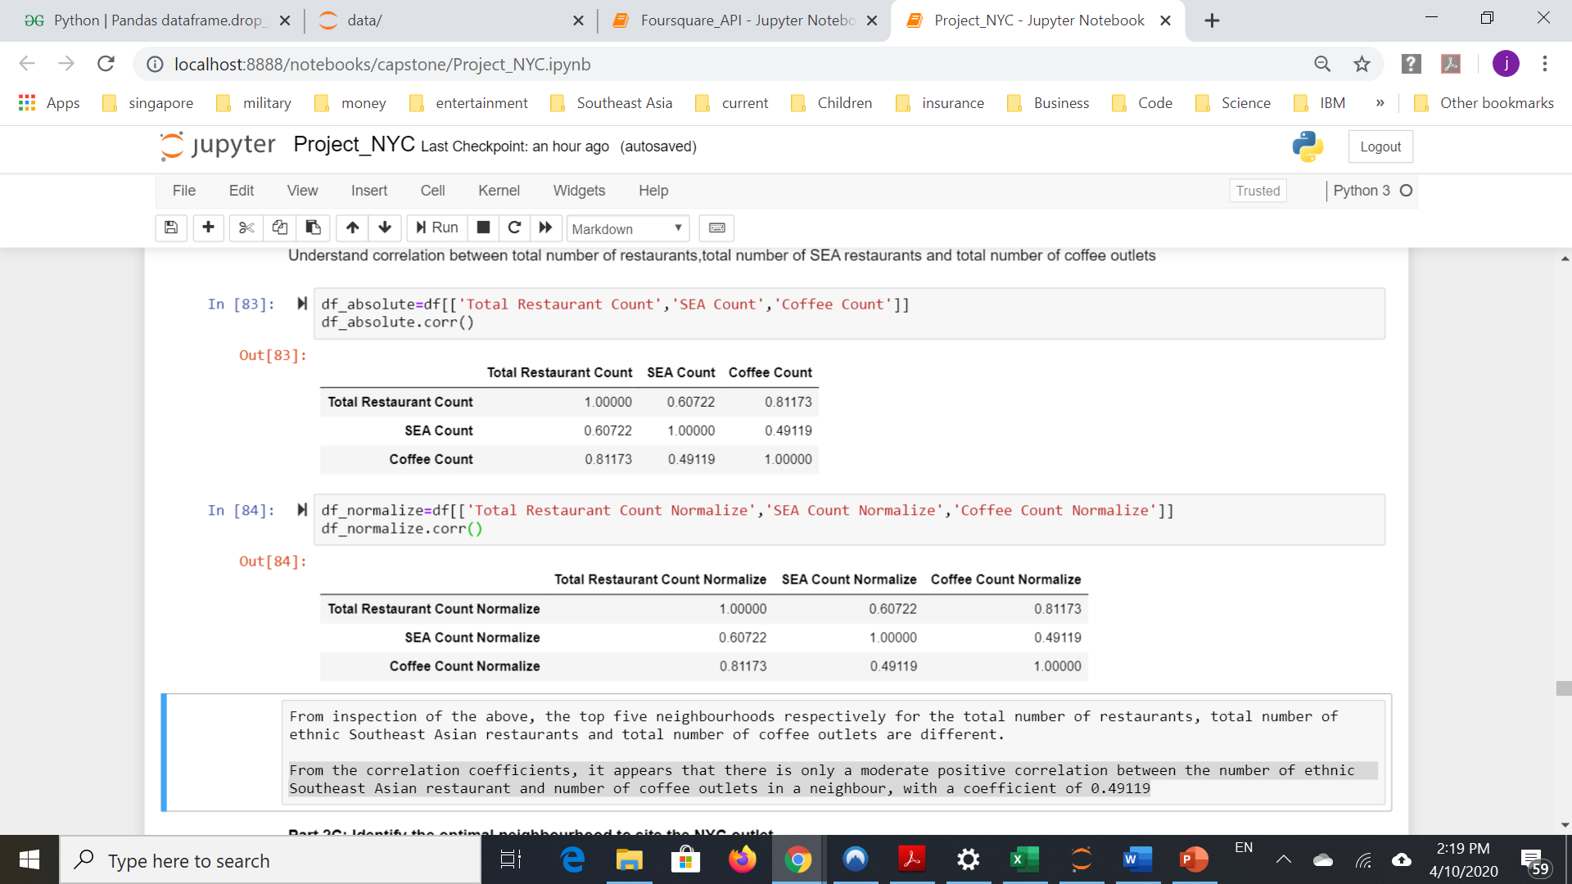
Results (3/4)
Moderate positive correlation between the number of ethnic Southeast Asian restaurant and number of coffee outlets in a neighbourhood.
Correlation Analysis

Slide 11
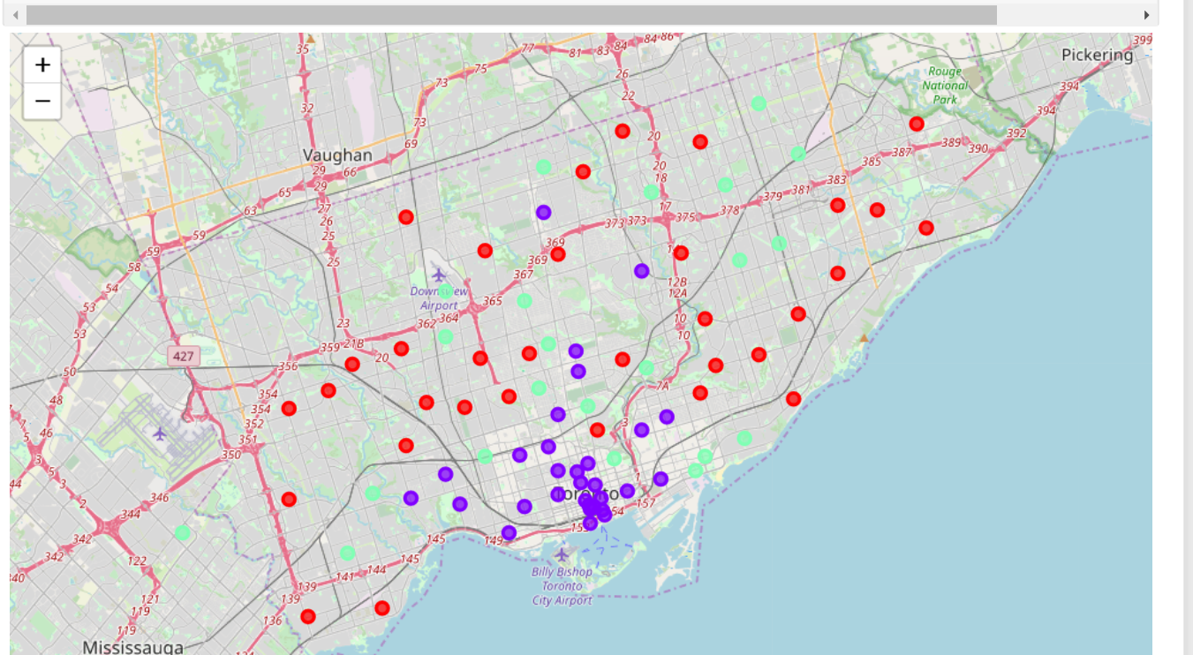
Results (4/4)
Three major clusters identified :
(1) low concentration of restaurants (of all sort) and coffee outlets
(2) high concentrations of restaurant and coffee outlets
(3) moderate concentration of restaurants (include SEA) and coffee outlets
Kensington Market/Chinatown/Grange Park as the location for the NYC at the center where most of Cluster 2 is located i.e. downtown Toronto.

Slide 12
Discussion
Recommends that the neighbourhood of Kensington Market/Chinatown/Grange Park as the location for the NYC outlet
Center of a cluster of neighbourhoods with relatively high concentration of restaurants (including SEA restaurants) and coffee outlets
Most advantageous in facilitating access to and exposure to the NYC outlet by potential customers.
Further study the assumption that Southeast Asians like to go for coffee after meals and the relevance of this assumption to ethnic Southeast Asians consumers in the Canadian market
Moderate positive correlation between the number of Southeast Asian restaurants and coffee outlets in the neighbourhoods in Toronto.
More data needed for more robust modelling to ascertain strength of relations

Slide 13
Conclusion
Recommends NYC to:
locate its first outlet in the neighbourhood of Kensington Market/Chinatown/Grange Park;
Undertake a deeper study on the behaviors and characteristics of its key targeted customer segments in the Canadian market.
Follow on works that the company could undertake on behalf of NYC to better optimize its product and service offerings in its first NYC outlet in Toronto
Finer differentiation of its target customer segments in the Canadian market
Analysis of the spending and consumption habits of its targeted customer segment

