Slide 1
Films
Rose Campos, Jessenia Contreras

Slide 2
Data Introduction
This data was collected by attendees of the University of Texas at Austin in 2017 for a Journal of Media Psychology publication. The goal of the original source was to determine how enjoyment and appreciation could impact viewers aggregate appraisals. The data used is available for download and review at Data.World.
Sample pool: 282
Only 69 males
Age Distribution: 19 to 37
Median Age: 22.25
Ethinicity Distribution:
39% was Caucasian
31.5% was Asian
~13.5% was Hispanic
~2% was African American
~12% Unknown
Remaining % Pacific Islanders and other ethnicities

Slide 3
Data Preparation
Below, we load in the packages we’ll be using to analyse our data.
#Packages loading to use library(tidyverse) ##Loaded for dplyr and to 'clean' data
## ── Attaching core tidyverse packages ──────────────────────── tidyverse 2.0.0 ── ## ✔ dplyr 1.1.4 ✔ readr 2.1.5 ## ✔ forcats 1.0.0 ✔ stringr 1.5.1 ## ✔ ggplot2 3.5.0 ✔ tibble 3.2.1 ## ✔ lubridate 1.9.3 ✔ tidyr 1.3.1 ## ✔ purrr 1.0.2 ## ── Conflicts ────────────────────────────────────────── tidyverse_conflicts() ── ## ✖ dplyr::filter() masks stats::filter() ## ✖ dplyr::lag() masks stats::lag() ## ℹ Use the conflicted package (<http://conflicted.r-lib.org/>) to force all conflicts to become errors
library(ggplot2) ##Loaded for plotting library(dplyr) ##Loaded for computer issues ##Read in data and save it to variable raw_data raw_data <- read.csv(file = "popular_film_data.csv")

Slide 4
Cleaning and Mutating Data
Some of the data contained in the the variables InflatedBudget, InflatedGross, and TotalGross have symbols such as “$” and and “,”. These symbols cause the the information in them to be read as characters rather then as integers. We use gsub to remove these symbols. Additionally, we mutated a variable called Proportion_female so we could store the female ratio of the sample group for that film.
#To remove "$" and "," from InflatedBudget raw_data$InflatedBudget <- gsub("\\$","", raw_data$InflatedBudget) raw_data$InflatedBudget <- as.numeric(gsub(",","", raw_data$InflatedBudget)) #To remove "$" and "," from InflatedGross raw_data$InflatedGross <- gsub("\\$","", raw_data$InflatedGross) raw_data$InflatedGross <- as.numeric(gsub(",","", raw_data$InflatedGross)) #To remove "$" and "," from TotalGross raw_data$TotalGross <- gsub("\\$","", raw_data$TotalGross) raw_data$TotalGross <- as.numeric(gsub(",","", raw_data$TotalGross)) #Mutating for new column stored in Proportion_female raw_data <- raw_data |> mutate (Proportion_female = (1 - Proportion_male))

Slide 5
Glimpse(raw_data)
#To view our data with the new variable. glimpse(raw_data)
## Rows: 50 ## Columns: 66 ## $ BoxOfficeMojo <int> 0, 0, 0, 0, 0, 1, 0, 0, 0, 0, 0, 0, 0, 0, 0, 0, 0… ## $ IMDB <int> 1, 1, 1, 1, 1, 1, 1, 1, 1, 1, 1, 1, 1, 1, 1, 1, 1… ## $ OriginalOrder <int> 1, 2, 3, 4, 5, 6, 7, 8, 9, 10, 11, 12, 13, 14, 15… ## $ FilmName <chr> "Shawshank_Classic", "Godfather_Classic", "Godfat… ## $ Classic <dbl> 0.87, 0.91, 0.74, 0.83, 0.49, 0.62, 0.70, 0.84, 0… ## $ ImDb_A <int> 1, 1, 1, 1, 1, 1, 1, 1, 1, 1, 1, 1, 1, 1, 1, 1, 1… ## $ Boxofficemojo_A <int> 0, 0, 0, 0, 0, 1, 0, 0, 1, 0, 0, 0, 0, 0, 0, 0, 0… ## $ Year <int> 1994, 1972, 1974, 1994, 1966, 2008, 1957, 1993, 2… ## $ InflatedBudget <dbl> 38705260, 32966408, 60592133, 1238568, 8501703, 1… ## $ TotalGross <dbl> 28341469, 245066411, 47542841, 213928762, 2510000… ## $ InflatedGross <dbl> 43878557, 1346493234, 221594012, 331206735, 17782… ## $ V15 <chr> "Shawshank", "Godfather", "Godfather p 2", "Pulp … ## $ Check_enj_label <chr> "Shawshank_enj", "Godfather_enj", "Godfather p 2_… ## $ Proportion_male <dbl> 0.38, 0.38, 0.42, 0.40, 0.44, 0.31, 0.33, 0.32, 0… ## $ Appr_alphas <dbl> 0.904, 0.938, 0.914, 0.835, 0.848, 0.923, 0.944, … ## $ Enj_alphas <dbl> 0.878, 0.906, 0.897, 0.918, 0.954, 0.838, 0.869, … ## $ Enjoyment <dbl> 5.508251, 5.428571, 5.254545, 5.763052, 4.911111,… ## $ Enjoyment_SD <dbl> 1.341305, 1.325478, 1.242200, 1.118373, 1.089600,… ## $ ViewerCount_enj <int> 101, 77, 55, 83, 30, 188, 53, 78, 113, 112, 84, 1… ## $ Check_appr_label <chr> "Shawshank_appr", "Godfather_appr", "Godfather p … ## $ Appreciation <dbl> 6.217822, 5.447368, 5.351852, 4.947791, 4.440860,… ## $ Appr_SD <dbl> 1.0692008, 1.3505035, 1.3681257, 1.3748436, 1.062… ## $ ViewerCount_appr <int> 101, 76, 54, 83, 31, 188, 52, 78, 112, 112, 84, 1… ## $ Crime <int> 1, 1, 1, 1, 0, 1, 1, 0, 0, 0, 0, 0, 0, 1, 0, 0, 0… ## $ Drama <int> 1, 1, 1, 1, 0, 1, 1, 1, 0, 1, 0, 0, 1, 1, 1, 0, 0… ## $ Western <int> 0, 0, 0, 0, 1, 0, 0, 0, 0, 0, 0, 0, 0, 0, 0, 0, 0… ## $ Action <int> 0, 0, 0, 0, 0, 1, 0, 0, 0, 0, 1, 0, 0, 0, 0, 1, 1… ## $ Biography <int> 0, 0, 0, 0, 0, 0, 0, 1, 0, 0, 0, 0, 0, 1, 0, 0, 0… ## $ History <int> 0, 0, 0, 0, 0, 0, 0, 1, 0, 0, 0, 0, 0, 0, 0, 0, 0… ## $ Adventure <int> 0, 0, 0, 0, 0, 0, 0, 0, 1, 0, 1, 1, 0, 0, 0, 0, 1… ## $ Fantasy <int> 0, 0, 0, 0, 0, 0, 0, 0, 1, 0, 1, 1, 0, 0, 0, 0, 1… ## $ Mystery <int> 0, 0, 0, 0, 0, 0, 0, 0, 0, 0, 0, 0, 0, 0, 0, 1, 0… ## $ SciFi <int> 0, 0, 0, 0, 0, 0, 0, 0, 0, 0, 0, 0, 0, 0, 0, 1, 0… ## $ Romance <int> 0, 0, 0, 0, 0, 0, 0, 0, 0, 0, 0, 0, 0, 0, 0, 0, 0… ## $ Thriller <int> 0, 0, 0, 0, 0, 0, 0, 0, 0, 0, 0, 0, 0, 0, 0, 0, 0… ## $ War <int> 0, 0, 0, 0, 0, 0, 0, 0, 0, 0, 0, 0, 0, 0, 0, 0, 0… ## $ Family <int> 0, 0, 0, 0, 0, 0, 0, 0, 0, 0, 0, 0, 0, 0, 0, 0, 0… ## $ Animation <int> 0, 0, 0, 0, 0, 0, 0, 0, 0, 0, 0, 0, 0, 0, 0, 0, 0… ## $ Comedy <int> 0, 0, 0, 0, 0, 0, 0, 0, 0, 0, 0, 0, 0, 0, 0, 0, 0… ## $ MovieImdbID <int> 111161, 442781, 71562, 110912, 60196, 468569, 500… ## $ UserRank <chr> "bronze member", "administrator", "gold member", … ## $ SubDownloadsCnt <int> 1124, 99, 5510, 456, 140, 5524, 12689, 734, 535, … ## $ TotalWords <int> 4645, 12610, 2002, 16555, 4609, 12833, 12738, 396… ## $ HarmVirtue <int> 7, 40, 3, 11, 10, 36, 9, 5, 23, 18, 0, 32, 5, 26,… ## $ HarmVirtueratio <dbl> 0.001507, 0.003172, 0.001499, 0.000664, 0.002170,… ## $ HarmVice <int> 8, 57, 10, 54, 16, 48, 69, 6, 55, 79, 12, 28, 15,… ## $ HarmViceratio <dbl> 0.001722, 0.004520, 0.004995, 0.003262, 0.003471,… ## $ FairnessVirtue <int> 4, 0, 1, 4, 6, 12, 17, 0, 2, 6, 0, 5, 2, 2, 1, 1,… ## $ FairnessVirtueratio <dbl> 0.000861, 0.000000, 0.000500, 0.000242, 0.001302,… ## $ FairnessVice <int> 0, 0, 0, 0, 0, 0, 3, 0, 0, 0, 0, 1, 0, 2, 1, 1, 0… ## $ FairnessViceratio <dbl> 0.00000, 0.00000, 0.00000, 0.00000, 0.00000, 0.00… ## $ IngroupVirtue <int> 7, 16, 10, 8, 2, 22, 2, 4, 4, 21, 4, 10, 5, 28, 2… ## $ IngroupVirtueratio <dbl> 0.001507, 0.001269, 0.004995, 0.000483, 0.000434,… ## $ IngroupVice <int> 1, 2, 0, 1, 4, 4, 0, 1, 16, 6, 1, 20, 1, 0, 6, 5,… ## $ IngroupViceratio <dbl> 0.000215, 0.000159, 0.000000, 0.000060, 0.000868,… ## $ AuthorityVirtue <int> 7, 136, 18, 31, 20, 31, 46, 12, 24, 22, 3, 20, 9,… ## $ AuthorityVirtueratio <dbl> 0.001507, 0.010785, 0.008991, 0.001873, 0.004339,… ## $ AuthorityVice <int> 0, 3, 1, 3, 4, 3, 0, 1, 5, 0, 8, 5, 2, 3, 0, 1, 2… ## $ AuthorityViceratio <dbl> 0.000000, 0.000238, 0.000500, 0.000181, 0.000868,… ## $ PurityVirtue <int> 8, 10, 2, 8, 3, 7, 5, 0, 0, 9, 0, 2, 2, 6, 2, 2, … ## $ PurityVirtueratio <dbl> 0.001722, 0.000793, 0.000999, 0.000483, 0.000651,… ## $ PurityVice <int> 1, 15, 3, 10, 17, 3, 5, 0, 7, 10, 0, 4, 4, 9, 5, … ## $ PurityViceratio <dbl> 0.000215, 0.001190, 0.001499, 0.000604, 0.003688,… ## $ MoralityGeneral <int> 14, 59, 14, 104, 30, 48, 35, 25, 13, 32, 6, 40, 3… ## $ MoralityGeneralratio <dbl> 0.003014, 0.004679, 0.006993, 0.006282, 0.006509,… ## $ Proportion_female <dbl> 0.62, 0.62, 0.58, 0.60, 0.56, 0.69, 0.67, 0.68, 0…

Slide 6
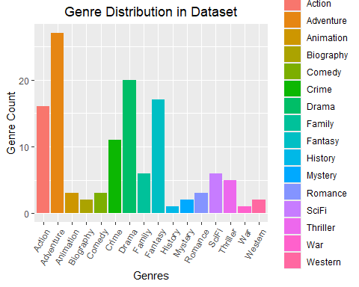
Data Analysis
## The year range of our data is 1942 to 2013 .
## ## Our dataset is made up of 50 films.

Slide 7
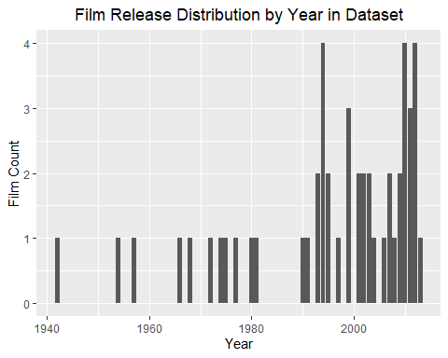
Film Count by Year

Slide 8
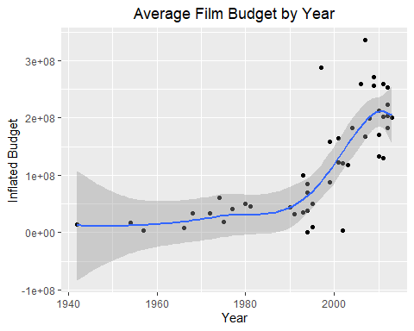
Average Budget by Year

Slide 9
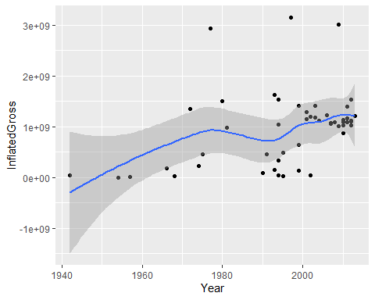
Inflated Grossing v. Year

Slide 10
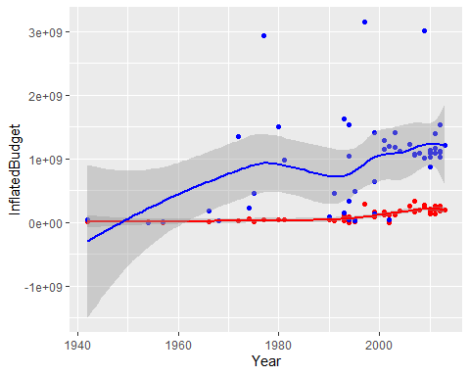
InflatedGross v. InflatedBudget by Year

Slide 11
InflatedGross v. InflatedBudget by Year (Side-By-Side)

Slide 12
Genres

Slide 13
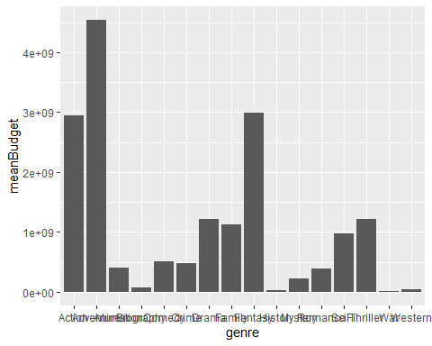
Mean Inflated Grossing v. Mean Inflated Budget for Genres

Slide 14
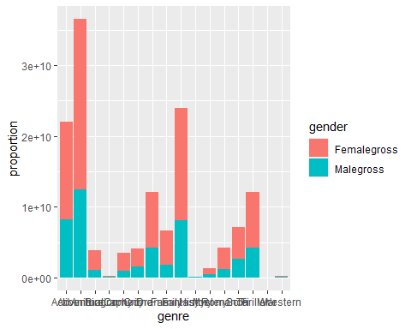
Female v. Male for Genre Mean Inflated Grossing

Slide 15
###T
#genre enjoyment genre_enj <- rbind(cbind(genre = "Comedy", raw_data %>% filter(Comedy == 1) %>% summarise(meanenj = mean(Enjoyment))), cbind(genre = "Drama", raw_data %>% filter(Drama == 1) %>% summarise(meanenj = mean(Enjoyment))), cbind(genre = "Western", raw_data %>% filter(Western == 1) %>% summarise(meanenj = mean(Enjoyment))), cbind(genre = "Action", raw_data %>% filter(Action == 1) %>% summarise(meanenj = mean(Enjoyment))), cbind(genre = "Biography", raw_data %>% filter(Biography == 1) %>% summarise(meanenj = mean(Enjoyment))), cbind(genre = "History", raw_data %>% filter(History == 1) %>% summarise(meanenj = mean(Enjoyment))), cbind(genre = "Adventure", raw_data %>% filter(Adventure == 1) %>% summarise(meanenj = mean(Enjoyment))), cbind(genre = "Fantasy", raw_data %>% filter(Fantasy == 1) %>% summarise(meanenj = mean(Enjoyment))), cbind(genre = "Mystery", raw_data %>% filter(Mystery == 1) %>% summarise(meanenj = mean(Enjoyment))), cbind(genre = "SciFi", raw_data %>% filter(SciFi == 1) %>% summarise(meanenj = mean(Enjoyment))), cbind(genre = "Romance", raw_data %>% filter(Romance == 1) %>% summarise(meanenj = mean(Enjoyment))), cbind(genre = "Thriller", raw_data %>% filter(Thriller == 1) %>% summarise(meanenj = mean(Enjoyment))), cbind(genre = "Crime", raw_data %>% filter(Crime == 1) %>% summarise(meanenj = mean(Enjoyment))), cbind(genre = "War", raw_data %>% filter(War == 1) %>% summarise(meanenj = mean(Enjoyment))), cbind(genre = "Family", raw_data %>% filter(Family == 1) %>% summarise(meanenj = mean(Enjoyment))), cbind(genre = "Animation", raw_data %>% filter(Animation == 1) %>% summarise(meanenj = mean(Enjoyment))))%>% arrange(desc(meanenj)) genre_enj |> slice(which(meanenj ==max(meanenj) | meanenj == min(meanenj))) |> distinct()
## genre meanenj ## 1 Animation 6.42 ## 2 History 4.23
#genre appreaction genre_app <- rbind(cbind(genre = "Comedy", raw_data %>% filter(Comedy == 1) %>% summarise(meanapp = mean(Appreciation))), cbind(genre = "Drama", raw_data %>% filter(Drama == 1) %>% summarise(meanapp = mean(Appreciation))), cbind(genre = "Western", raw_data %>% filter(Western == 1) %>% summarise(meanapp = mean(Appreciation))), cbind(genre = "Action", raw_data %>% filter(Action == 1) %>% summarise(meanapp = mean(Appreciation))), cbind(genre = "Biography", raw_data %>% filter(Biography == 1) %>% summarise(meanapp = mean(Appreciation))), cbind(genre = "History", raw_data %>% filter(History == 1) %>% summarise(meanapp = mean(Appreciation))), cbind(genre = "Adventure", raw_data %>% filter(Adventure == 1) %>% summarise(meanapp = mean(Appreciation))), cbind(genre = "Fantasy", raw_data %>% filter(Fantasy == 1) %>% summarise(meanapp = mean(Appreciation))), cbind(genre = "Mystery", raw_data %>% filter(Mystery == 1) %>% summarise(meanapp = mean(Appreciation))), cbind(genre = "SciFi", raw_data %>% filter(SciFi == 1) %>% summarise(meanapp = mean(Appreciation))), cbind(genre = "Romance", raw_data %>% filter(Romance == 1) %>% summarise(meanapp = mean(Appreciation))), cbind(genre = "Thriller", raw_data %>% filter(Thriller == 1) %>% summarise(meanapp = mean(Appreciation))), cbind(genre = "Crime", raw_data %>% filter(Crime == 1) %>% summarise(meanapp = mean(Appreciation))), cbind(genre = "War", raw_data %>% filter(War == 1) %>% summarise(meanapp = mean(Appreciation))), cbind(genre = "Family", raw_data %>% filter(Family == 1) %>% summarise(meanapp = mean(Appreciation))), cbind(genre = "Animation", raw_data %>% filter(Animation == 1) %>% summarise(meanapp = mean(Appreciation))))%>% arrange(desc(meanapp)) genre_app |> slice(which(meanapp ==max(meanapp) | meanapp == min(meanapp))) |> distinct()
## genre meanapp ## 1 History 6.367521 ## 2 Western 4.364370
Let see what movie is actually the best.
raw_data |> slice_max(Appreciation, n = 10)|> select(FilmName,Appreciation, Enjoyment)
## FilmName Appreciation Enjoyment ## 1 SchindlersList_Classic 6.367521 4.230000 ## 2 ForrestGump_Classic 6.303972 6.160000 ## 3 Shawshank_Classic 6.217822 5.508251 ## 4 LionKing_Classic 6.005979 6.450000 ## 5 Titanic_Classic 5.830357 5.640000 ## 6 ToyStory3_Classic 5.760360 6.350000 ## 7 CuckoosNest_Classic 5.743590 5.170000 ## 8 FightClub_Classic 5.648810 5.820000 ## 9 Inception_Classic 5.617284 5.980000 ## 10 FindingNemo_Classic 5.560332 6.460000
raw_data |> slice_max(Enjoyment, n = 10) |> select(FilmName, Enjoyment, Appreciation)
## FilmName Enjoyment Appreciation ## 1 FindingNemo_Classic 6.460000 5.560332 ## 2 LionKing_Classic 6.450000 6.005979 ## 3 ToyStory3_Classic 6.350000 5.760360 ## 4 ForrestGump_Classic 6.160000 6.303972 ## 5 HPSorcerersStone_Classic 6.100000 5.043519 ## 6 HPDeathlyHallows2_Classic 6.080000 5.371622 ## 7 StarWars_Classic 6.070000 4.991736 ## 8 TheAvengers_Classic 6.060000 4.000000 ## 9 DarkKnight_Classic 6.048759 5.320035 ## 10 DarkKnightRises_Classic 5.990000 5.179563
raw_data |> slice_max(InflatedGross, n = 10) |> select(FilmName, InflatedGross, Appreciation, Enjoyment)
## FilmName InflatedGross Appreciation Enjoyment ## 1 Titanic_Classic 3153199889 5.830357 5.64 ## 2 Avatar_Classic 3014400460 5.245989 5.86 ## 3 StarWars_Classic 2939933749 4.991736 6.07 ## 4 JurassicPark_Classic 1634773761 4.625259 5.87 ## 5 TheAvengers_Classic 1541373834 4.000000 6.06 ## 6 LionKing_Classic 1528832656 6.005979 6.45 ## 7 StarWars5_Classic 1499045455 4.964286 5.85 ## 8 StarWarsI_Classic 1419296470 4.512821 5.50 ## 9 LRReturnKing_Classic 1411841983 4.994048 5.78 ## 10 HPDeathlyHallows2_Classic 1390228199 5.371622 6.08

Slide 16
Questions
Which movies were top rated in appreciation / enjoyment?
Which genre have the highest appreciation rating?
Which genre have the highest enjoyment rating? which genre cost more to produce? dome which genre has the highest income? Which sex contributes more to that income. Mutate each film to multiply ratio by income. Then Summarize by genre = true. Repeat for male so you can see both contributions. **We still have the classical-ness and popularity to mess around with.
Gender and how it affects budget. (Which gender contributes more to the gross of each genre- after budge/gross | pink blue) apreciation per genre enjoyment and genre

