Slide 1
RansomwareAttacksAnalysis
Zack Espinoza, Christian Garza

Slide 2
Load data
library(tidyverse)
## ── Attaching core tidyverse packages ──────────────────────── tidyverse 2.0.0 ── ## ✔ dplyr 1.1.4 ✔ readr 2.1.5 ## ✔ forcats 1.0.0 ✔ stringr 1.5.1 ## ✔ ggplot2 3.5.0 ✔ tibble 3.2.1 ## ✔ lubridate 1.9.3 ✔ tidyr 1.3.1 ## ✔ purrr 1.0.2 ## ── Conflicts ────────────────────────────────────────── tidyverse_conflicts() ── ## ✖ dplyr::filter() masks stats::filter() ## ✖ dplyr::lag() masks stats::lag() ## ℹ Use the conflicted package (<http://conflicted.r-lib.org/>) to force all conflicts to become errors
library(dplyr) library(ggplot2) library(dslabs) library(ggh4x)#Installed
## ## Attaching package: 'ggh4x' ## ## The following object is masked from 'package:ggplot2': ## ## guide_axis_logticks
#<<<<<<< HEAD #======= #install.packages("patchwork") #run if patchwork not downloaded library(patchwork) #======= library(geosphere) #installed library(maps) #Installed
## ## Attaching package: 'maps' ## ## The following object is masked from 'package:purrr': ## ## map
#>>>>>>> eb922c317e58f6a713f58f0c22e0296e7311011c RA <- read.csv("Ransomware Attacks - Ransomware Attacks.csv") #Ransomware Attacks bitcoinHigh <- read.csv("bitcoinHighPrice.csv") #for bitcoin cost graph

Slide 3
Introduction
Ransomware refers to a type of malware that locks a user out of their system and can hold their data hostage. The expectation is that the victim will pay a ransom for the attacker to release the data back to the user or withhold it from the public. With the rise of cryptocurrency, these attacks have become far more common than the past due to the unregulated nature of coins so criminals can receive a ransom and hide their tracks. Our goal is to analyze some of these attacks and find out some answers about both the attacks, as well as common victims and outcomes of these attacks.

Slide 4
Explaining the Data
Due to the nature of these attacks, many of the examples are going to have unknown data such as ransom amount, this is because companies do not like making it public that their security has been breached unless necessary or the attacker has made their intentions public, or worst case scenario, leaked the data to the public or sold it on the black market. This could mean that our data does not apply to the whole situation of ransomware attacks, but we can make conclusions about the data we do know.

Slide 5
Questions: Christian(1, 2, 4, 5) Zack(3, 6, 7)
What industries are attacked by Ransomware the most?
Where are these attacks coming from
Does a company’s revenue or size have any correlation with the ransom amount?
Which regions are being attacked the most.
Which hacker groups are attacking which region most frequently, Europe, America, Asia/Oceania.
Average ransom amount vs average amount actually paid.
Is ransomware that we know about trending down or gaining popularity? Is this changed by the current price of bitcoin?

Slide 6
Unfiltered Data
glimpse(RA)
## Rows: 359 ## Columns: 29 ## $ Target <chr> "Kaseya", "Salvation Army", "Grup… ## $ AKA <chr> "", "", "", "", "", "Mountain Reg… ## $ description <chr> "", "", "Brazil's largest diagnos… ## $ sector <chr> "tech", "", "healthcare", "govern… ## $ organisation.size.1.5.10.25.100.300. <int> 300, 1, 10, 1, 1, 1, 5, 1, 1, 1, … ## $ revenue..USD.million <int> 300, NA, 686, NA, 9, NA, 22, NA, … ## $ cost <chr> "70", "unknown", "unknown", "unkn… ## $ ransom.cost <dbl> 70.00, NA, NA, NA, NA, NA, NA, NA… ## $ data.note <chr> "", "", "", "", "", "", "", "", "… ## $ ransom.paid <chr> "unknown", "unknown", "unknown", … ## $ YEAR.code <int> 1, 1, 1, 1, 1, 1, 1, 1, 1, 1, 1, … ## $ YEAR <int> 2021, 2021, 2021, 2021, 2021, 202… ## $ month <chr> "JUL", "JUN", "JUN", "JUN", "JUN"… ## $ location <chr> "USA", "UK", "Brazil", "Belgium",… ## $ interesting.story..edited. <lgl> NA, NA, NA, NA, NA, NA, NA, NA, N… ## $ interesting.story..long. <chr> "Between 800 and 1,500 businesses… ## $ interesting.story. <chr> "", "", "", "", "", "", "", "", "… ## $ Ransomware <chr> "REvil", "unknown", "REvil", "Ryu… ## $ stock.symbol <chr> "", "", "", "", "", "", "", "", "… ## $ revenue.as.of <chr> "", "", "", "", "", "", "", "", "… ## $ no.of.employees <chr> "", "", "", "", "", "", "", "", "… ## $ Data.Note <chr> "", "", "", "", "", "", "", "", "… ## $ Source.Name <lgl> NA, NA, NA, NA, NA, NA, NA, NA, N… ## $ URL <chr> "https://techcrunch.com/2021/07/0… ## $ URL.2 <chr> "", "", "", "", "", "", "", "", "… ## $ URL.3 <chr> "", "", "", "", "", "", "", "", "… ## $ URL.4 <chr> "", "", "", "", "", "", "", "", "… ## $ URL.5 <chr> "", "", "", "", "", "", "", "", "… ## $ X.ID <int> 359, 358, 357, 356, 355, 354, 353…

Slide 7
Explaining the Columns
Target/AKA/description - Name of the organization attacked
Sector - What kind of company they are, healthcare, tech, etc
Size - Number of employees
revenue - revenue of the company in millions USD
cost/ransom - cost of the ransom and explaination in millions
Ransomware - the individual or group taking credit for the attack
Nullifying irrelevant info from dataset
RA$AKA <- NULL RA$description <- NULL RA$organisation.size.1.5.10.25.100.300. <- NULL RA$data.note <- NULL RA$YEAR.code <- NULL RA$interesting.story..edited. <- NULL RA$interesting.story. <- NULL RA$stock.symbol <- NULL RA$interesting.story..long. <- NULL RA$revenue.as.of <- NULL RA$no.of.employees <- NULL RA$Data.Note <- NULL RA$Source.Name <- NULL RA$URL <- NULL RA$URL.2 <- NULL RA$URL.3 <- NULL RA$URL.4 <- NULL RA$URL.5 <- NULL RA$X.ID <- NULL

Slide 8
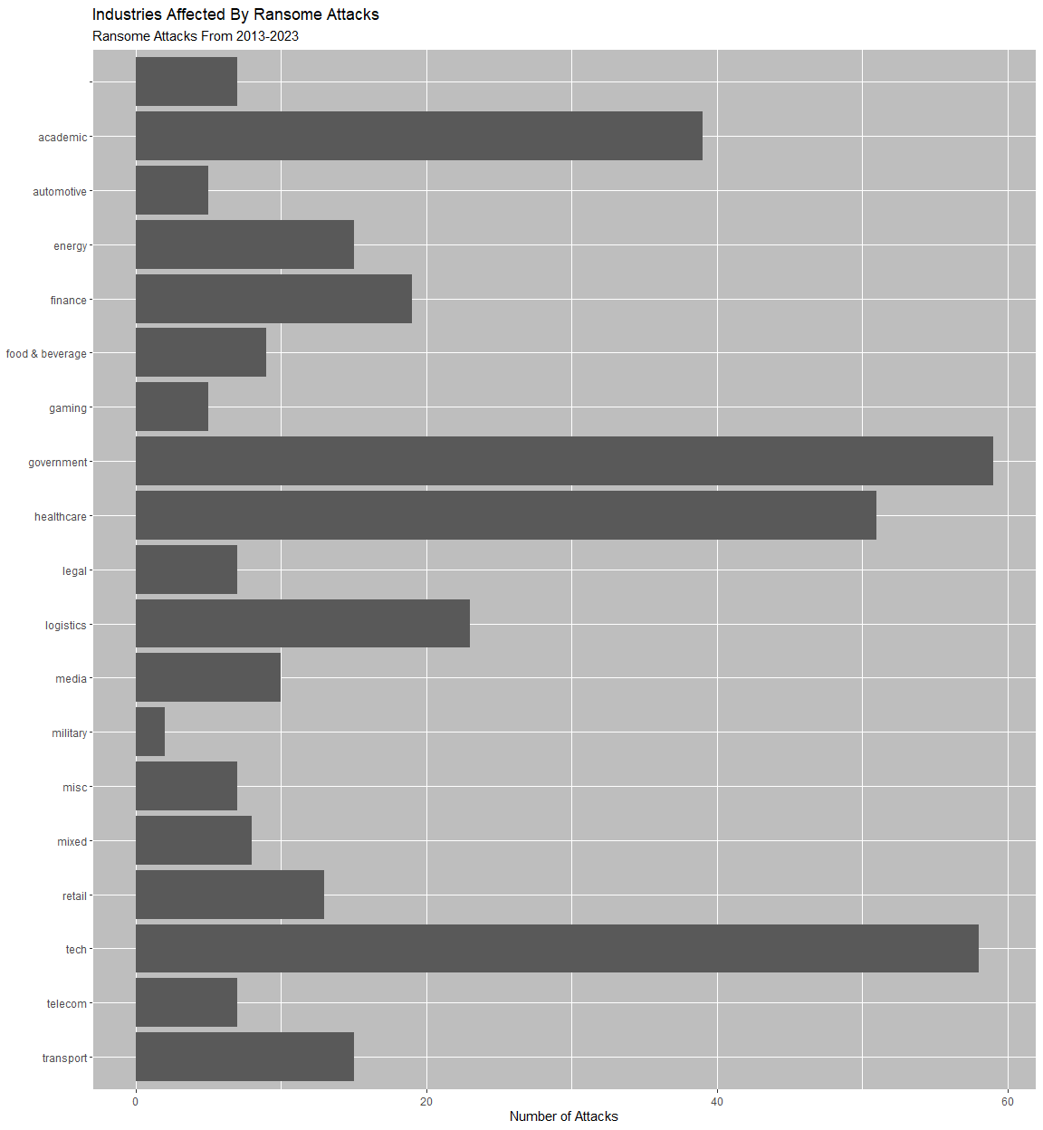
1. What Industries Are Attacked By Ransomware The Most?
most_affected <- RA %>% group_by(sector) %>% summarise(n=n()) %>% arrange(desc(n), sector) ggplot(most_affected, aes(y=fct_rev(sector), x = n)) + geom_col() + scale_x_continuous() + theme(panel.background = element_rect(color = "white", fill = "gray")) + labs(y=NULL, x = "Number of Attacks") + labs(title = "Industries Affected By Ransome Attacks", subtitle = "Ransome Attacks From 2013-2023")

Slide 9
(Explain how once we have all the data we can narrow it for what we want)

Slide 10
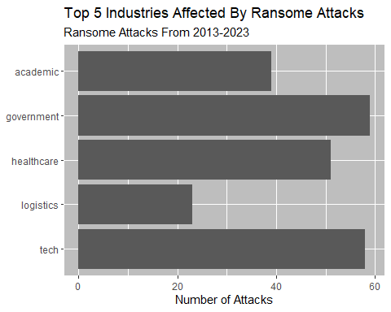
Top 5 Industries Attacked By Ransomware The Most
Top_5_RA <- RA %>% group_by(sector) %>% summarise(n=n()) %>% arrange(desc(n)) %>% head(5) most_affected <- RA %>% group_by(sector) %>% summarise(n=n()) %>% arrange(desc(n), sector) %>% slice(1:5) ggplot(most_affected, aes(y=fct_rev(sector), x = n)) + geom_col() + scale_x_continuous() + theme(panel.background = element_rect(color = "white", fill = "gray")) + labs(y=NULL, x = "Number of Attacks") + labs(title = "Top 5 Industries Affected By Ransome Attacks", subtitle = "Ransome Attacks From 2013-2023")

Slide 11
(Explain)

Slide 12
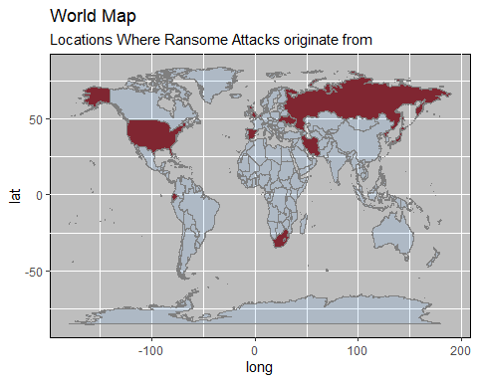
2. Where are these attacks coming from
RA_Hackers <- RA %>% group_by(Ransomware) %>% summarise(n=n()) Temp_RA_ATT <- RA_Hackers$region <- c("N/A", "USA", "Japan", "Russia", "Russia", "Russia", "Russia", "Russia", "Iran", "Russia", "Russia", "Russia", "Russia", "Russia", "Cuba", "Russia", "Russia", "UK", "Ukraine", "USA", "Turky", "Russia", "Russia", "Ukraine", "Ecuador", "Russia", "Russia", "Russia", "Russia", "Russia", "Russia", "Russia", "Russia", "N/A", "Russia", "Russia", "Netherlands", "Iran", "Russia", "Russia", "Russia", "Russia", "Spain", "Russia", "Russia", "Russia", "Russia", "Russia", "Russia", "USA", "Iran", "South Africa", "Russia", "Russia", "Russia", "Russia", "North Korea", "Russia", "Chinese", "Russia", "N/A") RA_loc_of_att <- merge(RA, RA_Hackers, by = c("Ransomware"), all.x = TRUE) RA_loc_of_att$n <- NULL RA_V.2 <- RA_loc_of_att[, c(2, 3, 8, 9, 10, 1, 11, 6, 7, 4, 5)] RA_Attacker_Map <- RA_V.2 %>% group_by(region) %>% summarise() mapdata. <- map_data("world") mapdata <- left_join(mapdata., RA_Hackers, by="region")
## Warning in left_join(mapdata., RA_Hackers, by = "region"): Detected an unexpected many-to-many relationship between `x` and `y`. ## ℹ Row 51671 of `x` matches multiple rows in `y`. ## ℹ Row 15 of `y` matches multiple rows in `x`. ## ℹ If a many-to-many relationship is expected, set `relationship = ## "many-to-many"` to silence this warning.
mapdata1 <- mapdata %>% filter(!is.na(mapdata$Ransomware)) map1 <- ggplot(mapdata1, aes(x= long, y = lat, group=group)) + geom_polygon(aes(fill = region),fill = "firebrick4", color = "black") + borders(alpha = 0.1, fill = "dodgerblue") + theme(panel.background = element_rect(color = "black", fill = "gray")) + labs(title = "World Map ", subtitle = "Locations Where Ransome Attacks originate from") map1

Slide 13
RA_Attacker_Map #List of Ransome Countries (WIP) Need to make Key
## # A tibble: 15 × 1 ## region ## <chr> ## 1 Chinese ## 2 Cuba ## 3 Ecuador ## 4 Iran ## 5 Japan ## 6 N/A ## 7 Netherlands ## 8 North Korea ## 9 Russia ## 10 South Africa ## 11 Spain ## 12 Turky ## 13 UK ## 14 USA ## 15 Ukraine

Slide 14
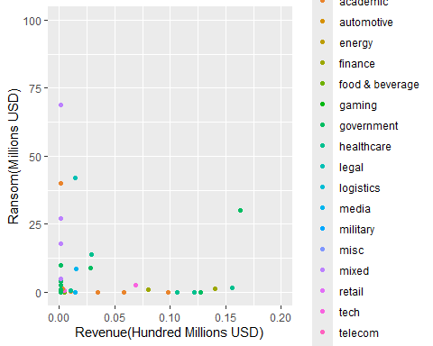
3. Does a company’s revenue or size have any correlation with the ransom amount?
scatterPlot <- RA %>% ggplot(aes(x = revenue..USD.million, y = ransom.cost, color = sector, na.rm = T)) + geom_point() + labs( x = "Revenue(Hundred Millions USD)" , y = "Ransom(Millions USD)" ) + scale_x_continuous(labels = scales::number_format(scale = 1e-3), limits = c(0,200)) + scale_y_continuous(limits = c(0, 100)) scatterPlot
## Warning: Removed 307 rows containing missing values or values outside the scale range ## (`geom_point()`).

Slide 15
There does not seem to be any relation between the revenue of a company and the requested ransom amount, nor does it have any correlation with what sector the company is in.

Slide 16
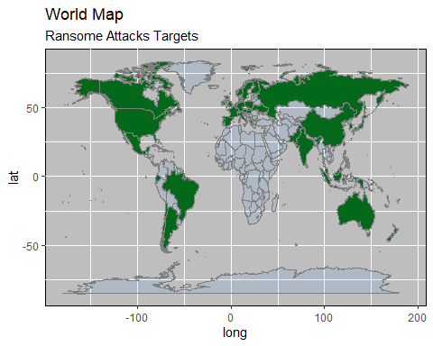
4. Which regions are being attacked the most.
RA_Victums <- RA_V.2 %>% group_by(location, sector) %>% summarise(n=n())
## `summarise()` has grouped output by 'location'. You can override using the ## `.groups` argument.
names(RA_Victums)[1] <- "region" Xmapdata. <- map_data("world") Xmapdata <- left_join(Xmapdata., RA_Victums, by="region")
## Warning in left_join(Xmapdata., RA_Victums, by = "region"): Detected an unexpected many-to-many relationship between `x` and `y`. ## ℹ Row 878 of `x` matches multiple rows in `y`. ## ℹ Row 46 of `y` matches multiple rows in `x`. ## ℹ If a many-to-many relationship is expected, set `relationship = ## "many-to-many"` to silence this warning.
Xmapdata1 <- Xmapdata %>% filter(!is.na(Xmapdata$sector)) Xmap1 <- ggplot(Xmapdata1, aes(x= long, y = lat, group=group)) + geom_polygon(aes(fill = region),fill = "darkgreen", color = "black") + borders(alpha = 0.1, fill = "dodgerblue") + theme(panel.background = element_rect(color = "black", fill = "gray")) + labs(title = "World Map ", subtitle = "Ransome Attacks Targets") Xmap1

Slide 17
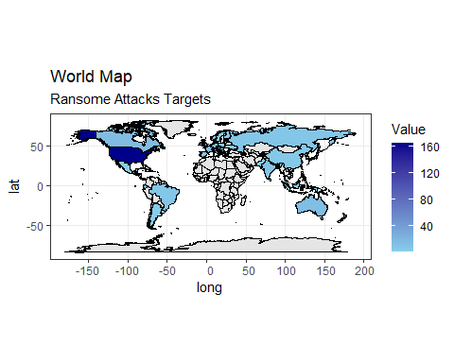
#Not Sure about this one
(This where they all are)
df <- tribble( ~Country, ~Value, "Argentina", 2, "Australia", 14, "Austria", 1, "Belgium", 2, "Brazil", 7, "Canada", 15, "Chile", 2, "China", 5, "Croatia", 1, "Denmark", 2, "Ecuador", 2, "Europe", 1, "Finland", 2, "France", 14, "Germany", 13, "Greece", 1, "Hong Kong,", 1, "Hungary", 1, "India", 8, "Indonesia", 1, "Ireland", 4, "Israel", 3, "Italy", 2, "Japan", 9, "Malaysia", 2, "Mexico", 2, "New Zealand", 1, "Norway", 4, "Pakistan", 1, "Phillipines", 1, "Poland", 1, "Portugal", 2, "Russia", 7, "Scotland", 3, "Seychelles", 1, "Singapore", 1, "Slovakia", 1, "South Korea", 4, "Spain", 6, "Sweden", 1, "Switzerland", 2, "Taiwan", 4, "Thailand,", 1, "The Netherlands", 5, "UK", 29, "Ukraine", 2, "USA", 165, "Worldwide", 5 ) map_data("world") %>% left_join(df, by = join_by(region == Country)) %>% ggplot(aes(long, lat)) + geom_polygon(aes(group = group, fill = Value), color ="black") + scale_fill_gradient(low = "skyblue", high = "darkblue", limits = c(1,165), na.value = "gray90") + coord_sf() + theme_bw() + labs(title = "World Map ", subtitle = "Ransome Attacks Targets")

Slide 18
(This one is good and hows many attacks in each country) Its North America.

Slide 19
5.A Which hacker groups are attacking which region most frequently, Europe, America, Asia/Oceania.
RA_Victums <- RA_V.2 %>% group_by(location, sector) %>% summarise(n=n())
## `summarise()` has grouped output by 'location'. You can override using the ## `.groups` argument.
names(RA_Victums)[1] <- "location" RA_Big_Victim <- RA_V.2 %>% group_by(location, Ransomware) %>% summarise()
## `summarise()` has grouped output by 'location'. You can override using the ## `.groups` argument.

Slide 20
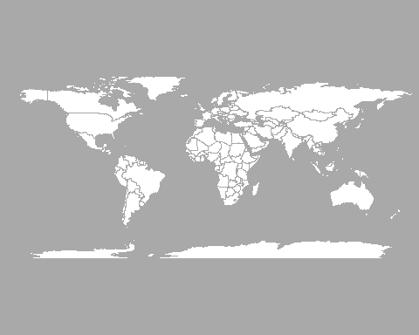
5.B
par(mar=c(0,0,0,0)) map('world', col="white", fill=TRUE, bg="darkgray", lwd=0.05, mar=rep(0,4),border=0, ylim=c(-80,80) )

Slide 21
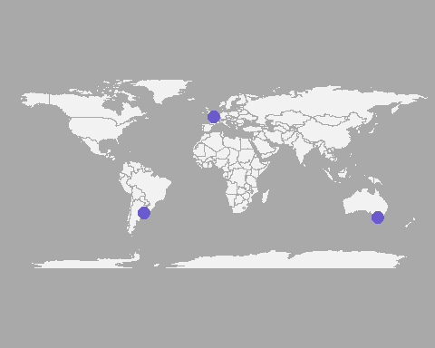
Buenos_aires <- c(-58,-34) Paris <- c(2,49) Melbourne <- c(145,-38) data <- rbind(Buenos_aires, Paris, Melbourne) %>% as.data.frame() colnames(data) <- c("long","lat") map('world', col="#f2f2f2", fill=TRUE, bg="darkgray", lwd=0.05, mar=rep(0,4),border=0, ylim=c(-80,80) ) points(x=data$long, y=data$lat, col="slateblue", cex=3, pch=20)

Slide 22
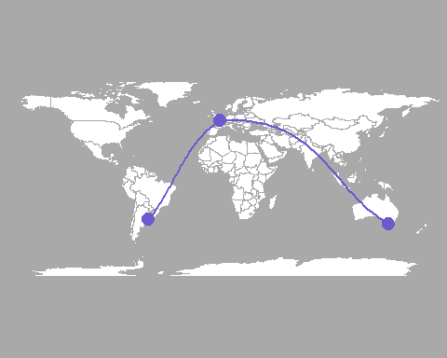
map('world', col="white", fill=TRUE, bg="darkgray", lwd=0.05, mar=rep(0,4),border=0, ylim=c(-80,80) ) points(x=data$long, y=data$lat, col="slateblue", cex=3, pch=20) inter <- gcIntermediate(Paris, Buenos_aires, n=50, addStartEnd=TRUE, breakAtDateLine=F) lines(inter, col="slateblue", lwd=2) inter <- gcIntermediate(Melbourne, Paris, n=50, addStartEnd=TRUE, breakAtDateLine=F) lines(inter, col="slateblue", lwd=2)

Slide 23
5.C
#```{r}
WorldMap <- map_data(“world”)
WorldMap <- left_join(WorldMap,data, by = c(“region” = “Country”))
ggplot(WorldData, aes(x = long, y = lat, group = group)) + geom_polygon(color=“black”, fill=“white”) + stat_centroid(data = subset(WorldData, region %in% data$country), aes(size = infection, group = region), geom = “point”, alpha = 0.75, color = “red”) #```
(WIP)

Slide 24
Average ransom amount vs average amount actually paid.
avgRansomCost <- RA %>% summarise(requested = mean(ransom.cost, na.rm = T)) avgRansomPaid <- RA %>% filter(ransom.paid == "ransom paid") %>% summarise(paid = mean(ransom.cost, na.rm = T)) avgRansomUnpaid <- RA %>% filter(ransom.paid == "refused") %>% summarise(refused = mean(ransom.cost, na.rm = T)) print("The average of all known ransom requests(in millions USD")
## [1] "The average of all known ransom requests(in millions USD"
avgRansomCost
## requested ## 1 32.68293
print("The average of paid ransoms(in millions USD)")
## [1] "The average of paid ransoms(in millions USD)"
avgRansomPaid
## paid ## 1 2.709991
print("The average of refused ransoms(in millions USD)")
## [1] "The average of refused ransoms(in millions USD)"
avgRansomUnpaid
## refused ## 1 17.70791
The paid average is significantly lower than the overall average and the refused average.

Slide 25
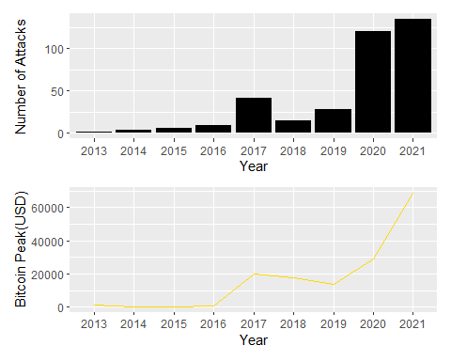
Is ransomware that we know about trending down or gaining popularity? Is this changed by the current price of bitcoin?
yearlyAttacks <- RA %>% filter(YEAR != 2023) %>% group_by(YEAR) %>% ggplot(aes(x = factor(YEAR))) + geom_bar(fill = "black") + labs( x = "Year" , y = "Number of Attacks" ) bitcoinCost <- bitcoinHigh %>% group_by(YEAR) %>% ggplot(aes(x = factor(YEAR), y = high, group = 1)) + geom_line(color = "gold") + labs( x = "Year" , y = "Bitcoin Peak(USD)" ) yearlyAttacks / bitcoinCost

Slide 26
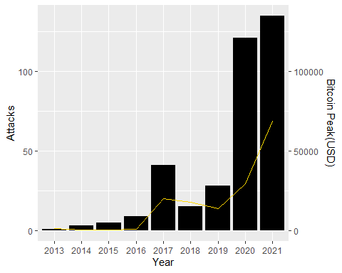
combinedData <- merge(RA, bitcoinHigh, by = "YEAR") combinedPlot <- ggplot(combinedData, aes(x = factor(YEAR))) + geom_bar(aes(y = ..count..), fill = "black") + geom_line(aes(y = high * .001, group = 1), color = "gold") + scale_y_continuous( name = "Attacks", sec.axis = sec_axis(~.*1000, name = "Bitcoin Peak(USD)"), ) + labs( x = "Year" ) combinedPlot
## Warning: The dot-dot notation (`..count..`) was deprecated in ggplot2 3.4.0. ## ℹ Please use `after_stat(count)` instead. ## This warning is displayed once every 8 hours. ## Call `lifecycle::last_lifecycle_warnings()` to see where this warning was ## generated.

Slide 27
The trend of bitcoin and number of attacks actually does seem to be similar, especially when it dips in 2018 and goes back up in 2020

