Slide 1

Urban Data Centre
Data Engineering
DATA472-24S1
Presented by:
Hua Wang
Jacob Reid
Swathy P Thankachan

Slide 2

GOAL
To build an Urban Data Centre that collects and records information, providing a more sustainable hub for extracting valuable insights from open data sources from various domains.

Slide 3




STAGES
Coordination and Standardization
Data Collection Protocols.
Standard API Specifications.
Documentation and Metadata.
Central Integration Point
Central API Gateway.
Collate datasets.
Design and build system scripts.
Data Quality and Validation.
Ingest data into the staging data lake.
Data Accessibility
Design user-friendly central data access point.
System Monitoring
Monitoring tools to track the health of the APIs and the central system.

Slide 4





STAGE 1
Coordination and Standardization
Student 1
API 1
Student 2
API 2
.
.
.
Choose an open dataset
Clean & Wrangle
Cleaned data in json
format
.
.
.
Student 21
API 21
Communicated protocols for data collection, cleaning, and formatting to ensure consistency across all datasets.
Provided detailed documentation and examples for implementing WEB APIs using various tools.
Offered continuous support to teammates to overcome roadblocks in their implementation process.

Slide 5



STAGE 2
Central Integration Point
Airflow Scheduler:
Manages and schedules data collection tasks.
Ensures periodic updates and validation of data.
Airflow DAGs:
Defined workflows for data collection and processing.
Includes tasks for calling individual APIs and storing results in a central database.
API 1
API 2
.
.
.
Stores the integrated data utilizing advanced amazon storage services
API 21
Data Collection Server

Slide 6
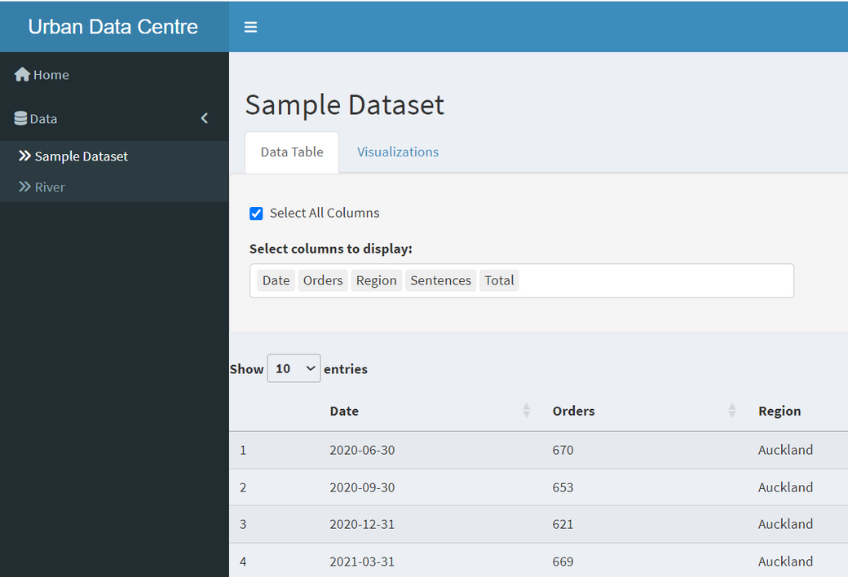


STAGE 3
Data Accessibility (Current scenario)
API 1
Developed a Shiny app to fetch cleaned data from API URLs and provide user-friendly interfaces for exploring and visualizing data insights.
API 2
.
.
.
Data Collection Server
API 21

Slide 7
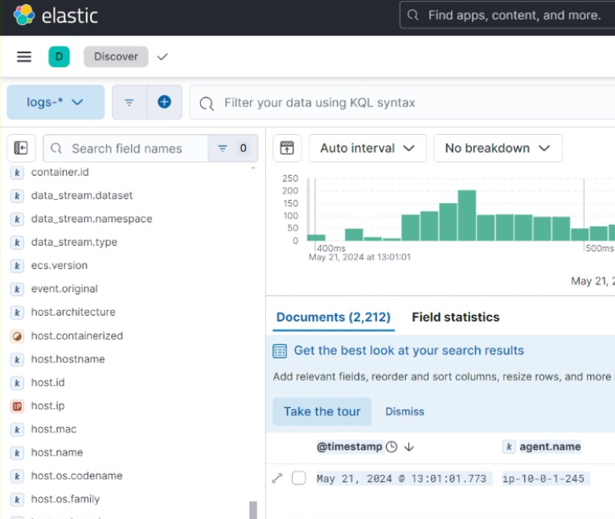



STAGE 4
System Monitoring
ELK stack components
Logstash
Collects and processes log data from log sources.
Sends processed logs to Elasticsearch.
Data Collection Server
Elasticsearch
Stores the processed log data.
Provides indexing and search capabilities for the stored logs.
Kibana
Kibana connects to Elasticsearch.
Provides a web-based interface for users to visualize and query the log data.
Docker
Log Server

Slide 8
NEXT STEPS..
All wrangled datasets need to be provided.
Aggregate all individual API datasets into the central data collection server.
Modify the Shiny app to fetch data from the consolidated database.

Slide 9
Thank you!

