Slide 1
Hyunji Moon (2015-13196)
Industrial Engineering, SNU
Corporate Diversification and
the Value of Individual Firms: a Bayesian Approach
By Tyson B. Mackey, Jay B. Barney, and Jeffrey P. Dotson
Strategic Management Journal 38: 322-341 (2017)

Slide 2
INDEX
Hyunji Moon
Introduction
Theory and hypothesis
Methods
Results
Discussion and Conclusion

Slide 3
CONTENTS. 01 Introduction
Mismatch between
theoretical diversification literature (diversification-firm performance relationship for individual firm)
empirical diversification literature (average relationship between diversification-firm performance)
‘Hierarchical Bayesian Modeling’
enables estimation of this relationship at the firms level
Re-examine relationship between firm’s diversification strategy and its performance with Hierarchical Bayesian Modeling.

Slide 4
CONTENTS. 02 Theory and Hypothesis
2.1 Theoretical diversification literature explains…
-conditions under which a firm can enhance its economic value by related, unrelated diversification or by remaining undiversified.
-conditions under which a firm may abandon its profit-maximizing objectives in choosing its diversification strategy.
Hypothesis:
“A profit maximizing firm will tend to pursue that corporate diversification strategy that enhances its economic value”
Related diversification
Unrelated diversification
Remain focused
Optimal strategy depends on each firm’s resources and situation

Slide 5
CONTENTS. 02 Theory and Hypothesis
2.2 Empirical diversification literature Explains…
positive average effect of diversification on firm value (Campa and Kedia, 2002).
average value created: diversification > a portfolio of focused firms
does not mean that remaining focused is not the most value strategy.
related diversification > unrelated diversification (Miller, 2006)
firms that have related knowledge assets are more likely to create value through diversification.
does not mean that unrelated diversification is not the most value creating strategy
Testing hypothesis in this article requires the examination of the relationship between a particular firm’s diversification and value across a firm.

Slide 6

CONTENTS. 03 Method
3.1 To remove heterogeneity…
use fixed or random effects models.
estimate firm-specific relationships.
apply contingency studies and mixed effects modeling.
random coefficient models, hierarchical linear models can be used to estimate average coefficient plus an individual specific deviation from the average coefficient.

Slide 7
CONTENTS. 03 Method
3.2 Hierarchical Bayesian model: beneficial to strategy research because…
estimates a distribution for firm-specific parameter.
improves precision by imposing a common distribution between the firm-specific coefficients.
Hierarchical Bayesian
Bayesian
non-Bayesian
Distinct modeling approach that estimates firm-specific parameters.
Adequately model heterogeneity in the value of diversification.
Estimates a distribution for each coefficient.
Estimates impact-prob. of independent variable on dependent variable.
Point estimation for the firm-specific parameter.
Weak confidence on firm-specific parameter.

Slide 8
CONTENTS. 03 Method
3.3 How are Data and Sample collected?
Firms in the Compustat Industry Segment file.
From year 1985 to 1996.
Remove firms with less than five observations.
Total of 7,442 observations on 838 firms.

Slide 9
CONTENTS. 03 Method
3.4 Research model
Independent Variables
Dependent Variables
Excess value
Tobin’s q
Corporate diversification
% shares owned by dominant shareholders
% shares owned by institutions
% shares owned by insiders
% of outsider directors
Control Variables
Firm size
Firm growth
Capital intensity
Level of R&D
Level of firm
profitability

Slide 10








CONTENTS. 03 Method
3.5 Model development
Impact of diversification on firm performance
Measure of performance(firm i, time period t)
Diversification state (firm i, time period t)
Endogenous diversification
Function for the value
Expected, long-term impact of diversification on performance
Probability that the firm will diversify

Slide 11
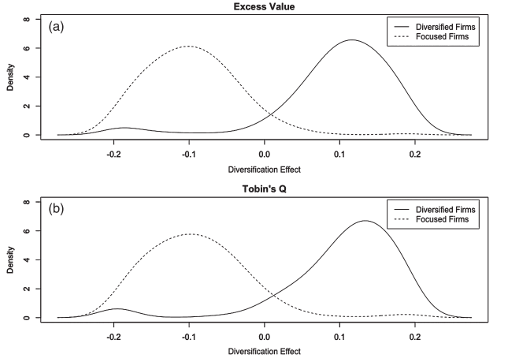
CONTENTS. 04 Results
4.1 Empirical implementation of the theory in this article is…
Divide the distribution of the firm specific diversification coefficients into focused + related diversifiers + unrelated diversifiers!
Effects of diversification on excess value and Tobin’s q for diversified and undiversified firms.
→ Diversified firms have an expected increase in value through diversification.
&
Focused firms are generally expected decrease in value through diversification.

Slide 12
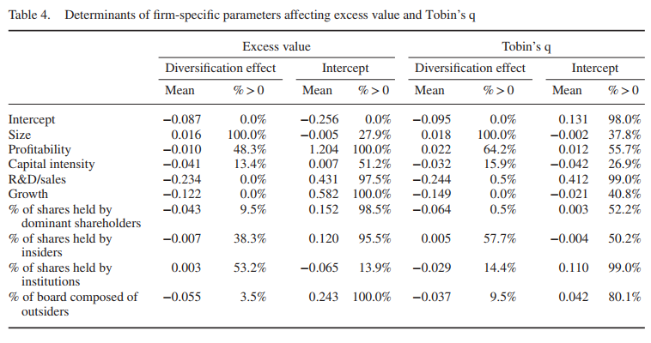
CONTENTS. 04 Results
4.2 What affects the relationship between diversification and firm value?
Independent, controlled variable analysis
Expected value of diversification has a strong effect on the diversification choice.
Larger firm size increases diversification’s effect on excess value with 48.3 percent probability.
Faster growth rate increases the value of diversification with 0 percent probability.
Higher capital intensity increases the value of diversification with 13.4 percent probability.
Higher R&D intensity are less likely to diversify successfully.
Governance has little impact on the value of diversification.

Slide 13
CONTENTS. 05 Discussion and Conclusion
5.1 Summary
What?
Relationship between a firm’s diversification strategy and its performance for individual firms.
How?
Hierarchical Bayesian modeling approach that allowed for firm-level estimates.
Firms tend to be profit-maximizing in their choice of diversification strategy.
Diversification has a higher expected value for related diversifiers than unrelated diversifiers, but that diversification also has a highest expected value that focus for unrelated diversifiers as well.

Slide 14
CONTENTS. 05 Discussion and Conclusion
5.2 Implication for strategy scholarship and practice
Incorporating firm heterogeneity into the analysis of the effects of diversification could be assimilated into other topics.
One example is governance and diversification and it was noted that poor governance does not affect the value of diversification.
Mismatch between
strategic management theory (individual firms, resources and capabilities to maximize value)
strategic management research methods (average relationship models).
Key Implications
Results should not be interpreted as a rule for riches suggesting that all firms should pursue this particular strategy.
Overall relationship between strategy and firm value require strategic management for new methodological approaches.

Slide 15
Hyunji Moon
The END

