Slide 1

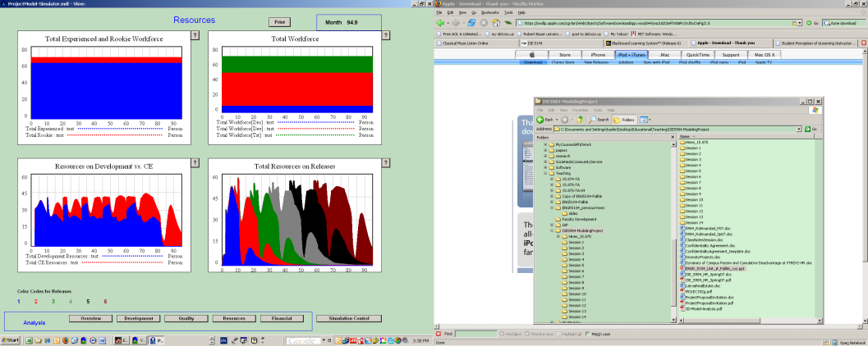
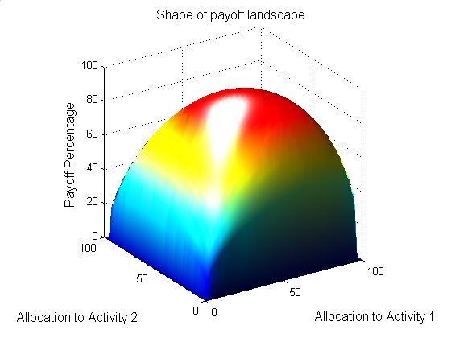
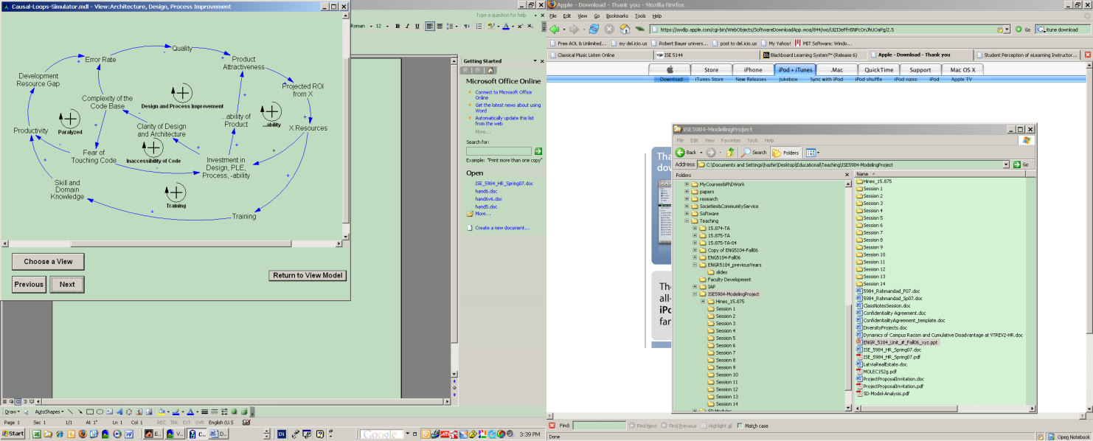
System Dynamics Seminar
15.879
Filtering and State Resetting

Slide 2
Model Assignments
SEIR: Celia, Ross
Economic Longwave: Jason, Zeynep
Project management: Rosa, Chan
Market Growth: Cathy, Andy
Commodity Cycles: Ali
Service Quality: Jose
Urban Dynamics: Arya+Alban
World 3: Alexander+Nunzio

Slide 3
Assignment 8 Presentations
Longwave: Zeynep
Urban Dynamics: Arya+Alban
Commodity Cycles: Ali
World 3: Alexander+Nunzio
Service Quality: Jose
Market Growth: Cathy
Backup: Longwave: Jason
You may bring in questions and insights from prior Assignments as well

Slide 4
SD Model Estimation Workflow
Build/Update Model
Find Data; Identify Target and Driving
Diagnose Problems:
Model?
Data Availability?
Computation (cost/algorithm)?
Process Noise? Measurement Noise?
Estimate with Synthetic Data; Cross Validate
Estimation with Real Data
Add State Resetting and Filtering
Better Likelihoods
Go Likelihood Free
Enhance Estimation
Alternative Algorithms
Break to Partial Calibration
Add Computational Resources

Slide 5
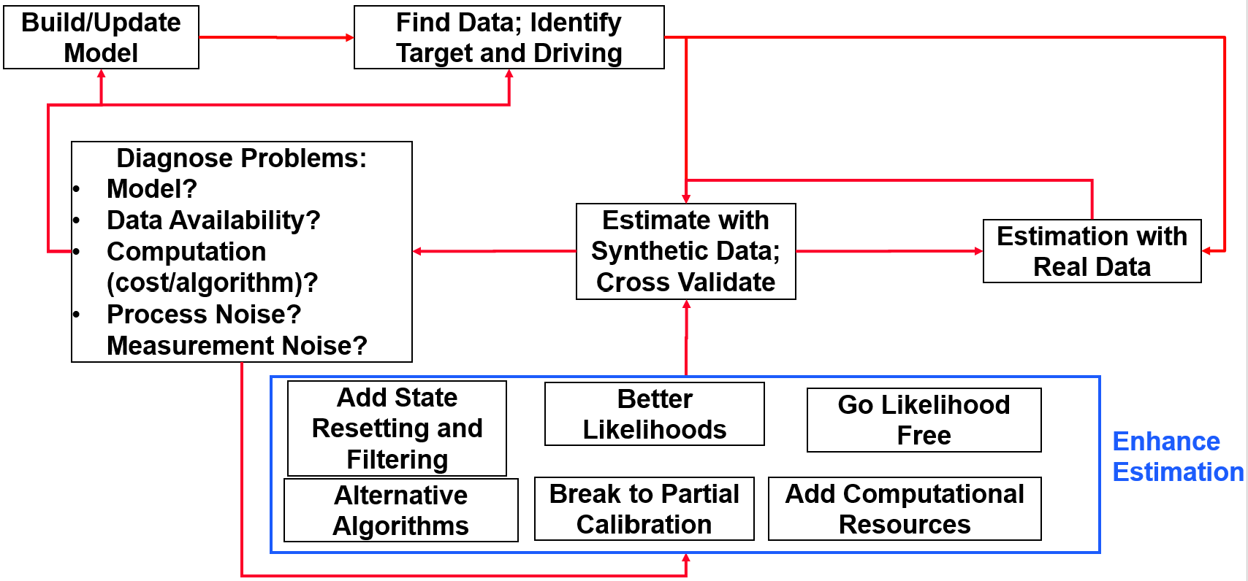
Diagnostics for Estimation workflow
LL with ground truth, or calibration starting from there, better than calibrated LL? ➔Multi-model likelihood surface
Run multiple restarts; if not finding the ground truth in reasonable time
Use the iterative calibration if feasible/applicable
Estimated parameters too far from ground truth?
Check test 1 above in case it is multi-modality; if real peak is far then:
Check likelihood function components against simulating with ground truth; see if likelihood distribution is the problem➔ change likelihood distribution
Check estimates without process noise; if improved ➔ go towards partial model calibration or state resetting
Estimated parameters are not off, but confidence intervals are too narrow
Test alternative distributions or scaling for variances
Test scaling of likelihood function
Test alternative MCMC methods

Slide 6
State Resetting
Problem:
Process noise leads to multiple futures (or past) trajectories from an identical model
Thus process noise acts as a model structure not captured ➔ can bias the simulation-based parameter estimates (i.e. parameter values that are different, in expectation, from the true value)
Solution
Reset the states every period to what data dictates

Slide 7
How to reset the states?
If all stocks are observed
Easy, just use the data, rather than simulation (what regression does)
If some stocks are unobserved
Infer unobserved stocks based on observables (when enough observables exist) OR
Infer likely stock values based on the prior distribution of stocks and the observations that inform stock values (a Bayesian inference problem; not necessarily easy)

Slide 8
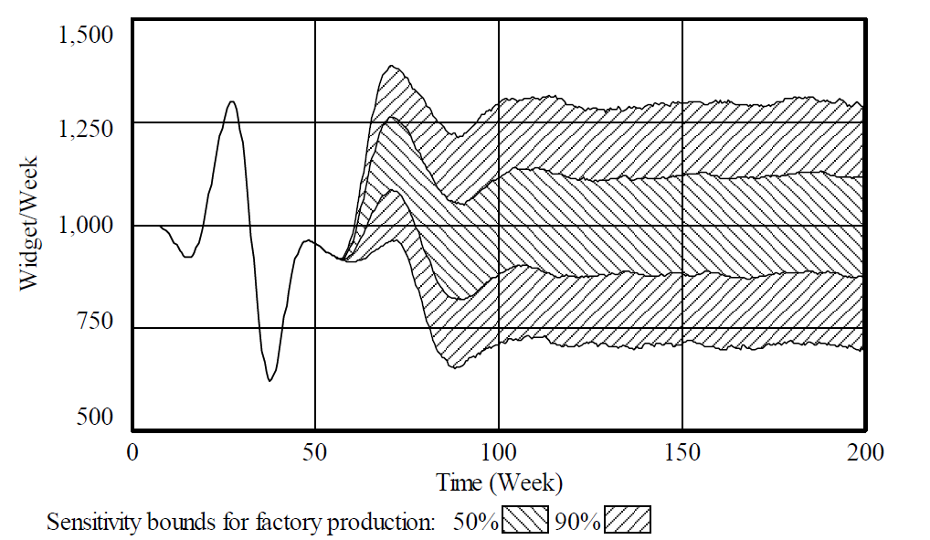
Uncertainty in the beer game model
➔
Perfect model can’t predict future
Calibrating to past observations may give the wrong parameters
Source: Eberlein 2015

Slide 9

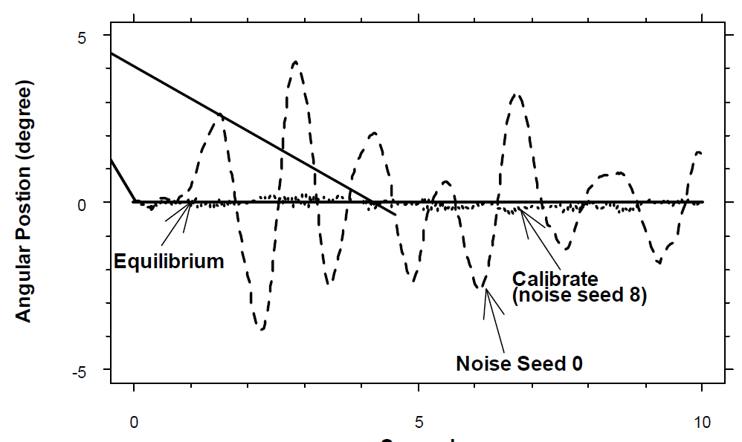
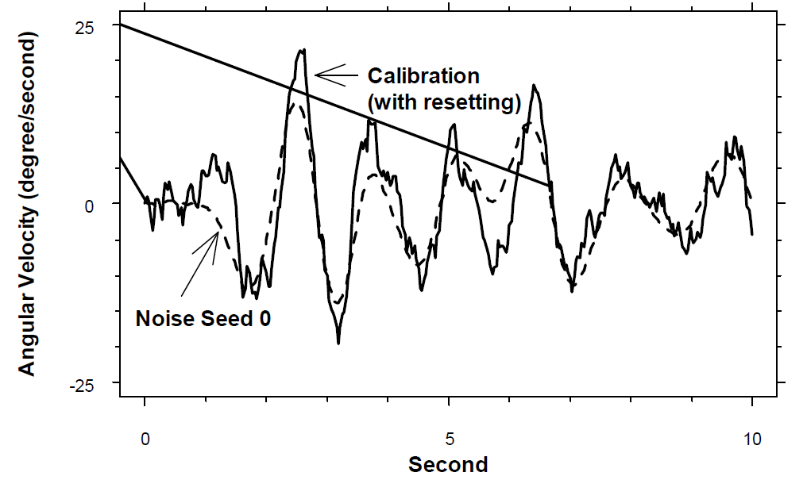
Pendulum Model: Deterministic Simulation and Naïve State Resetting
System’s dynamics:
A naïve deterministic calibration with correct model gives very wrong g/l, d, and epsilon
Restarting state (angular position) at inflection points (where angular velocity is zero) gives much better estimates.
Source: Eberlein 2015

Slide 10
What if there is noise in measurement?
Then simple reading/inference of stocks is also problematic. The solution:
Optimally reset the stocks somewhere between simulation—based inference and new measurements
Kalman filter does this optimally for linear systems with Gaussian measurement and process noise
Example: GPS on your cell-phone

Slide 11
Filtering’s basic idea
Simulate the model from t to t+1
E.g. find a car location based on previous speed, direction, and time interval
Find stocks based on (noisy) measures of the system at t+1
E.g. satellite measures of car location
Find a linear combination of the two that is the best estimate for the true values
This is the car position on your GPS system
Also infer the uncertainty in car location based on these measures, and use for next period simulations
Continue updating based on next data point

Slide 12
Filtering and Estimation: Basic Idea
Weighted average of two extremes for finding errors in calibration:
1) Pick one parameter, run through all the time, observe the payoff (typical SD practice)
2) Pick one parameter, start the model from the measurement for last data point and find error till the next datapoint, then sum errors over all intervals (typical regression practice)
Not all stocks are measured, so need estimates for each stock, based on the measured variables.
The equations are more involved, but automated in Vensim.

Slide 13
Kalman Filtering in Vensim
What you need:
Setup the filter: “Kalman.prm”
Specify the stocks exposed to process noise and their initial variance
Specify the covariance in the process noise
Setup the filter payoff (vpd file to connect data with model)
Make sure you turn off the process and measurement noise!
Lets work through our demo model

Slide 14
Example
A simple model of drug use and control.
Generated noisy “data” on “Users” and “Perceived Costs”; then fit the same model to this data with/without filtering.
Pink Noise

Slide 15
Results
The fit is good for both, but different future predictions
Less bias and tighter intervals for filtering and estimation methods
Blue: With Filtering
Striped: Without
Vertical line: Real parameter value

Slide 16
Interesting because
Overcomes some of the thorny parameter estimation issues with noisy models
Different versions increasingly used in looking at technical and environmental systems but less known in social science (except in structural model estimation in econometrics), thus you can add value
Especially important because (process and measurement) noise play a big role in our imprecise models of social systems

Slide 17
Practical Hints
In estimation, decide on usefulness of filtering by looking at variance of model predictions given different noise seeds.
Need the covariance matrix for driving noise and measurement noise
Good news: These can themselves be estimated in the process (but try to restrict ranges)
Some statistical calculations needed
Computational costs: O(N^2) for N stocks
Consider particle filters when Kalman assumptions are violated (but more expensive computationally)

