Slide 1
If Vensim is the answer, what is the question? Exploring the tool-user ecosystem and the future of SD
Tom Fiddaman & Angie Moon
10/20/2023

Slide 2
Abstract
Once upon a time, data was scarce, simulation was nearly unheard of, there were few ways to build and use quality dynamic models, and models rarely gave direct input to decisions. This made it easy for tool builders and tool users to coevolve within their own disciplinary stovepipes. The scale of our problems, and hopefully our opportunities, means that isolation is no longer viable. System Dynamics modelers can increasingly benefit from new tools in data science, AI and machine learning, and many fields could benefit from SD knowledge guiding better dynamics, realistic behavior, and useful interaction with decision makers.
Our future could be bright, with AI assistants freeing modelers from boring tasks, raising the productivity of thinking about systems, and making model results accessible to users. Or, it could be dark, with "ChatMDL" rapidly generating the simulation equivalent of 3-legged chicken images, models with superficial validity but more propaganda value than predictive accuracy, faster than we can debunk them.
In this seminar, I'd like to explore the state of the SD tool portfolio and the requirements of modelers and model consumers. In passing, I will mention the near-term roadmap for Vensim, as well as the broader ecosystem of SD tools many of us use. But the real goal is to discuss the long-term vision for System Dynamics. How do we realize a future in which:
it's easy to make every model a Bayesian blend of structure and parameter priors from subject matter expertise and data likelihoods?
aggregation is not a dark art, but automated in a flexible and principled way?
every model run is a synthetic data experiment supporting decision making under uncertainty?
support for exploration of the state space yields as much understanding as we get from analytical methods on simple models?
we have the computing power to support these innovations, and
we can explain what we're doing to influence people to solve our biggest problems.
I don't own the answers to all of these questions, so I hope we'll have an engaging discussion, and emerge with some common understanding of our prospects that will guide what we do next.

Slide 3
Agenda
Problem statement
Visions
First steps
How do we get there from here?

Slide 4
Hidden Agenda
Socialize some possible Bayesian System Dynamics innovations
Listen to the voice of the customer
What directions should Vensim 11+ pursue?
What new tech would delight you?
What do your customers want?
What are they willing to pay for?
Coordinate progress
Engage users, other fields
Solve big problems

Slide 5
What are our biggest societal problems?
Global
Environmental overshoot
Nuclear war
Pandemics
Ocean fishing
Universal
Poverty/inequality
Authoritarianism
Air & water pollution
Local fishing
Common origins
Misperceptions of feedback
Rent seeking
Free riding
Coordination costs
Diverse goals
Population growth
Material growth
Technology

Slide 6
Discussion (5min)
Q1: What do your customers want and what are they willing to pay for?

Slide 7
What are our biggest technical problems?
Data management
Connectivity to enterprise systems and other software
Long run times on big models with big parameter spaces
State estimation (filtering)
Understanding model behavior
Structural experimentation (aggregation, functional form)
Ad hoc data & relationships
Sparse matrices
Reuse
Including uncertainty
Diagnosing payoff behavior
Model management (e.g., source control)
Model quality maintenance
What are your pain points?

Slide 8
What are our biggest practical problems?
Getting people to act on the model
Pushing through worse-before-better behavior
Making model outcomes real to users
Engaging people who weren’t involved in building the model
Tackling skepticism about the very idea of modeling
Cost
Delivery time from question to answer
Communication with other disciplines
What are your pain points?

Slide 9
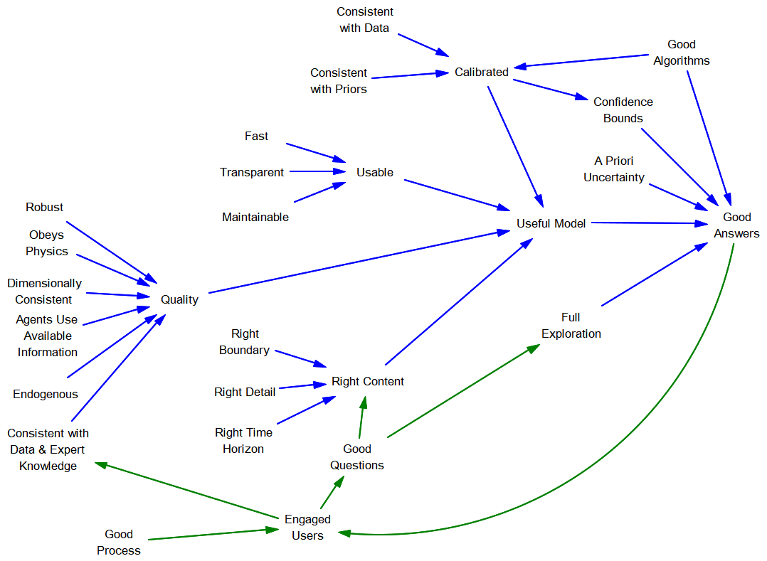
What is the secret sauce?

Slide 10
SD Weaknesses
Formal data
Measurement
Large datasets
Verification
Aggregation
Algorithms
Reuse
Threats
Brain drain
Replication crisis
Models as propaganda

Slide 11
What is modeling technology for?
Enrich representation
Bigger arrays
More agents
New functions
Enrich analysis
Pervasive uncertainty
Structure-behavior connections
Deeper inspection
Improve quality
Improve modeler productivity
More speed
Better analysis tools
Automation
Better data management
Reuse
Better – faster – cheaper: pick two

Slide 12


Visions

Slide 13
What if …
it's easy to make every model a blend of structure and parameter priors from subject matter expertise and data likelihoods?
aggregation is not a dark art, but automated in a flexible and principled way?
every model run is a synthetic data experiment supporting decision making under uncertainty?
support for exploration of the state space yields as much understanding as we get from analytical methods on simple models?
we have the computing power to support these innovations, and
we can explain what we're doing to influence people to solve our biggest problems.

Slide 14
Discussion (5min)
Q2: One wish and vision for Vensim use? What new tech would delight you (be as specific as possible)?

Slide 15
Several (not all) of these ideas are Bayesian
Exploitation of samples from a posterior for policy under uncertainty
Selection of alternative model structures
Automatic verification of methods
Propagation of uncertainty into policy

Slide 16
Most of us are already quasi-Bayesians
SD relies heavily on a priori information
Model structure
Reference modes
Dynamic hypotheses
CLDs
Parameters sourced from SMEs, literature, other models
We use Bayesian updates
Adaptive expectations or smoothing
Kalman filtering

Slide 17
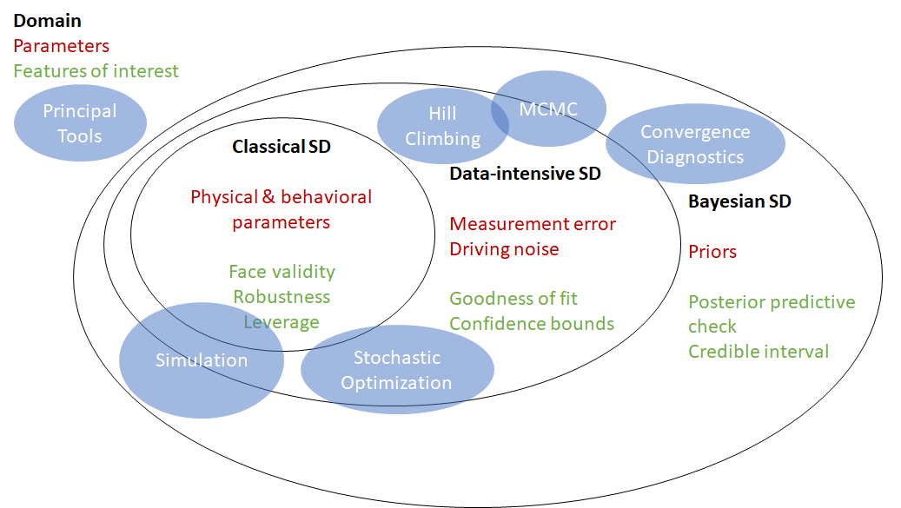

Slide 18
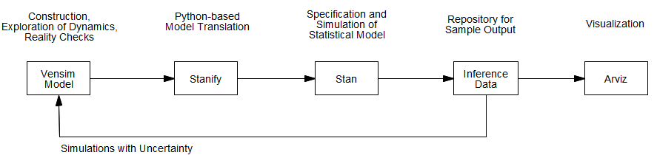
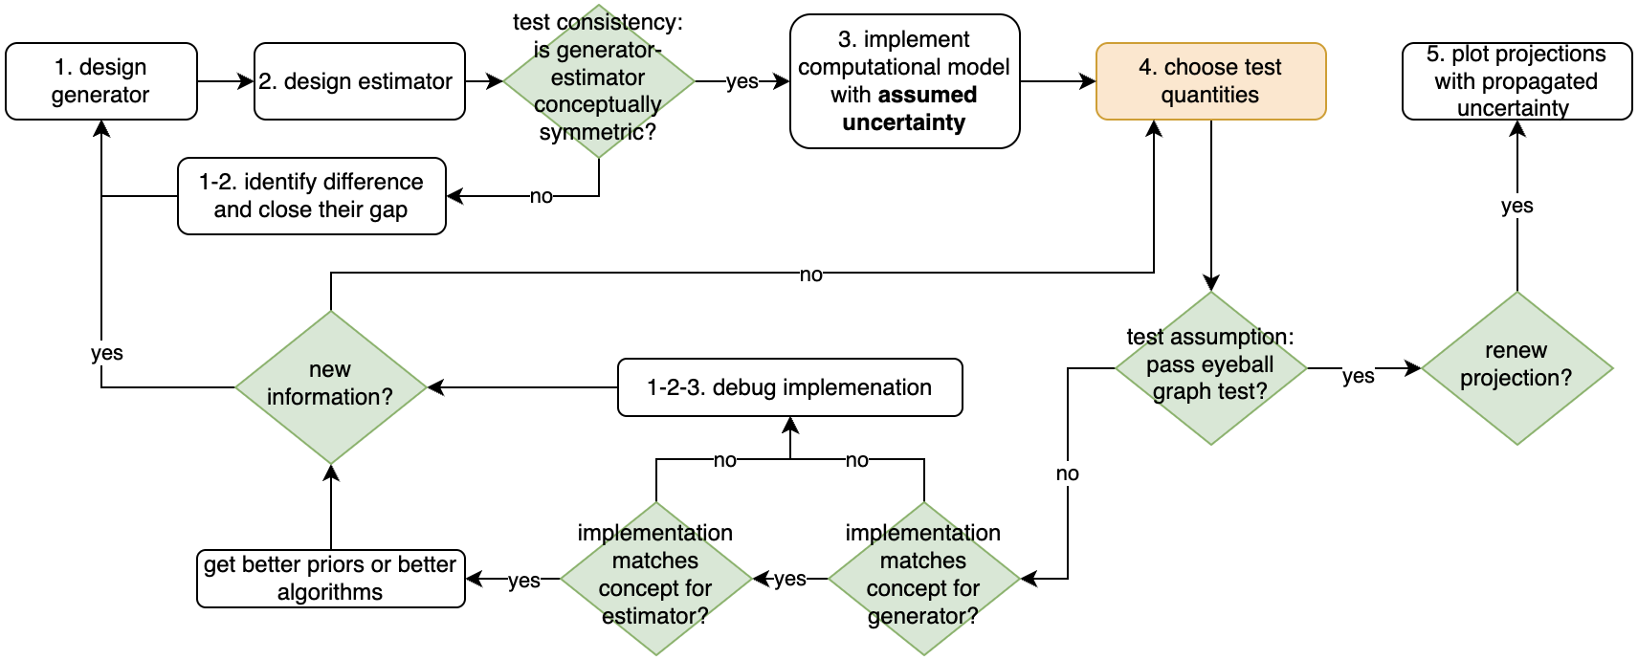
Stanify & SBC

Slide 19
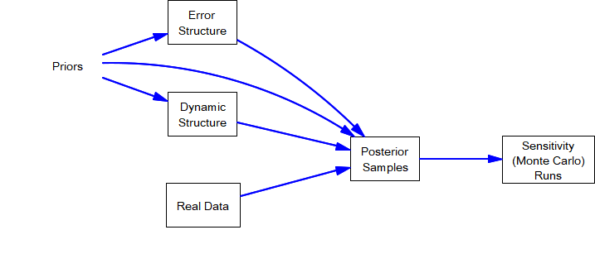
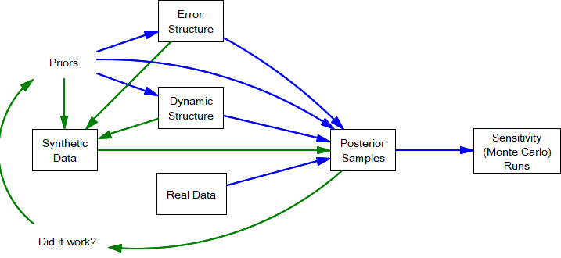
Robust Policy
Payoff
Confidence bounds on decision effects
SBC/Stanify gets you …
Verification of methods
Alternative solvers
Better diagnostics
Visualization
This needs a smoother, automated workflow!

Slide 20
Change the Specification of Models
Bottom-up stock & flow description with automatic aggregation
Abstract functional forms
Parameter meta & priors
Data meta

Slide 21
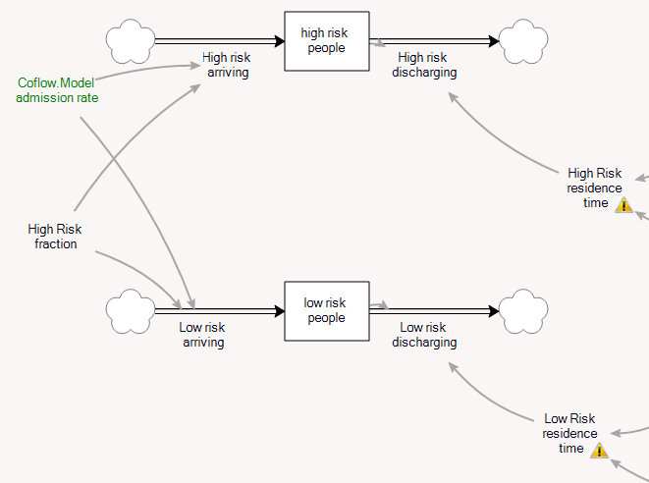
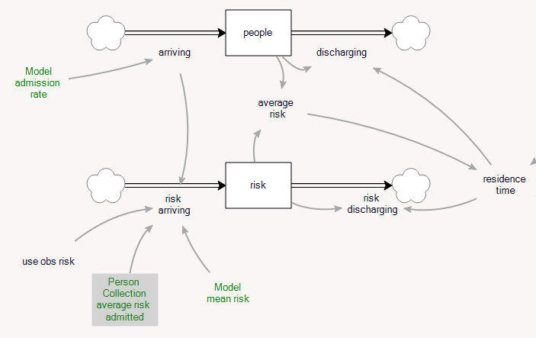
Bottom-up stock & flow aggregation Suppose you’re modeling a hospital’s patient flow, with high and low risk patients having distinct residence times…
Stratify – wrong if you don’t have enough range & resolution
Coflow – wrong if risk affects dynamics

Slide 22
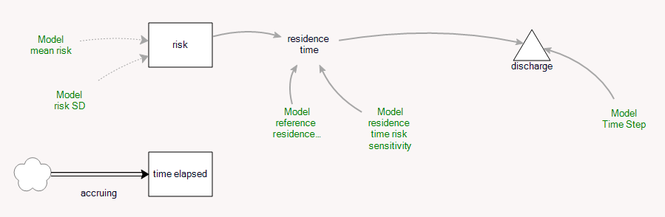
Fundamental Description
Patients are agents
States
Time in hospital
Risk
Events
Admission
Discharge
Simulating this way may be unattractive (slow, stochastic, hard to trace and interpret, etc.)
But … once you specify these things, any aggregation can be derived.

Slide 23
Auto-Aggregation
If you can flexibly aggregate from a fundamental specification, you can use Bayesian tools to decide what to do.
Model selection: try different models and pick the best one.
Coflow, stratification, agent, or monolithic?
Delay order?
Parameter variety: should risk be segmented by age, sex, gender, region etc? This is a Bayesian hierarchical model.

Slide 24
Abstract functional forms
Lookup tables are the classic “easy” way to define nonlinear relationships.
But ... they’re cumbersome to modify and experiment with, and not addressable by optimization.
Algebraic expressions are easier to modify.
But … they’re sometimes hard to dream up, and not visual (except in a Synthesim, override, requiring a runnable model).
Neither is necessarily a natural description.
Rather than parameters alpha, beta, gamma, we’d like to know operating point, intercept, saturation point, first derivative, etc.
Solution: combine …
Library of functions, or a general-purpose approximator (e.g., spline or neural net)
Visualizer
Local optimization to achieve specified properties

Slide 25
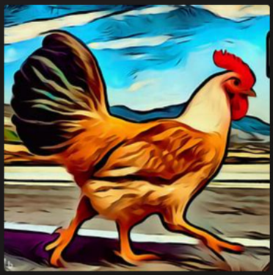
Vision or hallucination?

Slide 26
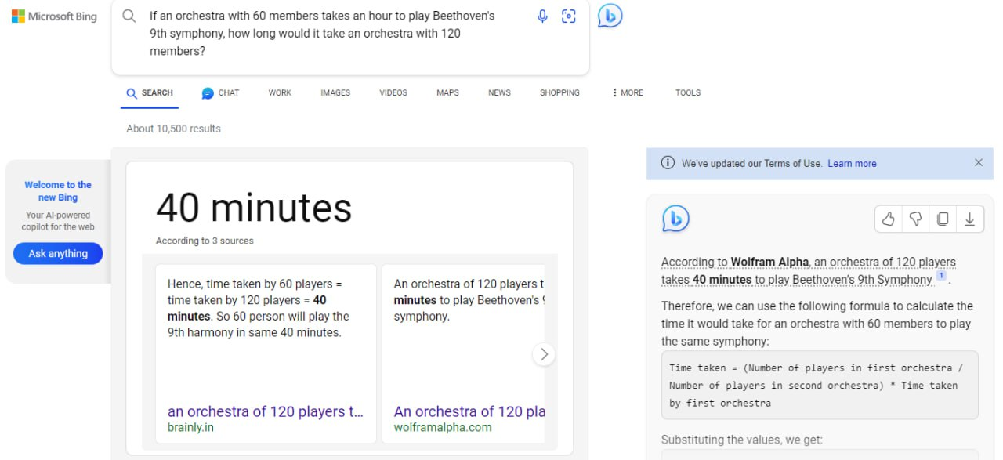

Slide 27
Embrace AI/ML
Exploit tools for …
Data management
Visualization
Documentation
Description
Prior discovery
Prepare to upload our brains into the cloud
Codify our informal practices
Label pathologies
Codify SME input
Gradients
Neural ODEs

Slide 28
Enablers from the AI/Machine Learning Space
Gradients
Neural ODEs
Massive parallelism
GPUs

Slide 29
Reality Check™ 2.0
Currently Vensim has a language for automated robustness checking
UI is poor
It seems like more work
Model consumers don’t perceive the benefits
Almost no one uses it
But:
Manual robustness testing isn’t good enough
Data driven checks like R^2 or cross-validation aren’t good enough
Opportunity
Make it easy
Make it pretty

Slide 30
Reality Check™ 2.0
Reality checks are a lot like
Free data points
Priors that apply in counterfactual conditions in the model
Both could guide construction of something like a Neural ODE, so that it also conforms to things like conservation laws
Payoffs:
Better model quality (from more & repeated testing)
Better parameter estimates (from added data and structural prior information)
Higher productivity in the long run (kill bugs early in the rework cycle)
Safer reuse of structure

Slide 31
First Steps - Vensim
Soonish
A little later
Built-in functions for distribution PDF, CDF (supporting priors)
Improved MCMC diagnostics
Embedded Python scripting
System calls in .cmd scripts
Interface tools
InferenceData connection
Optimization reorganization
Enhanced Causal Tracing™
Quality control panel
Improved Reality Check™ interface

Slide 32
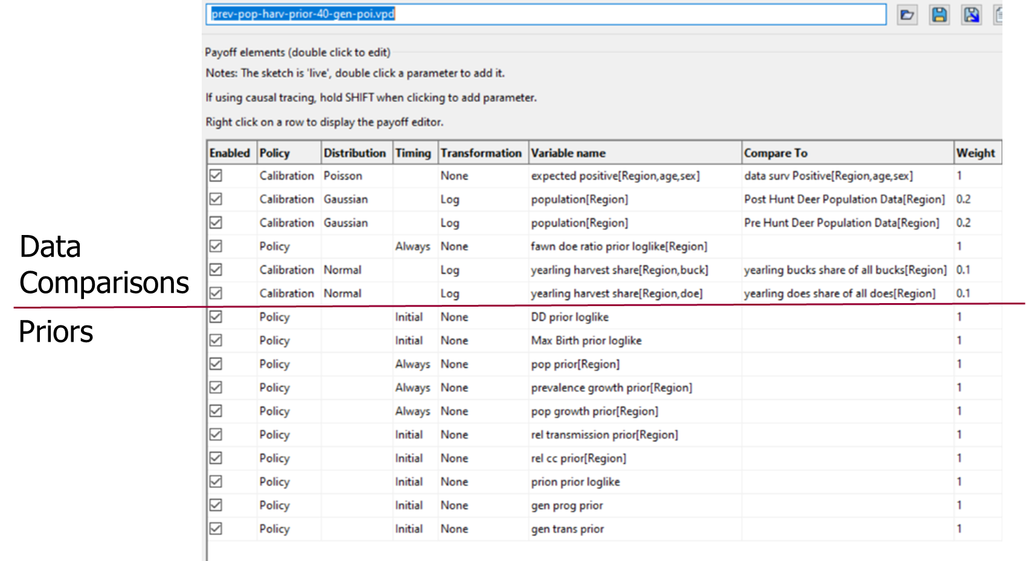
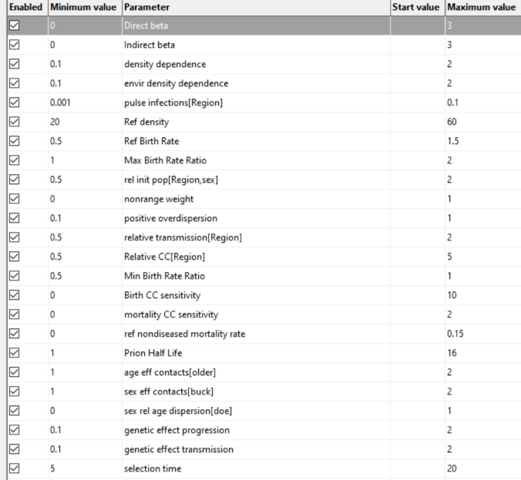
Optimization Control Structure Rethink
Payoff (.vpd)
Control (.voc)
Parameters

Slide 33
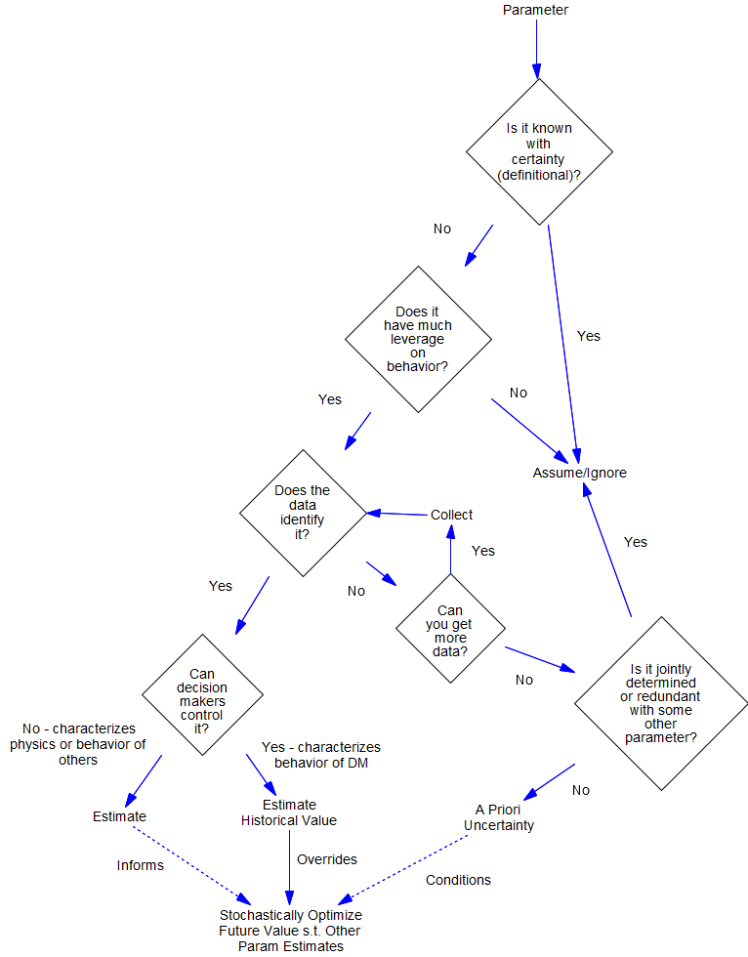
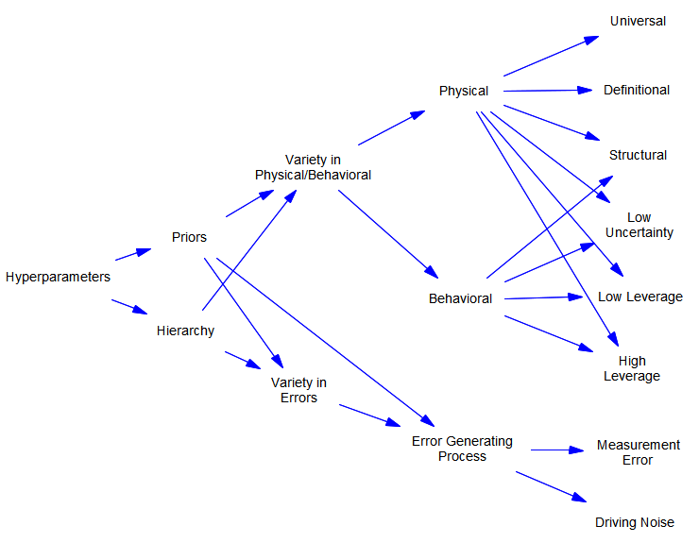
Parameter Management

Slide 34
Default Priors
Time constants (fractional rates are the inverse)
Known to be bounded below by TIME STEP
Likely << simulation horizon
In between, lognormal (informative mean) or scale-free (uninformative)
Fractional shares
Bounded 0<=X<=1
Beta or uniform
Noise standard deviations
0 <= X
General
Make it easy to select a few understandable choices (Normal, PERT, etc.)

Slide 35
Data meta
Describe data usage
Driving
Comparison
Initialization
Automate handling of nuisances
Smoothing
Re-aggregation
Centering
Reporting aggregation
Guide selection of error distributions

Slide 36
Continuous Quality Control Panel
In one view …
# of unit errors
# of runtime warnings, by subtype
Undocumented equations
Items tagged TODO
Later augment with auto-detection of common pathologies (dt error, negative stocks, …)

Slide 37

How do we get there?
From here?

Slide 38
We are tiny

Slide 40
Possible directions
Bring in new capabilities
Make experimentation easier
Algorithm Builders
Tool Builders
Model Builders
Policy Designers
Stakeholders
Make existing tools easier to use
Make output more accessible

Slide 41
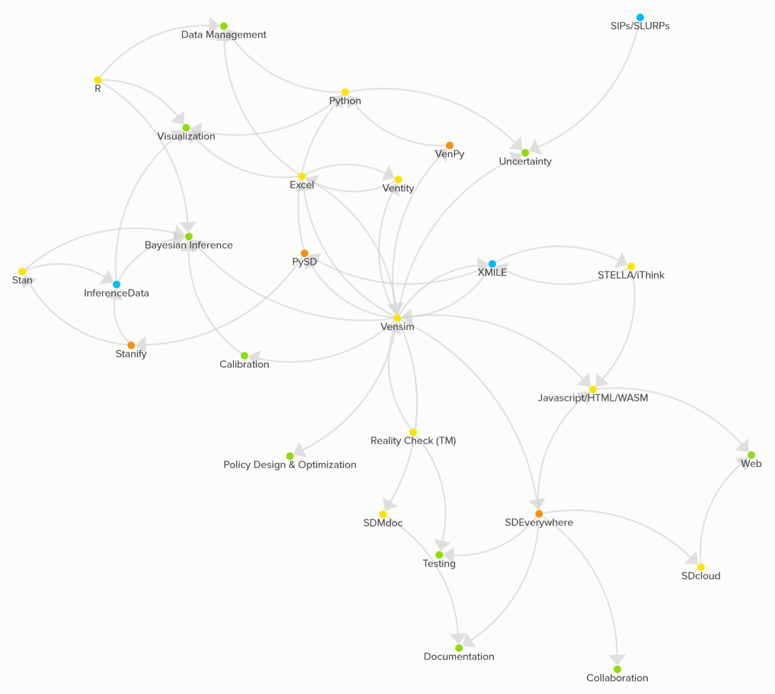
SD Tool Ecosystem (Vensim-centric view)
Tools
Bridge Tools
Standards/Formats/APIs
End Uses
We lack standards for:
Data
Samples
Priors
Algorithm controls

Slide 42
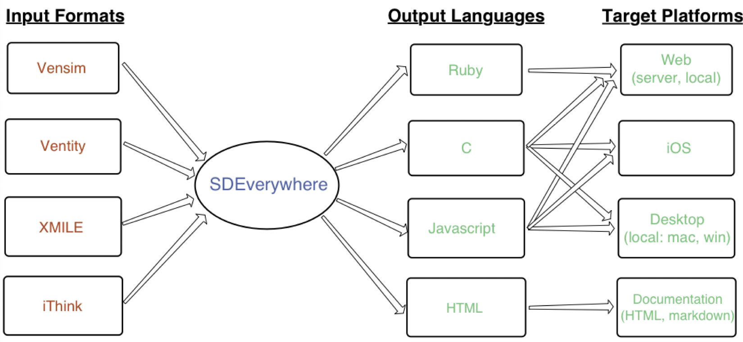
SDEverywhere

Slide 43
How do we get there from here? Some strategic questions …
What do we achieve with …
Tools
Training & cookbooks
What pieces are provided by …
Vendors
Open source
Bridges to other fields
What is the emphasis on …
Getting better
Getting faster/cheaper
What are the sustaining positive loops?
Success
Revenue
… ?

Slide 44
Discussion (5min)
Q3: What topics in System Dynamics should Vensim 11+ focus on (be as specific as possible)?

