Slide 1
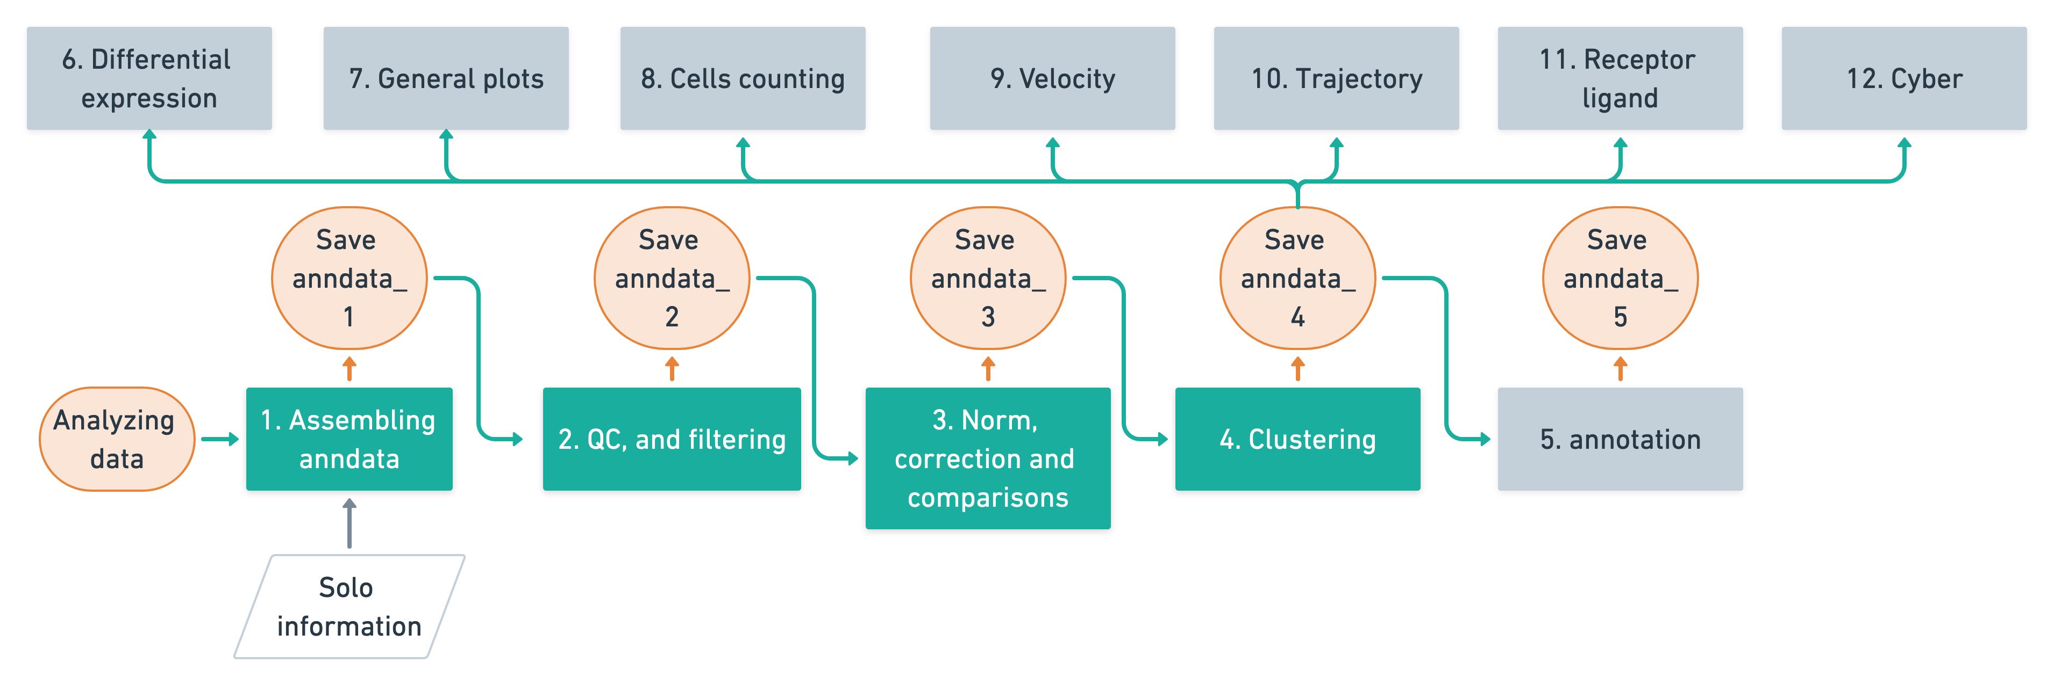
Workflow
Core codes

