Slide 1
Boom to Bust : The Tale of 4 Cities
Do oil prices drive the housing markets in the Lonestar State?

Slide 2
Boom to Bust: The Tale of 4 cities Through parsing through years of oil price and home price data in Texas’ four largest economies…
We seek to find if a correlation exists between these two economic indicators.
Houston, Dallas, San Antonio, and Austin are major hubs in the Texas economy, how much do they each depend on Texas Tea to keep the housing market fired up?
With the passage of time have any of these 4 Texas powerhouse economies diversified enough to untether their housing rates from the black gold Texas has long been associated with?

Slide 3
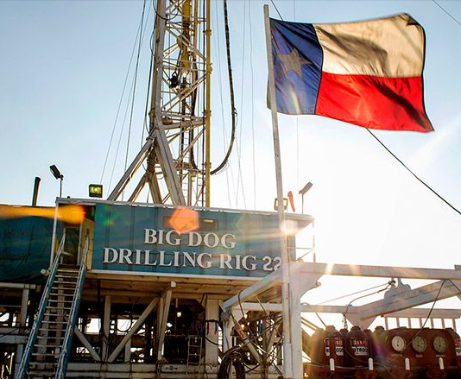
2 Texas size datasets were analyzed
Drilling Through the Data
Home prices from 1997 to 2019
https://www.zillow.com/research/data/
Oil prices from 1997 to 2019
Spot Prices for Crude Oil and Petroleum Products

Slide 4
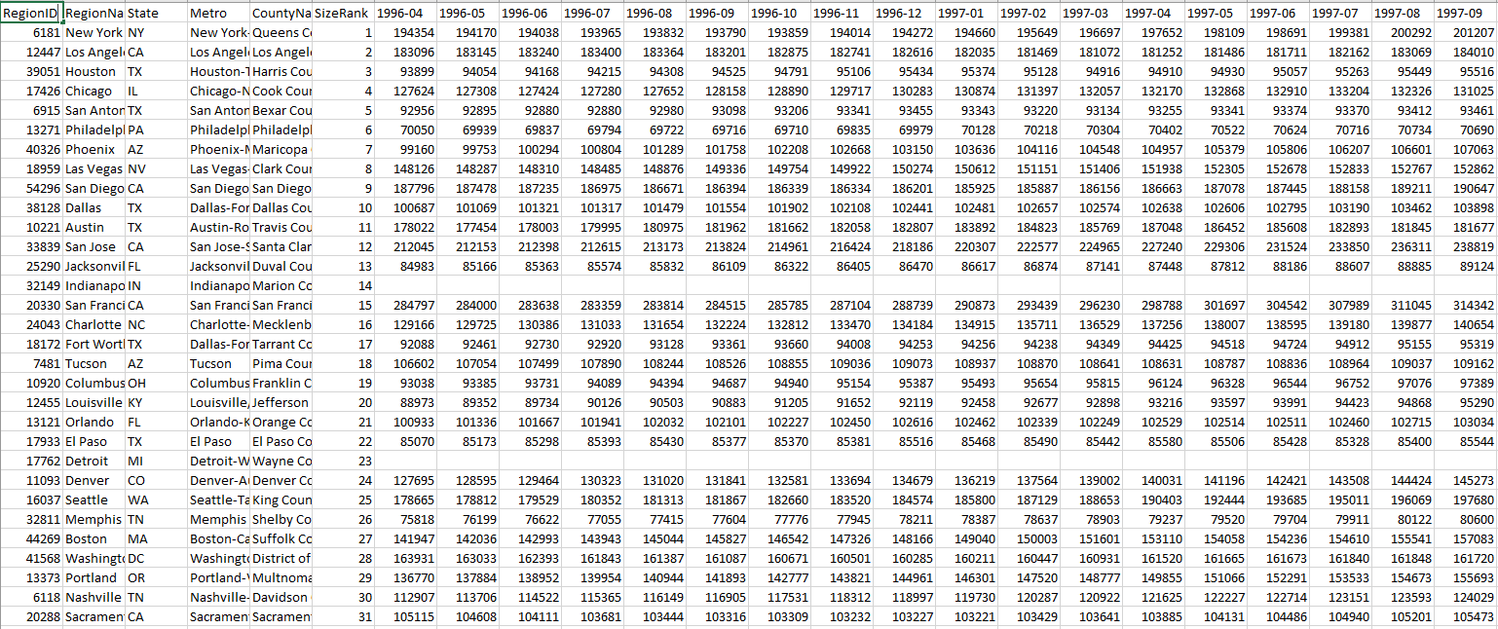
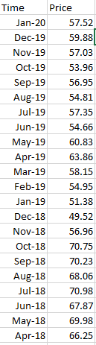
Taking a large housing data set and extracting what we need for efficient analytics

Slide 5
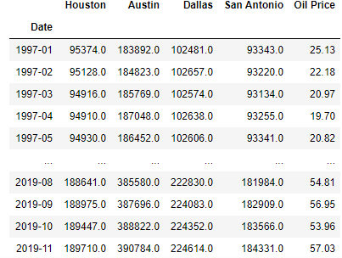
Merged Data Frame

Slide 6

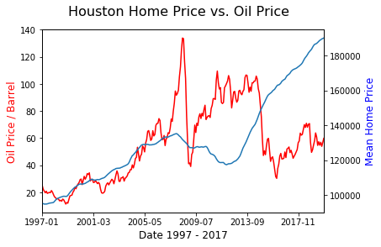
Houston The Bayou City

Slide 7
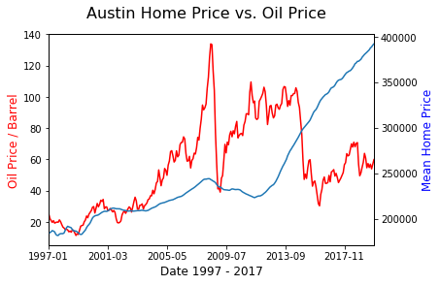

Austin The Capital City

Slide 8

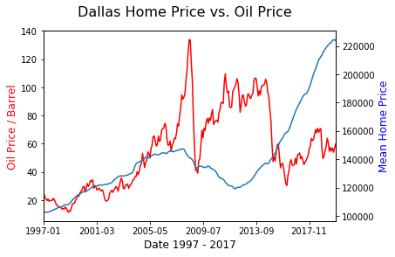
Dallas BIG “D”

Slide 9
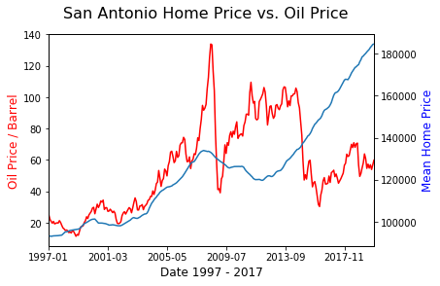

San Antonio The Alamo City

Slide 10
We seek to find if a correlation exists between these two economic indicators.
We looked at housing data in the 4 Texas cities and determined their was some correlation between the datasets, however once we broadened our search to economies that are not traditionally tied to energy markets we found …

Slide 11
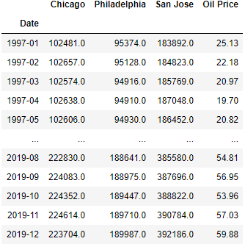
Decision to test hypothesis with additional data Added Data Frame to include more cities

Slide 12

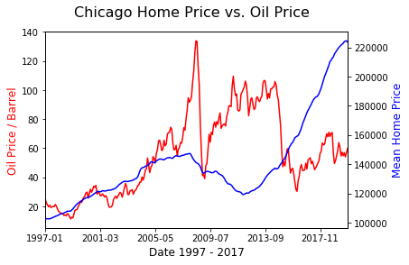
Chicago The Windy City

Slide 13
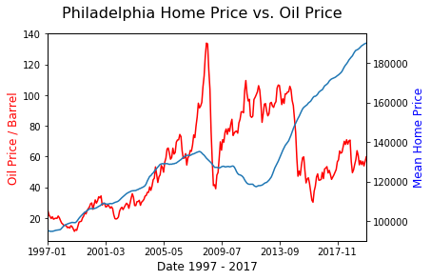

Philadelphia The City of Brotherly Love

Slide 14

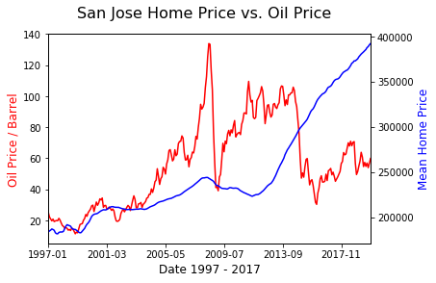
San Jose Surf City, USA

Slide 15
Houston, Dallas, San Antonio, and Austin are major hubs in the Texas economy, how much do they each depend on Texas Tea to keep the housing market fired up? The data shows linear correlation to other US cities. This suggests the Texas housing markets are more dependent on the national economy where Oil price is a factor but only a part of a more complex market.

Slide 16
UNEXPECTED linear correlation of NATIONAL home prices

Slide 17
Boom To Bust: The Tale of 4 Cities
Data selected, analyzed, visualized, and presented by:
Abral Erkin
Miguel Boada
Gavin Starling

