Slide 1

Impact of Coronavirus on Stock Market
Analysis by group 8

Slide 2
Questions for Analysis
How the U.S stock market has been affected since the emergence of COVID -19?
How has the stocks in various sectors (Pharma, Tech, Oil & Gas, Airlines etc.) been affected ?
Is there any common pattern in timeline of COVID cases in various countries (US, China, Italy etc.)?

Slide 3
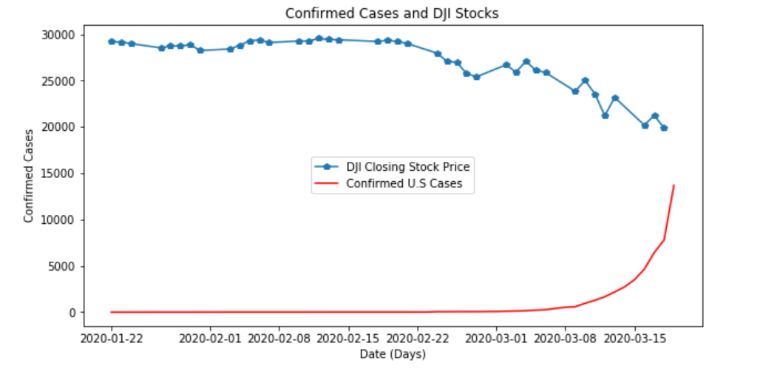
Trend in the Dow Jones Stocks
vs. Confirmed Cases in the U.S
Drop in stock price as cases began to rise

Slide 4
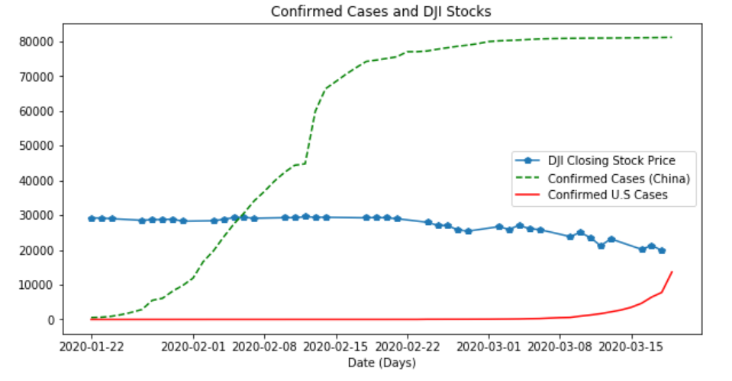
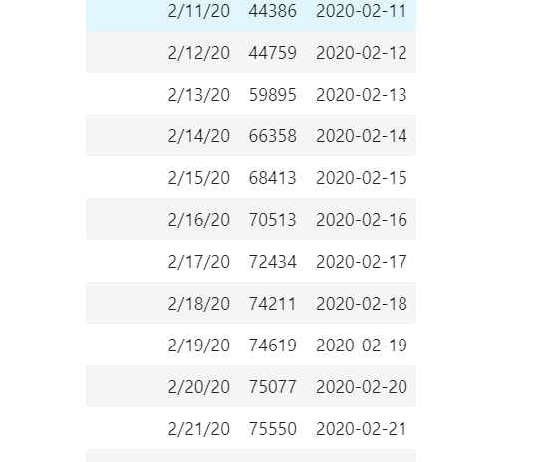
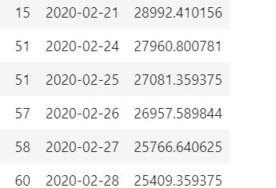
Different view of the Stock trend
China Cases Date
U.S Cases Date Closing Stock Price

Slide 5
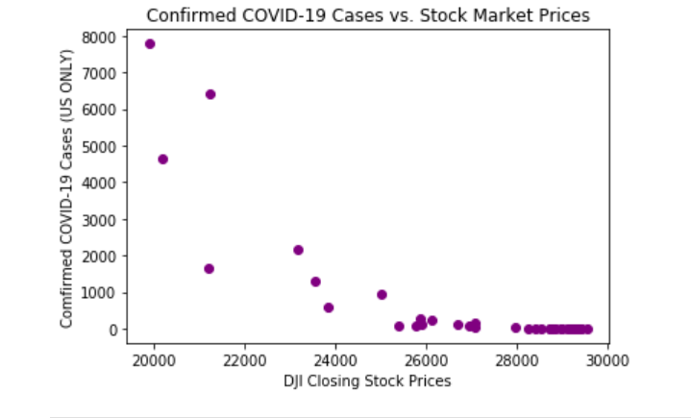
Trend in the Dow Jones Stocks
The correlation between COVID cases and DJI Stocks is -0.80, for the dates of 01-22-2020 to 03-18-2020.
Closing Stock prices were used for the analysis.

Slide 6
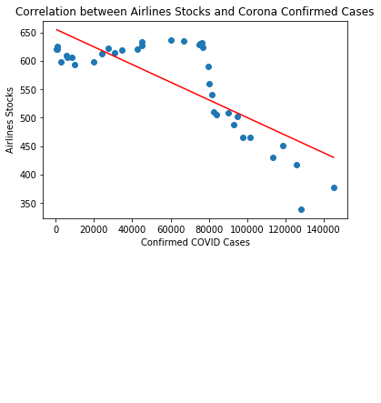
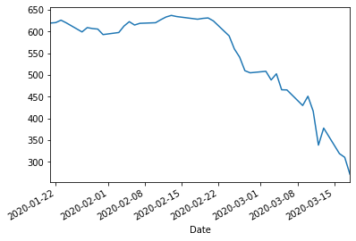
Trend of Airlines Stocks (Ticker : ALK, AVH ,AZUL ,CEA, ZNH, VLRS, CPA, DAL, FDX, GOL, LTM ,LUV SAVE)
Airlines Stock Prices Trend
There is a negative correlation between COVID cases and Airlines stocks have been trending downwards
The value of correlation coefficient between dates 1/21/2020 – 3/18/2020 is
-0.79
The closing price of all the stocks have been analyzed

Slide 7
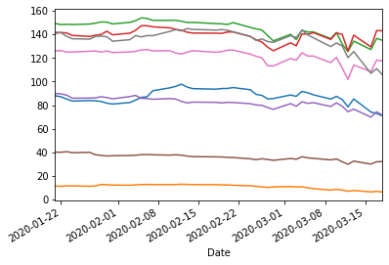
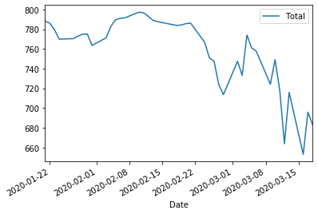
Trend of Top US Pharmaceutical Stocks (Ticker Symbols : ABBV , GE , JNJ , LLY, MRK, PFE, PG, ZTS)
Pharma Stock Prices Trend
Pharma Stock Prices Trend (Total)
Top eight Pharmaceutical stocks have been falling on downhill trend
The closing price of all the stocks have been analyzed

Slide 8
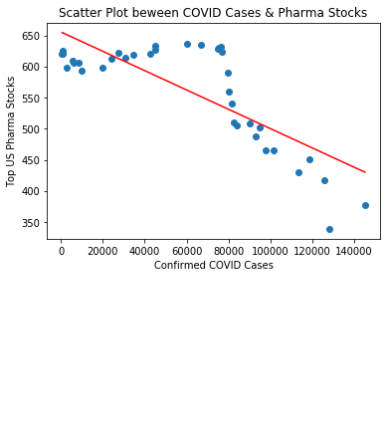
Correlation between Top US Pharma Stocks and COVID cases
There has been a negative correlation between COVID cases and Pharma Stocks
The value of correlation coefficient between dates 1/21/2020 – 3/18/2020 is -0.78
The closing price of all the stocks have been analyzed

Slide 9
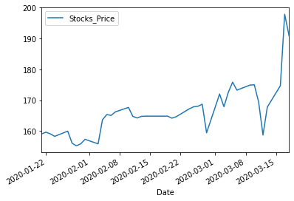
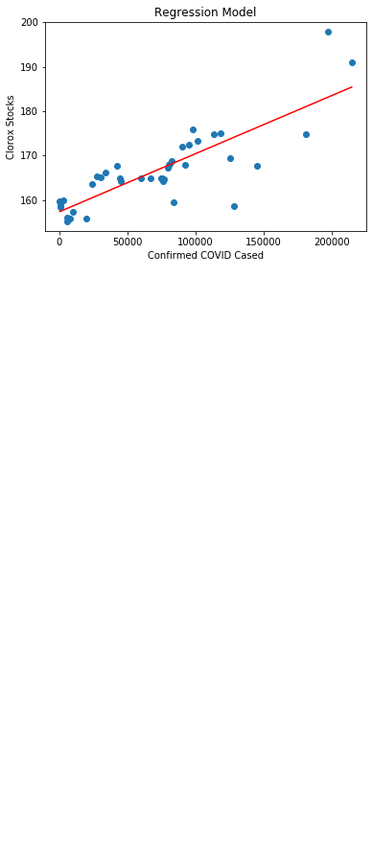
How about Clorox? (Ticker : CLX)
There is a positive correlation between COVID cases and Clorox stocks have been trending upwards
The value of correlation coefficient between dates 1/21/2020 – 3/18/2020 is
0.82
The closing price of all the stocks have been analyzed

Slide 10
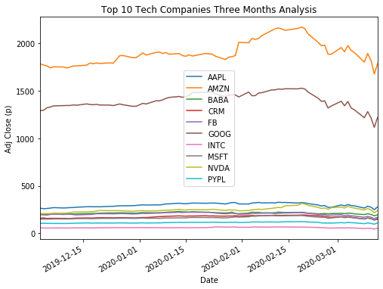
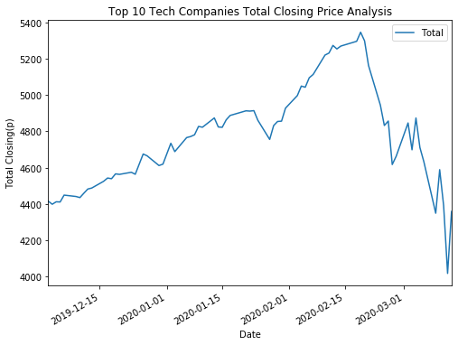
Trend of the Top Tech Companies Stocks
Tech Companies Stocks
Total Closing Stock Analysis

Slide 11
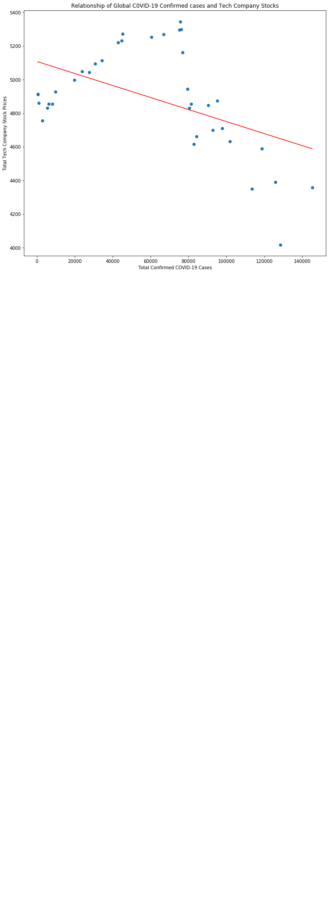
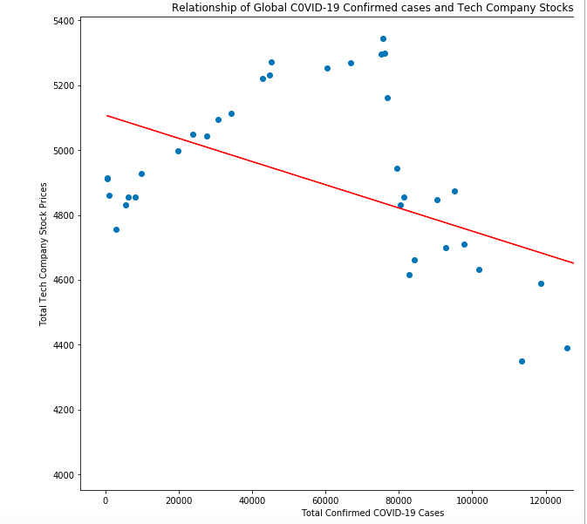
Relationship Between Global Confirmed Covid-19 Cases and Top Tech Companies
There is a negative correlation between Confirmed COVID cases and Top Tech Companies.
The value of correlation coefficient between dates 1/21/2020 – 3/18/2020 is -0.49

Slide 12
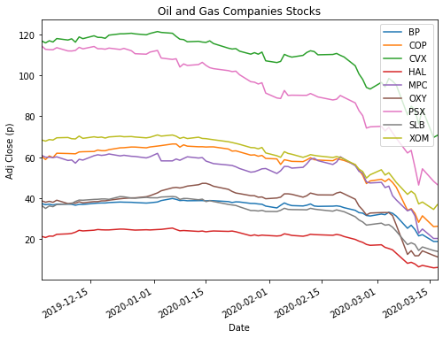
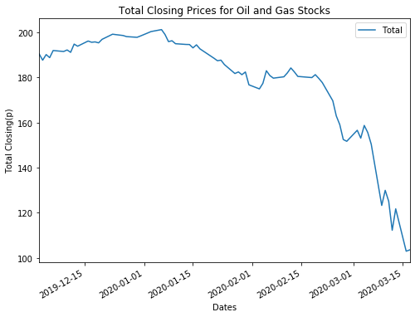
Trend of Some of the Top Oil & Gas Companies
Total Closing Prices of the Oil & Gas

Slide 13
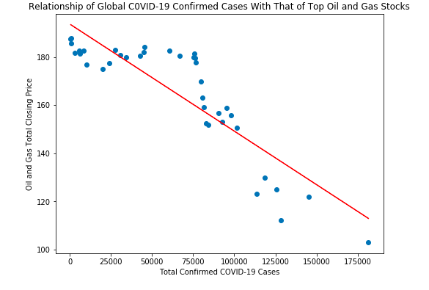
Relationship Between OnG Stocks and the Confirmed Covid-19 Cases
There is a negative correlation between Confirmed COVID cases and the Analyzed Oil and Gas Companies
The value of correlation coefficient between dates 1/21/2020 – 3/18/2020 is -0.87

Slide 14
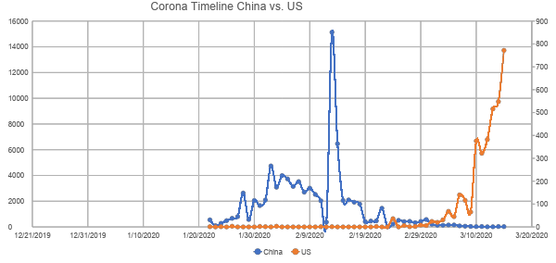
Timeline Coronavirus Cases China vs. U.S

Slide 15
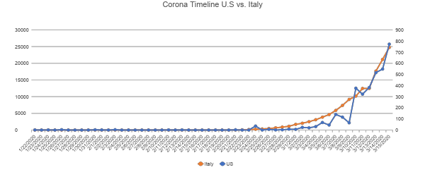
Timeline Coronavirus Cases Italy vs. U.S

Slide 16
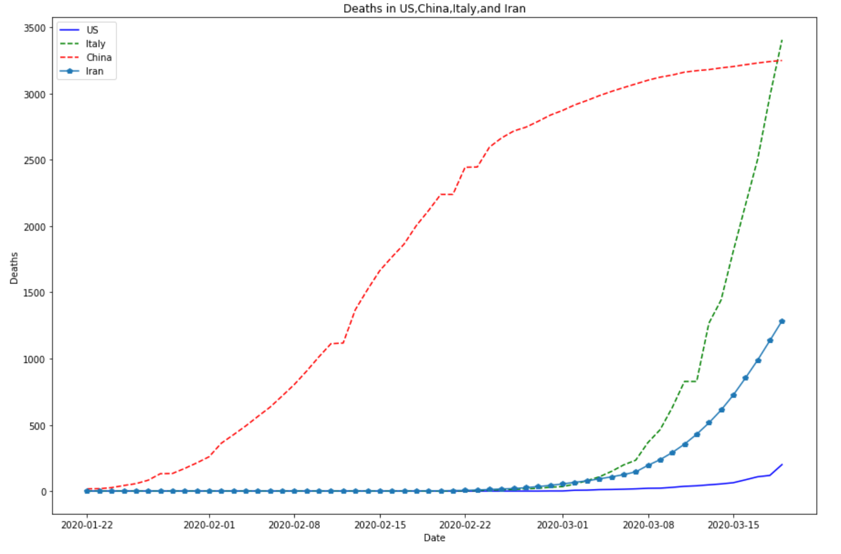
Comparison of Deaths in China, US, Italy, and Iran

Slide 17
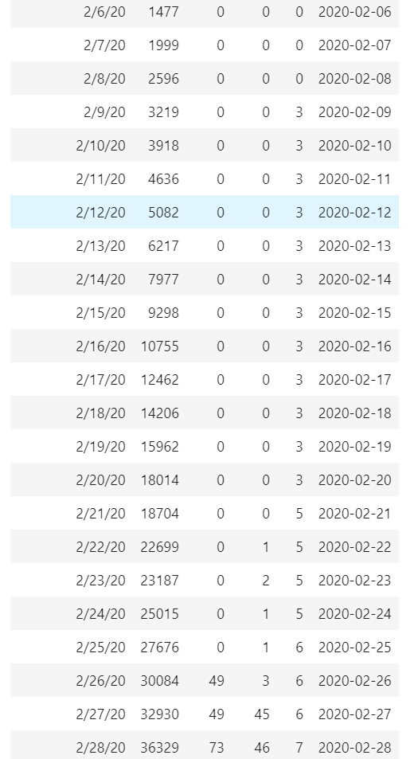
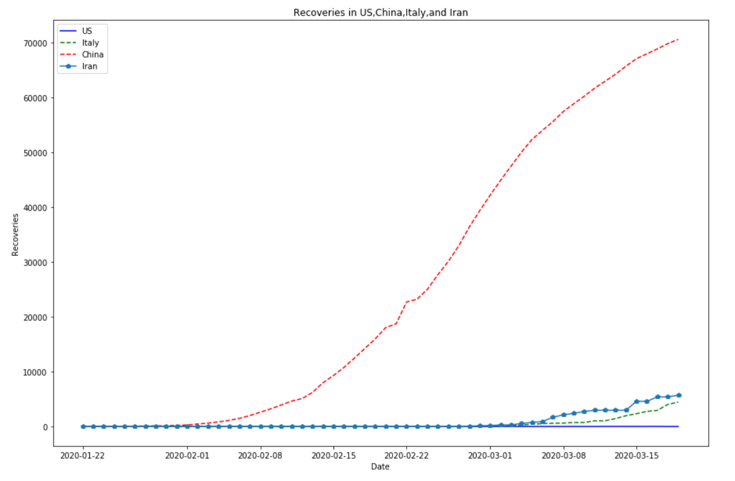
Recoveries within the US,China,Italy and Iran
China Iran Italy U.S

Slide 18
