Slide 1
Boom to Bust : The Tale of 4 Cities
Do oil prices drive the housing markets in the Lonestar State?

Slide 2
Boom to Bust: The Tale of 4 cities
Through parsing through years of oil price and home price data in Texas’ four largest economies, we seek to find if a correlation exists between these two economic indicators.
Houston, Dallas, San Antonio, and Austin are major hubs in the Texas economy, how much do they each depend on Texas Tea to keep the housing market fired up?
With the passage of time have any of these 4 Texas powerhouse economies diversified enough to untether their housing rates from the black gold Texas has long been associated with?

Slide 3
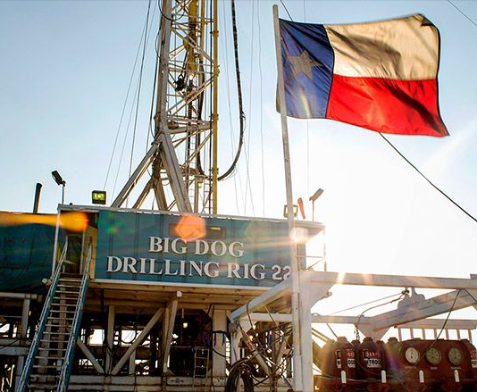
2 Texas size datasets were analyzed
Drilling Through the Data
Home prices from 1997 to 2019
https://www.zillow.com/research/data/
Oil prices from 1997 to 2019
Spot Prices for Crude Oil and Petroleum Products

Slide 4
San Antonio The Alamo City

Slide 5
Austin The Capital City

Slide 6
Dallas BIG “D”

Slide 7
Houston The Bayou City

Slide 8
Boom To Bust: The Tale of 4 Cities
Data selected, analyzed, visualized, and presented by:
Abral Erkin
Miguel Boada
Gavin Starling

