Slide 1
YOUTUBE SPAM ANALYSIS
Advance machine learning by Aman Gupta

Slide 2
INTRODUCTION

Slide 3
PROJECT OBJECTIVE
01
Advance machine learning models that can classify YouTube comments as spam or not based on their textual content.
PROBLEM STATEMENT
02
The task is to build a machine learning model to detect spam comments on YouTube based on text analysis. The model should differentiate between spam and legitimate comments.
DATASET OVERVIEW
03
Real comments from 5 YouTube videos.
Key Columns: comment_id, Author, Date, Content, video_name, class.
ASSOCIATED TASK
04
Text Classification, goal is to classify each comment as spam or non-spam.

Slide 4
IMPORTANCE OF YOUTUBE SPAM ANALYSIS
05
Protecting users from misleading or harmful content.
Ensuring a cleaner and more trustworthy comment section.
Preventing fraudulent promotion and scams.

Slide 5
DATASET OVERVIEW

Slide 6
SOURCE
01
dataset is publicly available and was collected for research on spam detection. It consists of comments from popular YouTube videos.
DATASET CHARACHERISTICS
02
Imbalanced classes: There are roughly equal spam and non-spam comments, but different types of spam may be more frequent (e.g. promotion).
Textual content: The Content column is the most important feature for training machine learning models.
Comment trends: The Date and video_name can provide insights into spam trends over time.

Slide 7
FEATURE OVERVIEW
03
Comment_ID
Type: Irrelevant for modeling
Description: Unique identifier for each comment, can be ignored for analysis.
Author
Type: Categorical
Description: The name or username of the person who posted the comment, possibly useful for identifying frequent spammers.
Date
Type: Categorical (Date/Time)
Description: The date on which the comment was made. Can be useful to detect trends in spam activity over time.
Content
Type: Text
Description: The actual text content of the comment. Primary feature for spam detection using text classification.
Video_Name
Type: Categorical
Description: The name of the video where the comment was posted, which might help identify patterns in spam activity across different videos.
Class
Type: Integer (Binary)
Description: Target variable indicating whether the comment is spam (1) or not spam (0).

Slide 8
DATA SUMMARY
04
Data Summary
Spam ratio: Around 50% of comments are spam.
Most common spam Types: Comments promoting channels, videos, or external websites.

Slide 9
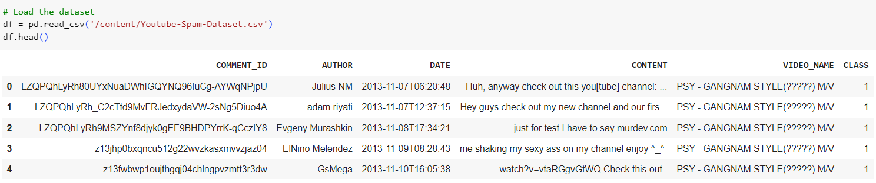
LOADING THE DATASET

Slide 10
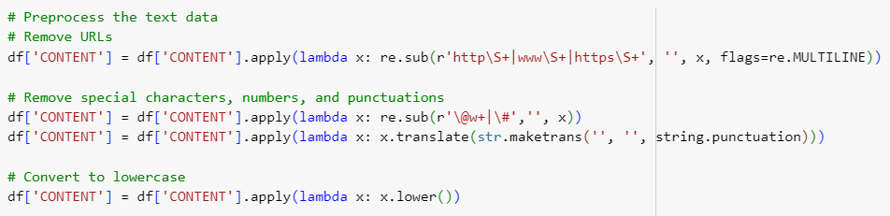
EDA AND PREPROCESSING

Slide 11
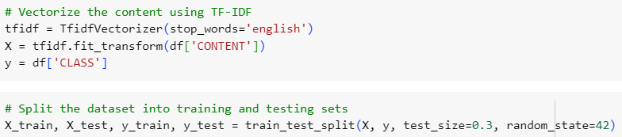
SPLITTING THE DATA

Slide 12
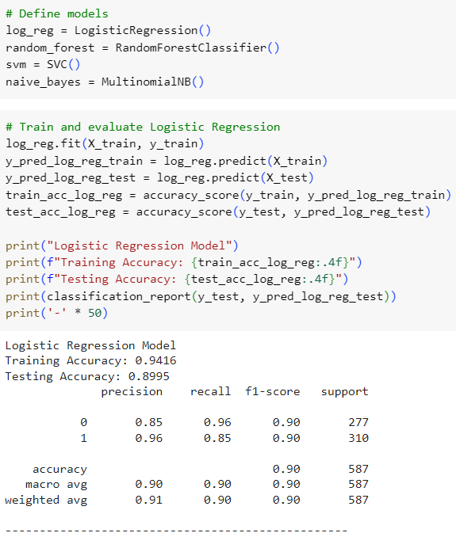
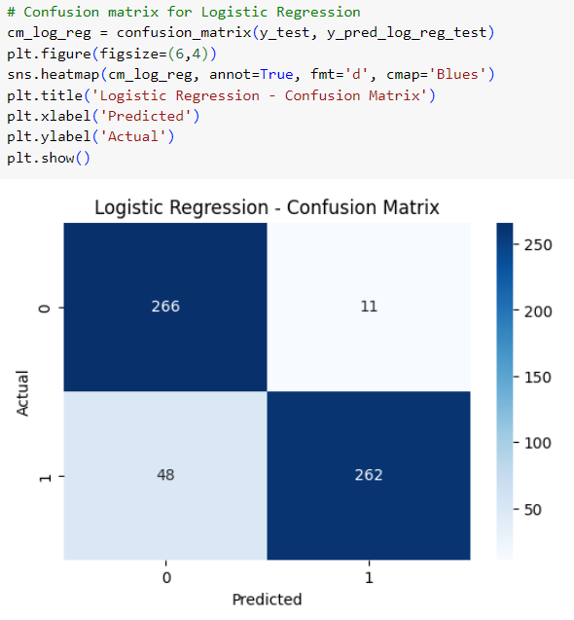
MODEL BUILDING

Slide 13
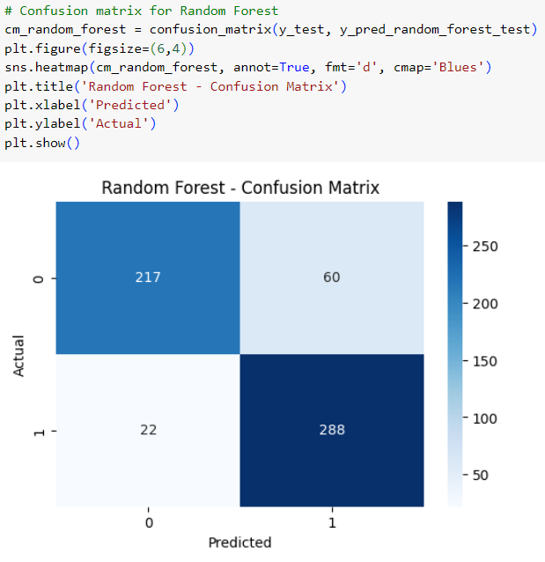
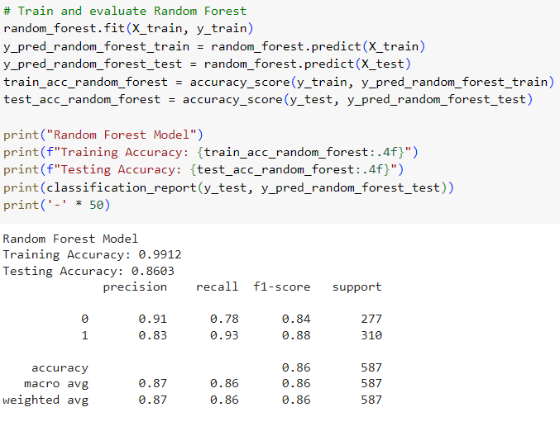

Slide 14
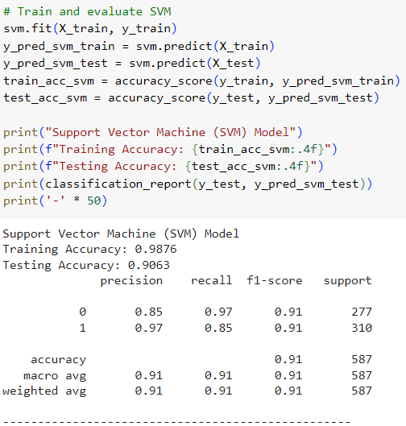
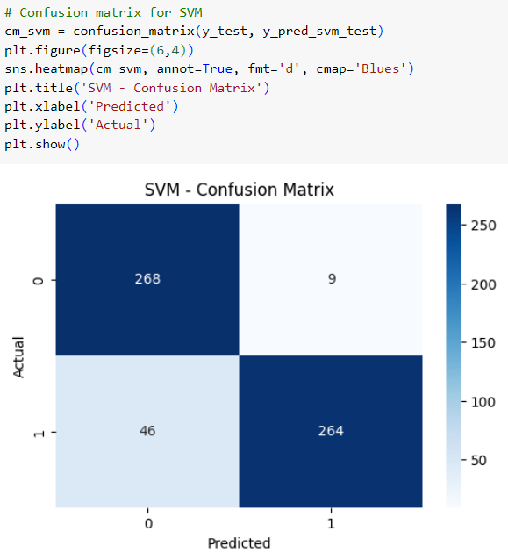

Slide 15
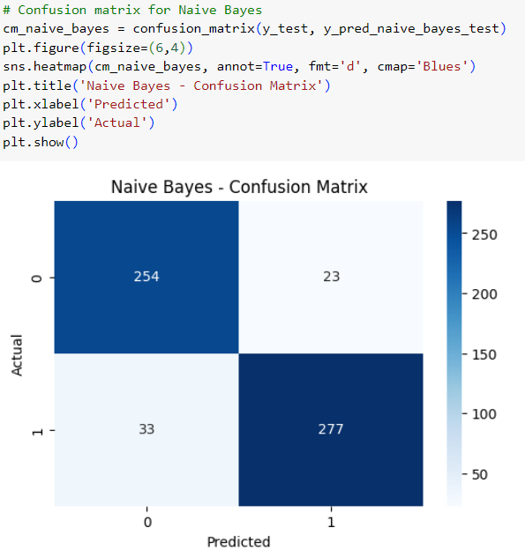
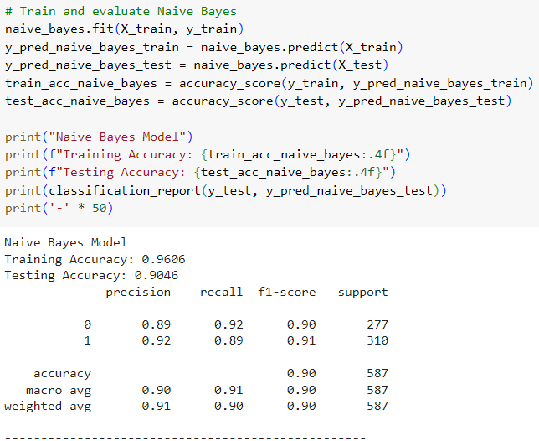

Slide 16
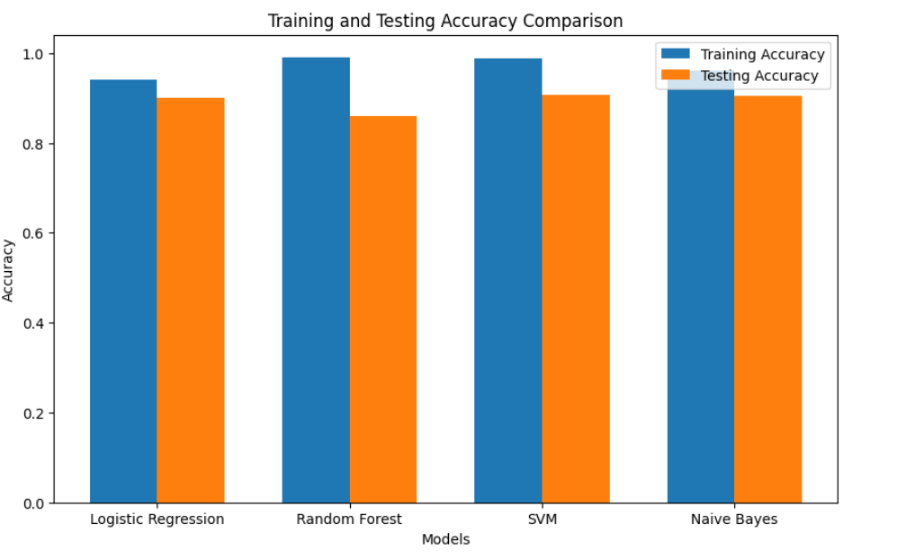

Slide 17
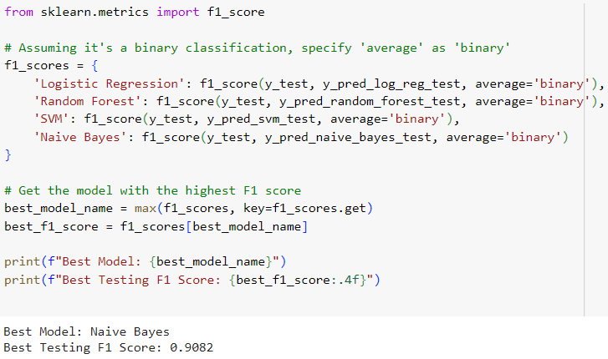
SELECT BEST MODEL

Slide 18
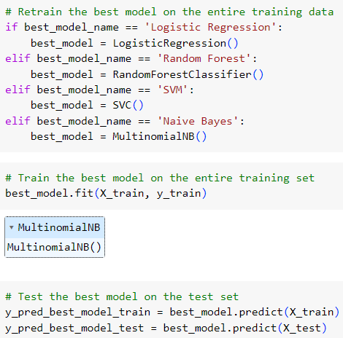
TRAINING AND TESTING BEST MODEL

Slide 19
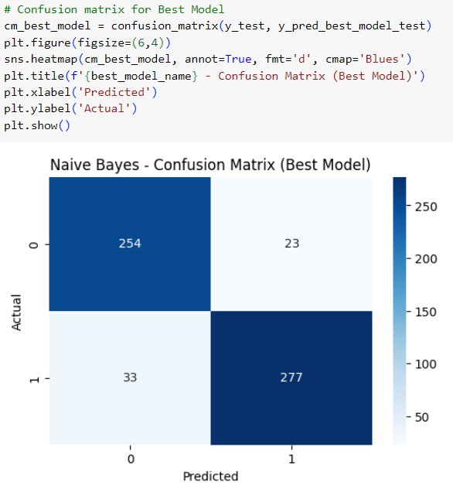
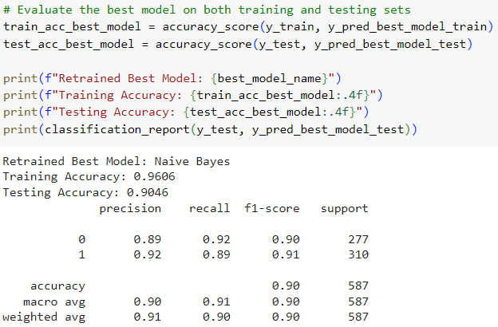
MODEL EVALUATION

Slide 20
THANK YOU

