Slide 1


SQL Project on Social Media Analytics
by Aman Gupta

Slide 2
SQL Project on Social Media Analytics
The "Social Media Analytics" project leverages SQL to analyze data from platforms like Facebook, Twitter, and LinkedIn.
It aims to extract insights to enhance marketing strategies and user engagement.
Project Overview:
Data Collection: Extract user profiles, posts, comments, likes, and shares from social media platforms.
Data Modeling: Design a relational database schema to organize social media data efficiently.
Data Analysis: Use SQL queries to analyze data for trending topics, influential users, user engagement, and sentiment analysis.
Performance Optimization: Optimize SQL queries for better performance using indexing and query tuning.

Slide 3
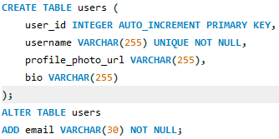
We start with Creating and Importing Data
1
Create Database
2
Use Database
3
Create and Table
4
Optimize Performance

Slide 4
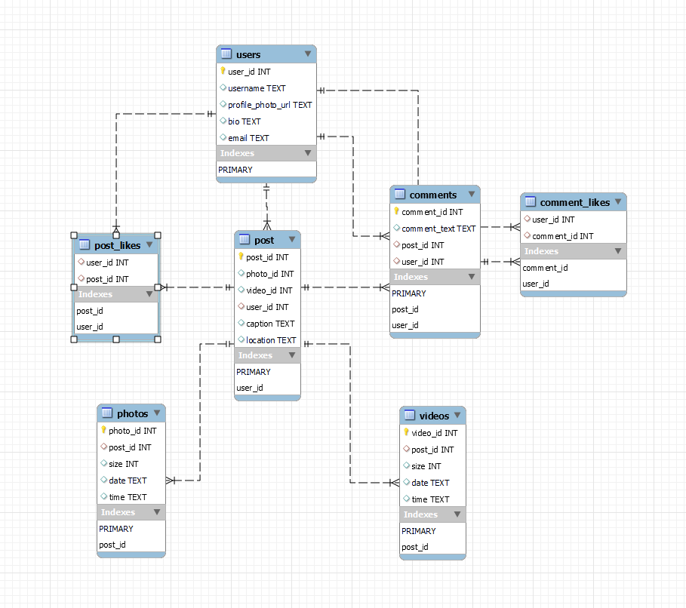
Entity Relationship Diagram

Slide 5
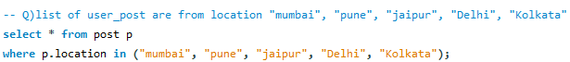
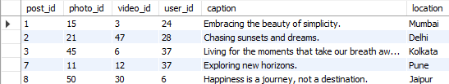
Data Manipulation Language
Select Statement

Slide 6
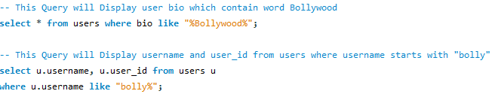
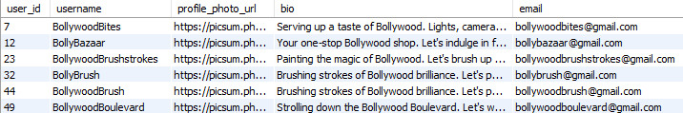
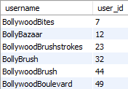
String Function

Slide 7
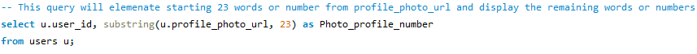
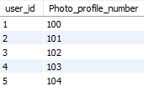
String Functions

Slide 8
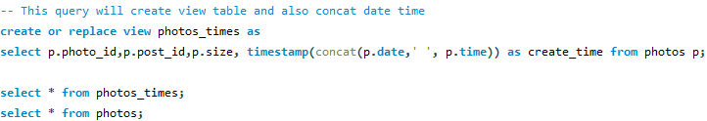
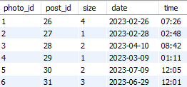
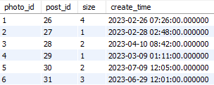
Views

Slide 9
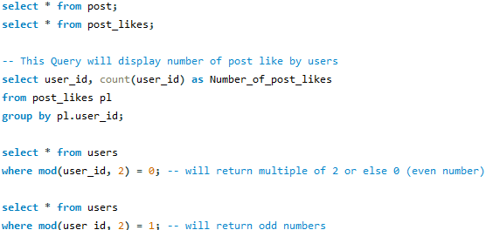
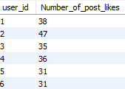
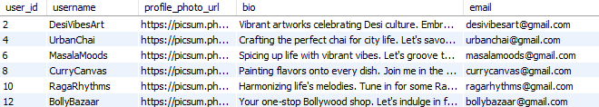
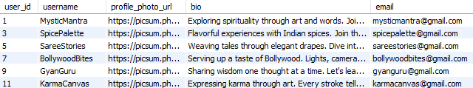
Numeric function

Slide 10

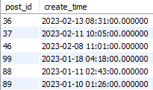
Date and Time Function

Slide 11


Window Function

Slide 12
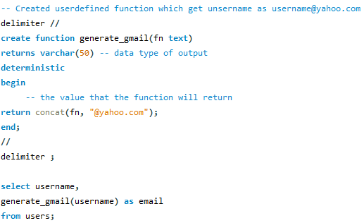
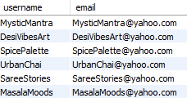
User Defined Function

Slide 13
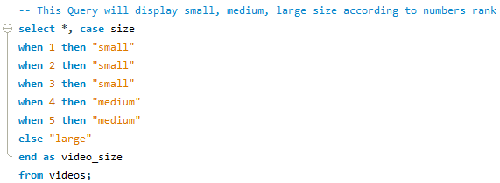
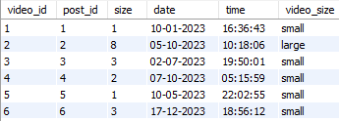
Control Flow Function

Slide 14
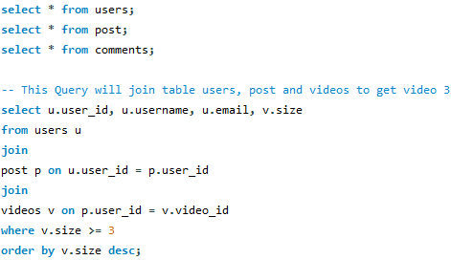
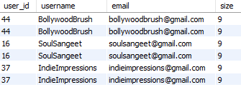
Joins

Slide 15
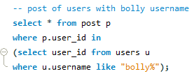
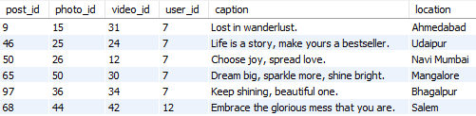
Subqueries

Slide 16


Common Table Expressions(CTE)

Slide 17
Common Table Expressions(CTE)

Slide 18
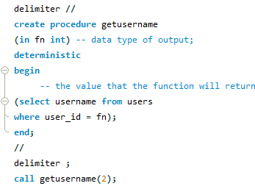

Stored procedure

Slide 19
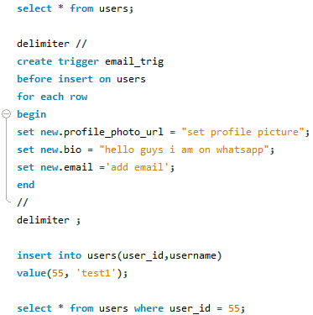
Trigger

Slide 20
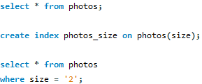
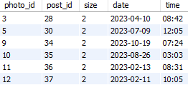
Indexing

Slide 21
Thank You

