Slide 1
“IT Nexus: Bridging Technologies & Workforce Dynamics”
By Federico Calarco

Slide 2
Summary
Project Objectives Overview of the goals and purpose of the project.
Methodology Explanation of the technical process, tools, and techniques used.
Key Results Insights into programming languages, databases, platforms, web frameworks and demographics.
Insights and Conclusions Summary of trends, findings, and their implications.
Next Steps Overview of future actions, improvements, and strategic implications based on project results.
Appendix: Analysis and Resources A detailed reference section with all relevant files and resources used throughout the project, including Python scripts, SQL queries, and the Power BI dashboard links.

Slide 3
Project Objectives
- Collect data from job portals, surveys, and training platforms.
- Demonstrate technical expertise in data extraction, cleaning, and analysis.
- Identify current and future trends in IT technologies (*).
- Develop an interactive Power BI dashboard for actionable insights.
(*) The data analyzed is based on interviews conducted in previous years, which may not fully reflect the current state of the sector.

Slide 4
Methodology
- Data extraction using Python (web scraping and from online sources with JSON and CSV files available).
- Data cleaning and transformation (handling missing values, addressing outliers, normalizing data).
- SQL analysis with SQLite3 embedded in Python for structured queries.
- Exploratory data analysis in Python to derive key insights, using Matplotlib and Seaborn for data visualization.
- Use Power BI to model data, build relationships in the data model, and develop interactive visualizations and dashboards.

Slide 5
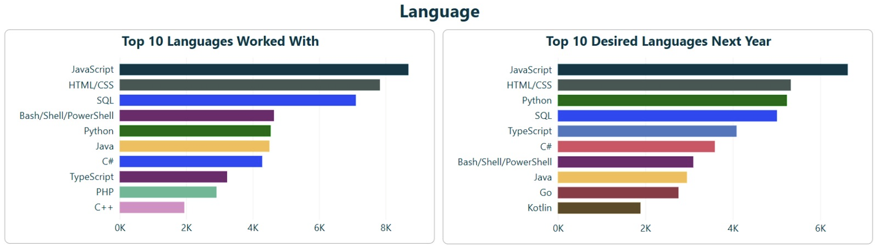
Key Results: Programming Languages
- Top 10 languages worked with: JavaScript, HTML/CSS, SQL, etc.
- Top 10 desired languages: Python, JavaScript, HTML/CSS, etc.

Slide 6
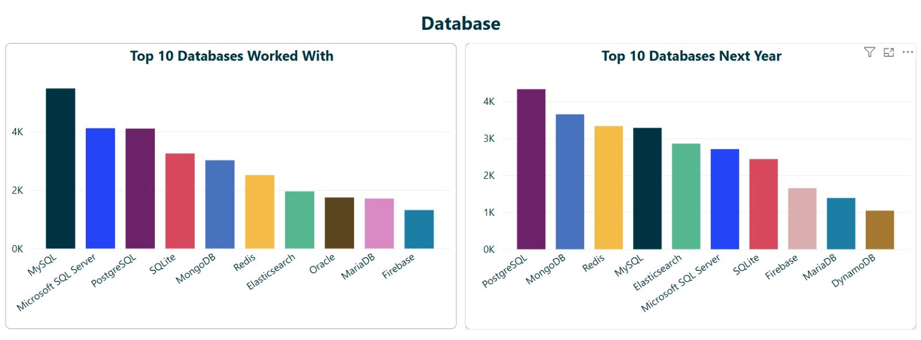
Key Results: Databases
- Top 10 databases worked with: MySQL, PostgreSQL, MongoDB, etc.
- Top 10 desired databases: PostgreSQL, MongoDB, Redis, etc.

Slide 7
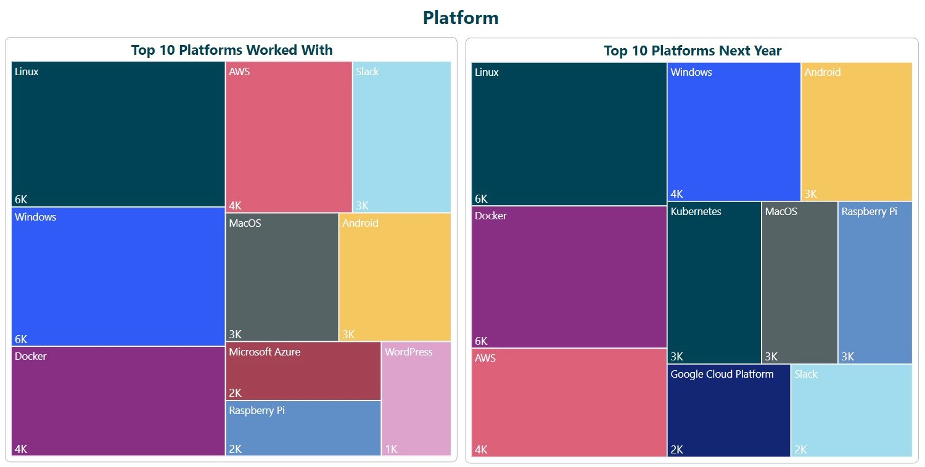
Key Results: Platforms
- Top 10 platforms worked with: Linux, Windows, Docker, AWS, etc.
- Top 10 desired platforms: Linux, Docker, AWS, Windows, etc.

Slide 8
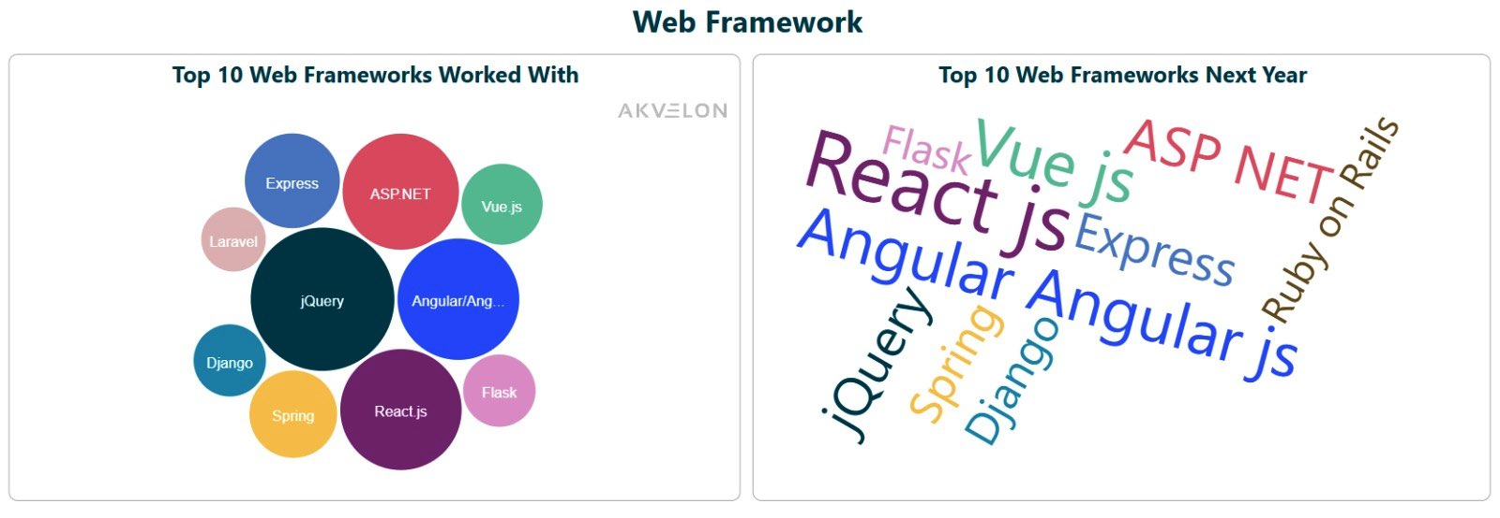
Key Results: Web Frameworks
- Top 10 Web Frameworks worked with: jQuery, Angular/Angular.js, React.js, etc.
- Top 10 Web Frameworks desired: React.js, Vue.js, Angular/Angular.js, etc.

Slide 9
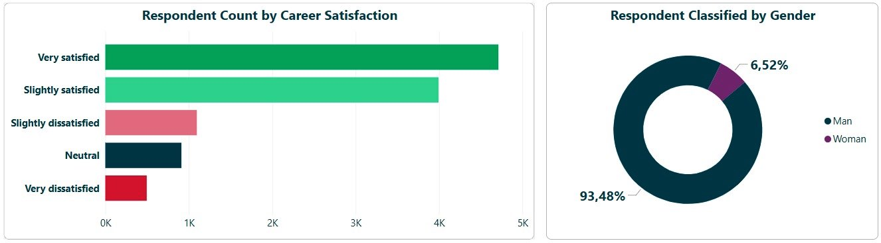
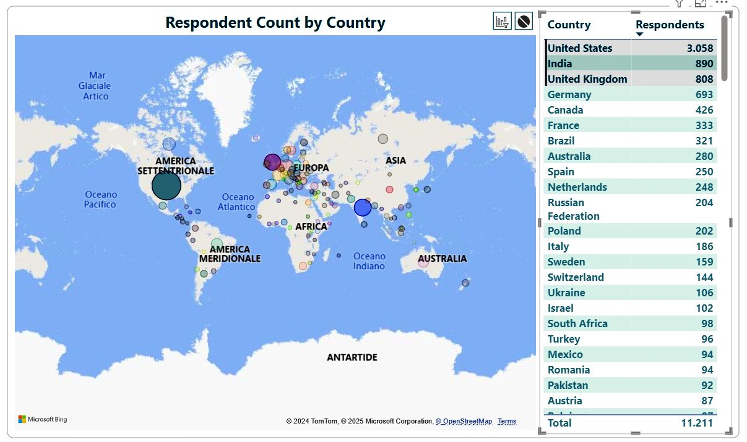
Key Results: Demographics
- Career satisfaction: Majority very satisfied or slightly satisfied.
- Respondents by Gender: 93% Men, 7% Women.
- Top 3 countries by number of respondents: United States, India, United Kingdom.

Slide 10
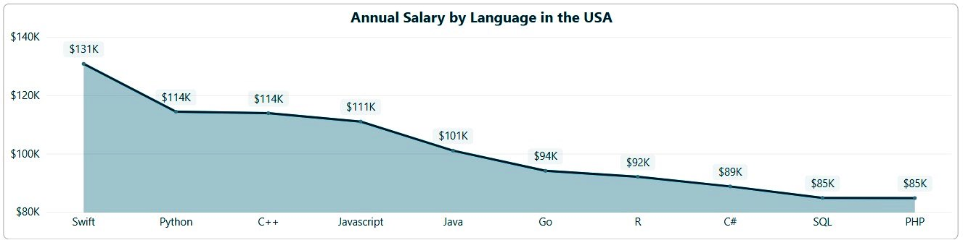
Key Results: Additional Viewpoints
- Highest salary Programming Languages in the USA: Swift, Python, and C++ are highest paying, while SQL and PHP are common but lower-paying.

Slide 11
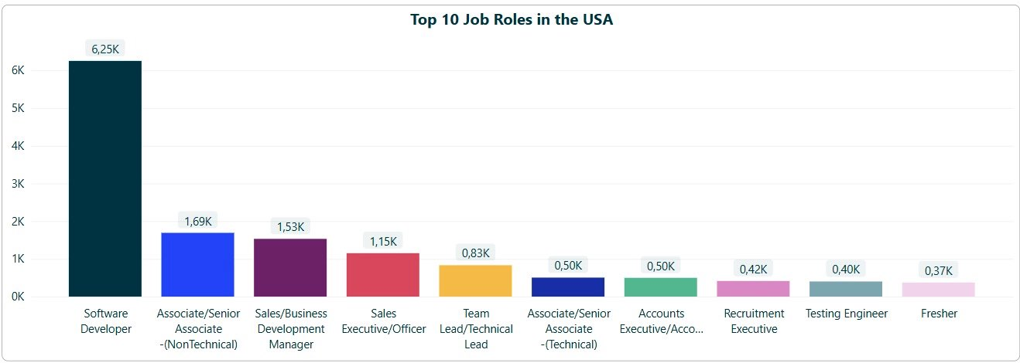
Key Results: Additional Viewpoints
- Most common job roles: Software Developer is dominant, with significant demand for non-technical and specialized technical roles.

Slide 12
Insights and Conclusions
Python and JavaScript are essential technologies for both current and future IT needs, with broad applicability across various domains.
PostgreSQL and MongoDB are rapidly gaining traction as preferred database technologies due to their scalability and flexibility.
Platforms like Linux and Docker are pivotal in the growing trend towards open-source software and containerization, reshaping the IT landscape.
Web frameworks such as React.js and Angular are critical for modern web development, driving the evolution of user interfaces and dynamic web applications.
The combination of technical expertise and data visualization bridges analysis and decision-making, providing actionable insights that support strategic planning.

Slide 13
Next Steps
- Recommend further upskilling in emerging technologies (e.g., Kubernetes, React.js).
- Expand the analysis to include sector-specific demands.
- Integrate additional data sources for enhanced insights.

Slide 14
Appendix: Analysis and Resources
All analysis and resources for this project are available at the reference URL. The work includes:
Python Analysis: Data extraction from JSON files and CSV files, with data cleaning and exploration using Matplotlib and Seaborn for visualizations.
SQL Analysis in Python: SQL queries executed via SQLite3 for data manipulation and trend analysis.
Dashboard: Interactive Power BI dashboard with a static PDF version for reference.
For the full work, visit:
- Python Analysis - Data Extraction and Cleaning (Part 1)
- Python Analysis - Data Extraction and Cleaning (Part 2)
- Python Analysis - Exploratory Analysis
- SQL Analysis - Trend Analysis Queries
- Interactive Power BI dashboard
- Static Power BI dashboard
- Capstone Project IT Nexus Page

Slide 15
“ Thank you for reviewing my project! “

