Slide 1




My Socials :
Examining Global Methane Emissions through SQL
Created by : POOJA

Slide 2
Objectives
Methane (CH₄) is a potent greenhouse gas which contributes significantly to global warming.
Sources of methane emissions includes both natural sources and human activities.
Despite efforts to reduce, they continue to increase globally.
Purpose of this project is to analyze the methane emissions dataset and identify trends and patterns to provide insights into the sources and impacts over time across different countries and sectors.

Slide 3



Objectives
This project aims to address the following :
Trend Analysis
Country Contribution Analysis
Sector Contribution Analysis
Case Study : Methane Emissions in India
Tools : For Analysis & Visualization

Slide 4
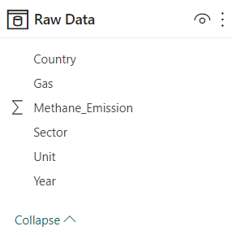
Data Exploration
Time Series Data from 1990 to 2018
Total Countries : 194
Total Sectors : 7
Unit of Measurement : MTCO₂e (Metric tons of carbon dioxide equivalent)
Number of Attributes : 33
Number of Records : 1738

Slide 5

Trend Analysis : Insights

Slide 6
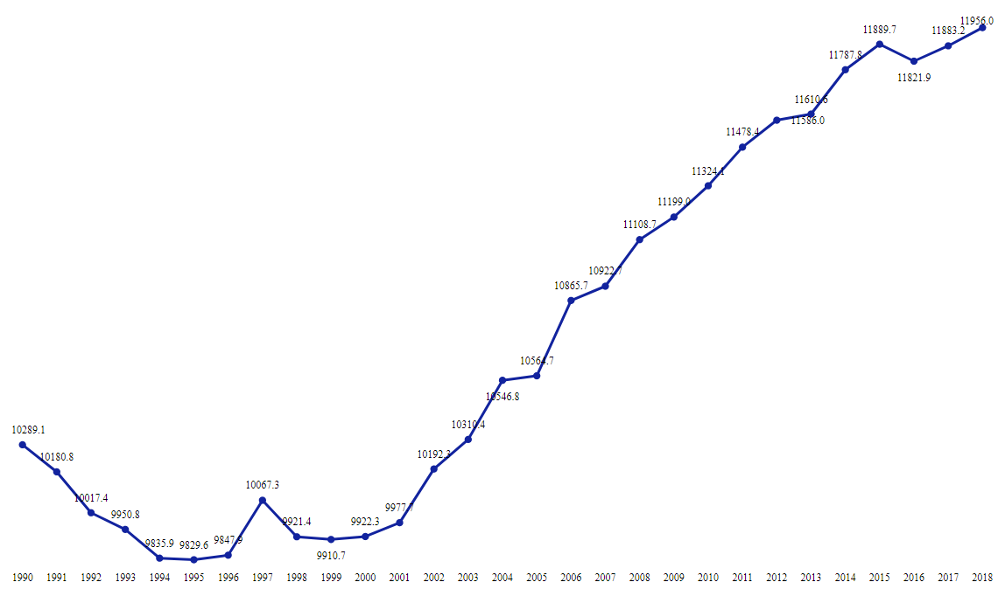
Trend Analysis : Insights
Overall, there has been a upward trend in methane emissions observed between 1990 to 2018 across different countries and sectors, indicating a growing concern for the environment.
Highest Emission
in 2018
11956.0 MTCO₂e
Lowest Emission
in 1995
9829.6 MTCO₂e

Slide 7

Trend Analysis : Insights
Data reveals a noteworthy, 16.2 % increase in methane emissions from 1990 to 2018 (in 28 years) which highlights the need for more effective measures to control and reduce these emissions.
Percentage
Change 16.2 %
11956.0
10289.1
1990
2018

Slide 8

Country Contribution Analysis : Insights

Slide 9
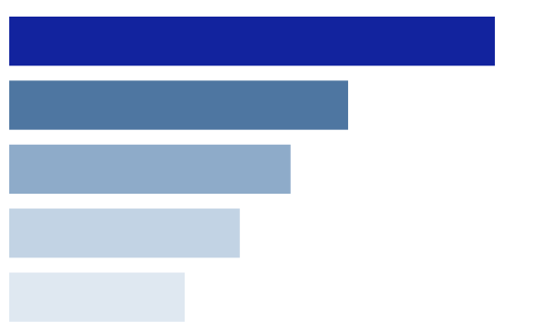
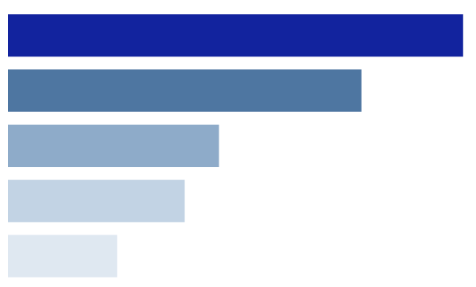
Country Contribution Analysis : Insights
Top 5 countries with highest methane emission in 1990 :
Russia
1635.4
United States
1141.2
Total Methane Emission in 1990
10289.1 MTCO₂e
China
947.4
European Union (27)
776.4
India
591.0
Top 5 countries with highest methane emission in 2018 :
China
1978.5
Russia
1536.6
Total Methane Emission in 2018
11956.0 MTCO₂e
United States
917.4
India
768.4
European Union (27)
474.6

Slide 10
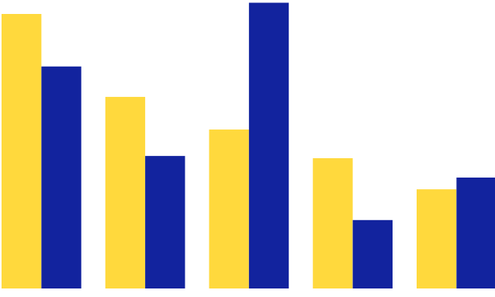
Country Contribution Analysis : Insights
Top 5 countries with highest contribution in 1990 :
Russia | 15.89 %
United States | 11.09 %
China | 9.20 %
European Union (27) | 7.54 %
India | 5.74 %
1990
2018
15.89 %
16.54 %
12.85 %
11.09 %
9.20 %
Top 5 countries with highest contribution in 2018 :
7.67 %
7.54 %
5.74 %
6.42 %
China | 16.54 %
Russia | 12.85 %
United States | 7.67 %
India | 6.42 %
European Union (27) | 3.96 %
3.96 %
Russia
United States
China
European
Union (27)
India

Slide 11

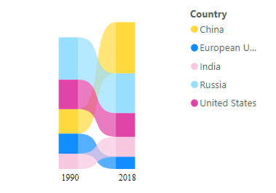
Country Contribution Analysis : Insights
Ranking of top 5 countries with highest contribution in methane emission in 1990 vs 2018 :
Country | 1990 | 2018
Russia | 15.89 % | 12.85 %
United States | 11.09 % | 7.67 %
China | 9.20 % | 16.54 %
European Union (27) | 7.54 % | 3.96 %
India | 5.74 % | 6.42 %
China
European Union (27)
15.89 %
16.54 %
India
Russia
United States
11.09 %
12.85 %
9.20 %
7.67 %
7.54 %
6.42 %
5.74 %
3.96 %
1990
2018
Countries responsible for methane emissions have been same in 1990 and 2018, with minor differences in their rankings.

Slide 12




Sector Contribution Analysis : Insights

Slide 13

Sector Contribution Analysis : Insights
List of sectors w.r.t methane emissions (in MTCO₂e) in 1990 vs 2018 :
3730.0
1990
2018
3452.6
3265.4
2697.8
2612.7
2215.9
1565.1
1443.8
567.8
10.7
160.6
396.7
6.8
119.3
Agriculture
Energy
Fugitive
Emissions
Industrial
Processes
Land-Use Change and
Forestry
Other Fuel Combustion
Waste

Slide 14

Sector Contribution Analysis : Insights
Percentage change of sectors w.r.t methane emissions (in MTCO₂e) in 1990 vs 2018 :
Sector | 1990 | 2018 | % Change
Agriculture | 3452.6 | 3730.0 | 8.0 %
Energy | 2612.7 | 3265.4 | 25.0 %
Fugitive Emissions | 2215.9 | 2697.8 | 21.7 %
Industrial Processes | 6.8 | 10.7 | 58.3 %
Land-Use Change and Forestry | 160.6 | 119.3 | - 25.7 %
Other Fuel Combustion | 396.7 | 567.8 | 43.1 %
Waste | 1443.8 | 1565.1 | 8.4 %
Suggestions :
Fuel Switching
Energy Efficient Equipment
Renewable Energy
Capture and Reuse Methane
Training and Awareness

Slide 15
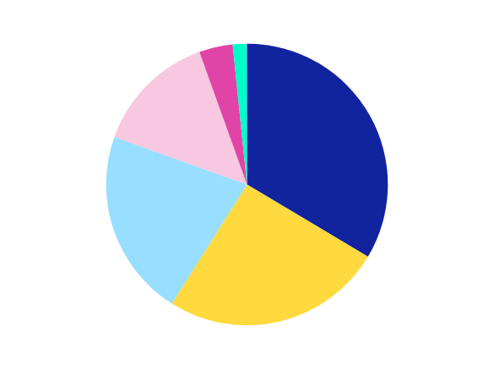
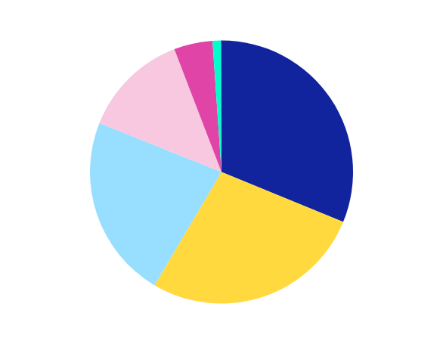
Sector Contribution Analysis : Insights
Contribution of sectors w.r.t methane emissions in 1990 :
Agriculture | 33.55 %
Energy | 25.39 %
Fugitive Emissions | 21.53 %
Waste | 14.03 %
Other Fuel Combustion | 3.85 %
Land-Use Change and Forestry | 1.56 %
Industrial Processes | 0.06 %
3.85 %
1.56 %
14.03 %
33.55 %
21.53 %
Agriculture
Energy
25.39 %
Fugitive Emissions
Waste
Contribution of sectors w.r.t methane emissions in 2018 :
Other Fuel Combustion
4.74 %
0.99 %
Land-Use Change and Forestry
Agriculture | 33.19 %
Energy | 27.31 %
Fugitive Emissions | 22.56 %
Waste | 13.09 %
Other Fuel Combustion | 4.74 %
Land-Use Change and Forestry | 0.99 %
Industrial Processes | 0.08%
13.09 %
Industrial Processes
33.19 %
22.56 %
27.31 %

Slide 16
Case Study : Methane Emissions in India

Slide 17
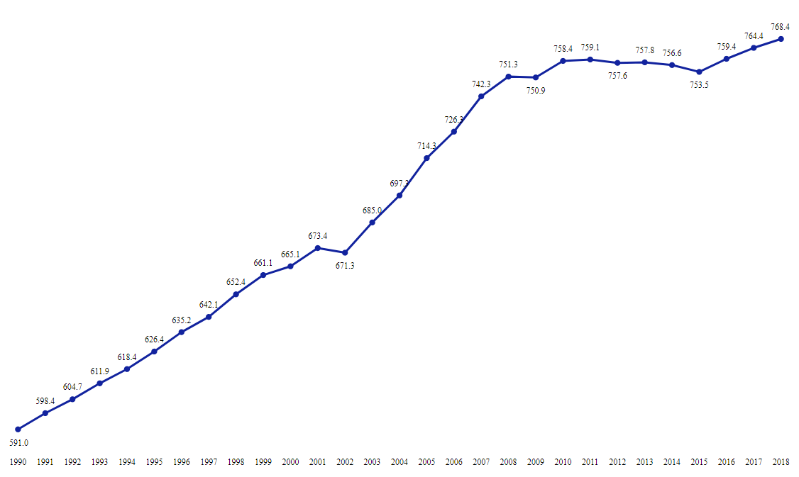

Methane Emissions in India : Insights
Methane emissions in India have shown a continuous upward trend from 1990 to 2018.
There has been a 30% increase in methane emissions across all sectors in India.
10289.1
Percentage
Change 30 %
768.4
591.0
1990
2018

Slide 18
Methane Emissions in India : Insights
Percentage change of sectors w.r.t methane emissions (in MTCO₂e) in 1990 vs 2018 :
Sector | 1990 | 2018 | % Change
Agriculture | 433.9 | 498.5 | 14.9 %
Energy | 66.2 | 99.1 | 49.7 %
Fugitive Emissions | 26.5 | 53.0 | 99.8 %
Industrial Processes | 0.05* | 0.13 | 160.0 %
Land-Use Change and Forestry | 2.1 | 2.8 | 34.8 %
Other Fuel Combustion | 39.7 | 46.1 | 16.3 %
Waste | 22.6 | 68.8 | 203.9 %
ALARMING
ALARMING
Suggestions :
Proper management of municipal solid waste, agricultural waste and livestock waste.
Encouraging the use of clean green sources and public transport.
Adopting stricter regulations and policies.
* : For computation, methane emission of 1994 is taken as from 1990 to 1993 it is zero.

Slide 19
Thank You !

