Slide 1

DDI-Cross-Domain Integration (DDI-CDI): Current Status and Further Developments
Arofan Gregory, CODATA
Chair, DDI-CDI WG
EDDI 2023
License: Creative Commons Attribution 4.0 International (CC BY 4.0)

Slide 2
Outline
Overview of DDI-CDI
Status
Dagstuhl and Upcoming Events
Topics for Further Work
Prototypes
Prospects
Summary

Slide 3
Overview of DDI-CDI
Model-driven standard
  UML model in Canonical XMI is the core specification (UCMIS subset of UML features)
  XML and RDF syntax representations (OWL, JSON-LD) produced programmatically
  Other representations in development (Python, ShEx, SHACL, Java, etc.)
Domain-neutral, but designed to work with DDI-C and DDI-L
Designed to work with other popular web standards (Schema.org, DCAT, SKOS/XKOS, SDTL, PROV-O, etc.) and domain standards
Supports machine-actionability for dissemination/reuse
Based on the DDI 4/”Moving Forward” model

Slide 4
What Does It Do?
Describes data in new formats for easier integration with traditional data
  Wide (traditional) data
  Long data (sensor/event)
  Key-value (big) data
  Multi-dimensional (cube) data
Exposes data resources for easier integration by users from any domain
  Describes the variables/datums in a data set
  Describes how semantics (codelists/ontologies/concepts) as attached to the data and the roles they play
  Supports re-assembly of variables/datums into any needed data structure
Describes the process of data integration so that users can understand unfamiliar data
DDI-CDI does not cover study-level metadata: it relies on other standards to provide this

Slide 5
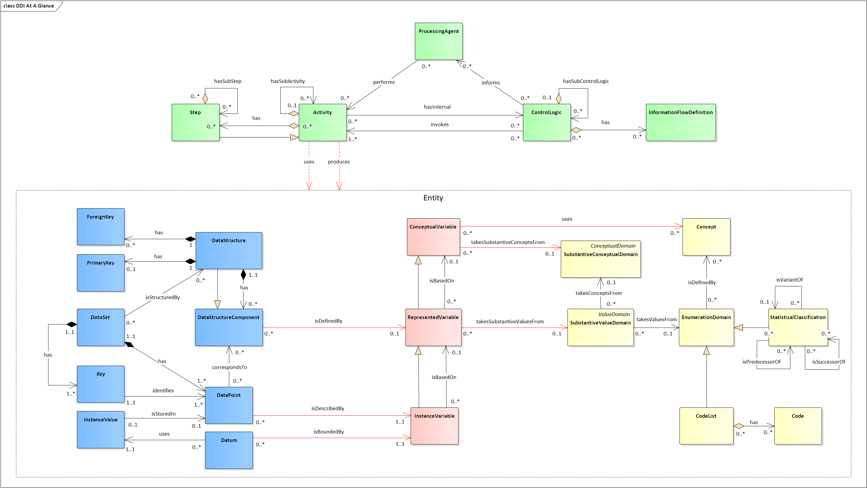
DDI-CDI at-a-glance
Process Description
Data Organization
Variable Cascade
Concepts & Representations
Courtesy of the amazing Flavio Rizzolo, Statistics Canada

Slide 6
DDI-CDI Model
Predictable,
automatable
DDI-CDI
Description
DDI-CDI
Description
Domain Metadata Standards/ Models
- Variables
- Structure
- Roles (Dimensions, Measures)
- Physical arrangement
[TRANSFORMATION]
- Variables
- Structure
- Roles (Identifiers, Attributes. Measures)
- Physical arrangement
Predictable,
automatable
[TRANSFORMATION]
Dimensional Data Set:
Age x Year x Region x Education Level x Sex
Wide Data Set: Dimensions viewed as
Variables (properties)

Slide 7
AGE
YEAR
AGE
YEAR
SEX
REGION
EDUC LEVEL
MEASURE
AGE
YEAR
SEX
REGION
EDUC LEVEL
MEASURE
SEX
REGION
AGE
YEAR
SEX
REGION
EDUC LEVEL
MEASURE
EDUC LEVEL
AGE
YEAR
SEX
REGION
EDUC LEVEL
MEASURE
MEASURE
The target format is wide, with the dimensions treated as variables (properties):
at least one must be a place where integration can be performed with
another data set (typically time and geography). Other variables may be
combined into compound identifiers, or may be treated as additional
descriptors or measures, depending on what they are. The roles of variables
Change according to the structures – the meanings/values do not.
Aggregate values would be repeated to align with micro-data records as
needed to provide the “complete” records for analysis.
Recoding/semantic transformations are handled separately as appropriate
to the structural re-arrangement.
VARIABLES

Slide 8
Status
Candidate release turned over to DDI Technical Committee in May 2023
  Download: https://bitbucket.org/ddi-alliance/ddi-cdi/
Revised candidate release now being finalized after implementation/testing
  Finalize XML schema optimization for generation of syntax representations
  Updated examples of XML and RDF syntaxes
Focused review of syntax representations
  Detailed notes on generation of syntaxes prepared
Vote for release as specification
  Webinar for DDI community

Slide 9
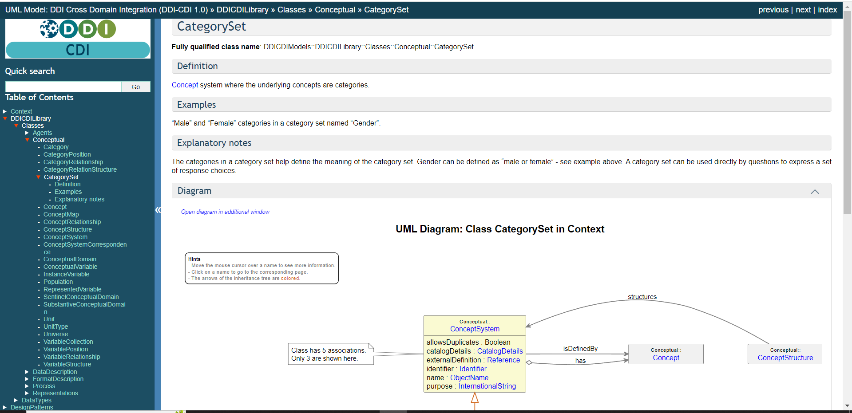
Integrated Field-Level Documentation

Slide 10
Dagstuhl and Upcoming Events
Workshop in September 2023 at Schloss Dagstuhl
Groups:
  Implementation guides/supporting implementation
  Non-numeric, non-coded datums (“qualitative”)
  Using DDI-CDI: documentation on what the standard is for and how it can be used by organizations
  Dependencies between variables (O-ADOPT, O&M, etc.)
  Syntax representations
Informal face-to-face at EDDI 2023
Face-to-face in Paris, April 2024 (margins of COSMOS)
Dagstuhl 2024

Slide 11
Topics for Further Work
Finalize “Using DDI-CDI” documentation (explanatory)
Implementation Guides: creating community profiles for use
  Subset of model
  Syntax representations
  Other standards
Tools
  Improve community subset documentation tool
  DDI transformations (DDI-C, DDI-L)
  Collaborate with Developer’s Group
Non-numeric, non-coded datums (N3CD) – qualitative sub-group?
Further syntax representations
“Beta” release process to support implementers
  Coordinate with TC
Refinements to model (Complex Units of Measure, etc.)

Slide 12
Prototypes
UKDA Data Product Builder
  Variables
  Wide, long, multi-dimensional data structures
EOSC Future Science Project “Climate Neutral and Smart Cities” (Sikt)
  DDI-CDI Process description
  Integration with DDI Lifecycle/Colectica
Transformation tools
  CSV-to-CDI (JSON-LD) : https://ddialliance.github.io/ddi-cdi-sample-generator
  STATA/SPSS Sample Generator (Sikt): https://bbeuster.pythonanywhere.com/
  Bureau of Labor Statistics
  Indicator model

Slide 13
Prospects
FAIR Implementation offers new users
  WorldFAIR “Cross-Domain Interoperability Framework” (CDIF)
  Other EOSC Implementations (FAIR Impact, EOSC Interoperability Framework)
Cross-domain FAIR implementations within DDI Community
  Combined with DDI-C/DDI-L

Slide 14

Cross-Domain Interoperability Framework (CDIF)
Guidelines for the coordinated use of a set of cross-domain standards as a “lingua franca” for FAIR data exchange and use
  Specific profiles of DDI-CDI for data description
CDIF has gathered 30 experts from different standards communities
  Working Group: Meets bi-weekly to draft CDIF recommendations
  Advisory Group: Reviews drafts and identifies direction/advises
Major inputs:
  WorldFAIR FAIR Implementation Profiles and 11 Domain Use Cases, from social science to bio-diversity to nano-technology to geo-chemistry…
  FAIR domain and cross-domain metadata standards
  FAIR initiatives (EOSC IF, FAIR Impact, EOSC Future, GO FAIR, DRUM, etc.)
Initial draft of CDIF to be delivered as part of WorldFAIR outputs in Summer 2024

Slide 15
FAIR Activities and Standards: CDIF
Foundational: FAIR Digital Object Framework (FDOF)
Find
  Discover FAIR resources and explore/evaluate their utility prior to access (coverage, etc.)
  Schema.org, DCAT. DDI-CDI (variables)
Access
  Negotiate access to non-public data
  Enhance efficiencies through automation
  ODRL, DPV
Assess/Integrate
  Understand data structure (DDI-CDI)
  Understand semantics (SKOS/XKOS, OWL, SSSOM)
  Determine origination/context (PROV-O, I-ADOPT/O&M)

Slide 16
Summary
DDI-CDI extends existing DDI specifications to use different types of data from other domains
It is a vehicle for cross-domain FAIR implementation
Version 1.0 in coming months
  Well-documented
  Well-tested
  Builds on existing specifications/processes
Helps bring DDI products in line with current technologies and modular standards approaches

Slide 17
Questions?

