Slide 1
Implementing the DDI-CDI Process Model for Describing Data Integration: Insights from the EOSC Future Science Project “Climate Neutral and Smart Cities”
Benjamin Beuster, Sikt - Norwegian Agency for Shared Services in Education Joachim Wackerow
EDDI 2023, 15th DDI European User Conference, Ljubljana, November 27-29, 2023
License: Creative Commons Attribution 4.0 International (CC BY 4.0)

Slide 2
Outline
EOSC Future Science Project “Climate Neutral and Smart Cities”
DDI-CDI Process Model - Subset
Provenance Tool – Live Demonstration

Slide 3
Climate Neutral and Smart Cities project
Goal: Demonstrate that relevant environmental data and data on citizens’ values, attitudes, behavior and involvement can be combined for social, political and scientific analysis

Slide 4
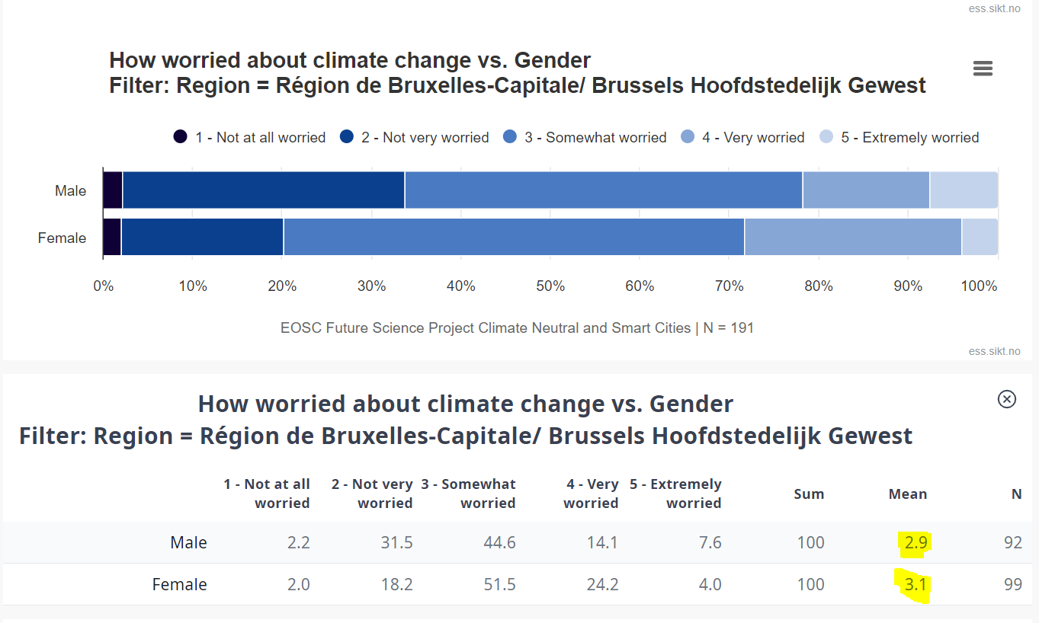

Slide 5
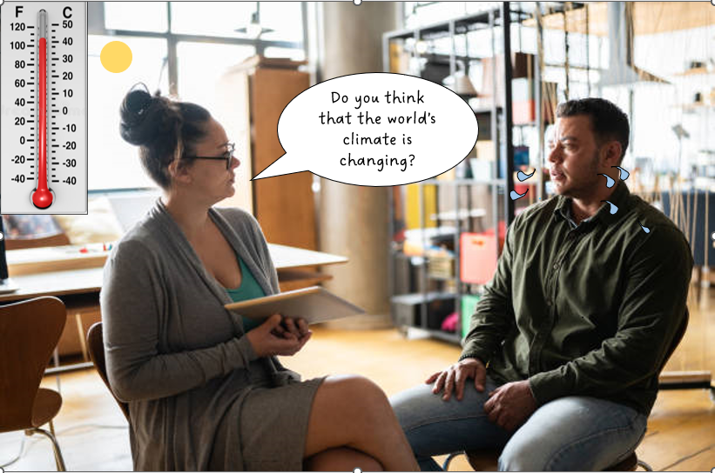

Slide 6
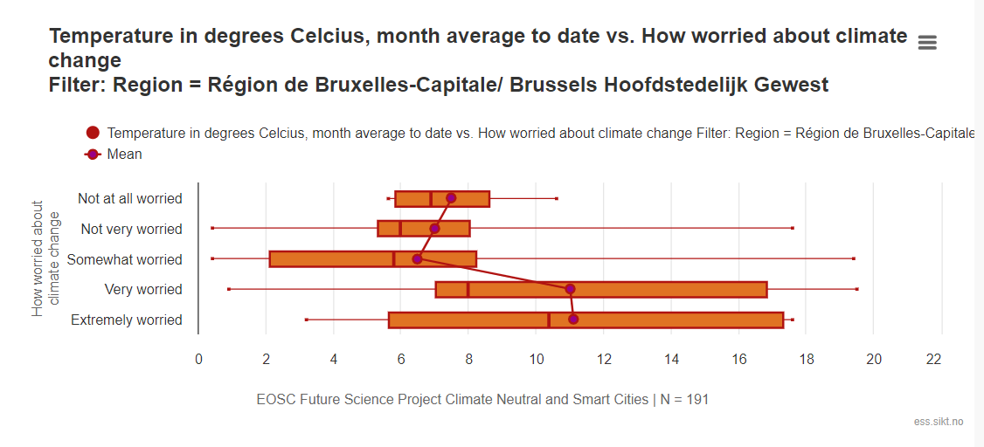

Slide 7
What are the Best Practices for Documenting the Data and the Data Integration Process?

Slide 8
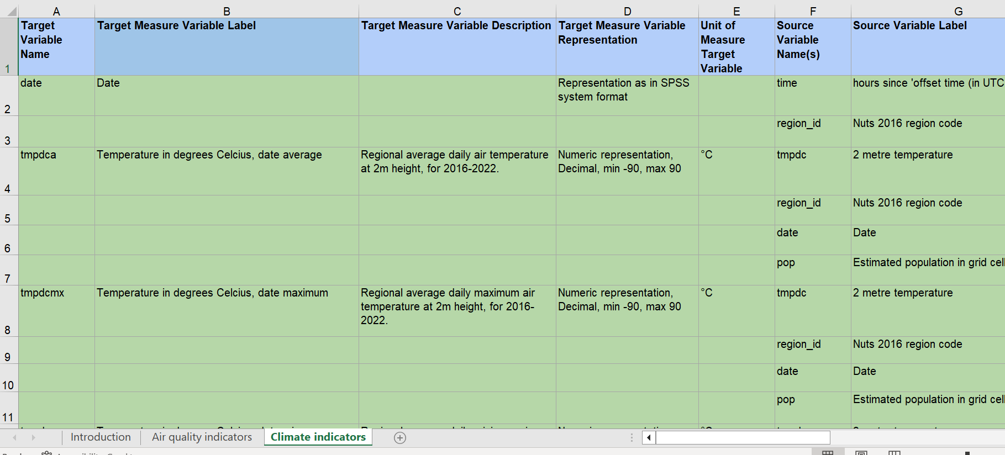
Climate and Air Quality Indices for the ESS - Design spreadsheet for variables
Notes:
The spreadsheet describes how the air quality and climate related indices were developed, including characteristics of the target variables produced, as well as the source variables used to create them. The spreadsheets also include human readable descriptions about how the variables have been computed, and a links to the code in the Python script that produce them.

Slide 9

Variable Documentation
Target and Source Data Files
Target and Source Variables
Name and Label
Representation
Codelists, Missing Values
Unit of Measure, Description
Variable Groups

Slide 10
But How Can We Describe the Data Integration Process and Variable Computation?

Slide 11

Process Model

Slide 12
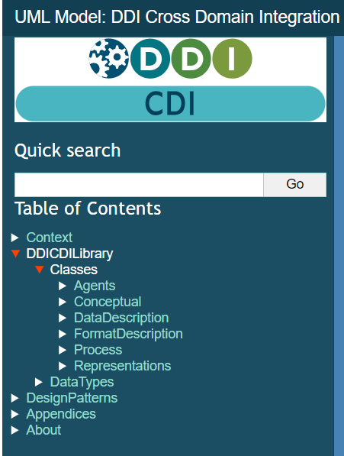
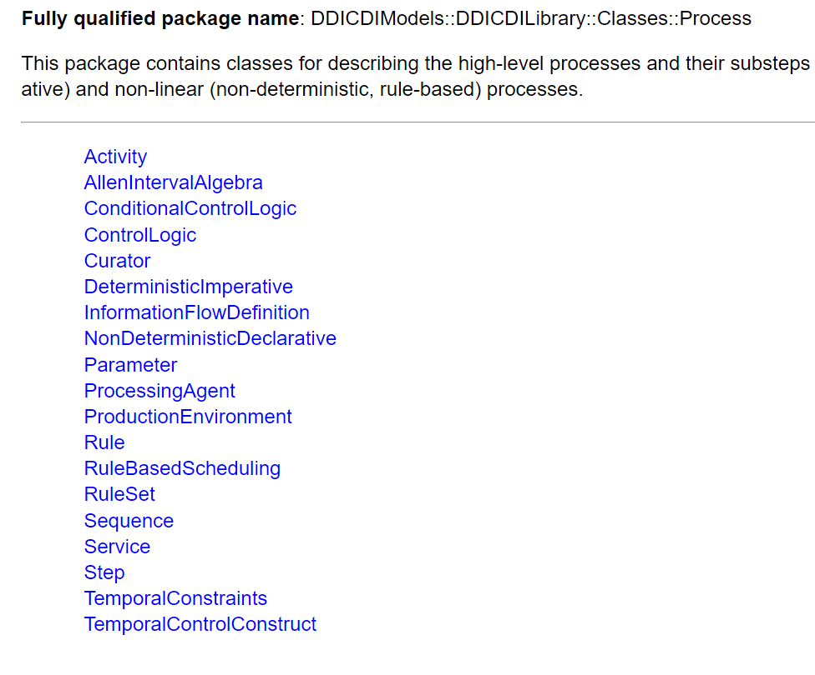
Process Model

Slide 13
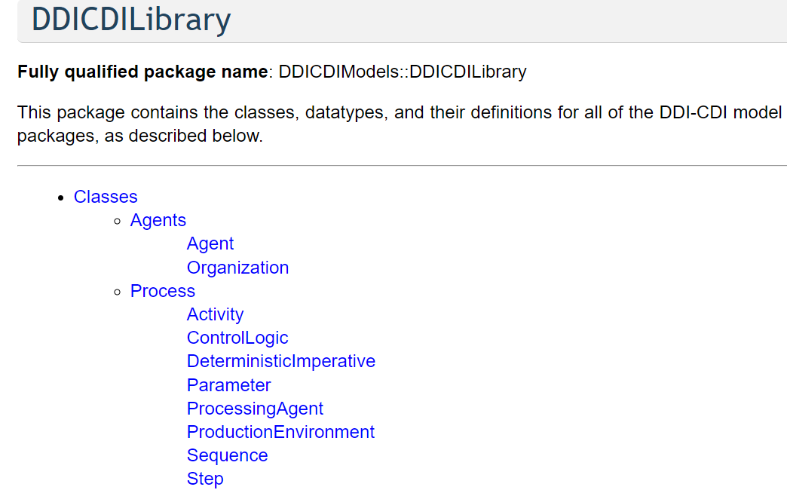
Subset of
Process Model

Slide 14
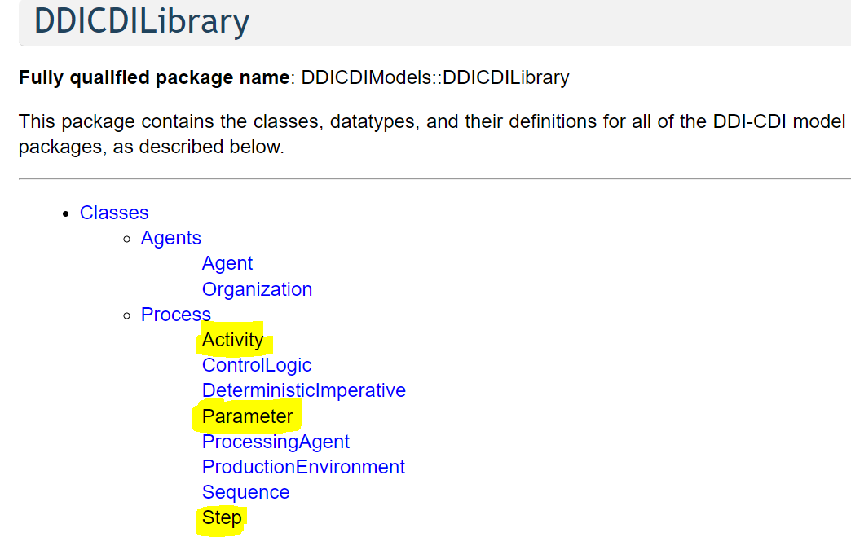
Subset of
Process Model

Slide 15
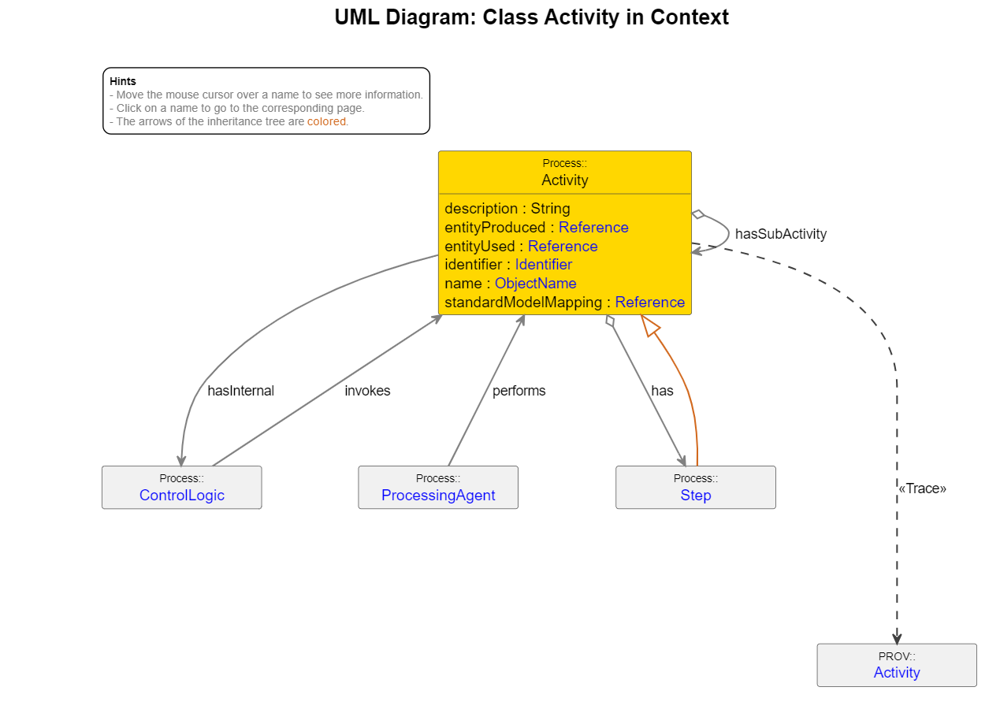
Activity

Slide 16
Serve as high-level overviews and can include sub-activities to establish a hierarchical structure. Broader scope, such as the data file level, not parameterized.

Slide 17
Attribute entityUsed refers to resources used in the activity,
and entityProduced refers to the outcomes resulting from the activity.

Slide 18
Implementation: The resources include different types of web input, such as files available via the internet and APIs, web pages, and source data descriptions.
The outcomes are typically Digital Object Identifiers (DOI) of data files that resolve to landing pages in the ESS Data Portal.

Slide 19
Can be broken down into steps for a more detailed account of data processing and variable computation.

Slide 20
Activity
Sub Activity
Step
Step
Sub Activity
Step
Activity
Sub-Activity
Step

Slide 21
Integrate climate data and air quality data with the ESS
Process data from
ERA5
Create variable
tempdca
Create variable
paccta
Process data from EEA Air Quality
Create variable
aqiwd
Activity
Sub-Activity
Step

Slide 22
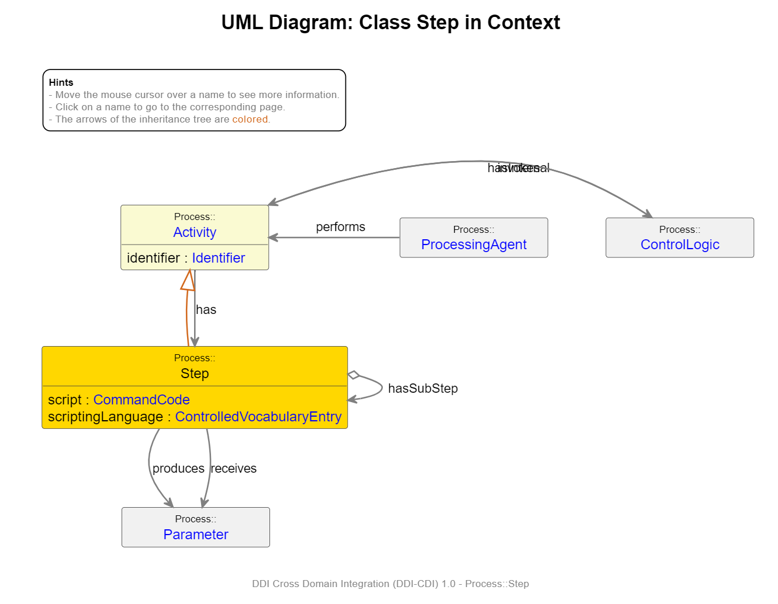
Step and Parameter

Slide 23
Steps are modular, parameterized sub-processes within an activity that manage the flow of information. They process input parameters and generate output parameters, which can take various forms like data files or specific variables.

Slide 24
Parameters are tailored to be instance variables, typically represented as columns within a unit record data file.
Implementation: Each parameter has an attribute named entityBound which contains a URI directing to the variable's display location in the ESS Data Portal (DDI-L).

Slide 25
The Script attribute within the step holds details about the command used for data processing. This can include a description of the command or a URI linking to an external command script.
Implementation: the URI leads to a specific Python file in a GitHub repository and pinpoints the exact line where the output parameter is computed.

Slide 26
How to generate the DDI-CDI metadata?

Slide 27
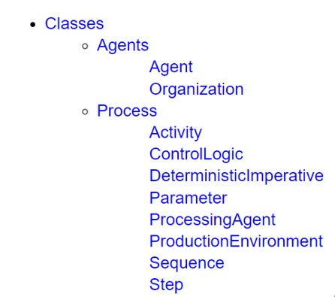
For each class of the subset, we have created a dedicated table

Slide 28
Each table was then converted into CDI-XML using Python
Python
XML
Notes:
The spreadsheet describes how the air quality and climate related indices were developed, including characteristics of the target variables produced, as well as the source variables used to create them. The spreadsheets also include human readable descriptions about how the variables have been computed, and a links to the code in the Python script that produce them.

Slide 29
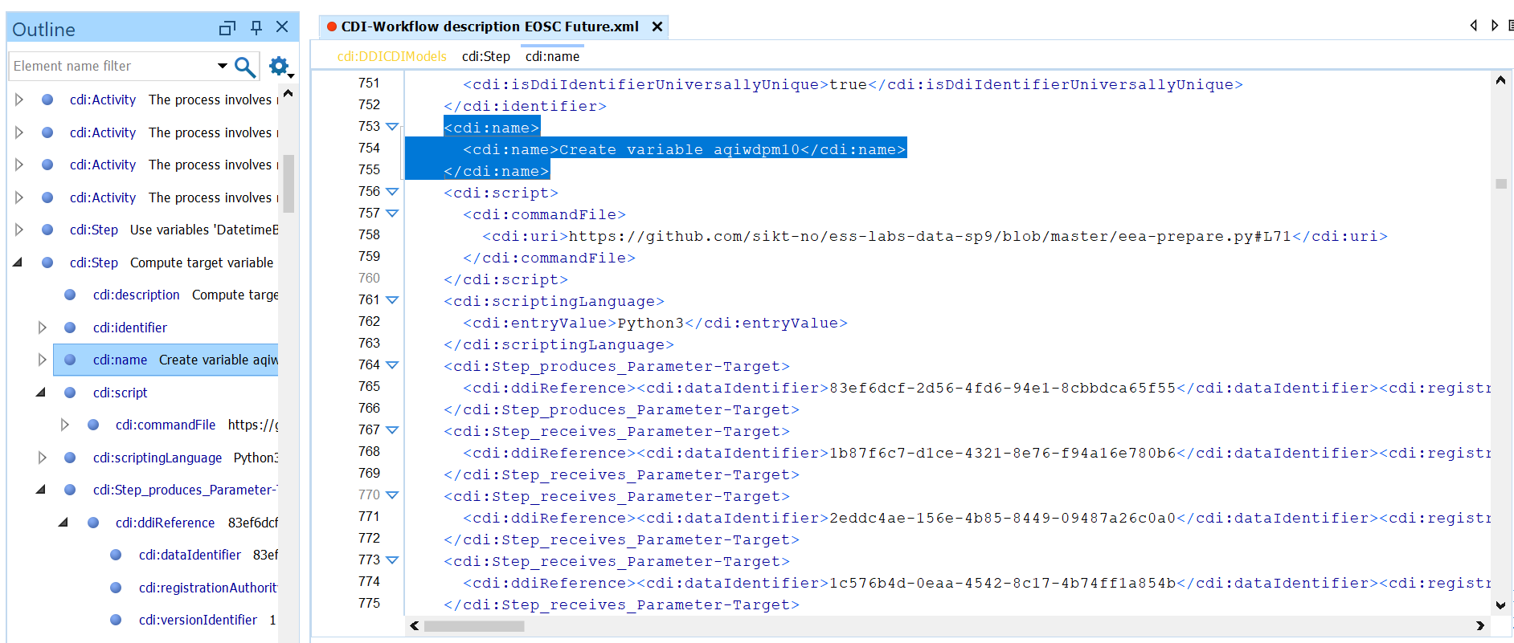

Slide 30
Tour of the tool https://eosc-provenance.sikt.no/#

Slide 31
Accreditation
The following sections are authored by the Hilde Orten, based on materials developed under the EOSC Science Project 9.
  Slide 2, 3, 5
  The content has been adapted for the purpose of this presentation

Slide 32
Thank you!
https://eosc-provenance.sikt.no/#
https://ess.sikt.no
benjamin.beuster@sikt.no
joachim.wackerow@posteo.de

Slide 33
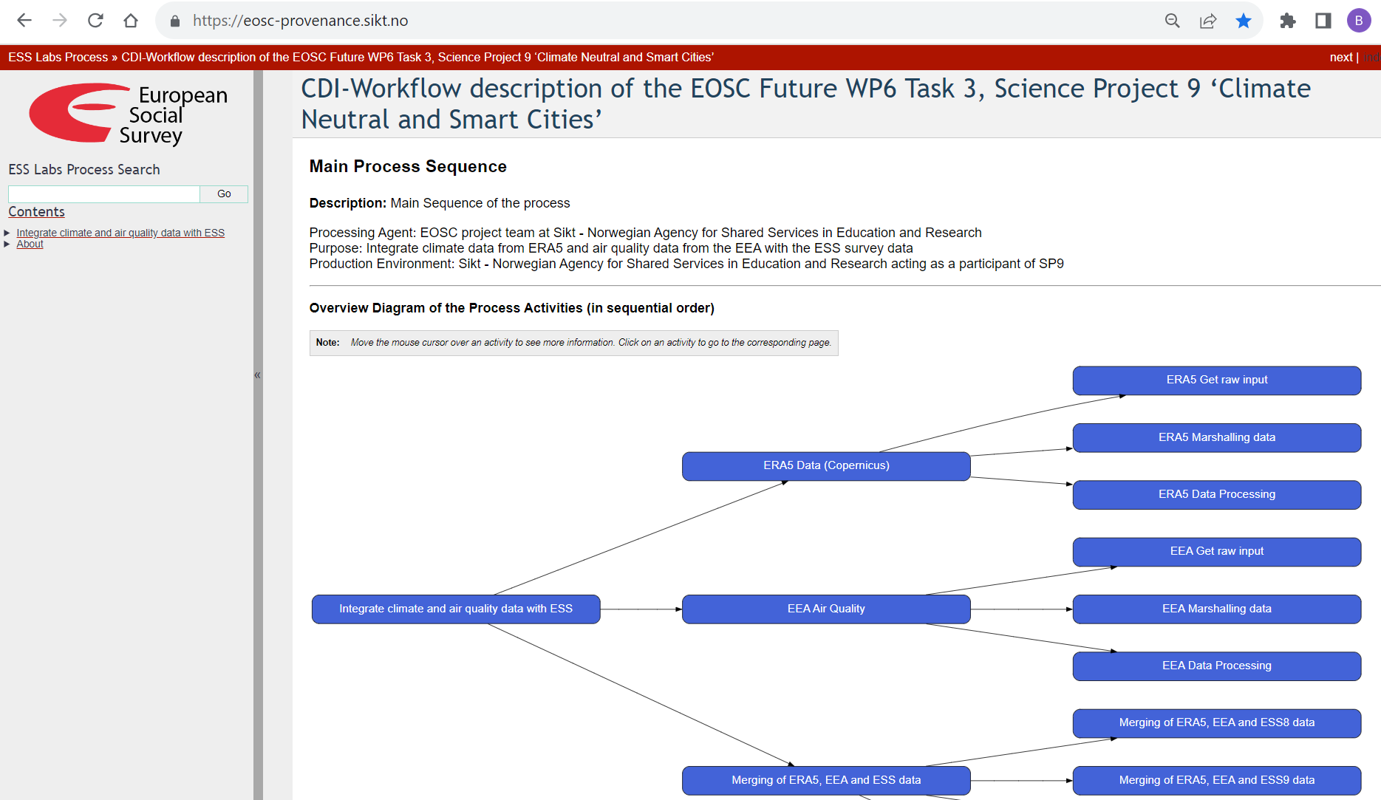

Slide 34
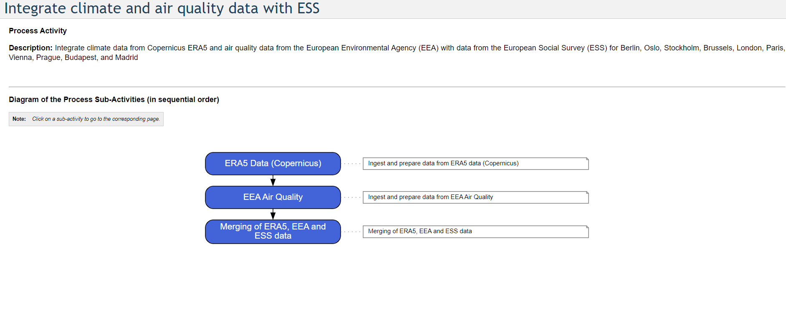

Slide 35
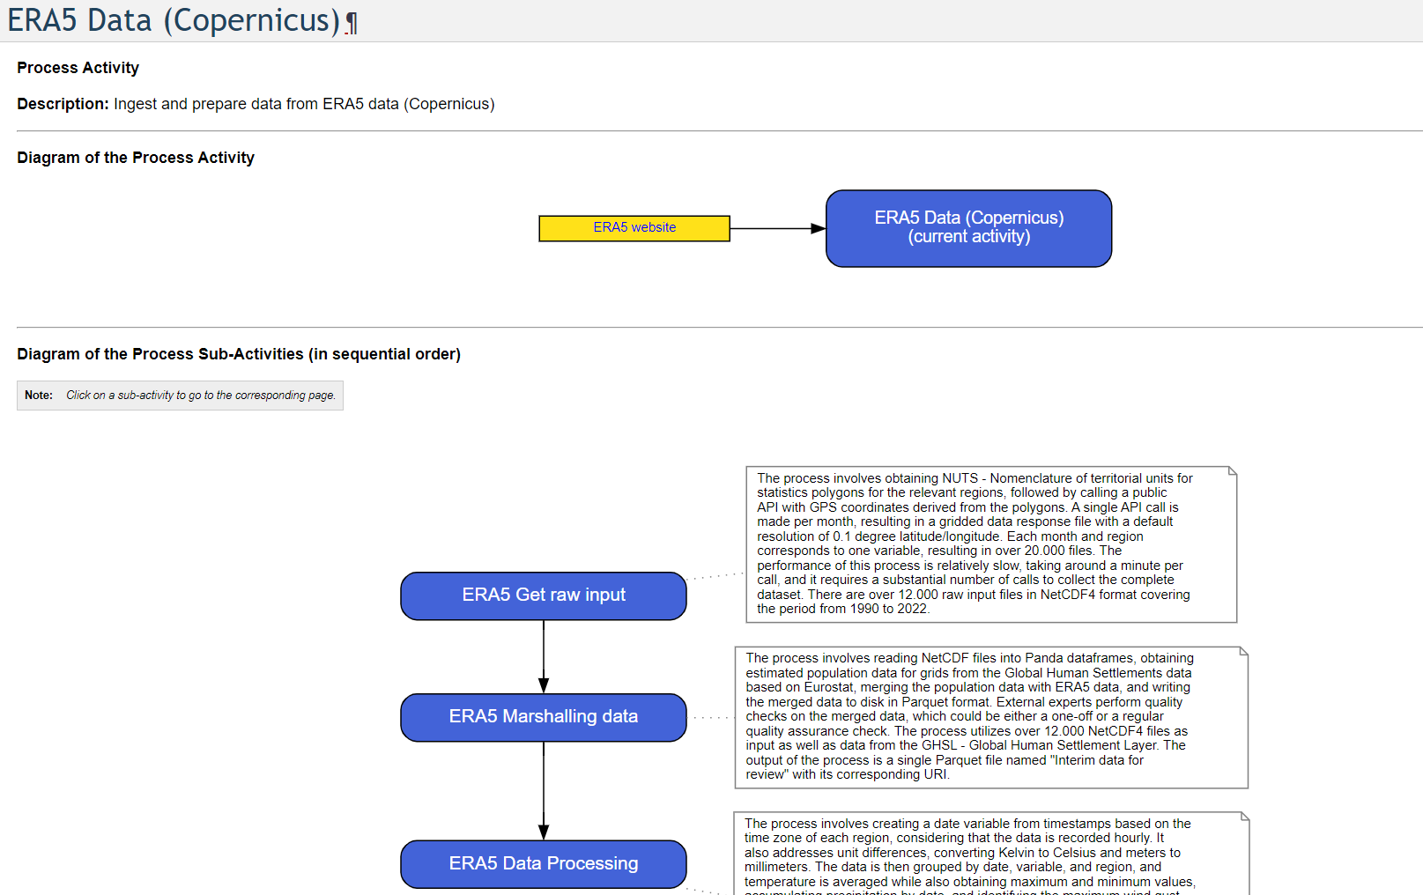

Slide 36
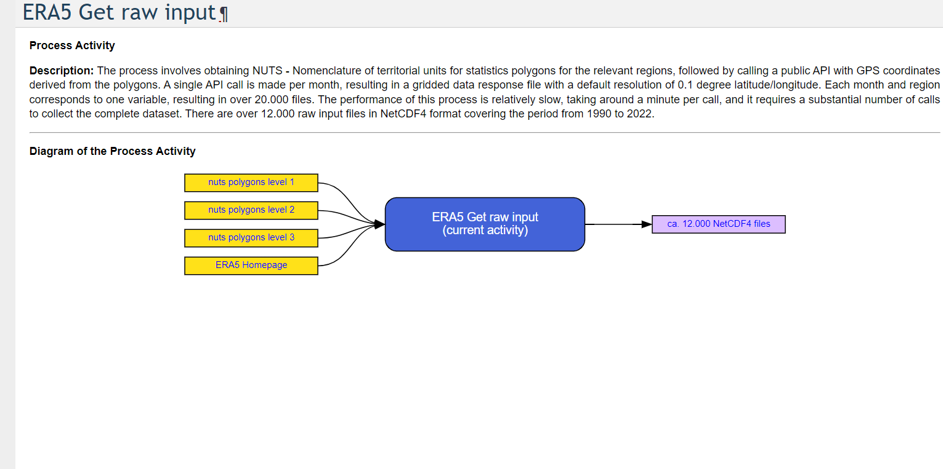

Slide 37
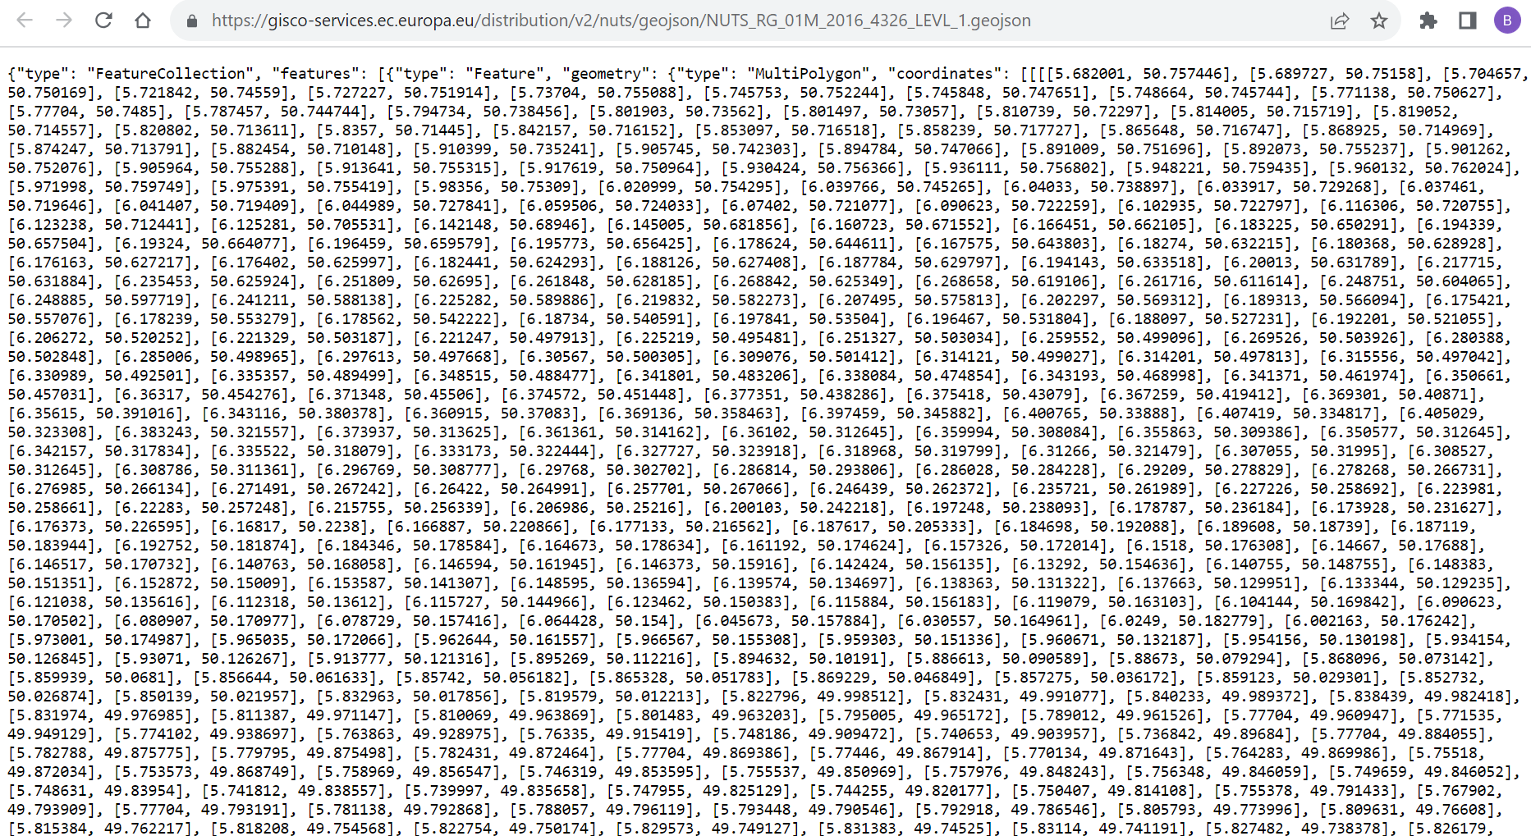

Slide 38
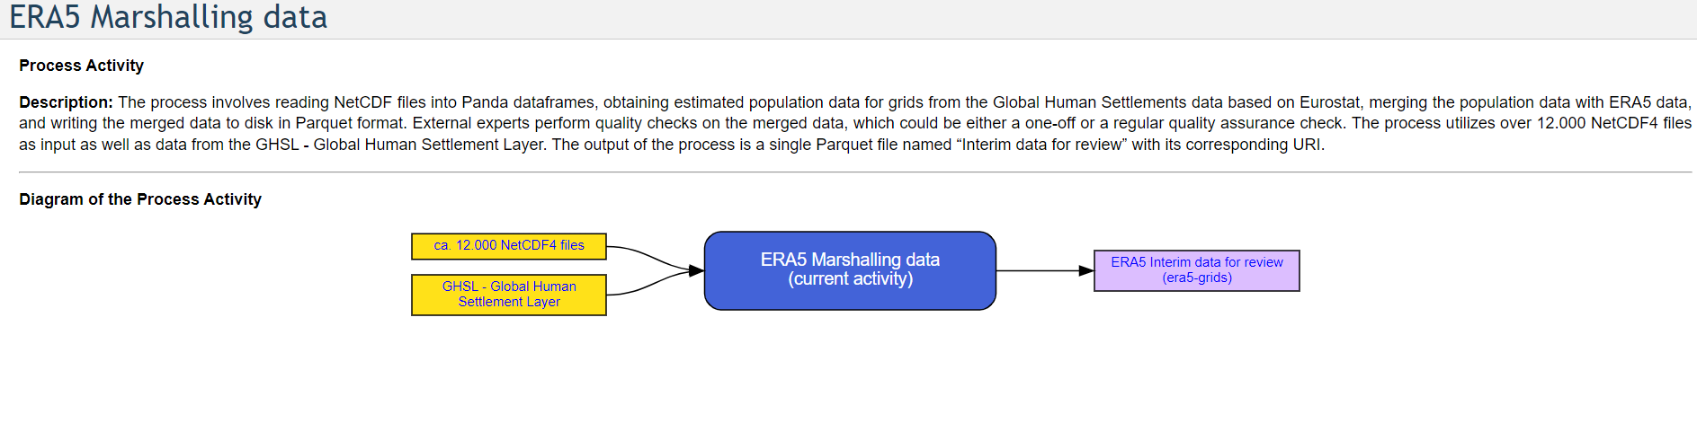

Slide 39
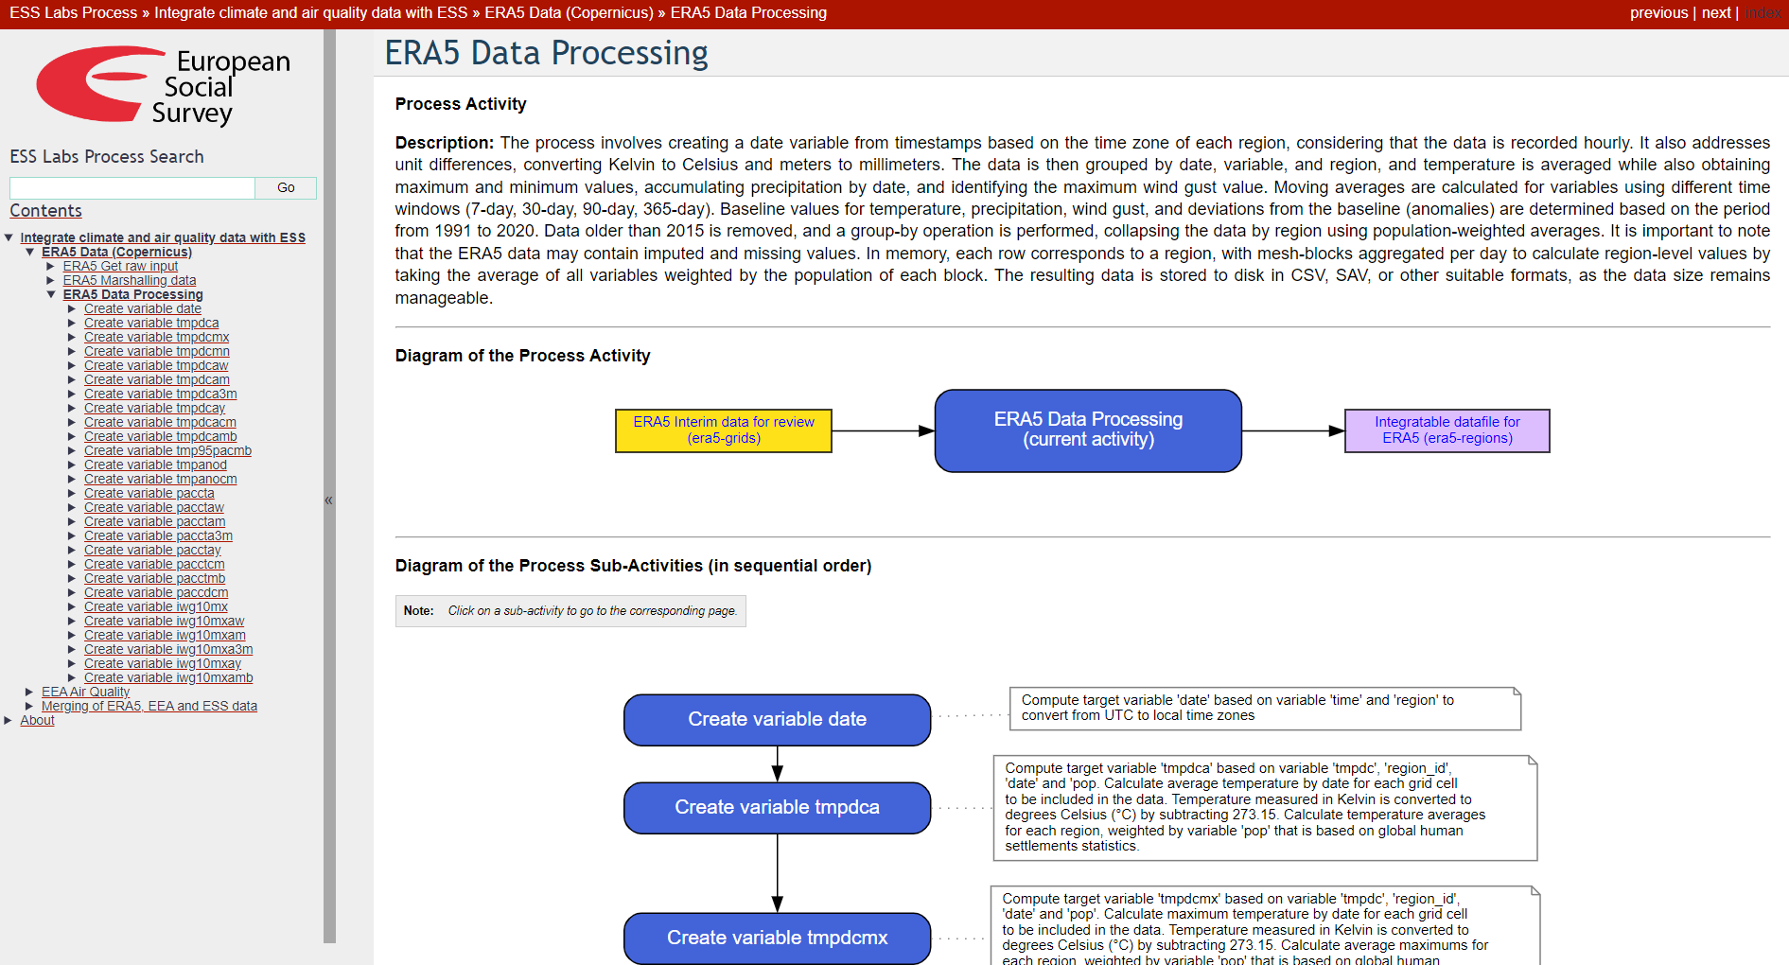

Slide 40
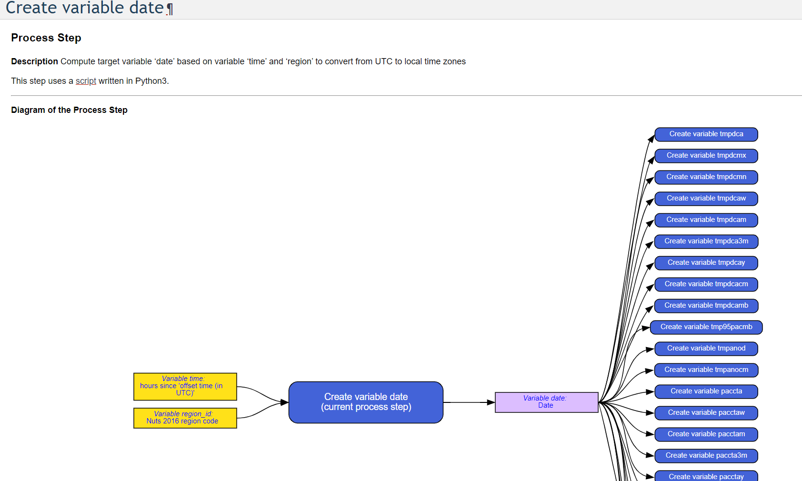

Slide 41
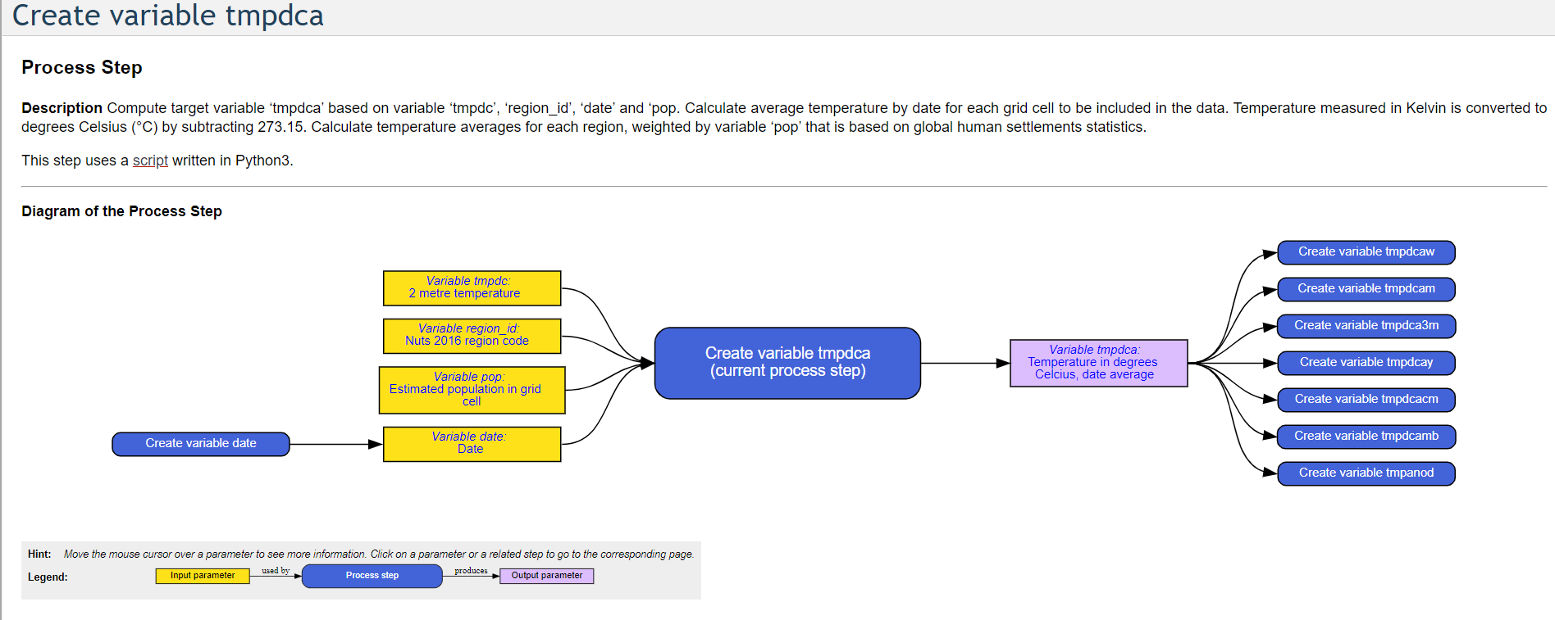

Slide 42
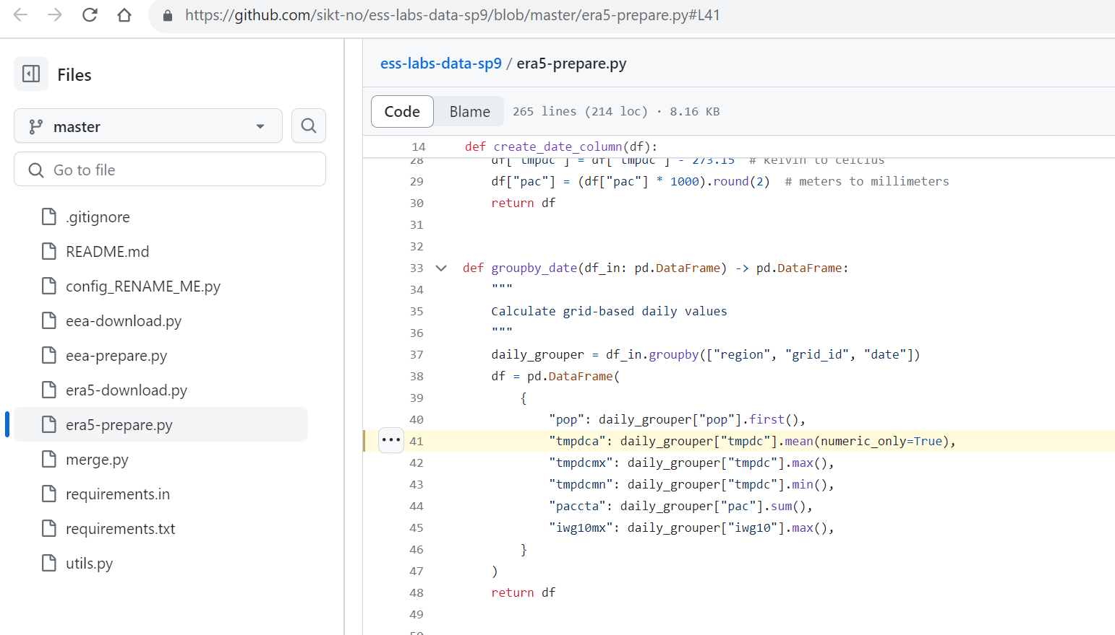

Slide 44
