Slide 1

DDI-CDI Overview
EDDI, December 2024
Arofan Gregory
Chair, DDI-CDI WG

Slide 2
A New DDI Specification!
DDI-CDI is a new specification
  Vote just completed – 1.0 specification approved
  Now in publication process – not yet officially released
DDI-CDI is an implementation of the “DDI 4”/”DDI Moving Forward” model
  Specific focus on cross-domain data integration
  Model-based standard – Canonical XMI describes UML model
  XML and other syntax representations supported (JSON-LD and Turtle)
  Designed to be machine-actionable
Complementary to other DDI specifications
  Works with DDI Codebook and DDI Lifecycle
  Extends metadata coverage to support integration with other domain data
  Can work directly with other (non-DDI) domain metadata specifications (esp. RDF)
Designed to be implemented using subsets (“profiles”)

Slide 3
DDI-CDI Functionality
Structural description across diverse sources/types of data
  Wide (rectangular) data
  Tall (long), event data, sensors
  Key-vale data (big data, No SQL data)
  Multi-dimensional data cubes, indicators, time series
Describes provenance of data between different structures/forms
  Processing framework
  Relies on other standards (PROV-O, SDTL, etc.)
Describes data at an atomic level
  Variables
  Datums/cells

Slide 4
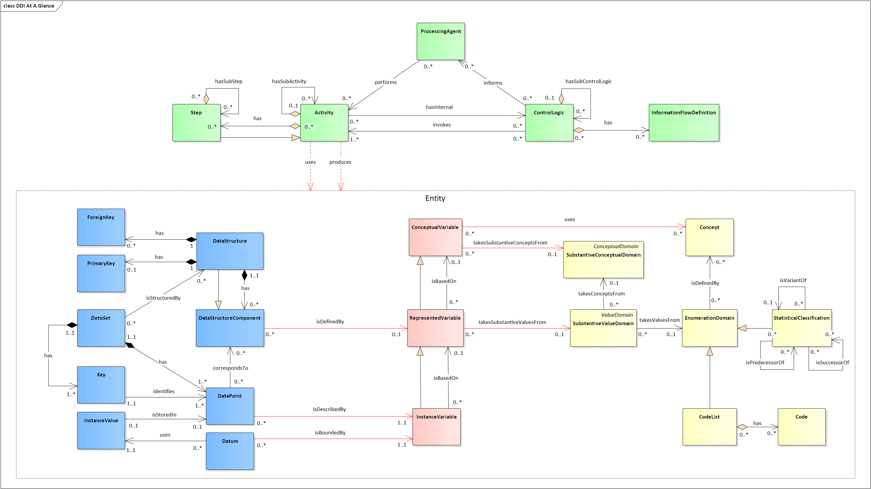
DDI-CDI at-a-glance
Process Description
Data Organization
Variable Cascade
Concepts & Representations
Courtesy of the amazing Flavio Rizzolo, Statistics Canada

Slide 5
Specification and Documentation
High-level specification: https://github.com/ddi-cdi/ddi-cdi/blob/main/build/high-level-documentation/DDI-CDI_Model_Specification.pdf
Full specification download: https://github.com/ddi-cdi/ddi-cdi/archive/refs/tags/v1.0-rc3.zip
Field-level documentation: https://ddi-cdi.github.io/ddi-cdi_v1.0-rc3/field-level-documentation/

Slide 6
What Is the Purpose?
To enable data disseminators to describe the data they provide in a way that makes it comprehensible to those from other domains
This often requires a re-structuring of the data to agree with a target data set to be integrated with
  E.g., using existing environmental data from a domain-external source (EEA air quality) to provide a context for domain data (the European Social Survey)
  Sensor data is re-structured to be integrated with survey data (it is also processed to create temporal and geographical alignments, but this is in additional to needed structural transformations)
DDI-CDI allows “data sets” to be processed as if they were a pool of atomic pieces to be re-combined
  The provider does not need to atomize their data
  The receiver can still perform re-combination
Bridges the gap between data structures and logical/conceptual content

Slide 7
Summarizing the Problem
Data providers cannot anticipate all of the capabilities and requirements of data users
Data providers understand (and can describe) their data as they understand it
The provided data structures contain implicit information about the values which comprise them
  Data users may not understand this implicit knowledge
DDI-CDI makes this information understandable across structures by giving a standard model of how this implicit structural information is expressed across structural types
The provider describes what they understand – the user can derive what they need from this description
Requires that there be a strong focus on variables and datums
NOTE: RDF descriptions of individual datums can be used to perform this re-combining function, but fail the “practicality” test:
  It is difficult to manage vast pools of individual observations
  The “bibliographic” culture of data dissemination discourages this level of data management: everyone understands “data sets”

Slide 8
DDI-CDI Model
Predictable,
automatable
DDI-CDI
Description
DDI-CDI
Description
Domain Metadata Standards/ Models
- Variables
- Structure
- Roles (Dimensions, Measures)
- Physical arrangement
[TRANSFORMATION]
- Variables
- Structure
- Roles (Identifiers, Attributes. Measures)
- Physical arrangement
Predictable,
automatable
[TRANSFORMATION]
Dimensional Data Set:
Age x Year x Region x Education Level x Sex
Wide Data Set: Dimensions viewed as
Variables (properties)

Slide 9
AGE
YEAR
AGE
YEAR
SEX
REGION
EDUC LEVEL
MEASURE
AGE
YEAR
SEX
REGION
EDUC LEVEL
MEASURE
SEX
REGION
AGE
YEAR
SEX
REGION
EDUC LEVEL
MEASURE
EDUC LEVEL
AGE
YEAR
SEX
REGION
EDUC LEVEL
MEASURE
MEASURE
The target format is wide, with the dimensions treated as variables (properties):
at least one must be a place where integration can be performed with
another data set (typically time and geography). Other variables may be
combined into compound identifiers, or may be treated as additional
descriptors or measures, depending on what they are. The roles of variables
Change according to the structures – the meanings/values do not.
Aggregate values would be repeated to align with micro-data records as
needed to provide the “complete” records for analysis.
Recoding/semantic transformations are handled separately as appropriate
to the structural re-arrangement.
VARIABLES

Slide 10
Alignment/Combination with other Standards
DDI-CDI is designed to work in the context of other standards
We are looking at:
  Schema.org (discovery)
  DCAT (cataloguing)
  PROV-O (provenance/process)
  SKOS/XKOS (concepts and codelists)
  I-ADOPT/O&M
  DDI Codebook/DDI Lifecycle
  ODRL
Model-driven standard (UML, in Canonical XMI) can produce different equivalent syntaxes
  XML
  RDF (Turtle, JSON-LD)
  Python
  ShEx, SHACL
  Others
Part of the Cross-Domain Interoperability Framework (CDIF) being developed by WorldFAIR

Slide 11
DDI-CDI is “Semantics-Neutral”
Describes structures and the roles played by concepts in describing the data
The Concepts themselves can come from any type of controlled vocabulary
  SKOS/XKOS
  Ontologies (OWL, RDF-S, etc.)
  Classifications, codelists, thesauri
Semantics are domain-specific – structures are not!

Slide 12
Important Upcoming Feature
We have a very active group looking at how qualitative data can be managed alongside quantitative data
  The model draws heavily on relevant W3C standards for annotation and “deep linking” (for segment selection)
  The idea is that mixed-method collections could be managed as unitary logical ones
    E.g., images of a patient’s brain could be held alongside relevant quantitative measures
    Qualitative inputs to quantitative data sets could be described (like any other process)
  Focus is on qualitative data as data for management and reuse – not on qualitative social science methods (etc.)

Slide 13
Early Adopters of the Specification
UKDA: “Product Builder” application based on description of all variables in the archive in DDI-CDI
ESS “Climate Neutral and Smart Cities”: Implementation of DDI-CDI Process model in combination with DDI Lifecycle for integrated social science and climate/environment data
WorldFAIR “Cross-Domain Interoperability Framework” (CDIF): Implementation of DDI-CDI as part of a package of RDF vocabularies used for cross-domain FAIR exchange of data & resource

Slide 14
Tools and Projects
Sikt: Stata/SPSS-to-DDI-CDI Converter, SQL Tools
High-Value Data Services: Wrappering of municipal “open data” from Socrata with DDI-CDI metadata (also DDI Codebook)
Implementation in Harvard Dataverse
UNSD: SDMX Web Services-to-DDI-CDI prototype (part of CDIF work)
DDI Alliance-SDMX Alignment (UN/ECE Modern Stats): Mapping SDMX data cubes to DDI-CDI dimensional data
Climate Adapt for EOSC: Integrating data with CDIF
EOSC OSCARS: X-Ray Absorption Spectroscopy
Other WorldFAIR+ Projects (CDIF)
“Nectar” spreadsheet tool (DDI Developer’s Group)
DDI-CDI/Croissant transformations

Slide 15
Discussion Slides

Slide 16
Brief Tour of Core Data Description Features
Data sets, logical records, and variables
The Variable Cascade
Wide Data Structures
Long Data Structures
Dimensional Data Structures
Physical Representation of Data
Here we use the CDIF profile as an example, which does not show all of the available classes, and makes a very restricted use of the variable cascade
  Requires only Instance Variables, and allows for optional use of Represented Variables (Instance Variables can be used in their stead as they are a sub-class of Represented Variables in the model)
Other profiles employ more of the variable cascade

Slide 17
DESCRIBE THE DATA SET OR SERVICE
DATA SET
DATA STRUCTURE
isStructuredBy
LOGICAL RECORD
organizes
has
INSTANCE VARIABLE
has
DATA STORE

Slide 18
Variables and the Variable Cascade
A variable is defined by a (formal) Concept
  Together, these form a reusable metadata construct termed a “Conceptual Variable”
Variables have representations
  May be a data type
  May be categorical (typically using a code list of some type)
  A Conceptual Variable with added description of its representation is a reusable construct termed a “Represented Variable”
Variables appear in data as the definition of sets of values (in wide data, a column, etc.)
  They are templates for a sub-set of the values provided
  They are non-reusable applications of Represented Variables, and are termed “Instance Variables”
These different types of variables can be associated with the real-world subject of observation, at different levels of specificity (unit type, universe, population)

Slide 19
DESCRIBE THE VARIABLES
REPRESENTED VARIABLE
recommendedDataType
SUBSTANTIVE VALUE DOMAIN
SKOS CONCEPT SCHEME
uses
takesSubstantiveValuesFrom
INSTANCE VARIABLE
XSD DATA TYPES
XSD DATA TYPES
XSD DATA TYPES
takesSentinelValuesFrom
XSD DATA TYPES
SENTINEL VALUE DOMAIN

Slide 20
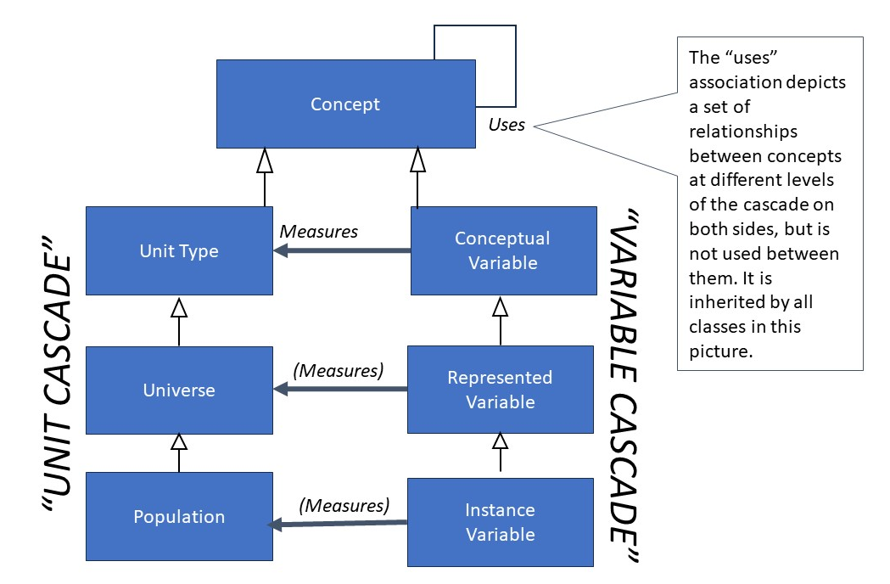
The Variable Cascade in the Model

Slide 21
Variable Cascade as Used in CDIF
UNIT TYPE
REPRESENTED VARIABLE
isDefinedBy
measures
[subclass of]
LOGICAL RECORD
UNIVERSE
uses
isDefinedBy
INSTANCE VARIABLE
isDefinedBy
[subclass of]
measures
POPULATION

Slide 22
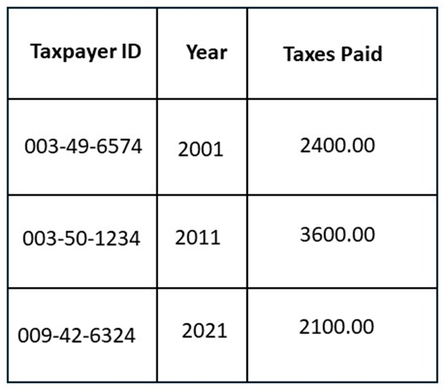
Wide Data Example
“Wide” data is also described as “unit-record data”
  Each row describes one observed unit using a set of variables (columns)
Here, Taxpayer ID, Year, and Taxes Paid are variables
At least one variable holds the observation value (Taxes Paid)
Other variables provide a “key” for identifying the observation value(s)
  Taxpayer ID + Year
Other variables can act as descriptors (none in this example)

Slide 23
PRIMARY KEY COMPONENT
correspondsTo
IDENTIFIER COMPONENT
WIDE DATA STRUCTURES
isComposedOf
correspondsTo
isDefinedBy
PRIMARY KEY
INSTANCE VARIABLE
MEASURE COMPONENT
has
isDefinedBy
has
has
isDefinedBy
WIDE DATA STRUCTURE
ATTRIBUTE COMPONENT
has

Slide 24
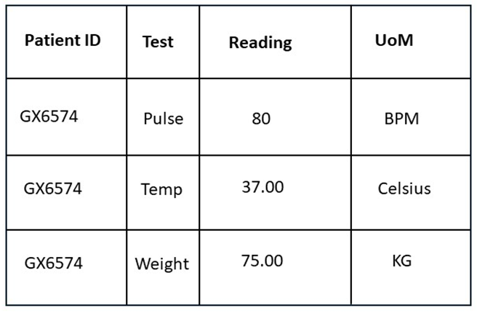
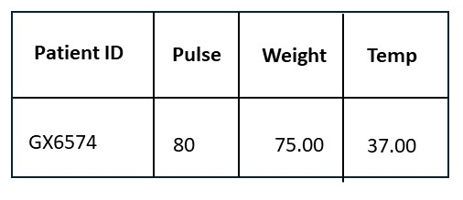
Long Data Example
Long data is often seen as the output of sensors, in event registers, and similar “streams” of data
Each entry is a value plus identifiers and descriptors to tell you what the logical content is
  The smaller table below shows how this data could be understood as Wide data, with a “logical” variable in each column
  Note that the UoM (unit of measure) is part of the variable descriptions in this example (and thus not shown)

Slide 25
VARIABLE VALUE COMPONENT
REFERENCE VARIABLE
Additional classes needed to describe
long data – classes for “logical”
wide data also used
isDefinedBy
DESCRIPTOR VALUE DOMAIN
takesSubstantiveValuesFrom
refersTo
DESCRIPTOR VARIABLE
hasValueFrom
VARIABLE DESCRIPTOR COMPONENT
isDefinedBy
DESCRIPTOR
INSTANCE VARIABLE
DESCRIPTOR VARIABLE
DESCRIPTOR
identifies

Slide 26
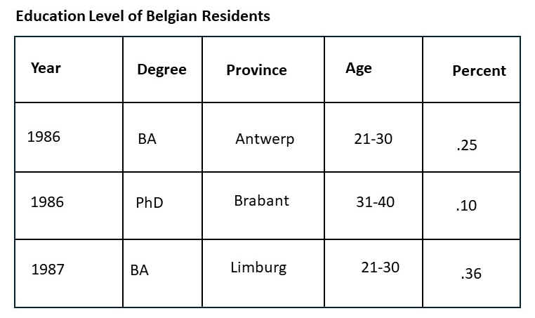
Dimensional Data Example
Each observation is identified with a structured key, composed of dimensions
Dimensions often have computable values (time, hierarchical categories, etc.) which can be used to “roll up” and “roll down” the values
  Think OLAP cubes
In practice, the dimensions of keys are often presented in a standard sequence for convenience and ease of computation

Slide 27
DIMENSIONAL DATA STRUCTURES
PRIMARY KEY COMPONENT
COMPONENT POSITION
DIMENSION COMPONENT
correspondsTo
indexes
isComposedOf
isDefinedBy
MEASURE COMPONENT
PRIMARY KEY
has
INSTANCE VARIABLE
isDefinedBy
has
isDefinedBy
has
ATTRIBUTE COMPONENT
DIMENSIONAL DATA STRUCTURE
has

Slide 28
Describing Physical Data
Assumption is that data is in a text-based form (delimited ASCII, CSV, etc.)
Physical data references a specific type of structure. It holds data formed into a single type of Logical Record, and then maps the Instance Variables in that record to positions/fields within a Physical Record Layout.
This is a simple description which works for a wide range of data, but does not cover all possibilities
  Single record layout
  Single logical record

Slide 29
INSTANCE VARIABLE
VALUE MAPPING
DATA STRUCTURE
formats
indexes
isStructuredBy
has
VALUE MAPPING POSITION
DATA SET
LOGICAL RECORD
organizes
has
has
formats
PHYSICAL
SEGMENT LAYOUT

Slide 30
Other Significant Parts of the Model
This brief introduction does not cover the Process part of DDI-CDI
  Can describe Activities, Steps, and Sub-Steps in a process flow – useful for describing business-level flows and chaining together other standard descriptions of processing (SDTL, PROV, etc.)
  Can describe “black box” processes with a set of inputs, outputs, completion criteria and “playbook” functions
This introduction does not describe Datums
  Individual data values within data
  Powerful, but potentially complex
These features not currently used in CDIF

Slide 31
DDI-CDI Sample Generator
https://ddialliance.github.io/ddi-cdi-sample-generator/

