Slide 1
Game Theory in Electricity Markets
Week 1 – Warm-up
Notes:
Tell that today is warm up
They can always ask questions
My first lecture, therefore always feedback please

Slide 2
Why do we have electricity markets?
1880s Centralizing power supply
Edison’s Pearl Street Station (1882) sells electricity as a commodity. That’s cheaper than every building running its own generator and safer than lighting your house with gas.
1880s–1890s War of the currents
AC transmission wins the war of currents against DC, as it was easier to transport. Many DC girds become one AC grid.
1930s–1960s Utilities interconnect into grids
For reliability and scale, it made sense to connect the smaller grids into national-wide grids. Additionally, it became political will to electrify more and more households.
1960s–2000s Market structure and reliability upgrades
Some say oil shocks, cost overruns, and blackouts expose monopoly inefficiency. Other say it was just the sign of the time. Anyways many countries unbundle generation from the wires to break these monopoles.
2000s–today Using smart technologies and incorporating renewables
Adjusting the grid to keep it resilient while demand rises. Reacting to the structural changes that come with the incorporation of renewables
Notes:
Finish with: have talked about electricity markets, now lets see how they really work

Slide 3




How to fulfill the demand in the best way?
We just ask every generator to tell us how much it costed them to produce.
Coal
Gas
Offshore
Solar
Onshore
30 MWh at 65$/MWh
30 MWh at 40$/MWh
40 MWh at 12.5$/MWh
100 MWh at 5$/MWh
50 MWh at 25$/MWh

Slide 4
Market Clearing 101
.
Price (€/MWh)
Demand
Market clearing price
Quantity (MWh)
G1
G2
G3
G4
G5
Graphic from: https://www.britannica.com/

Slide 5
Market Clearing 101
.
Price (€/MWh)
Demand
Market clearing price
Quantity (MWh)
G1
G2
G3
G4
G5
Generating power
Off

Slide 6
Market Clearing 101
.
Price (€/MWh)
Everyone reports their true cost
G1 and G2 earn some money, the rest does not
Demand
Profit $$$
Market clearing price
Quantity (MWh)
G1
G2
G3
G4
G5

Slide 7
Strategic behaviour
.
Price (€/MWh)
Demand
G3 bids higher than their true cost, to maximize its profit
True cost
Quantity (MWh)
G1
G2
G3
G4
G5

Slide 8
Strategic behaviour
.
Price (€/MWh)
Re-arrangement according to the reported cost
Quantity (MWh)
G1
G2
G4
G3
G5

Slide 9

Strategic behaviour
.
Price (€/MWh)
Demand
Market is cleared with this information
Suddenly G3 makes a (small) profit
New market clearing price
Consumers:
Old market clearing price
Quantity (MWh)
G1
G2
G4
G3
G5

Slide 10
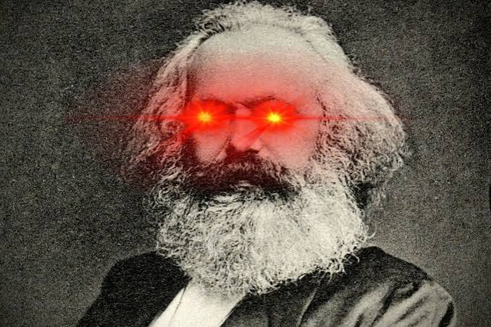
Stop thinking about your money – think of our money!

Slide 11
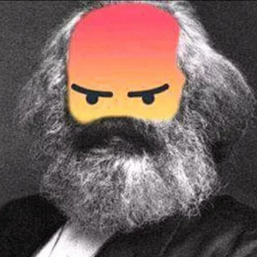


High prices are not the problem
Consumers pay more = generators earn more
pay more
Consumers
Generators
For society the price does not matter
Imag from: https://www.lustiges-taschenbuch.de/

Slide 12
The real problem
Coal
Gas
Offshore
Solar
Onshore
30 MWh at 55$/MWh
30 MWh at 40$/MWh
40 MWh at 12.5$/MWh
100 MWh at 5$/MWh
50 MWh at 25$/MWh
We might use fossil fuels although we do not need to!

Slide 13
Let’s formalize that
.
Price (€/MWh)
Generator | Producing cost | Generation
G1 | 500 | 100%
G2 | 500 | 100%
G3 | 1000 | 80%
G4 | 0 | 0%
Total | 2000 | -
Demand
Market clearing price
Quantity (MWh)
G1
G2
G3
G4
G5
Generating power
Off

Slide 14
Let’s formalize that
.
Price (€/MWh)
Generator | Producing cost | Generation
G1 | 500 | 100%
G2 | 500 | 100%
G3 | 250 | 20%
G4 | 1200 | 100%
Total | 2450 | -
Demand
Market clearing price
Quantity (MWh)
G1
G2
G4
G3
G5
Generating power
Off

Slide 15
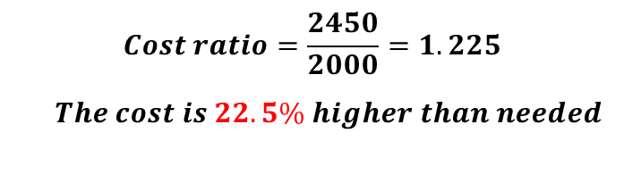
Generator | Producing cost | Generation
G1 | 500 | 100%
G2 | 500 | 100%
G3 | 1000 | 80%
G4 | 0 | 0%
Total | 2000 | -
Generator | Producing cost | Generation
G1 | 500 | 100%
G2 | 500 | 100%
G3 | 250 | 20%
G4 | 1200 | 100%
Total | 2450 | -
$$Cost ratio=\frac{2450}{2000}=1.225$$
$The cost is 22.5\% higher than needed$

Slide 16
Which scenario do you think is more realistic?

Slide 17
It rationally makes sense for G3
to artificially inflate their price
As it could make sense for G1 to do so…
Generator | Producing cost | Generation
G1 | 300 | 600%
G2 | 500 | 100%
G3 | 1250 | 100%
G4 | 1200 | 100%
Total | 3250 | -
G1
G2
G4
G3
G5
Generator | Producing cost | Generation
G1 | 500 | 100%
G2 | 500 | 100%
G3 | 250 | 20%
G4 | 1200 | 100%
Total | 2450 | -
$Cost ratio=\frac{3250}{2000}=1.625,$
62.5% higher than needed!
G2
G4
G3
G1
G5
Who knows, maybe it can get even worse…

Slide 18

How to measure inefficiency of a market
“when each participant tries to maximize their profit”
There might be many possible outcomes
$$Price of Anarchy=max\frac{Cost of the emergent market outcome}{Minimum cost}$$
𝑷𝒓𝒊𝒄𝒆 𝒐𝒇 𝑨𝒏𝒂𝒓𝒄𝒉𝒚 = 1, society pays as little as possible to satisfy demand
𝑷𝒓𝒊𝒄𝒆 𝒐𝒇 𝑨𝒏𝒂𝒓𝒄𝒉𝒚 = 2, we might pay twice as much to satisfy (same) demand

Slide 19
Should we be angry?

Slide 20
In case you said we should:
In case you said we shouldn’t:
It is rational for them to act like that.
Thay could occur loses when others act strategically but they do not.
In some countries it might even be illegal to not do what is best for the company.
That is just how our world works.
We are losing money as a society. That means we are investing work and resources without getting anything out of it.
We should not burn fossil fuels if we do not need to do so.
In some systems it is illegal to lie about your producing costs.

Slide 21
Let’s see how others handle such situation
https://www.youtube.com/watch?v=hdK4vPz0qaI&t=10s
One can also watch:
  https://www.youtube.com/watch?v=TbuD-6BbnQw&t=184s
  https://www.youtube.com/watch?v=M0mHp3iyWGg

Slide 22
Losing on purpose: London 2012
The setup London 2012 introduced a round-robin group stage before the knockouts, the first time in Olympic badminton history.
The incentive A shock upset reshuffled the bracket. Several top pairs realized that winning their last group match could mean a tougher tournament tree than losing it. (All because a Danish team performed better than expected.)
What happened Four pairs served into the net and hit shots long, in front of a booing crowd, until the referee stopped the matches.
The ruling The Badminton World Federation disqualified all eight players for “not using one’s best efforts to win.”
Nobody broke a rule. The rules were the problem.

Slide 23
The Disgrace of Gijón: 1982
The setup 1982 World Cup, final group match: West Germany vs Austria. It is played a day after Algeria had already finished their own group games.
The incentive West Germany and Austria both knew Algeria's results in advance: a West German win by one or two goals would send both of them through on goal difference, eliminating Algeria.
What happened Horst Hrubesch scored for West Germany in the 10th minute. For the remaining 80 minutes, both teams just passed the ball around, protecting the exact scoreline they both needed. Fans chanted “Que se besen!” (“Let them kiss!”). A German commentator refused to keep commentating.
The ruling No rule was broken, so no one was disqualified. The FIFA rewrote the rules: from 1986 onward, every group's final two matches kick off at the same time.
This time nobody was punished the FIFA changed the rules instead.

Slide 24
Why we need mechanism design
The pattern In Gijón and in London, skilled, rational people made the strategically optimal choice and it made everyone worse off.
The parallel An electricity market is the same kind of game. Strategic bidding pushed up total cost significantly. This extra cost is payed by everyone on the grid.
The stakes A badminton match is one bad afternoon. A market clears every settlement period (15 min), forever, and the bill goes to households and industry. That’s worse than a stadium of booing fans.
The task Mechanism design asks the Gijón question before the game, not after: how do we design the rules of the market so that self-interested bidding still gives low Price of Anarchy?
We can't fix the players. We can design the game.

Slide 25
Why is this so hard?
Price of Anarchy
Mechanism Design
Level 3 — Maximize the cost ratio over all such settings
Level 4 — Minimize over the space of rules
Price of Anarchy
Level 2 — Players maximize revenue
Level 3 — Maximize the cost ratio over all such settings
Level 1 — The operator clears the market, given fixed bids
Level 2 — Players maximize revenue
Level 1 — The operator clears the market, given fixed bids
The market clearing in itself is an optimization problem!
The market clearing in itself is an optimization problem!

Slide 26
Mechanism Design
Generally, already level 1 + 2 is computationally hard and needs additional assumptions, for example on how much players know about each other.
Level 4 — Minimize over the space of rules
Level 3 — Maximize over all such settings
Level 2 — Players maximize revenue
Nevertheless, our goal and your final project will be to use mechanism design to make qualitative statements on how to lower the inefficiency in electricity markets.
Level 1 — The operator clears the market, given fixed bids
The market clearing in itself is an optimization problem!
This is an ongoing research topic. If you get interesting results, we may take them further in a master thesis and/or publish them together.

Slide 27
Plan for the next weeks
Today
Warm-up
Weeks 2–4
General Game
Theory
Week 5
Price of Anarchy
Week 6
Mechanism design
Week 7
Modeling markets
From week 8
Project phase
The project phase continues for the rest of the semester.

Slide 28
The project
You work in groups of 3
Your grade only depends on the quality and correctness of this report
With every group together I define the task of the report
Use AI as much as you want
The report needs to be short; maximum 8 standard latex pages
The idea is that you extend the result section of a paper by me to get further insights
The paper is “only” on how to bound PoA. Projects could be:
  Use the method on different models for electricity markets
  Use the method within mechanism design
  Asses the quality of the bound

Slide 29
Literature
Osborne, M. J., & Rubinstein, A. (1994). A Course in Game Theory. MIT Press.
Nisan, N., Roughgarden, T., Tardos, É., & Vazirani, V. V. (Eds.). (2007). Algorithmic Game Theory. Cambridge University Press.
Roughgarden, T. (2013). Lecture Notes on Algorithmic Game Theory (Stanford CS364A). https://theory.stanford.edu/~tim/f13/f13.pdf
Solé Àvila, M., Ebrahimy, R., & Tsaousoglou, G. (2025). How Inefficient Can an Electricity Market Be? In Proceedings of the 2025 IEEE Kiel PowerTech (pp. 1–6). IEEE.
Strauch, L, Kamgarpour, M. & Tsaousoglou, G. (2026, not published yet). Electricity Markets as Games: Bounding the Price of Anarchy

