Slide 1
Game Theory in Electricity Markets
Week 2 – Solution Concepts 1
Notes:
Tell that today is warm up
They can always ask questions
My first lecture, therefore always feedback please

Slide 2

Thank you, Marcel!
Marcel Solé Àvila

Slide 3
Strategic games in normal form
Definition. A strategic game in normal form is a tuple
Γ = (N, (A_{i})_{i∈N}, (c_{i})_{i∈N})
where:
N finite, non-empty set of players
N = {1, …, n}: the set of players participating in the game.
A_{i} non-empty set of actions for player i
The set of actions available to player i ∈ N. We write A = A₁ × A₂ × ⋯ × Aₙ for the set of joint actions (action profiles), and a = (a₁, …, aₙ) ∈ A for a typical joint action.
c_{i} : A → ℝ cost function for player i
Maps a joint action a ∈ A to the cost cᵢ(a) incurred by player i.

Slide 4
The market clearing game
Let's instantiate Γ = (N, (Aᵢ), (cᵢ)) for last week's market clearing problem:
N = {G₁, …, G₅} the five generators
Each of the five generators from last week's market-clearing example (G₁–G₅) is a player.
A_{i} = [0, bid_ub_{i}] generator i's bid
Generator i's action is the price it bids for its capacity.
c_{i}(a) = c_{i} · dispatch_{i}(a) − price(a) · dispatch_{i}(a) generator i's cost under bids a
True production cost minus market revenue: the area between generator i's true-cost block and the market-clearing price, over the quantity it is dispatched — the same “profit” area from last week, now written as a cost.
N =
A_{i} =
c_{i}(a) =

Slide 5
Dominant and dominated strategies
Dominant strategy
A strategy a_{i}* ∈ A_{i} is a dominant strategy for player i if it gives i the lowest possible cost no matter what the other players do:
c_{i}(a_{i}*, a_{−i}) ≤ c_{i}(a_{i}, a_{−i})
for every a_{i} ∈ A_{i} and every a_{−i} ∈ A_{−i}.
A dominant strategy is a best response to everything the other players might do — no guessing required.
Dominated strategies
Strictly dominated
a_{i} ∈ A_{i} is strictly dominated if some a_{i}′ ∈ A_{i} is always strictly better:
c_{i}(a_{i}′, a_{−i}) < c_{i}(a_{i}, a_{−i})
for every a_{−i} ∈ A_{−i}.
Weakly dominated
a_{i} ∈ A_{i} is weakly dominated if some a_{i}′ ∈ A_{i} is never worse, and sometimes strictly better:
c_{i}(a_{i}′, a_{−i}) ≤ c_{i}(a_{i}, a_{−i})
for every a_{−i} ∈ A_{−i}, with strict inequality for at least one a_{−i}.

Slide 6
Checking for dominated actions
Q1 What are the dominated actions in the bed problem? Are they weakly or strictly dominated?
A1 To get the bed at any day except the first day is strictly dominated by getting it on the first day.
Q2 Are there any dominated actions in the war of attrition?
A2 No, how good an action performs always depends on what the other person does.
Q3 Are there any dominated actions in our market model?
A3 To bid below your actual cost is weakly dominated by bidding exactly your own cost.

Slide 7
Dominant strategy equilibrium
Dominant strategy equilibrium
An action profile a* = (a₁*, …, a_{n}*) ∈ A is a dominant strategy equilibrium if a_{i}* is a dominant strategy for every player i ∈ N:
c_{i}(a_{i}*, a_{−i}) ≤ c_{i}(a_{i}, a_{−i})
for every i ∈ N, every a_{i} ∈ A_{i}, and every a_{−i} ∈ A_{−i}.
No player can do better by deviating, no matter what anyone else does.
The Prisoner's Dilemma
 | P2: Silent | P2: Confess
P1: Silent | 2, 2 | 10, 0
P1: Confess | 0, 10 | 9, 9
Confess strictly dominates Silent for both prisoners, so (Confess, Confess) is the dominant-strategy equilibrium.

Slide 8
Elimination of strictly dominated actions
Rationality tells us that no one will ever play a strictly dominated action, as they would always be better of by playing the action that strictly dominates it.
We may therefore eliminate them from the game as they are not adding anything
The Prisoner's Dilemma 2
 | P2: Silent | P2: Confess | P2: Attack
P1: Silent | 2, 2 | 10, 0 | 2, 100
P1: Confess | 0, 10 | 9, 9 | 10, 100
P1: Attack | 100, 2 | 100, 10 | 100,100
No dominant strategy equilibrium anymore.
We can eliminate dominated actions.
Afterwards we have a dominant strategy equilibrium. We say the game is dominant solvable.

Slide 9
Hawk and Dove
Consider Hawk and Dove with V = 10 and C = 8.
Payoff matrix:
There is none in Rock, Paper, Scissors
Neither in the war of attrition
Neither in our market model
They are very rare.
 | H | D
H | -3, -3 | 9, 1
D | 1, 9 | 5, 5
Is there a dominant strategy equilibrium?
No!
We need a better solution concept!

Slide 10
Imagine a drumroll and Gregorian chants.

Slide 11
(pure) Nash equilibrium
Definition. An action profile a* = (a₁*, …, a_{n}*) ∈ A is a Nash equilibrium if no player can lower their own cost by unilaterally deviating:
c_{i}(a_{i}*, a_{−i}*) ≤ c_{i}(a_{i}, a_{−i}*)
for every player i ∈ N and every a_{i} ∈ A_{i}.
Weaker than a dominant strategy equilibrium: here a_{i}* only depends on the other players' equilibrium actions a_{−i}*, it does not need to be optimal for everything they might do.

Slide 12
Nash equilibrium in action
Consider Hawk and Dove with V = 10 and C = 8.
Payoff matrix:
Consider war of attrition with v_1 < v_2.
What are the Nash equilibria?
 | H | D
H | -3, -3 | 9, 1
D | 1, 9 | 5, 5
Is there a Nash equilibrium?
Yes, even two!

Slide 13
Nash equilibrium in action
Consider the war of attrition with v₁ < v₂. The Nash equilibria are
a₁ = 0, a₂ > v₁
No proof, just intuition:
Why someone must bid 0
Whoever is losing pays their own bid and gets nothing for it. Lowering that bid down to 0 doesn't change the outcome but strictly reduces their cost. In any equilibrium, the lower bidder must bid exactly 0.
Why a₂ must exceed v₁
With a_{i} = 0, player j wins and pays nothing at all, so any a_{j} > 0 is equally good for them. The only remaining question is player i: could they gain by overbidding a_{j} and winning instead? That would yield them v_{i} - a_{j} which beats their current cost of 0 only if a_{j} < v_{i}. The equilibrium survives exactly when a_{j} > v_{i}. This only works when i=1 and j=2.

Slide 14
Best response
Definition. For player i and given the other players' actions a_{−i} ∈ A_{−i}, player i's best-response set is
BR_{i}(a_{−i}) = { a_{i} ∈ A_{i} :
c_{i}(a_{i}, a_{−i}) ≤ c_{i}(a_{i}′, a_{−i}) for all a_{i}′ ∈ A_{i} }
the action(s) in A_{i} that minimize player i's cost, holding everyone else's actions fixed.
Nash equilibrium, restated
a* ∈ A is a Nash equilibrium if and only if
a_{i}* ∈ BR_{i}(a_{−i}*) for every i ∈ N.
Finding an equilibrium is the same as finding a profile where every player is simultaneously best-responding to everyone else.

Slide 15
Best response algorithm
Best-response algorithm
If it does not converge, we know nothing!
We saw that not every game has a pure Nash equilibrium
To check if a game has a pure NE is exponential in the number of players
Even when we know there must exist one, finding it is exponential in the number of players
Generally, we know nothing.
But there is hope:
Input: any action profile a = (a₁, …, a_{n})
repeat
for each player i ∈ N:
a_{i} ← BR_{i}(a_{−i})
until no player's action changes
return a
If it converges, we found a Nash equilibrium.

Slide 16
Best response algorithm
Rock, Paper, Scissors
Rock, Paper, Scissors, Kiss
 | R | P | S
R | 0, 0 | -1, 1 | 1, -1
P | 1, -1 | 0, 0 | -1, 1
S | -1, 1 | 1, -1 | 0, 0
 | R | P | S | K
R | 0, 0 | -1, 1 | 1, -1 | 0, -10
P | 1, -1 | 0, 0 | -1, 1 | 0, -10
S | -1, 1 | 1, -1 | 0, 0 | 0, -10
K | -10, 0 | -10, 0 | -10, 0 | 100, 100
If we start by playing actual R,P,S the algorithm never stops playing.
There is no pure Nash equilibrium, so it will never converge.
A pure Nash exists. But it can't be found if the starting point is wrong.

Slide 17
If the best-response algorithm does not converge, we know nothing!

Slide 18
ε-Nash equilibrium
ε-Nash equilibrium
Definition. Fix a tolerance ε ≥ 0. An action profile a* = (a₁*, …, a_{n}*) ∈ A is an ε-Nash equilibrium if no player can lower their own cost by more than ε by unilaterally deviating:
c_{i}(a_{i}*, a_{−i}*) ≤ c_{i}(a_{i}, a_{−i}*) + ε
for every player i ∈ N and every a_{i} ∈ A_{i}.
Every Nash equilibrium is a 0-NE. Allowing ε > 0 only enlarges the set of qualifying profiles. This is useful when an algorithm can only guarantee approximately-best responses.
ε-best-response algorithm
Input: a = (a₁, …, a_{n}), ε ≥ 0
repeat
# 1. compute all best responses
for each player i ∈ N:
b_{i} ← BR_{i}(a_{−i})
# 2. Check if the ε-condition fails
for any player j ∈ N:
if c_{i}(a_{i}, a_{−i}) > c_{i}(b_{i}, a_{−i}) + ε for any i:
a_{j} ← b_{j}
until no player’s cost changes enough
return a
Calculate all best response first – then update

Slide 19
This helps finding a Nash equilibrium. It does not help if there is none.

Slide 20
Mixed strategies
So far, player i chose a single action a_{i} ∈ A_{i} with certainty. A mixed strategy instead lets player i randomize over their actions:
σ_{i} ∈ Δ(A_{i}) player i's mixed strategy
A probability distribution over player i's action set Aᵢ, assigning probability σᵢ(aᵢ) to each pure action aᵢ ∈ Aᵢ.
σ = (σ₁, …, σ_{n}) the joint mixed strategy
We assume the players randomize independently, so σ is the product distribution: σ(a) = σ₁(a₁) · σ₂(a₂) ⋯ σₙ(aₙ), for every joint action a = (a₁, …, aₙ) ∈ A.
Player i's expected cost under σ is then defined by the integral
c_{i}(σ) = ∫_{A} c_{i}(a) dσ(a)
the expectation of the (deterministic) cost c_{i}(a) over joint actions are drawn according to the independent product distribution σ.

Slide 21
Mixed Nash equilibrium
Definition. A mixed profile σ* = (σ₁*, …, σ_{n}*) is a mixed Nash equilibrium if no player can lower their expected cost by unilaterally deviating:
c_{i}(σ_{i}*, σ_{−i}*) ≤ c_{i}(σ_{i}, σ_{−i}*)
for every player i ∈ N and every σ_{i} ∈ Δ(A_{i}).
Recall player i's expected cost, now written as an expected value rather than an integral:
c_{i}(σ) = Σ_{a∈A} σ(a) c_{i}(a) = E_{a∼σ} [c_{i}(a)]
A pure Nash equilibrium is the special case where every σ_{i}* puts probability 1 on a single action.

Slide 22
Support and best responses
Proposition
A profile σ* = (σ₁*, …, σ_{n}*) is a mixed Nash equilibrium if and only if, for every player i ∈ N, every pure action in the support of σ_{i}* is a best response to σ_{−i}*:
supp(σ_{i}*) ⊆ BR_{i}(σ_{−i}*) for every i ∈ N.
where supp(σ_{i}) = { a_{i} ∈ A_{i} : σ_{i}(a_{i}) > 0 } is the set of actions player i plays with positive probability.
Beyond finite games
This characterization is completely general: it holds in any game, including ones with infinite actions.

Slide 23
More drumroll, more Gregorian chants!

Slide 24
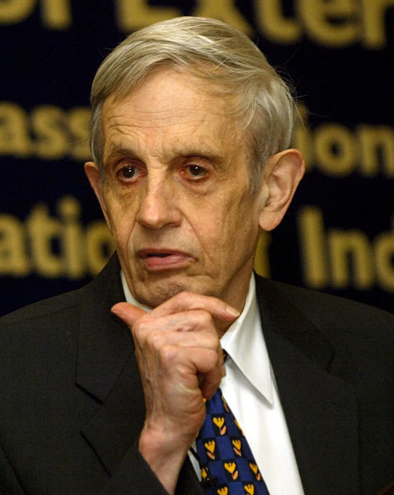
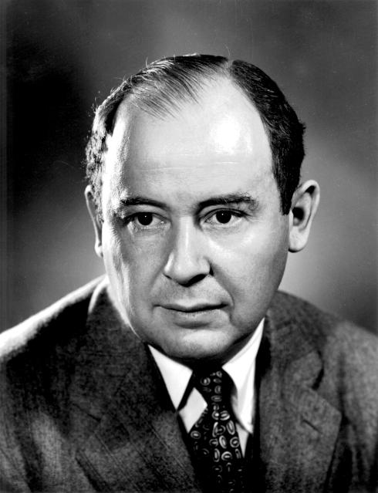
Existence of Nash equilibrium
Theorem (Nash, 1950)
Every finite game Γ = (N, (A_{i})_{i∈N}, (c_{i})_{i∈N}) , that is one with finitely many players, each holding a finite action set A_{i}, has at least one mixed Nash equilibrium:
∃ σ* = (σ₁*, …, σ_{n}*) ∈ Δ(A₁) × ⋯ × Δ(A_{n})
That’s trivial
John Nash, Nobel Laureate (1994)
John von Neumann
Image from: https://www.wikipedia.org/
Image from: https://www.britannica.com/

Slide 25
Existence in infinite games
Theorem (Glicksberg, 1952)
Let Γ = (N, (A_{i})_{i∈N}, (c_{i})_{i∈N}) be a game with N finite, where every A_{i} is a non-empty compact subset of a metric space, and every cost function c_{i} : A → ℝ is continuous. Then Γ has at least one mixed Nash equilibrium.
∃ σ* = (σ₁*, …, σ_{n}*) ∈ Δ(A₁) × ⋯ × Δ(A_{n})
each σ_{i}* is now a probability measure on A_{i}, rather than a finite list of probabilities.

Slide 26
Rock, Paper, Scissors
We can assume every player uses all three actions, otherwise the opponent could win for certain, by never playing the one action that beats it.
Every action played is then in the support, so by the Proposition, R, P and S must all be best responses. This means player 1's expected cost is the same for each:
c₁(R, σ₂) = c₁(P, σ₂) = c₁(S, σ₂)
Writing σ₂ = (q_{R,2}, q_{P,2}, q_{S,2}) for player 2's mixing probabilities, this indifference condition becomes:
−q_{P,2} + q_{S,2} = q_{R,2} − q_{S,2}
q_{R,2} − q_{S,2} = −q_{R,2} + q_{P,2}
q_{R,2} + q_{P,2} + q_{S,2} = 1
Solving this system gives q_{R,2} = q_{P,2} = q_{S,2} = 1/3. The same argument for player 1 shows the unique mixed Nash equilibrium has both players randomizing uniformly over Rock, Paper and Scissors.
 | R | P | S
R | 0, 0 | -1, 1 | 1, -1
P | 1, -1 | 0, 0 | -1, 1
S | -1, 1 | 1, -1 | 0, 0

Slide 27
Mixed Nash equilibrium, fact sheet
If a game fulfills the condition of either one of the theorems, it has at least one mixed Nash equilibrium
To find it is PPAD hard (not in polynomial time)
To check if there are two is NP-complete
The set of mixed Nash equilibria is not arbitrary, but ugly
Mixed NE
Nash
Equilibria
dominant-strategy equilibrium

