Slide 1


Dynamic Excel Dashboard For Cookie Company
By Swapna Macha
Notes:
Line spacing + Page numbers

Slide 2
Contents
01-Project Brief
02-Dataset Overview
03-Dataset Structure
04-Problems or challenges in the Data
05-Data Cleaning Process
06-Data Transformation Insights
07-Recommendations

Slide 3
Project Brief
01
This project focuses on the creation of an interactive Excel dashboard to analyze cookie sales data from the years 2019 and 2020.
The goal is to leverage data visualization techniques to gain actionable insights into sales, costs, and profits across various cookie types.
The dashboard serves as a powerful tool for stakeholders to:
Understand the performance of different cookie products over time.
Identify seasonal trends and fluctuations in sales and profitability.
Pinpoint areas where costs can be optimised, or profits can be maximized.
The insights derived from the dashboard are intended to inform strategic planning and enhance overall operational efficiency.

Slide 4
Dataset Overview
02
The dataset used in this project captures cookie sales details for the years 2019 and 2020. It includes transactional data that provides insights into sales performance, costs, and profitability across different products and regions.
Key Metrics Captured:
Country: Location where the sales were recorded.
Product Type: The specific cookie type sold (e.g., Chocolate Chip, Fortune Cookie).
Units Sold: Total number of units sold for each product.
Revenue: Total income generated from sales.
Cost: The expenses incurred in producing the sold units.
Profit: The difference between revenue and cost for each transaction.
Date: The time period when the transaction occurred.

Slide 5
Dataset Structure
03
Table Name | Key Variables – Data Type
2019(data) | Country – Categorical
 | Product – Categorical
 | Units Sold – Numerical
 | Revenue – Numerical
 | Cost – Numerical
 | Profit – Numerical
 | Date – Date
2020(data) | Country – Categorical
 | Product – Categorical
 | Units Sold – Numerical
 | Revenue – Numerical
 | Cost – Numerical
 | Profit – Numerical
 | Date – Date
Profit By Cookie | Cookie Type – Categorical
 | Average Profit – Numerical
Profit By Month | Month – Categorical
 | Total Profit – Numerical
Units Sold by Month | Month – Categorical
 | Total Units Sold – Numerical
Dashboard Sheet | Summarized insights and KPI visuals based on all datasets

Slide 6
Problems or Challenges in the Data
04
During the analysis of the dataset, several issues and challenges were identified that required attention to ensure accurate and meaningful insights:
Inconsistent Data Formats:
The 2020 dataset contained currency fields (e.g., Revenue, Cost, Profit) stored as text with symbols, requiring conversion to numerical formats for analysis.
Date formats were not standardized, leading to inconsistencies when merging data from different years.
Missing or Incomplete Entries:
Some pivot summary sheets contained missing or incomplete data points, which impacted the ability to cross-verify calculations.
Certain months lacked complete entries, potentially affecting trend analysis over time.
Structural Variance Between Sheets:
The raw data sheets (2019 and 2020) had a clear structure, but summary sheets such as "Profit By Cookie" and "Profit By Month" had inconsistent layouts, requiring additional transformation to extract insights.
Column names and field arrangements varied, making it necessary to standardize them before creating the dashboard.
Duplicate or Redundant Data Entries:
Instances of duplicate rows were identified in the raw datasets, which needed to be removed to prevent skewed results.

Slide 7
Data Cleaning Process
05
To ensure the dataset was accurate and ready for analysis, several data cleaning steps were undertaken. These steps addressed inconsistencies, missing values, and formatting issues to improve data quality and reliability:
1. Standardizing Currency Values in the 2020 Dataset:
The 2020 dataset had currency fields often including symbols like "$."
These fields were converted to numerical values.
2. Removing Duplicates and Handling Missing Data Points:
Duplicate entries were identified and removed.
Missing values in key fields (e.g., Units Sold, Profit) were addressed by:
Cross-verifying with other sheets for the same records.
Using average or median values as appropriate for imputation.
3.Reformatting Date Fields for Consistency:
Dates across the datasets were found in different formats, leading to inconsistencies when merging or filtering data.
All date fields were reformatted to a standard YYYY-MM-DD format.
Ensured that all numerical fields (e.g., Units Sold, Revenue, Cost, Profit) were correctly formatted as numbers.
Categorical fields (e.g., Product, Country) were checked for typos or inconsistencies, and corrections were made to maintain uniformity.

Slide 8
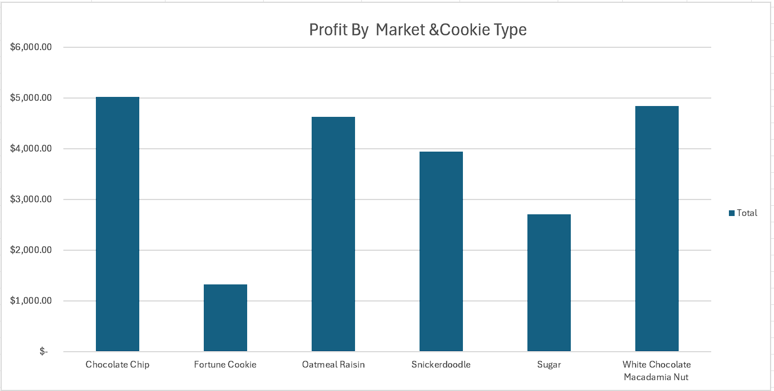
Chocolate Chip was the highest-performing cookie type in terms of profit.

Slide 9
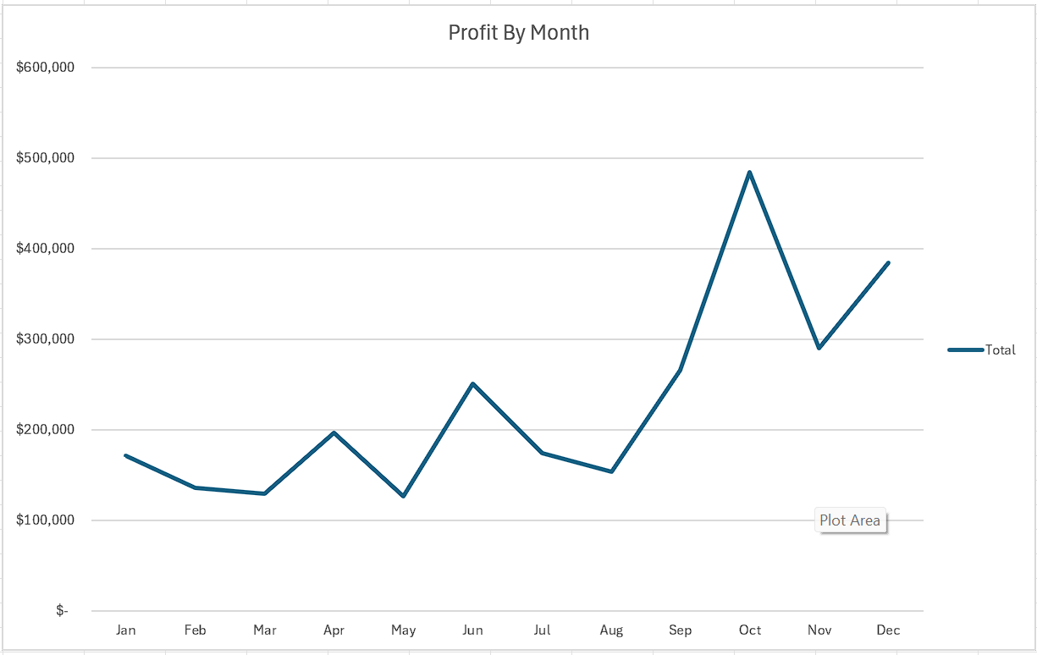
Seasonal trends were evident, with higher sales in certain months

Slide 10
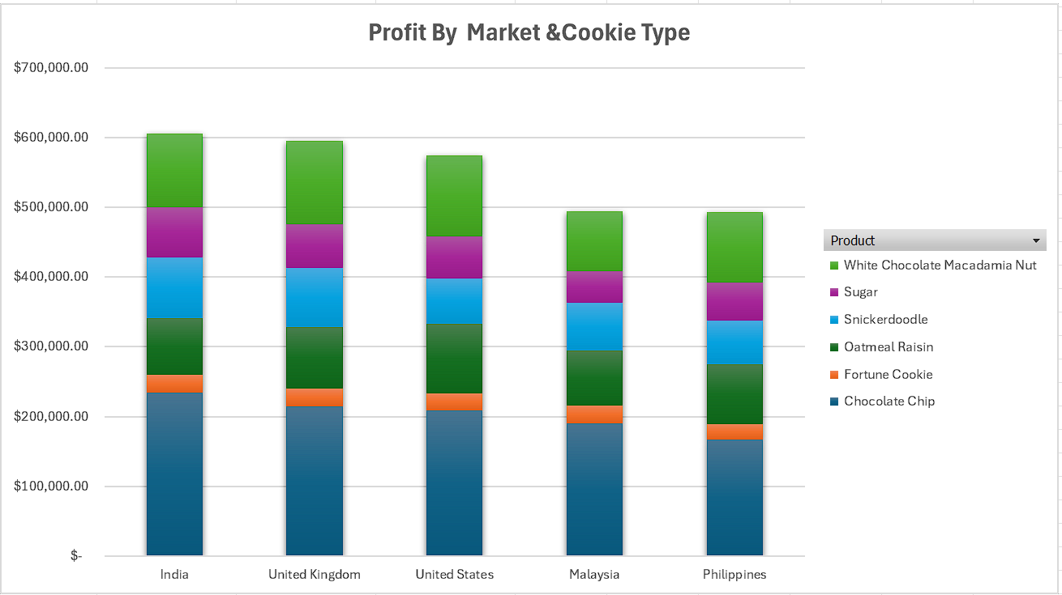
India and the United States were the most profitable markets, while Fortune Cookies and Sugar Cookies underperformed, requiring improvement strategies.

Slide 11
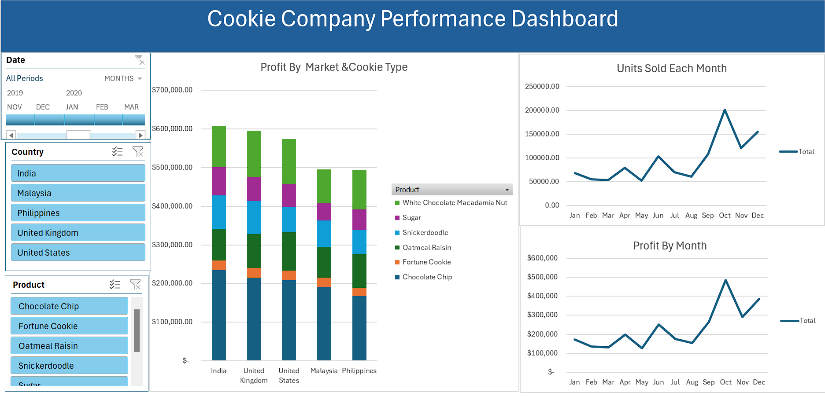

Slide 12
Recommendations
04
Focus on promoting high-performing products like Chocolate Chip during peak months.
Address cost inefficiencies for low-profit cookies to improve margins.
Focus on expanding sales in India and the United States, the most profitable markets.
Increase marketing for top-selling products like Chocolate Chip and White Chocolate Macadamia Nut Cookies.
Improve sales strategies for Fortune Cookies and Sugar Cookies to increase their performance.
Launch special campaigns during peak sales months like November and December.

Slide 13
Thank You

