Slide 1

Title of Training Presentation
Spotify Data Analysis
by
Swapna Macha

Slide 2
Contents
Project Brief
Dataset Overview
Problems or challenges in the Dataset
Data Cleaning and Transformation Process
Insights and Findings
Recommendations

Slide 3
Project Brief
The Spotify Features Data Analysis project aimed to explore:
Relationships between track attributes (e.g., danceability, energy, tempo, loudness).
How these attributes impact track popularity.
Utilized tools like Excel and Tableau to:
Analyze patterns and trends in the data.
Identify correlations between musical features and popularity.
Key focus areas included:
Understanding what makes a track successful.
Providing actionable insights into how musical features influence listener engagement.
Notes:
How presentation will benefit audience: Adult learners are more interested in a subject if they know how or why it is important to them.
Presenter’s level of expertise in the subject: Briefly state your credentials in this area, or explain why participants should listen to you.

Slide 4
Dataset Overview
The dataset includes information on Spotify track features, such as:
Danceability, Energy, Tempo, Loudness: Measures of a track’s audio properties.
Popularity: Listener engagement metrics.
Genre and Track Details: Metadata about the track.
Data spans thousands of tracks across multiple genres, enabling a comprehensive analysis.
Notes:
Lesson descriptions should be brief.

Slide 5
Identified Problems or Challenges in the Dataset
Several challenges were encountered during the analysis:
Missing or Incomplete Data:
Some track features or popularity scores were missing, requiring data imputation or removal.
Outliers in Numerical Data:
Extreme values in attributes like tempo and loudness needed to be handled to avoid skewing the analysis.
Dataset Complexity:
The high dimensionality of the dataset made it challenging to identify clear trends without thorough preprocessing and visual exploration.
Notes:
Example objectives
At the end of this lesson, you will be able to:
Save files to the team Web server.
Move files to different locations on the team Web server.
Share files on the team Web server.

Slide 6
Data Cleaning And Transformation Process
The following steps were taken to clean and prepare the data for analysis:
Removed missing and null values.
Standardized numerical fields like tempo and loudness for consistent analysis.
Categorized tracks by popularity tiers (low, medium, high).
Aggregated data by genre and track attributes to enable segmented analysis.

Slide 7
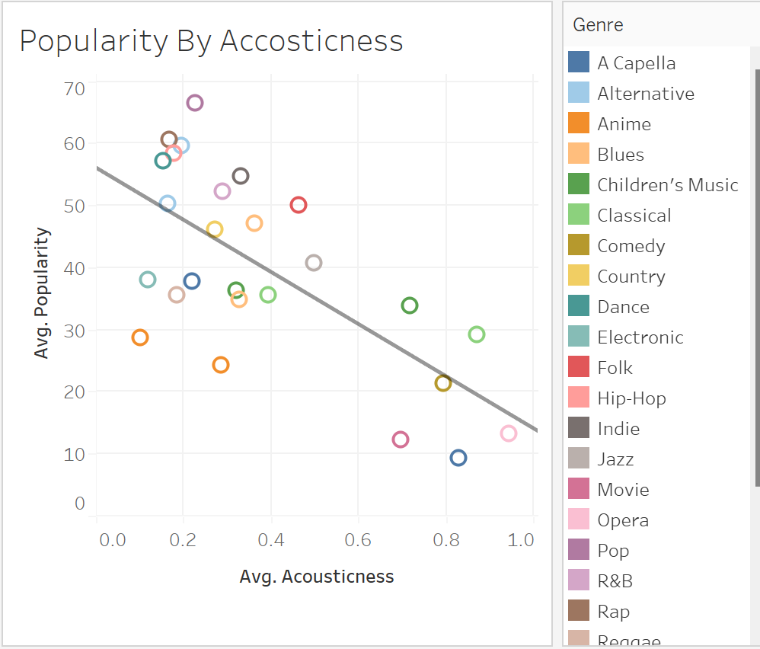
Popularity decreases as acousticness increases, showing a negative correlation.
Pop, Dance, and Electronic genres are highly popular with low acousticness.
Classical, Opera, and Jazz have high acousticness but lower popularity.

Slide 8
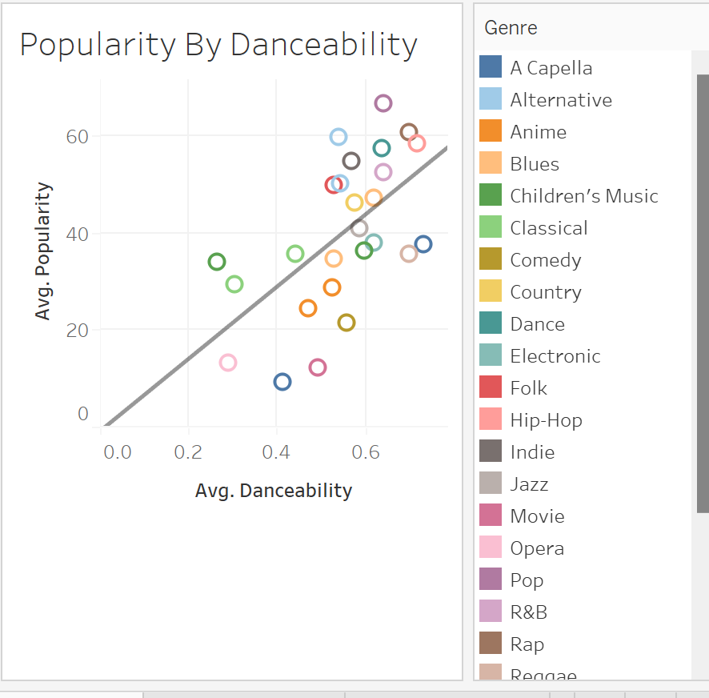
Genres like Classical and Opera exhibit low danceability and lower popularity.
Folk and Country have moderate danceability and corresponding popularity levels.
High danceability aligns with mainstream and widely consumed genres.

Slide 9
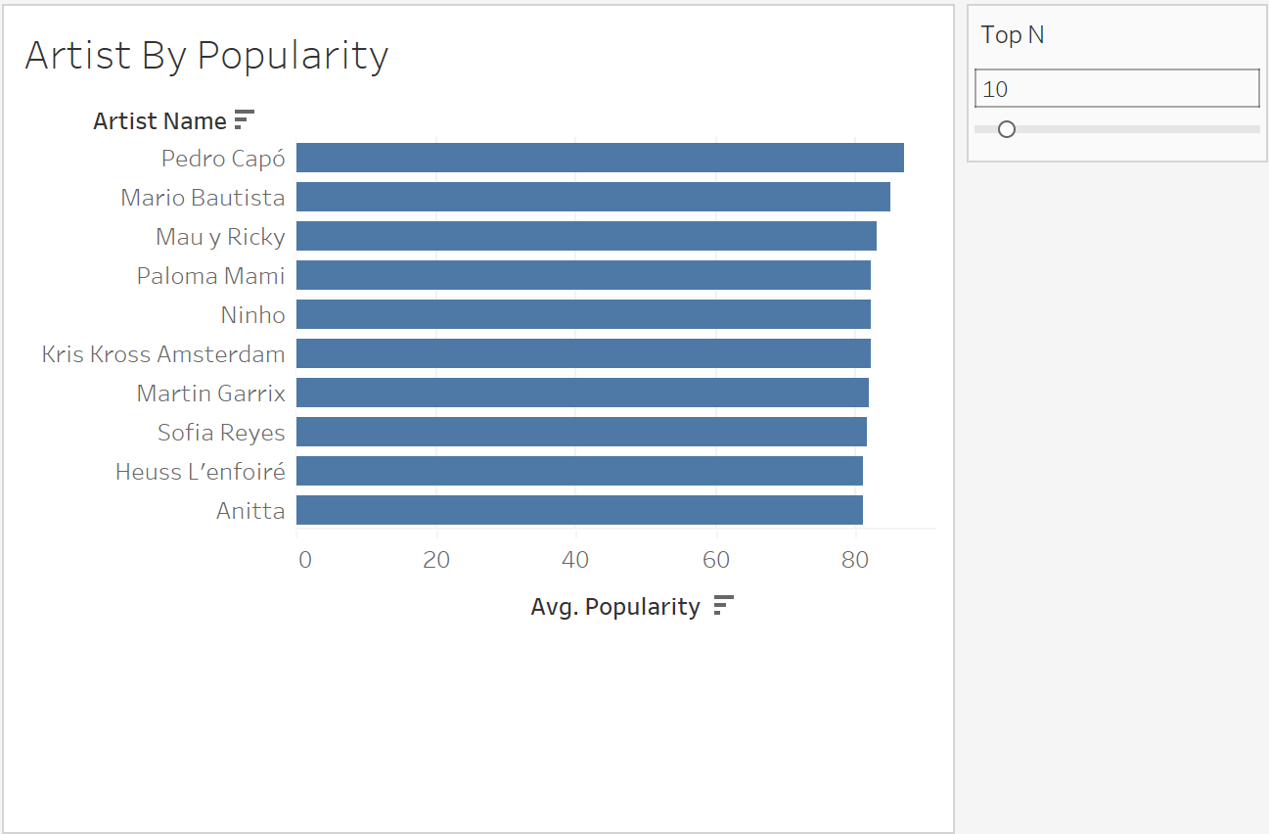
Pedro Capo leads with the highest average popularity among the top 10 artists.
Paloma Mami shows strong listener engagement with an average popularity of 82.
All top 10 artists have an average popularity score above 80, reflecting widespread appeal.
These artists showcase diverse music styles, contributing to their popularity.

Slide 10
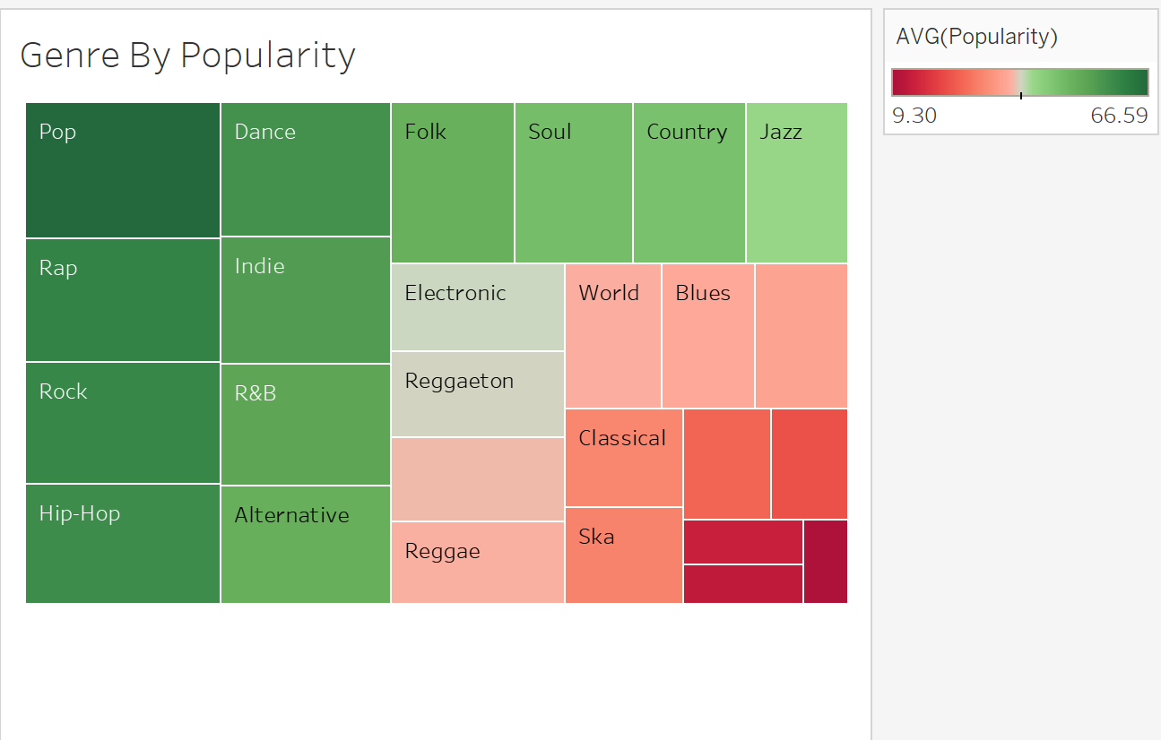
Pop, Dance, and Rap genres have the highest average popularity.
Classical, Ska, and Reggae genres have the lowest popularity.
popularity than mainstream genres.
High popularity aligns with modern and upbeat genres like Pop and Dance.

Slide 11
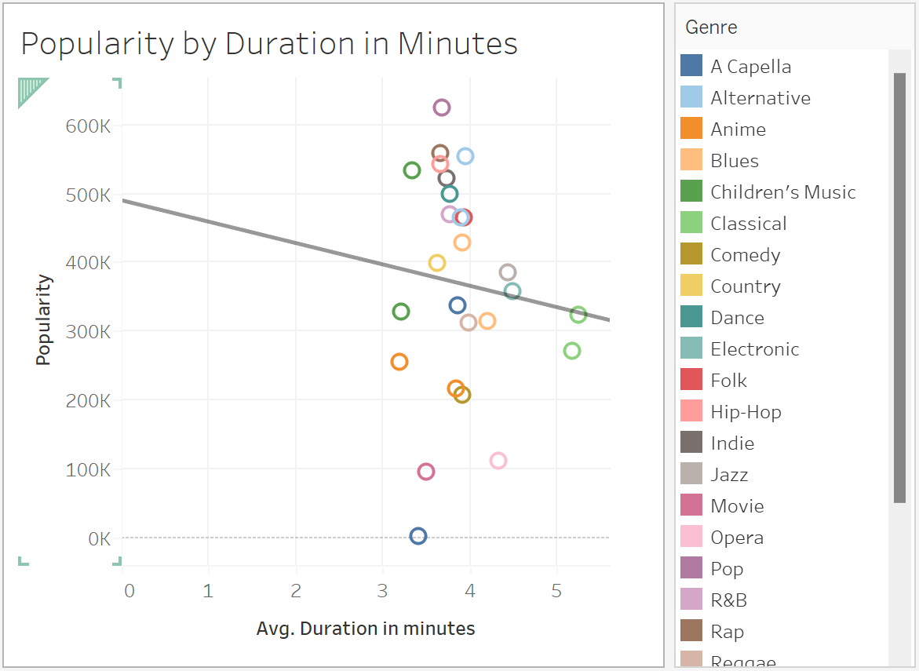
Popularity decreases as the average track duration increases, showing a negative correlation.
Shorter tracks (around 2-3 minutes) tend to be more popular compared to longer tracks.
Genres with shorter track durations, like Pop and Dance, align with higher popularity levels.
Longer-duration genres, such as Classical and Jazz, show lower popularity.

Slide 12
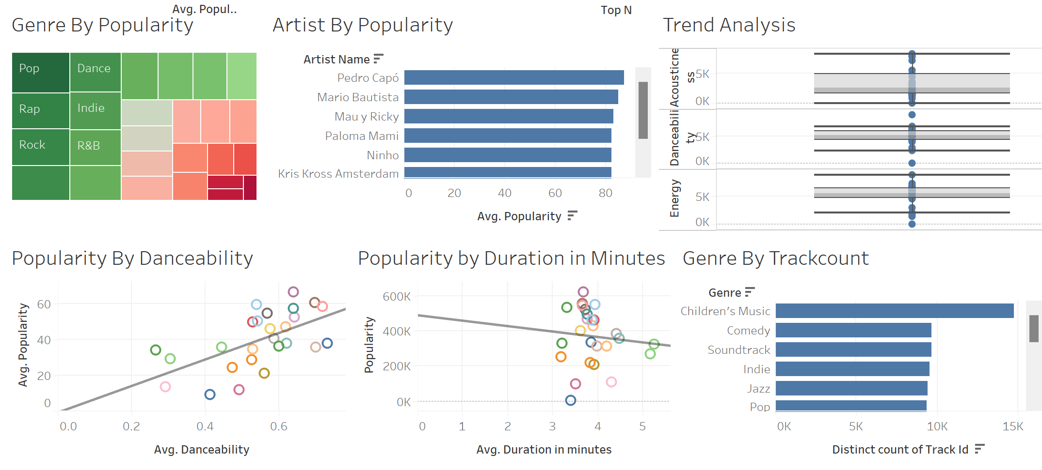

Slide 13
Recommendations
Focus on High-Engagement Features: Optimize danceability and energy levels in track production.
Genre-Specific Strategies: Tailor track features to align with genre-specific listener preferences.
Target Moderate Tempo Ranges: Tracks with a balanced tempo appeal to broader audiences.
Expand Analysis Scope: Include additional listener demographics and streaming data for deeper insights.

Slide 14
Thank You

