Slide 1

Enhancing Blockchain, Federated Learning, and Homomorphic Encryption Integration
This presentation explores advanced solutions to improve privacy, scalability, efficiency, and applicability of integrated Blockchain, Federated Learning (FL), and Homomorphic Encryption (HE) systems. We'll examine current strengths, address limitations, and propose enhancements for deploying scalable and efficient decentralized learning systems in real-world environments.

Slide 2
Current Strengths: Privacy and Security
Federated Learning
Homomorphic Encryption
Blockchain Security
Ensures raw data remains localized at individual nodes, addressing privacy concerns and aligning with regulations like GDPR and HIPAA.
Enables computations on encrypted data, ensuring privacy even during processing and transmission of model updates.
Provides an immutable ledger, decentralization, and smart contracts for automated validation and aggregation processes.

Slide 3

Current Limitations
Scalability Bottlenecks
Computational Overhead
Blockchain latency and high node count lead to processing and storage limitations.
Homomorphic Encryption and complex smart contracts increase processing demands.
Domain Narrowness
Non-IID Data Handling
Current frameworks focus heavily on financial applications, leaving other critical domains underexplored.
Difficulty in generalizing models across non-independent and identically distributed data patterns.

Slide 4




Enhancing Scalability
Sharded Blockchain
Partition the blockchain into shards for parallel processing, boosting transaction throughput.
Layer 2 Solutions
Use off-chain computations for faster processing, reducing main chain congestion.
Asynchronous FL
Allow nodes to submit updates asynchronously, reducing synchronization delays.

Slide 5




Optimizing Computational Efficiency
Hybrid Encryption
Combine Homomorphic Encryption with Differential Privacy to balance privacy and computational overhead.
Edge Computing
Perform data preprocessing and encryption on edge devices before submitting updates to the network.
Compressed Updates
Reduce model update size using gradient sparsification or quantization techniques.

Slide 6

Improving Security and Robustness
Zero-Knowledge Proofs
Dynamic Smart Contracts
Validate model updates without revealing their contents, enhancing privacy while maintaining trust.
Adjust aggregation rules based on network activity and node reliability to ensure model robustness.
Adversarial Testing
Simulate and test the framework against potential attacks to ensure system resilience.

Slide 7
Handling Non-IID Data
Clustered Federated Learning
1
Group nodes with similar data distributions for localized training.
Meta-Learning
2
Teach global models to adapt dynamically to local data distributions.
Improved Model Accuracy
3
Enhanced generalizability and reduced training iterations.

Slide 8
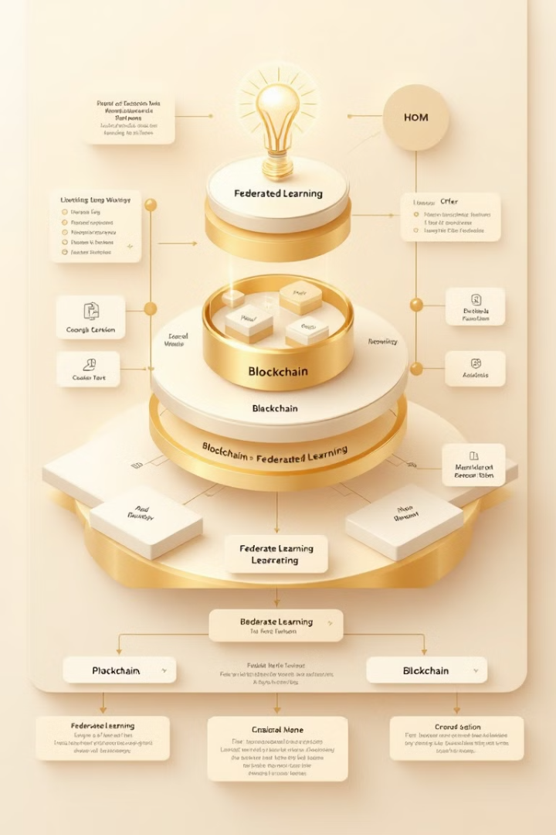
Technical Implementation Plan
1
Multi-Tier Blockchain System
Implement a two-tier blockchain architecture with permissioned and public layers for optimized performance and compliance.
2
Dynamic Model Aggregation
Use smart contracts to adjust aggregation rules based on node reliability and data quality.
3
Edge Processing and Encryption
Preprocess data locally and encrypt sensitive features before sharing with the blockchain.
4
Deployment Stages
Progress from Proof of Concept to Full-Scale Deployment across multiple industries.

Slide 9



Conclusion and Future Directions
Enhanced Framework
1
Scalable, efficient, and secure decentralized learning
Broad Applicability
2
Finance, healthcare, IoT, and beyond
Real-World Impact
3
Practical solutions for evolving technological landscapes
By addressing scalability, computational efficiency, and domain adaptability, these enhancements elevate Blockchain-FL-HE frameworks to a new level of practicality and impact. The integration of advanced techniques ensures the framework remains relevant in evolving technological landscapes, enabling secure and efficient decentralized learning across diverse domains.

