Slide 1

R PROGRAMMING PROJECT (DASHBOARD) ON
By:
Ruchika (A019) Gauri(A016)

Slide 2
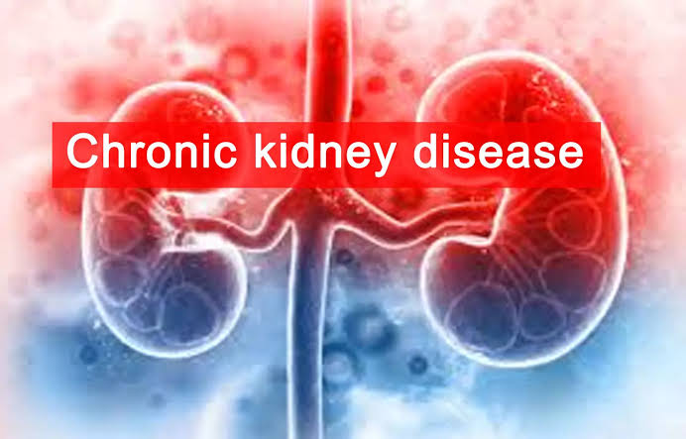
INTRODUCTION
Chronic Kidney Disease (CKD) is a long-term, progressive condition in which the kidneys are unable to function at their full capacity. It's characterized by a gradual loss of kidney function over time. Common causes include high blood pressure, diabetes, and certain kidney disorders
40% of people with severely reduced kidney function (not on dialysis) are not aware of having CKD.
Every 24 hours, 360 people begin dialysis treatment for kidney failure. In the United States, diabetes and high blood pressure are the leading causes of kidney failure, accounting for 3 out of 4 new cases.

Slide 3

DATASET
VARIABLES
Id
Age groups
Classification
Appetite
Anaemia
Diabetes
Hypertension
Bp: diastolic & systolic
Haemoglobin (g/dl)
Blood Urea (mg/dl)
Serum Creatinine (mg/dl)

Slide 4
OBJECTIVE OF THE STUDY
The objective of the study is to investigate the potential association between age and the presence of Chronic Kidney Disease (CKD) while exploring how various factors, including blood urea levels and hypertension, are related to CKD. Also, to better understand how these factors can have an impact on different age groups.

Slide 5
CODING
On R markdown

Slide 6
INFERENCES
Age is a significant risk factor in the development of chronic kidney disease (CKD), with a notably high prevalence observed within the age group from 41 to 70 years.
Anaemia is prevalent among individuals aged 41 to 60, while hypertension and diabetes show heightened incidence in those aged 51 to 70 and a moderate incidence in the age range of 41 to 50.
Individuals falling within the age groups of 41 to 50 and 51 to 60 exhibit lower levels of haemoglobin and elevated blood urea levels, indicating a heightened susceptibility to CKD.
Furthermore, the prevalence of CKD is significantly higher among individuals with hypertension and diabetes across the entire spectrum of adult age groups. Importantly, this association exhibits a statistically significant increase in strength when observed within the younger age cohorts.
Individuals afflicted with CKD tend to present with elevated blood pressure and heightened blood urea levels. Hence, Hypertension and high blood pressure are significant factors affecting Chronic Kidney Diseases.

Slide 7
THANKYOU

