Slide 1

Bank Marketing Project Proposal
…
Gauri Gonjari

Slide 2


Introduction
While bank marketing campaigns have largely remained traditional, standard bank advertising is boring for both marketers and their consumers.
Thinking outside the box and implementing creative marketing ideas for banks will help you to develop creative campaigns, benefiting your bank, consumer engagement, and likely the success of the actual bank marketing campaigns as well.
Most consumers see banking as a mundane necessity, something they’d rather avoid if they could.
Taking a creative approach to bank marketing campaigns might change that, especially if you integrate creative marketing ideas for banks like gamification, automation, chatbots, and rewards so that consumers are motivated to use your services.

Slide 3
Objectives
Prediction of the results of the marketing campaign for each customer and clarification of factors which affect the campaign results. This helps to find out the ways how to make marketing campaigns more efficient.
Finding out customer segments, using data for customers, who subscribed to term deposit. This helps to identify the profile of a customer, who is more likely to acquire the product and develop more targeted marketing campaigns.

Slide 4
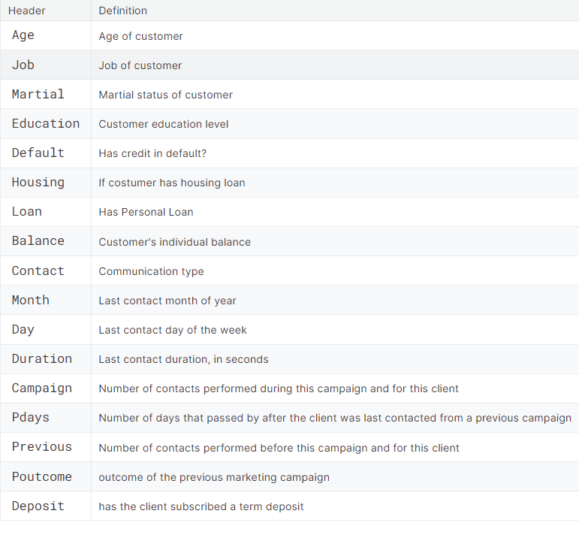
Data

