Slide 1
Beating the ACT: A Demographic of Opportunity
Mr. Chukwudi I. Uraih

Slide 2
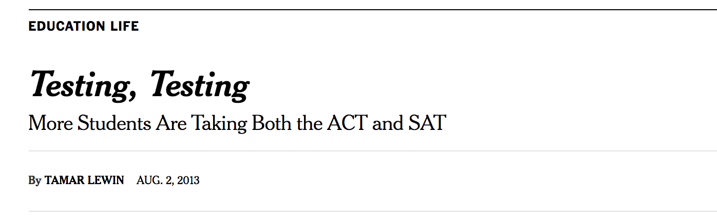

Where We Are
Notes:
https://www.washingtonpost.com/blogs/answer-sheet/post/how-act-overtook-sat-as-the-top-college-entrance-exam/2012/09/24/d56df11c-0674-11e2-afff-d6c7f20a83bf_blog.html?utm_term=.ca6599e2b6ea
1) The ACT is perceived as a more consumer-friendly exam by students.
2) ACT has shrewdly marketed its exam to many states as a replacement for (or supplement to) high school exit exams, arguing that adoption will reduce the number of tests a college-bound student must take while encouraging more teenagers to consider college.
* with taxpayers footing the bill.
3) The College Board was very slow to adopt a similar marketing strategy, signing up only the less-populated state of Maine to require the SAT of all students.

Slide 3
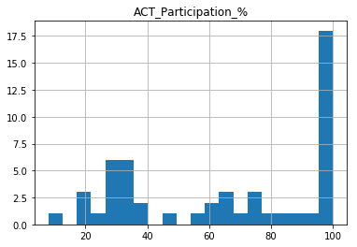
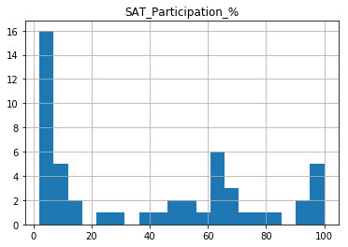
Test Participation Rates

Slide 4
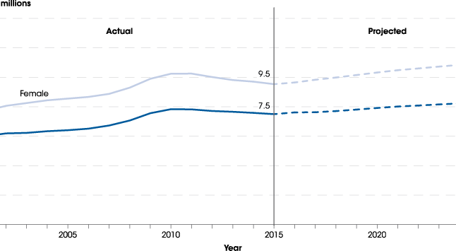
College Enrollment Projections

Slide 5
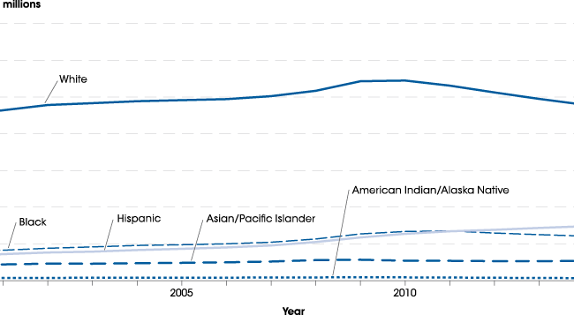
College Enrollment Demographics
Notes:
https://nces.ed.gov/programs/coe/indicator_cha.asp

Slide 6
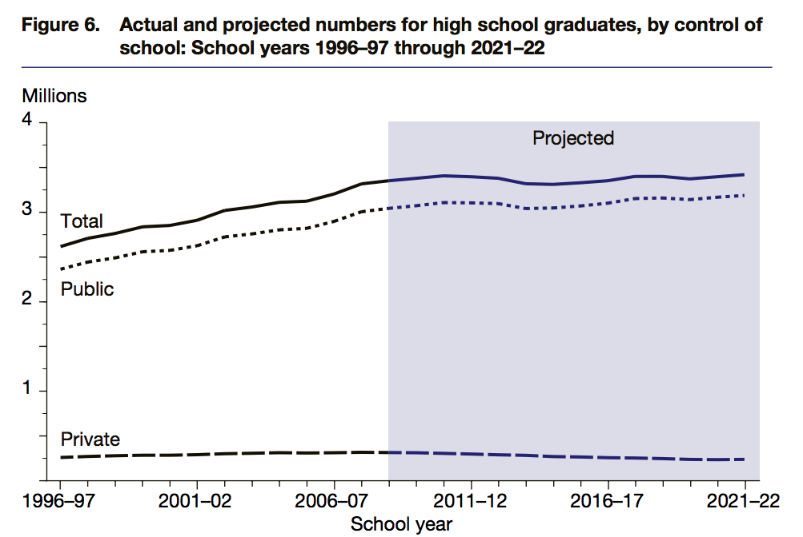
High School Graduate Projections
Notes:
The total number of high school
graduates
S increased 28 percent between
1996–97 and 2008–09, a period
of 12 years; and
is projected to be 2 percent
higher in 2021–22 than in
2008–09.
The number of public high school
graduates
S increased 29 percent between
1996–97 and 2008–09; and
is projected to increase 5 percent
between 2008–09 and 2021–22.
The number of private high school
graduates
S increased 22 percent between
1996–97 and 2008–09; and
is projected to decrease 25
percent between 2008–09 and
2021–22.

Slide 7
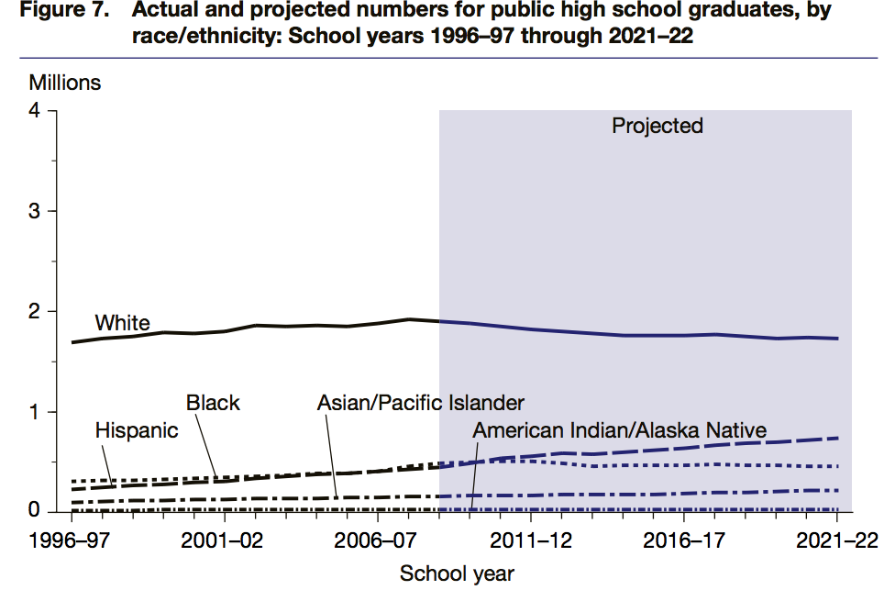
High School Graduate Demographics
Notes:
https://nces.ed.gov/pubs2013/2013008.pdf
High school graduates by
race/ethnicity
The number of public high school
graduates is projected to
T decrease 9 percent between
2008–09 and 2020–21 for
students who are White;
decrease 6 percent between
2008–09 and 2020–21 for
students who are Black;
increase 63 percent between
2008–09 and 2020–21 for
students who are Hispanic;
increase 35 percent between
2008–09 and 2020–21 for
students who are Asian/Pacific
Islander; and
be 1 percent lower in 2021–22
than in 2008–09 for students
who are American Indian/Alaska
Native.

Slide 8
Recommended Strategy
Aggressively market exam to many states as a replacement for (or supplement to) high school exit exams
Develop a PSAT-like product to target Hispanic students
Give away the PSAT
Notes:
The PLAN is a preliminary ACT test that is generally administered in the sophomore year.[1] ACT, Inc. claims that it predicts success on the ACT.
The PSAT registration fee for the 2017-2018 school year is $16. Some high schools may charge students an additional fee to defray the cost of administering the test.

